Slide 1
PLAGUE
Project 1
James Dawson

Slide 2


Slide 3
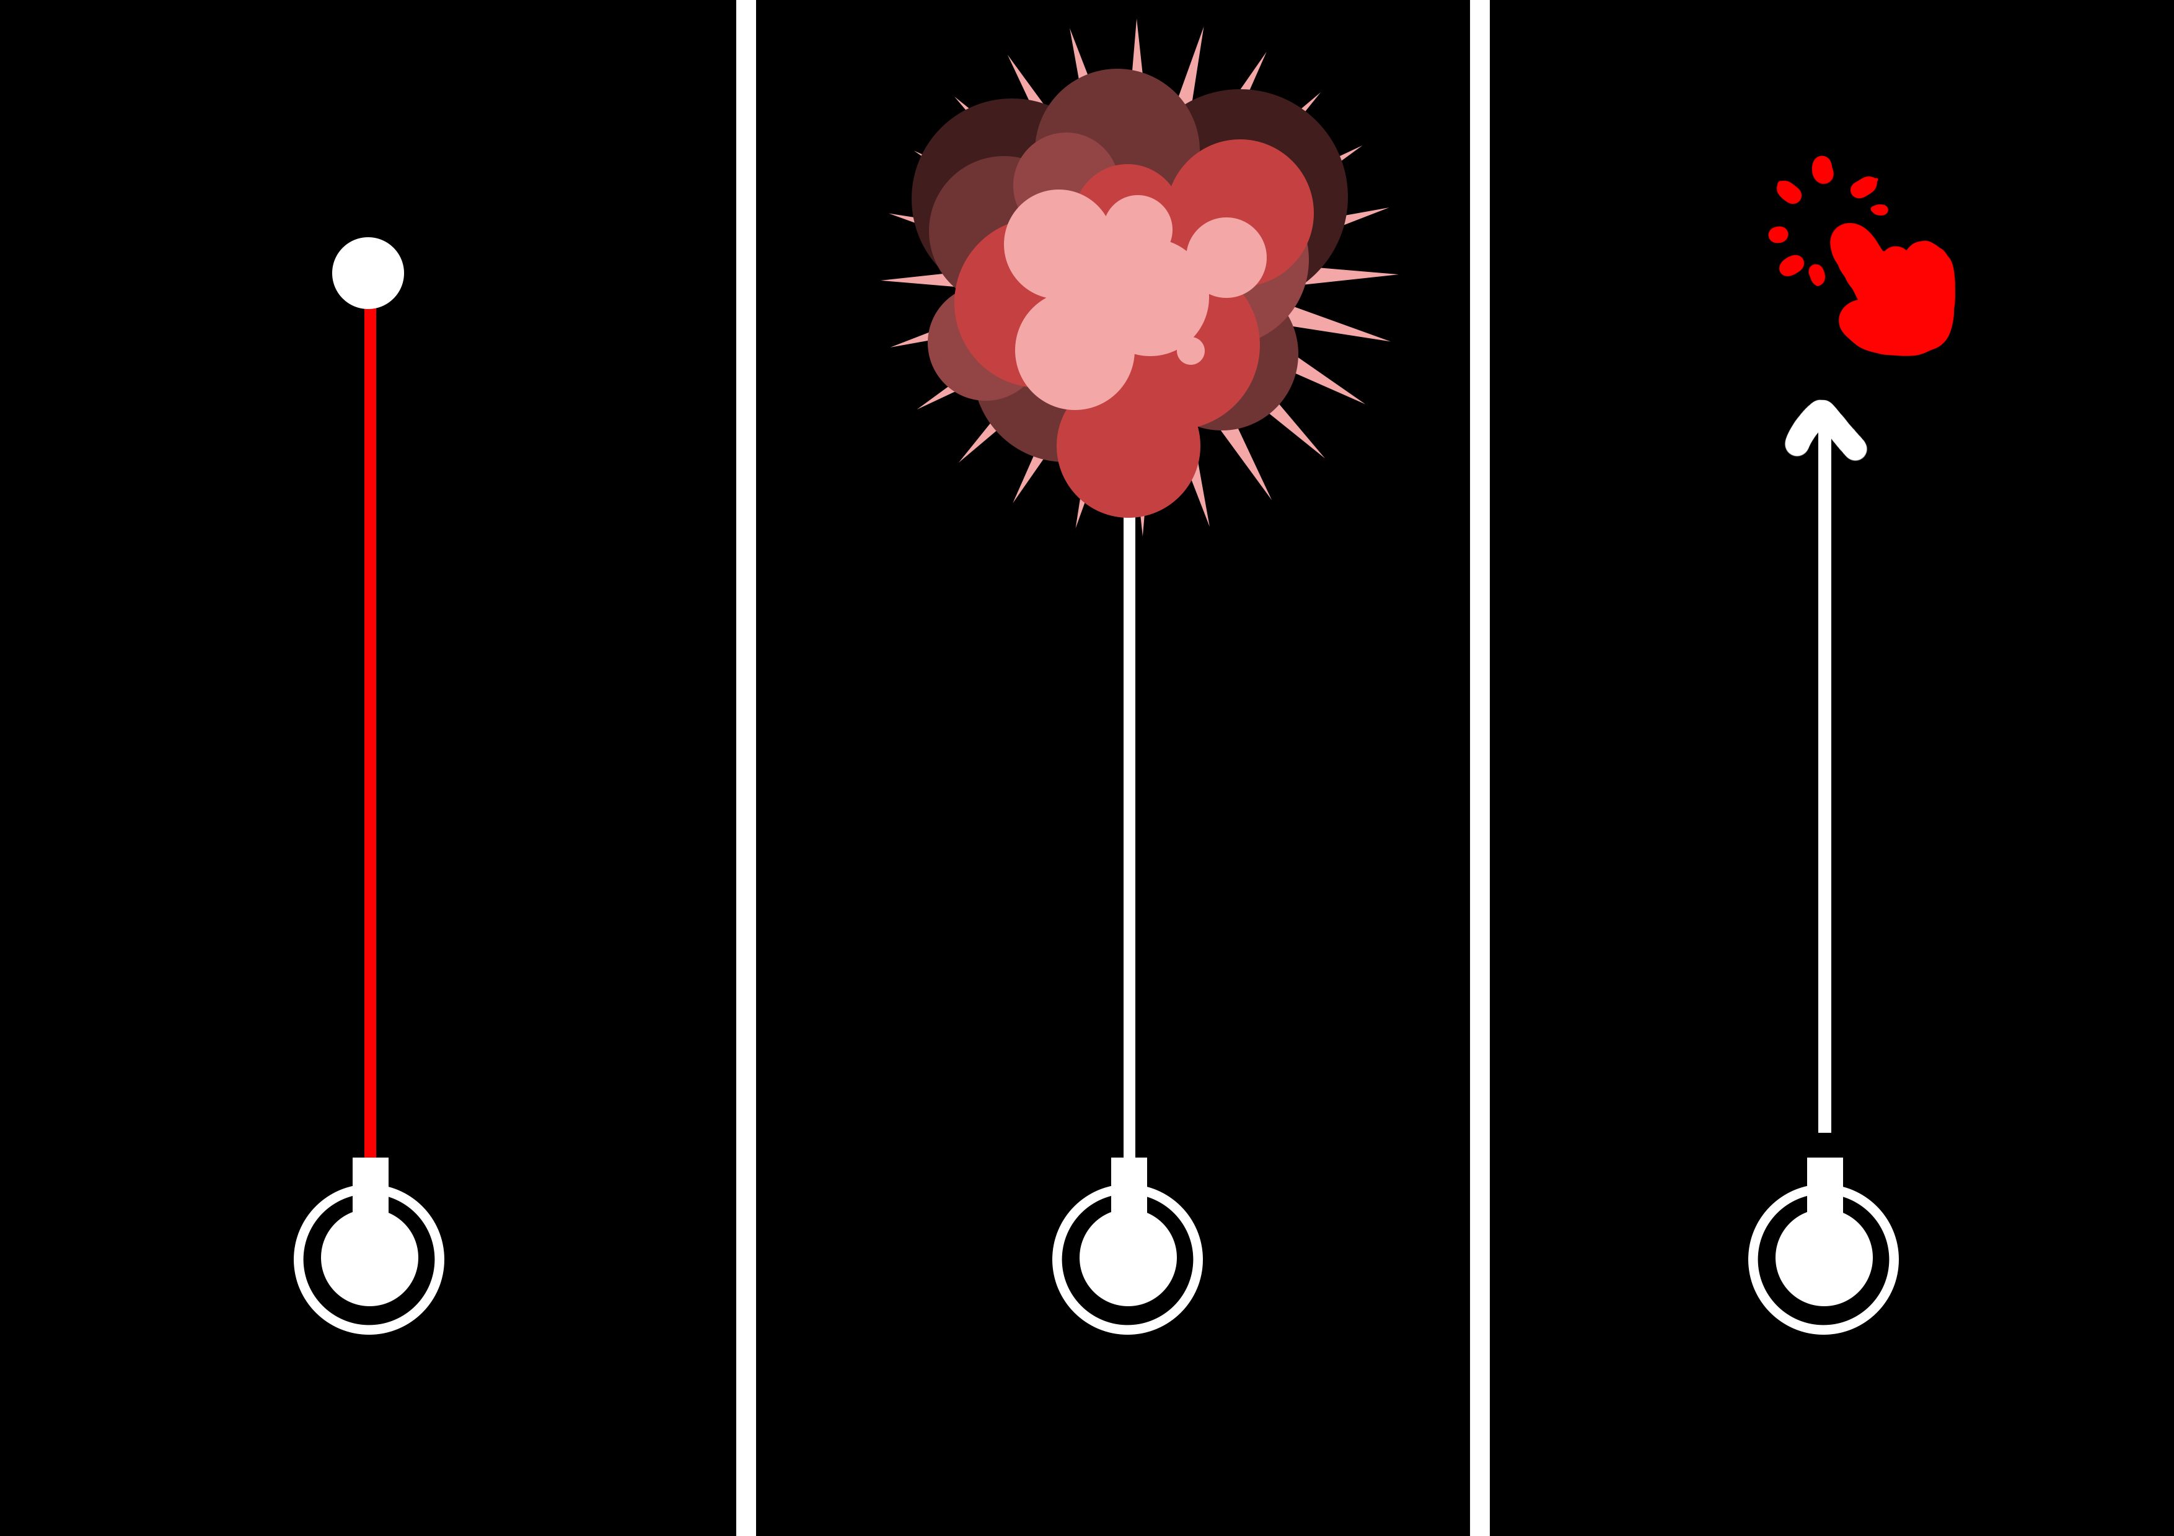

Slide 4
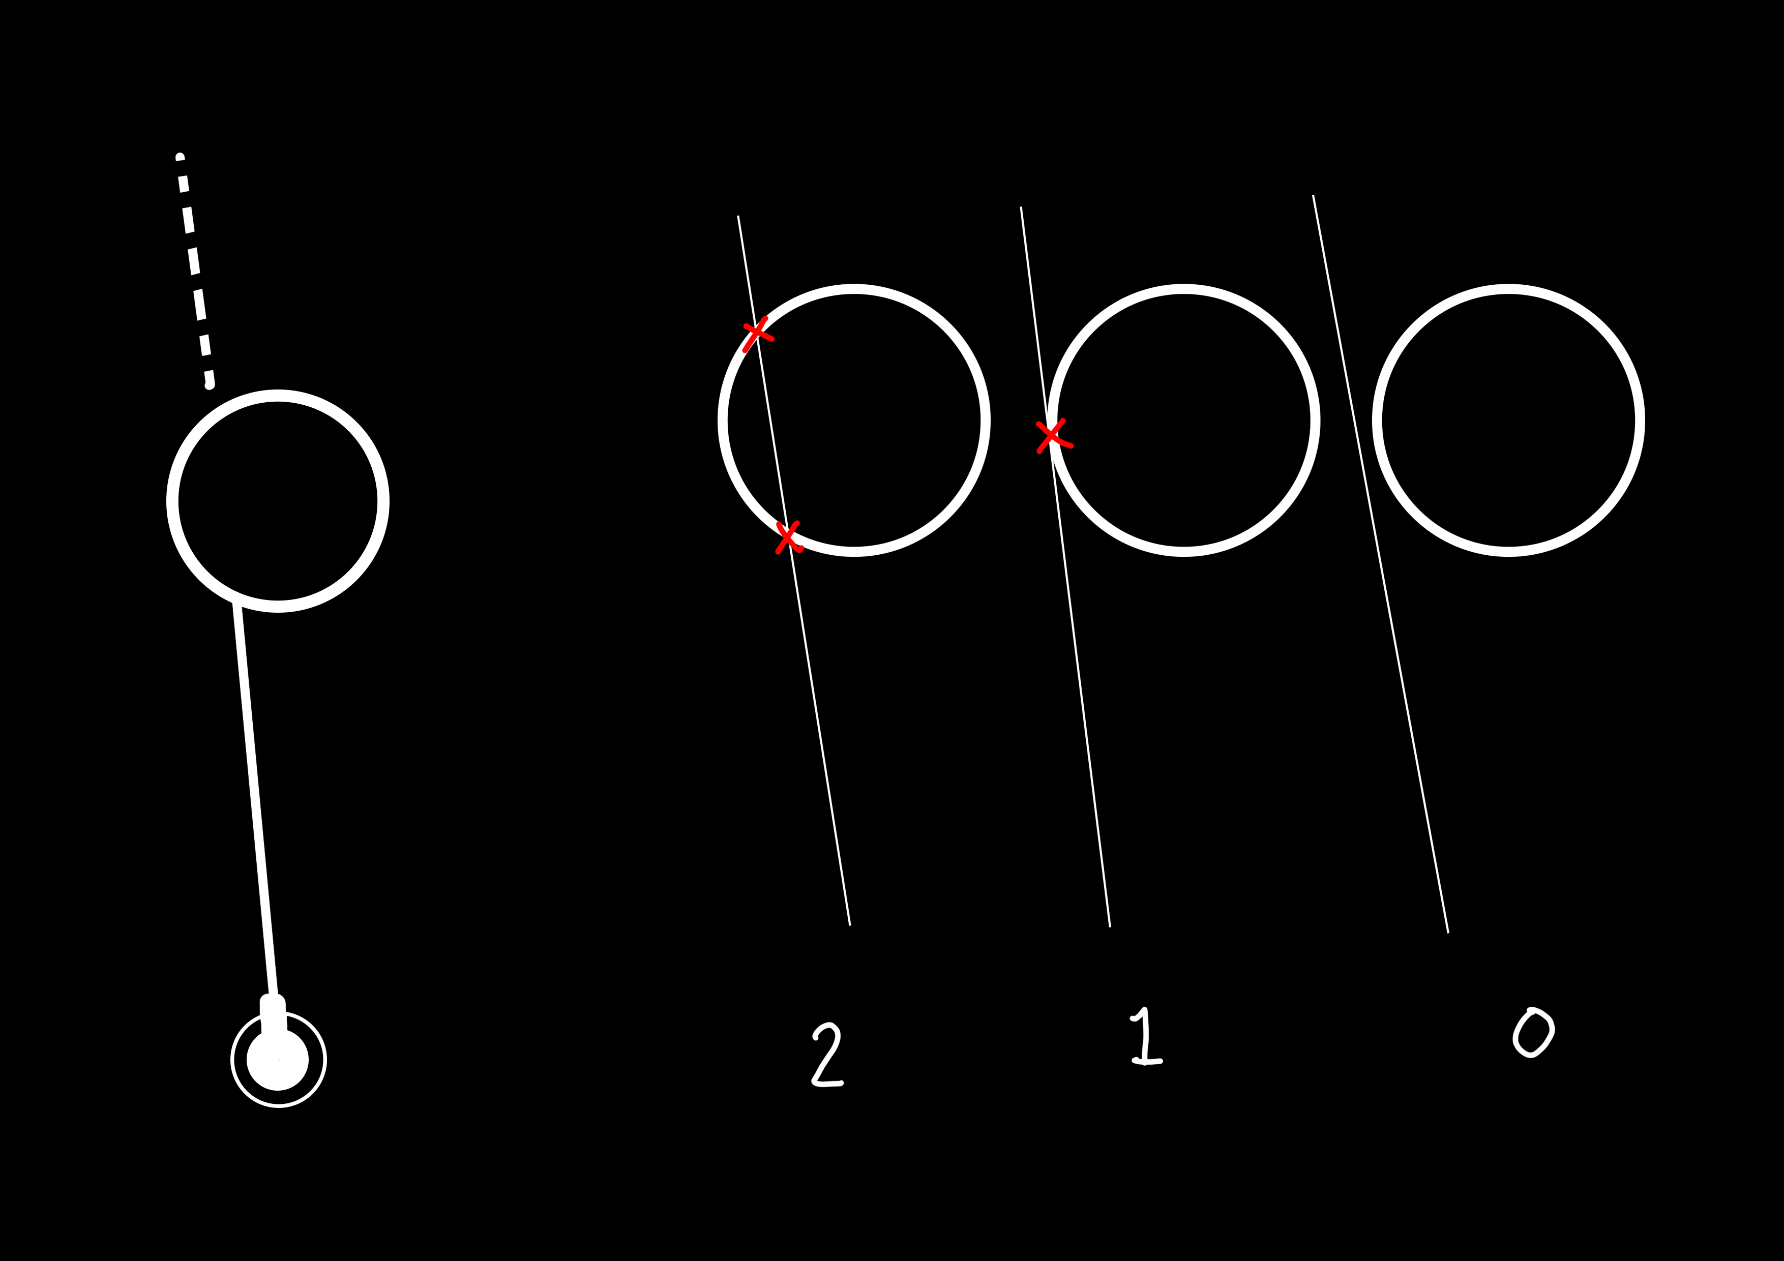

Slide 5
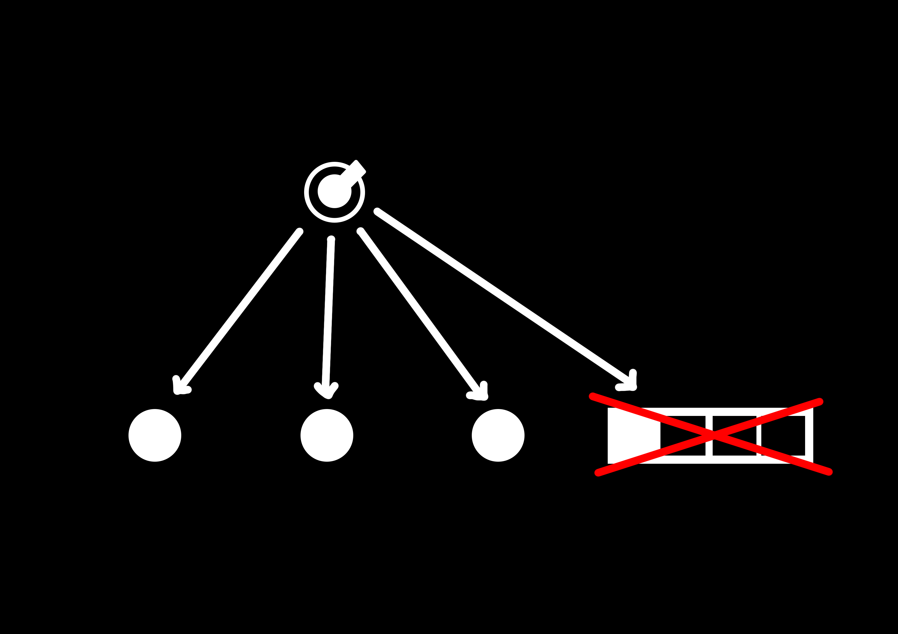

Slide 6
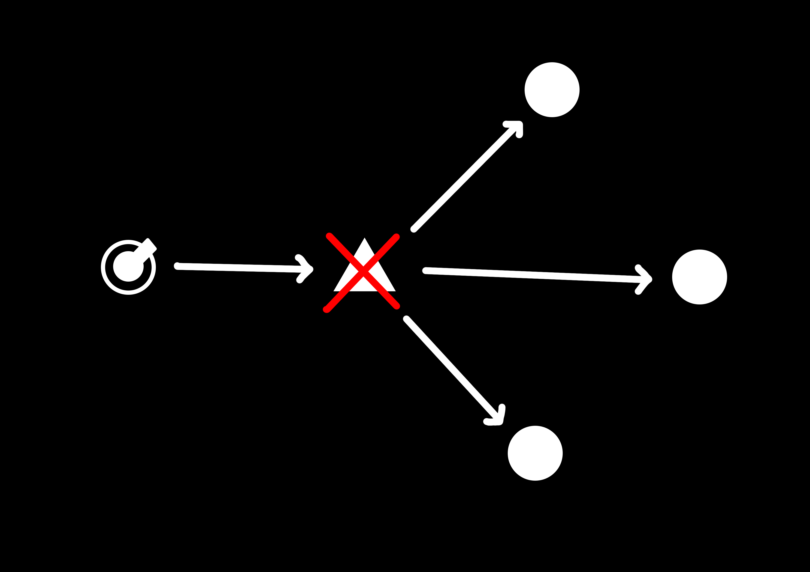

Slide 7
DEMO

Slide 8
PLAGUE
Project 1
James Dawson

