Slide 1









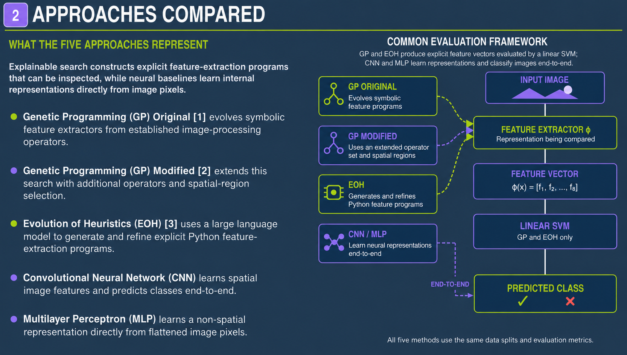
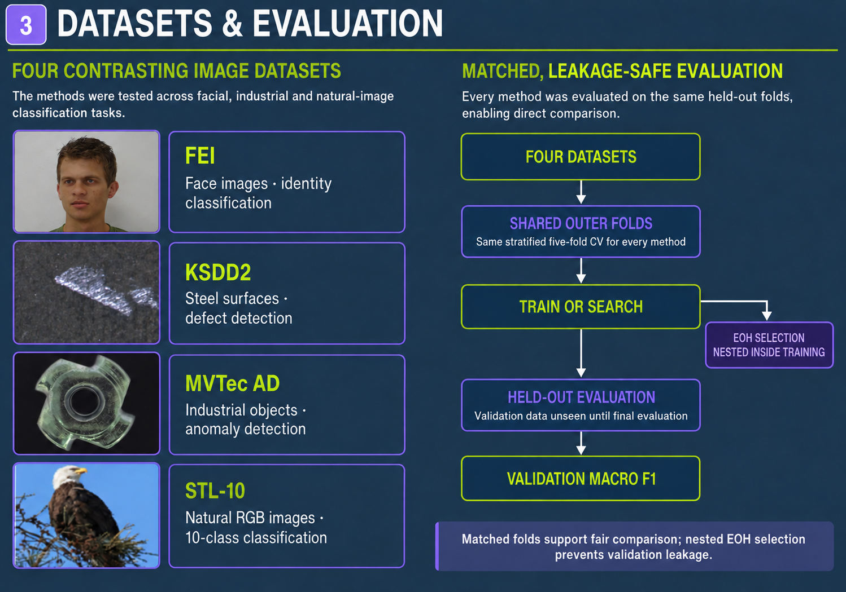
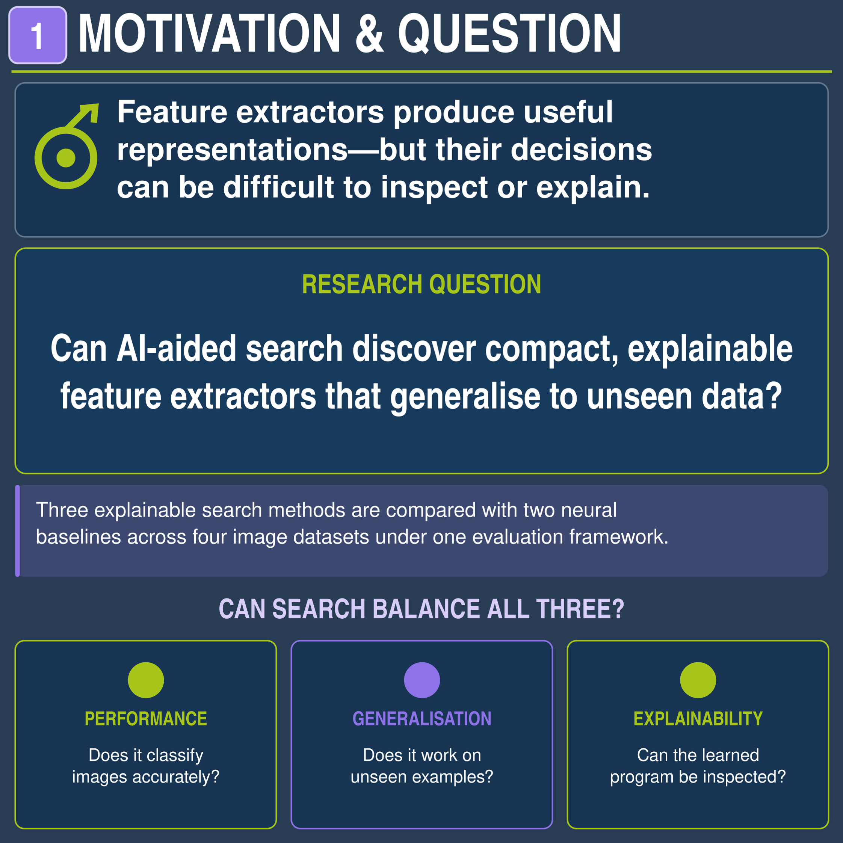


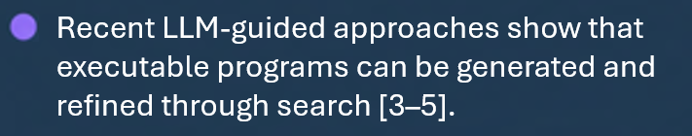


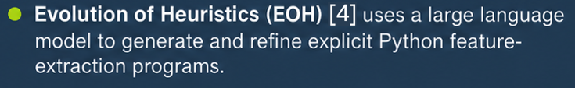


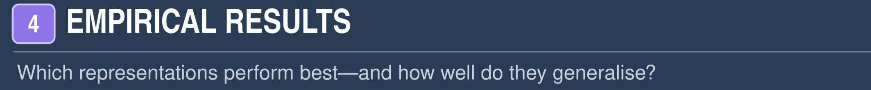
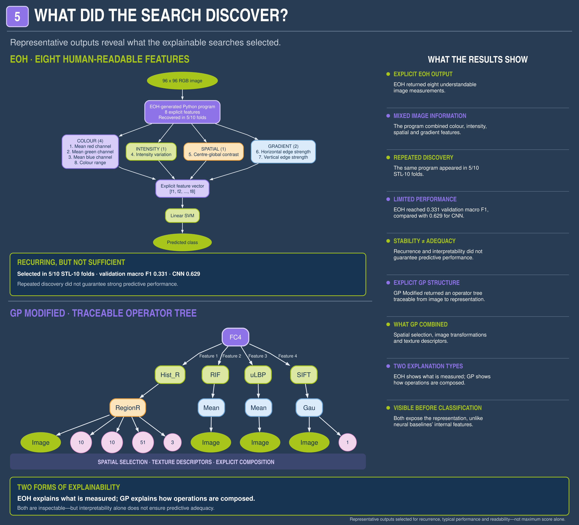
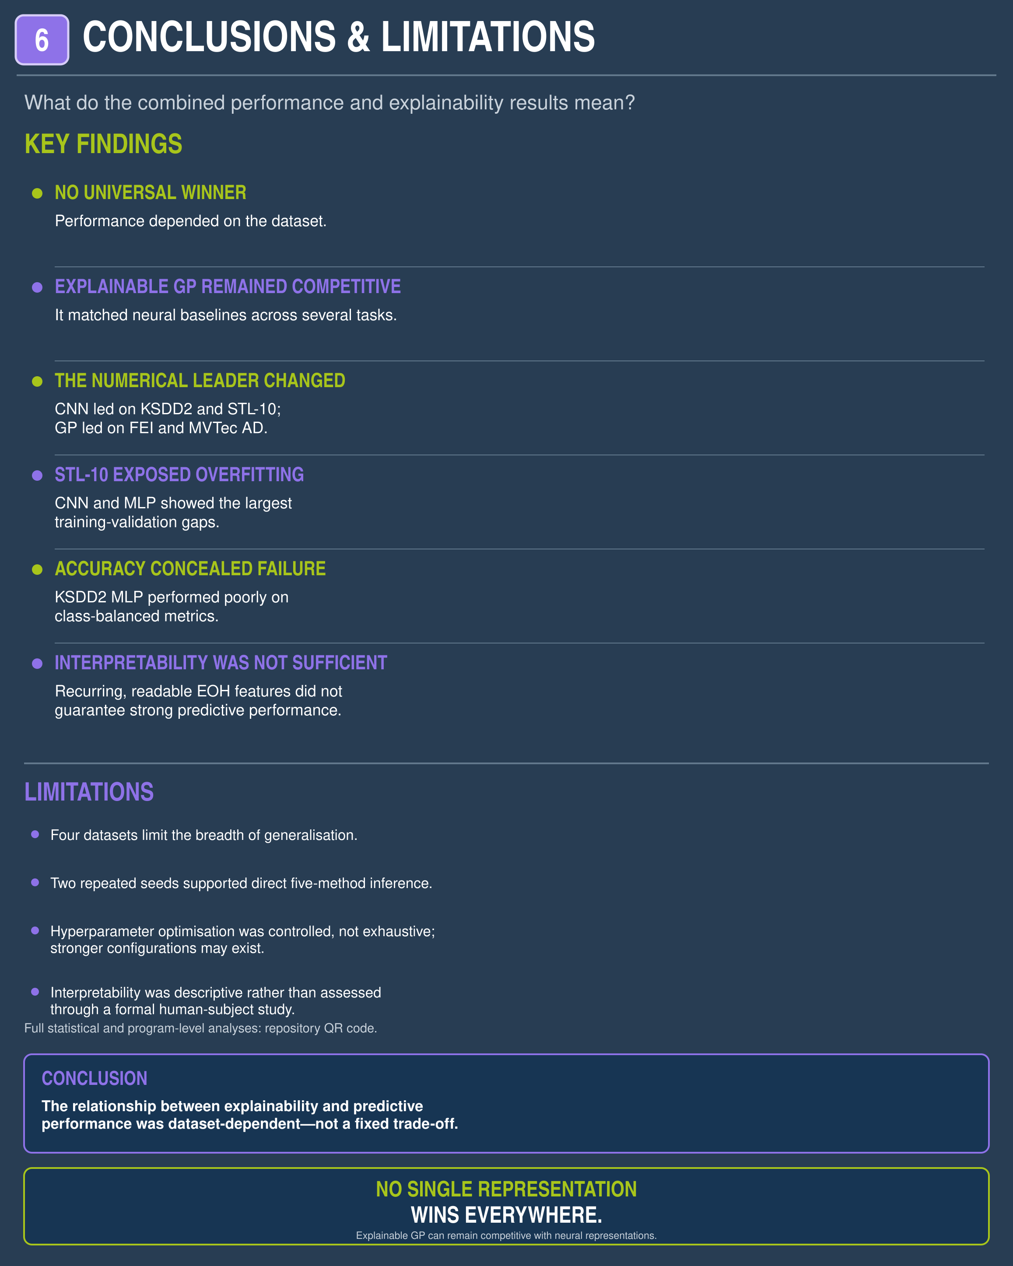
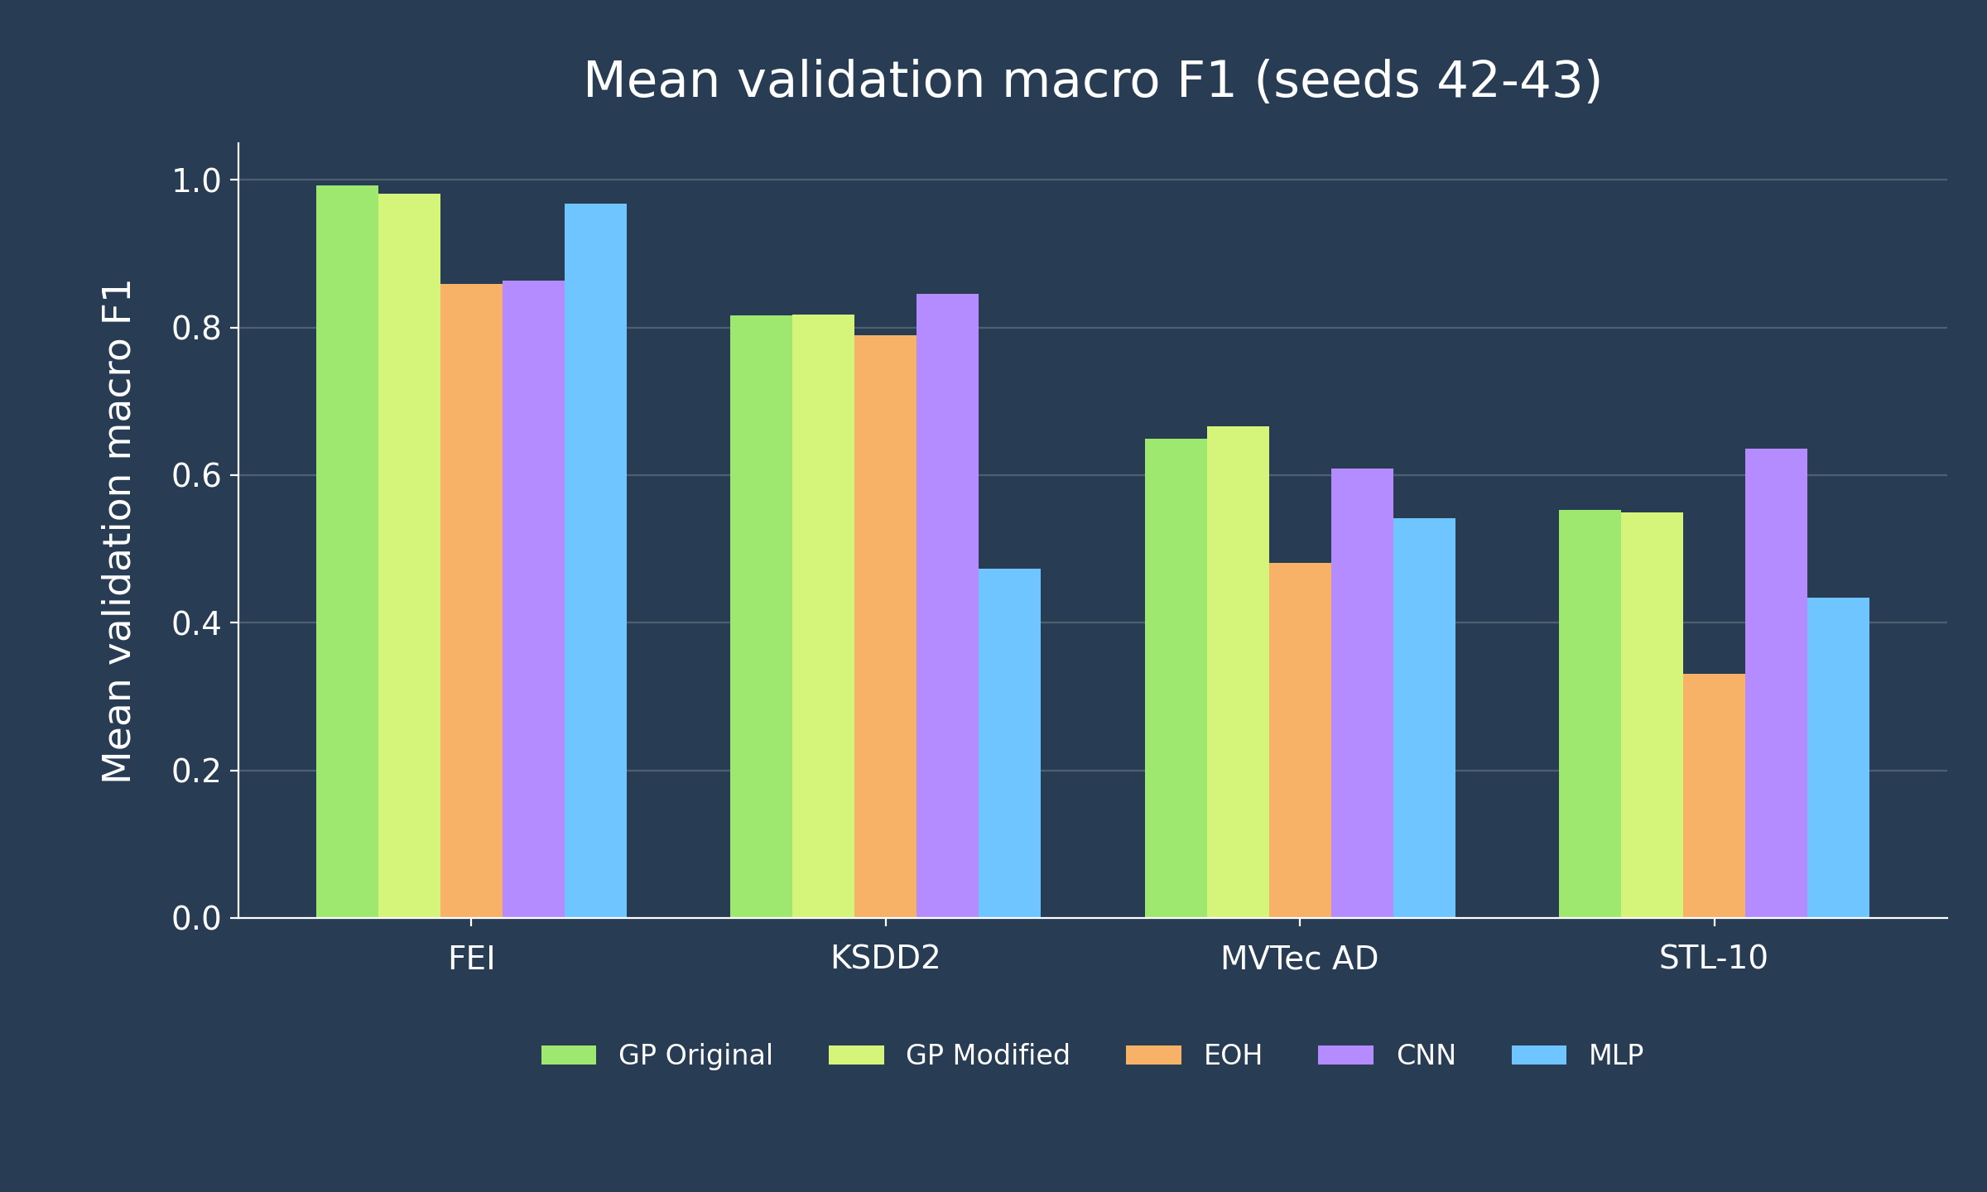
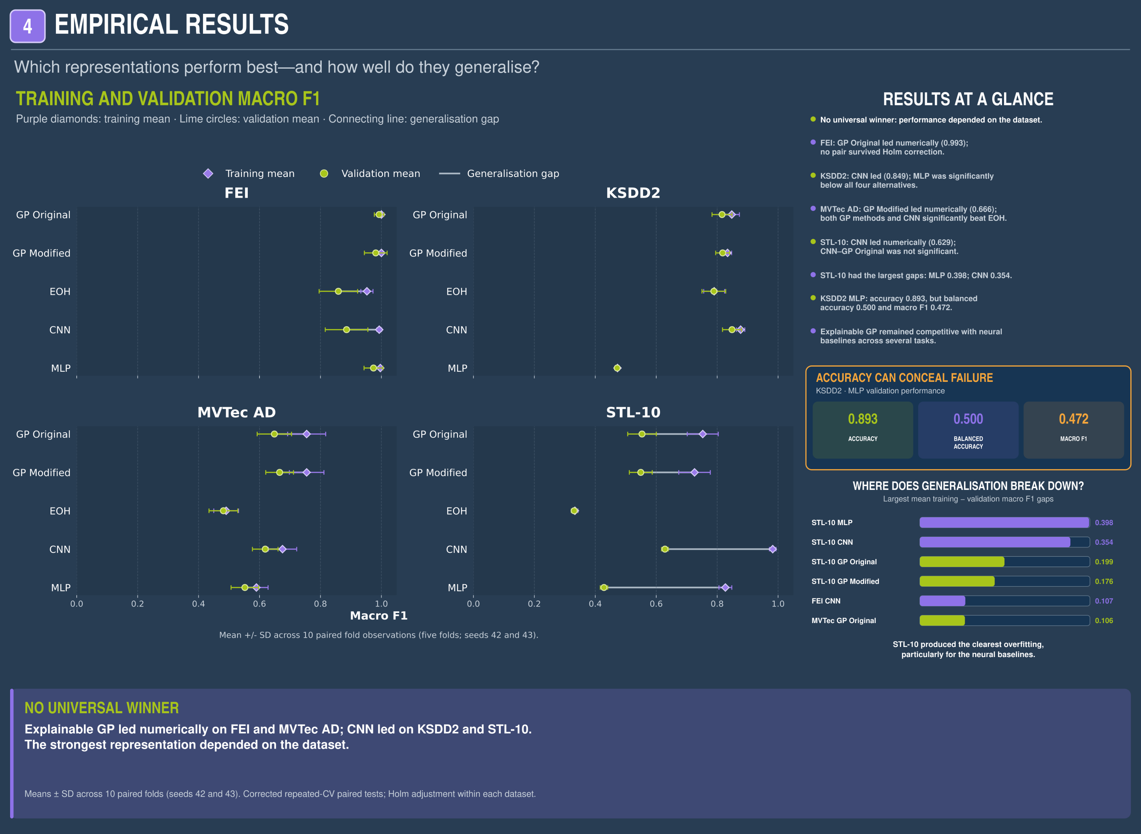
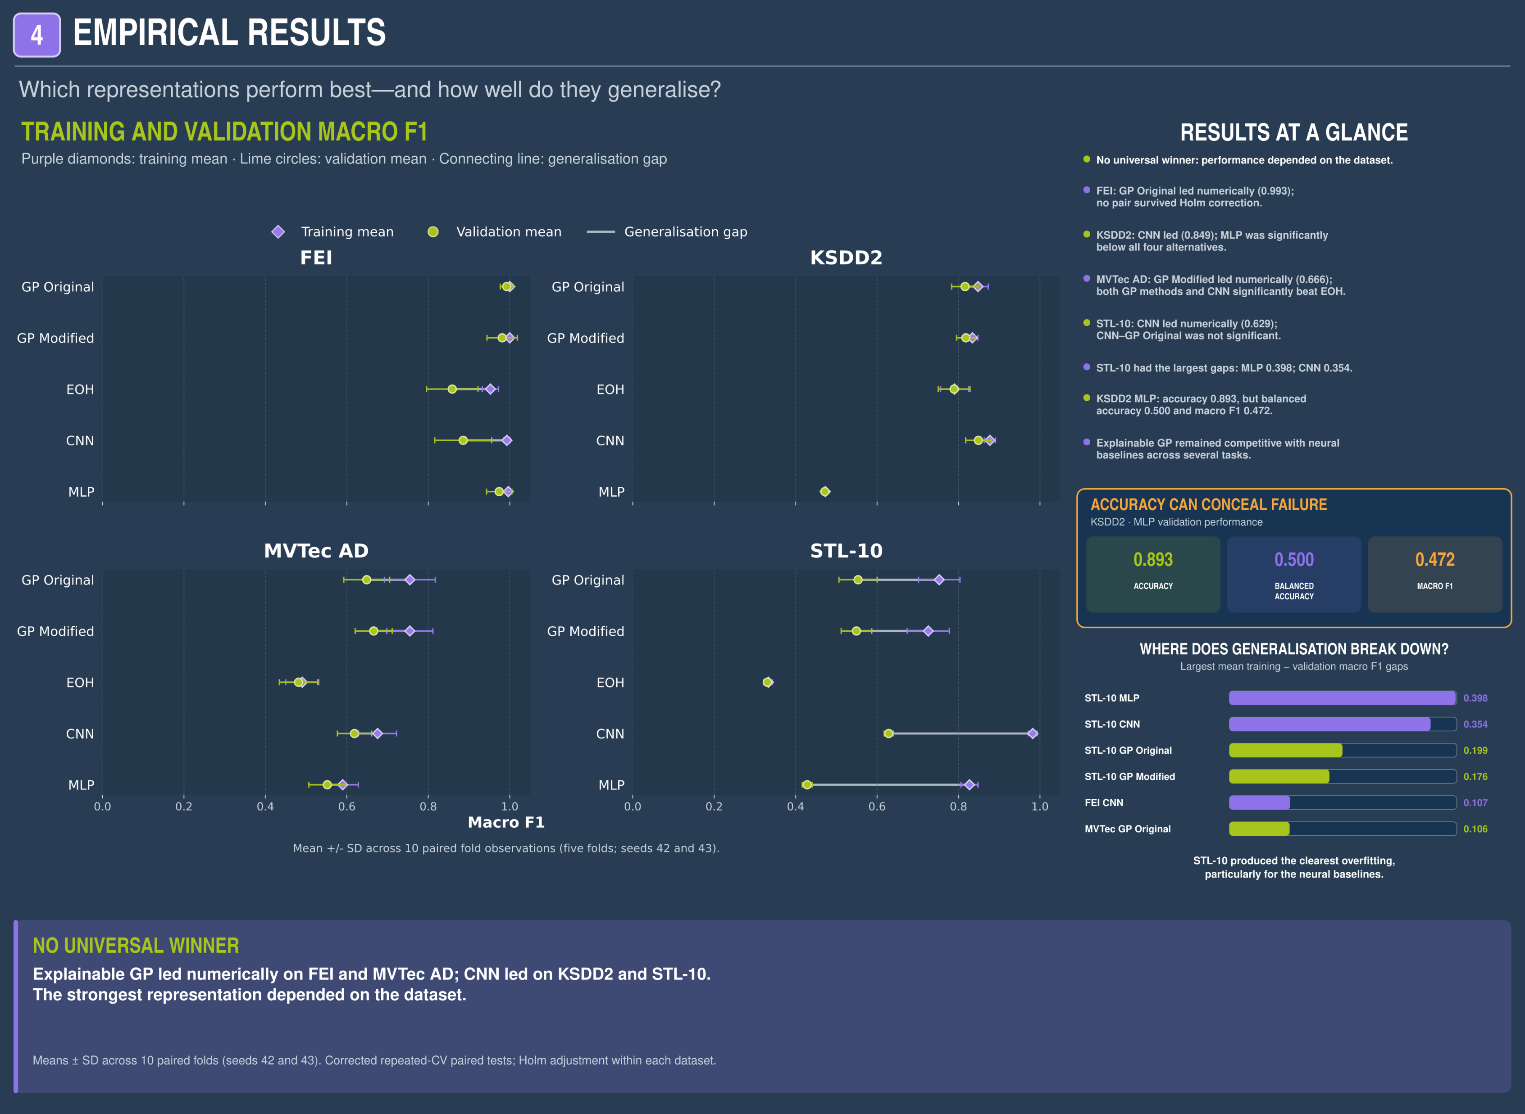
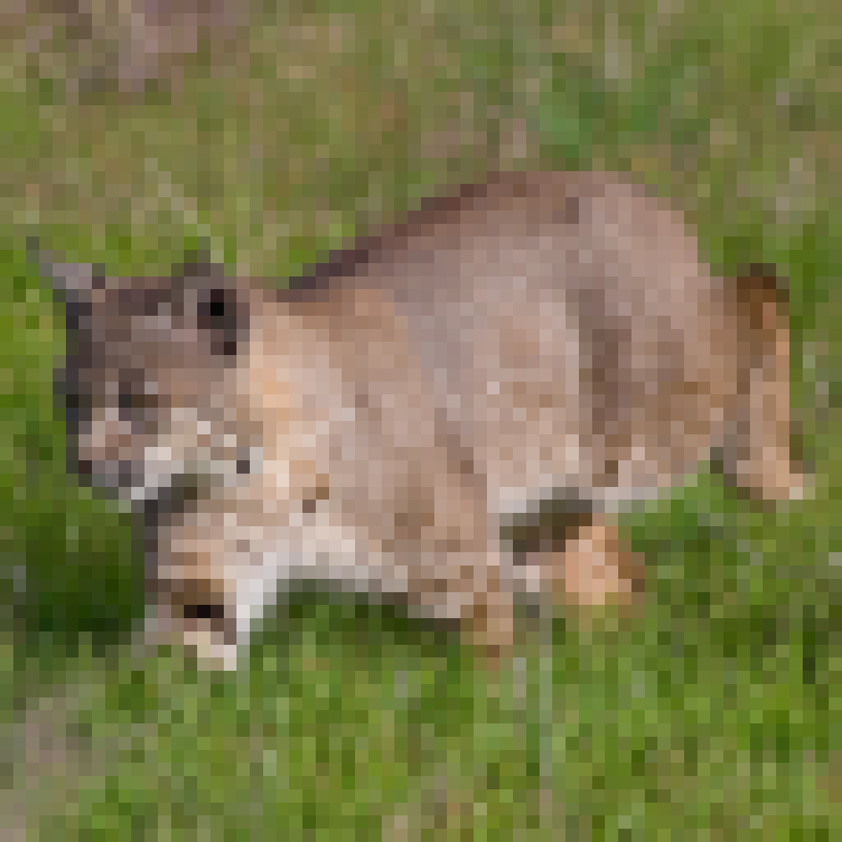
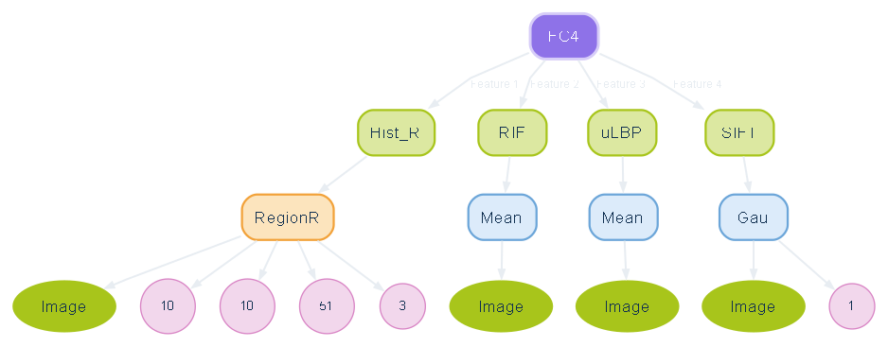
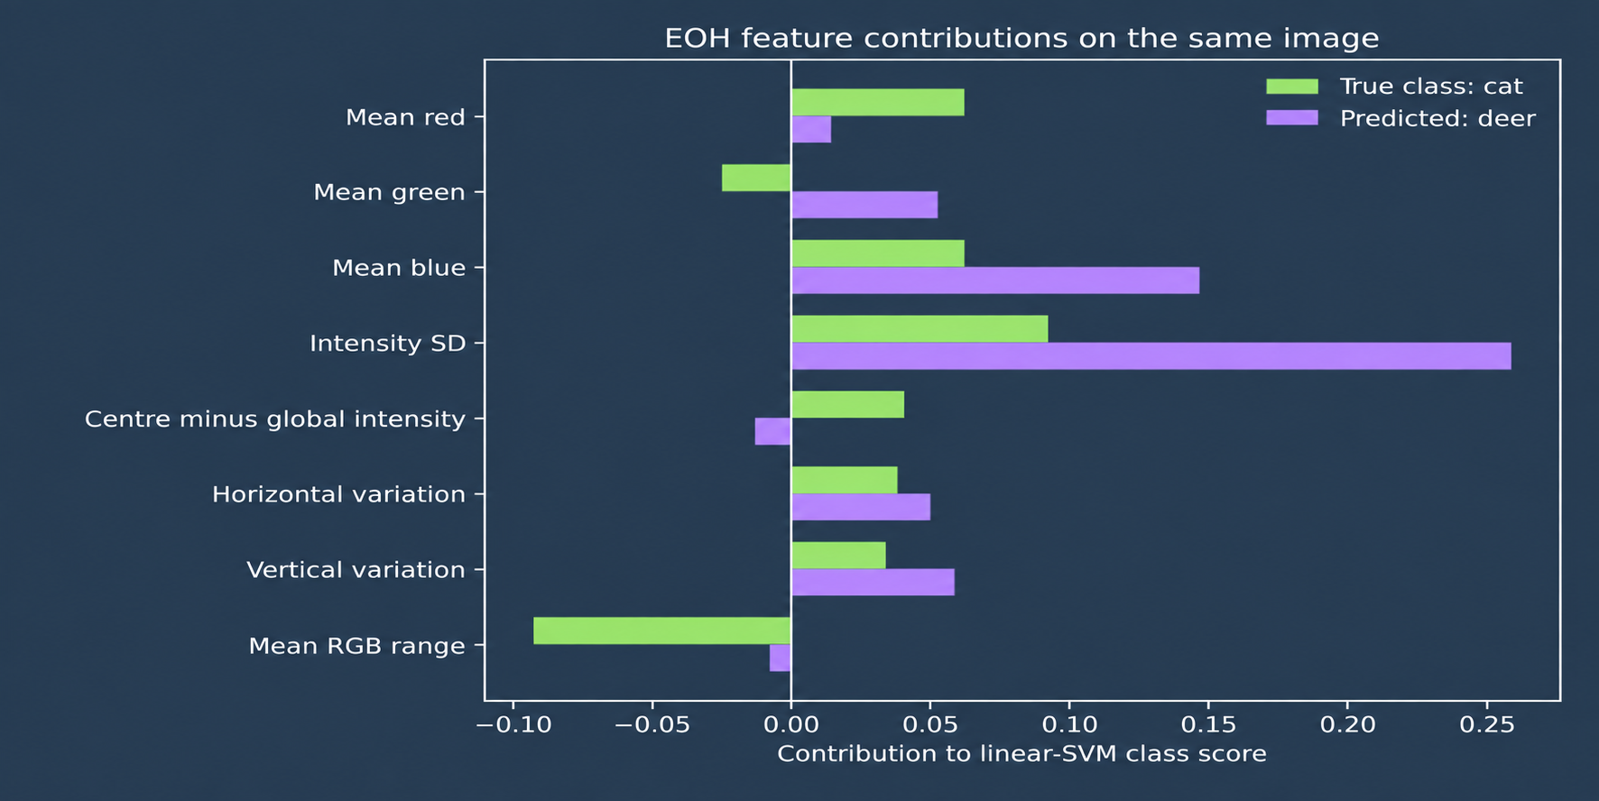
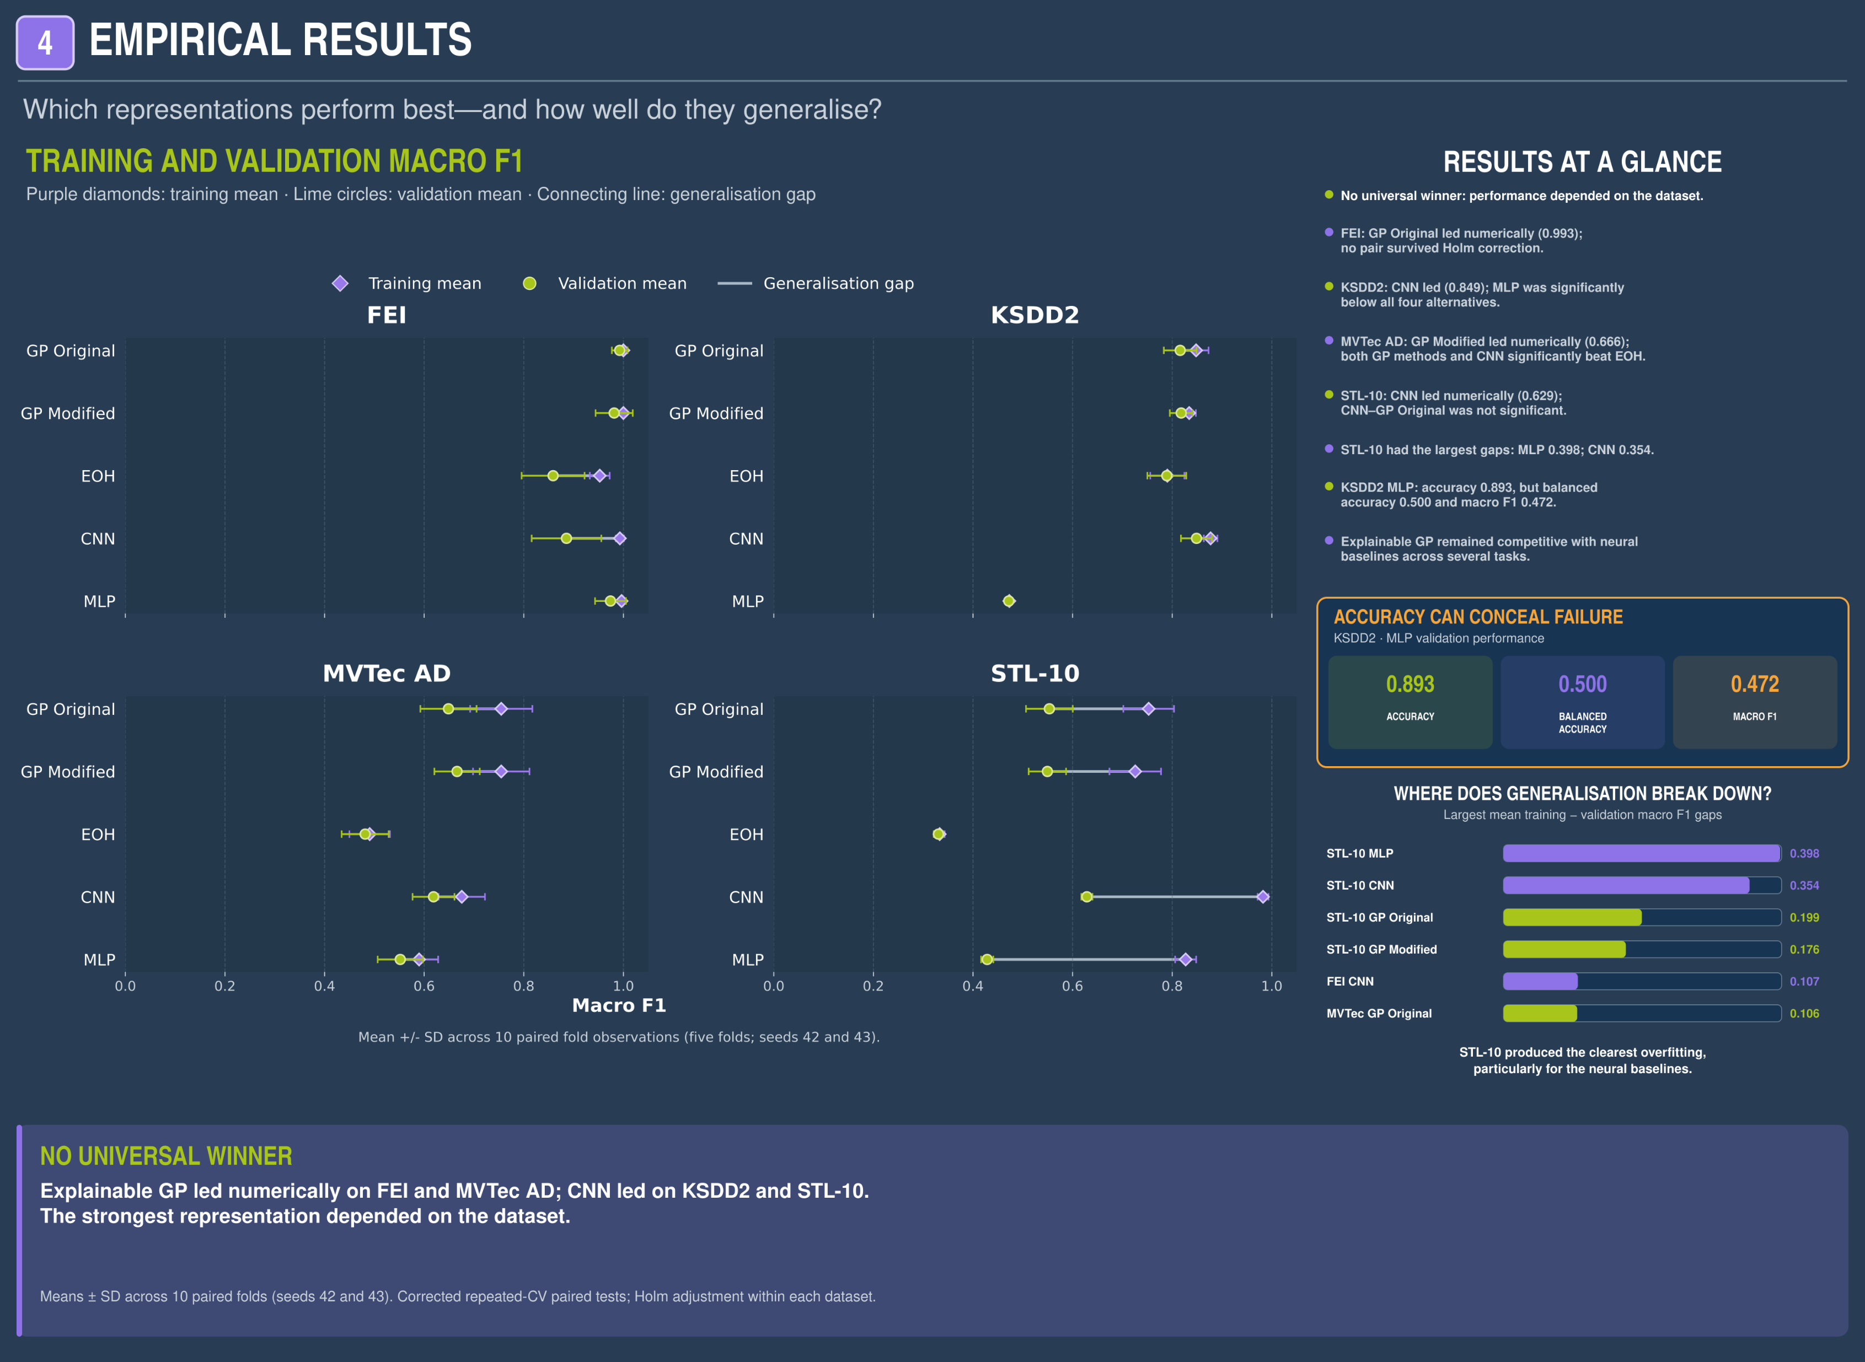
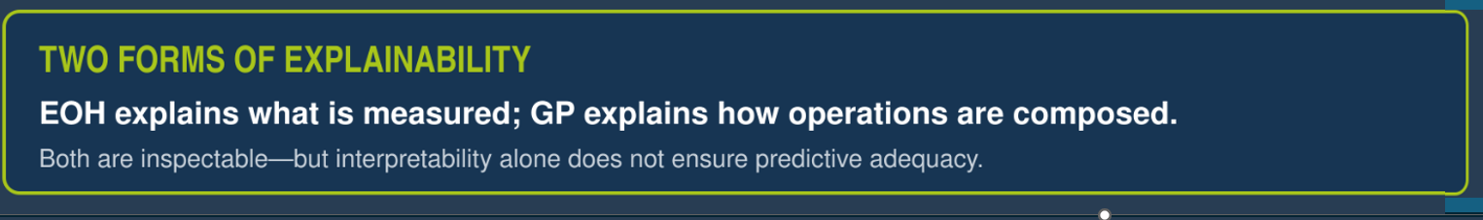

4. WHICH METHODS PERFORMED BEST?
5. EXPLAINING TWO MODELS ON THE SAME IMAGE
6. WHAT IMAGE-LEVEL ANALYSIS REVEALS?
NUMERICAL WINNERS
Objectively selected from 69 eligible validation images: GP Modified was correct and EOH failed in both seeds.
36,404
seed-level observations
18,202 underlying images
FEI GP Original 0.993
KSDD2 CNN 0.845
MVTec AD GP Modified 0.666
STL-10 CNN 0.635
TRUE CLASS
CAT
GP MODIFIED — 783 FEATURES
ALL 8 DATASET × SEED BLOCKS PASSED
0 missing keys • 0 extra keys • 0 identity mismatches
GP Modified: CAT ✓
EOH: DEER ✕
No method dominated every dataset. After Holm correction, FEI contained no significant pairwise differences. The clearest separation occurred on KSDD2 and STL-10.
STL-10 COMPLEMENTARY SUCCESSES
10,10 = crop origin
51,3 = crop width × height • 1 = Gaussian σ
2,466
4,474
EOH - 8 HUMAN-READABLE FEATURES
observations where CNN was correct while both GP and EOH failed
observations where at least one GP method was correct while CNN failed
Mean red, green and blue
Intensity contrast
Central-global intensity
Horizontal/vertical variation
Mean RGB colour range
KSDD2 ACCURACY WARNING
MLP: accuracy 0.893 | balanced accuracy 0.501 | macro F1 0.473
High accuracy concealed near-majority-class behaviour.
Aggregate scores conceal image-specific strengths and failures. Interpretable feature search and neural models often solve different cases—even when their overall scores are similar.
Exact standardised-feature × linear-SVM-weight contributions. They describe the fitted model, not causal importance.
Primary metric: validation macro F1 across 10 matched folds (5 folds × 2 seeds). Corrected repeated-CV paired t-tests; Holm adjustment within each dataset.
Same image, different representations: GP combined regional colour, texture and SIFT descriptors; EOH remained compact but supported the wrong class.
NO SINGLE REPRESENTATION WINS EVERYWHERE
REFERENCES:
[1] H. Al-Sahaf et al., IEEE TEVC, 21(1):83–101, 2017. [4] F. Liu et al., ICML, pp. 32201–32223, 2024.
[2] Y. Bi et al., IEEE TEVC, 25(1):87–101, 2021. [5] P. Shojaee et al., ICLR, 2025.
[3] B. Romera-Paredes et al., Nature, 625:468–475, 2024.
CONTACT:
James Davies MSci Mathematics & Statistics, Lancaster University GitHub: Scan the QR code to view the project repository and code.
ACKNOWLEDGEMENTS: This research was conducted as part of the Mathematics for AI in Real-world Systems (MARS) programme at Lancaster University, under the supervision of Dr Jixiang Qing, with support from Reliable Insights.
PROJECT CODE & FURTHER ANALYSIS:

