Slide 1

TouchReg
James Dewar
Richard Bard
Richard Lan Chow Wing
William Moore
Zakaria Ahmed
Gergely Kiss

Slide 2
This Presentation Will Include
About the project
Benefits
Plans
Flowchart
Questioner
Hardware
Questions

Slide 3
About the project
TouchReg Is a system that would eliminate the need for those tedious paper registers that distract students, consume time and can easily be forgotten.
TouchReg offers a quick and painless solution. Simply touching a device with the new student card, students will be recorded as being present at their class or lab.

Slide 4
Advantages
Quick
Cost effective
Environmentally Friendly
Accurate
Allows University staff to concentrate on more important issues.
Easily updated

Slide 5
Disadvantages
Initially expensive to install
If students lose their card they can’t register for class
Should the system go down for any reason, the paper registration would be required

Slide 6
Five Versions Considered For The Project
Hard Wired Hybrid Version
Hard Wired Internet Version
Hard Wire LAN Version
LAN Stand alone Version
Stand Alone WIFI Version

Slide 7
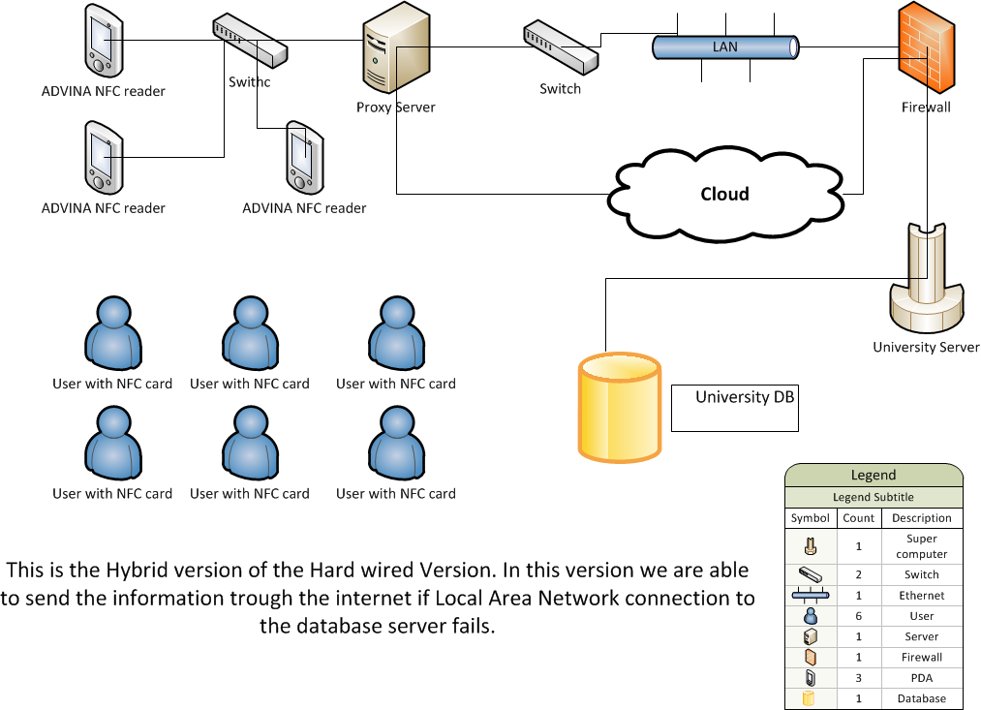
Hard Wired Hybrid Version

Slide 8
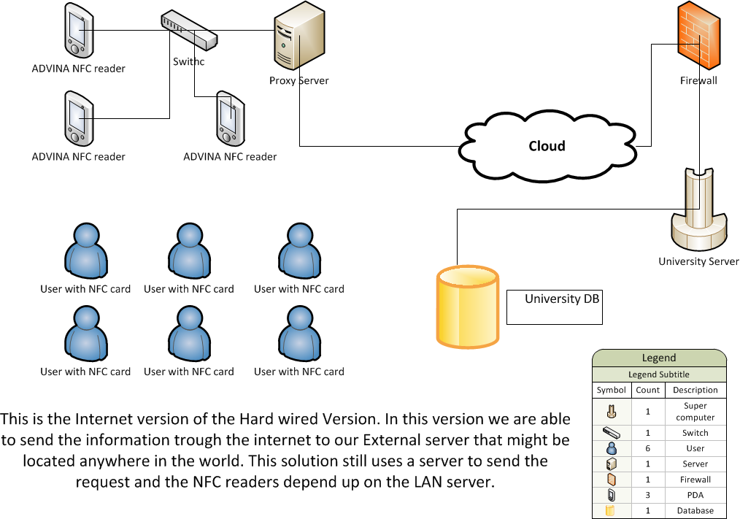
Hard Wired Internet Version

Slide 9
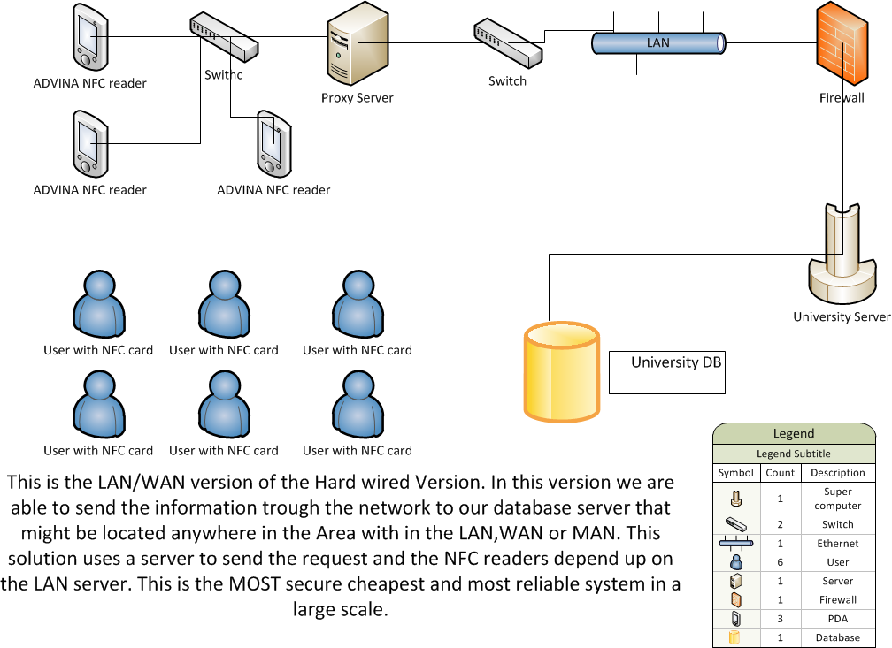
Hard Wire LAN Version

Slide 10
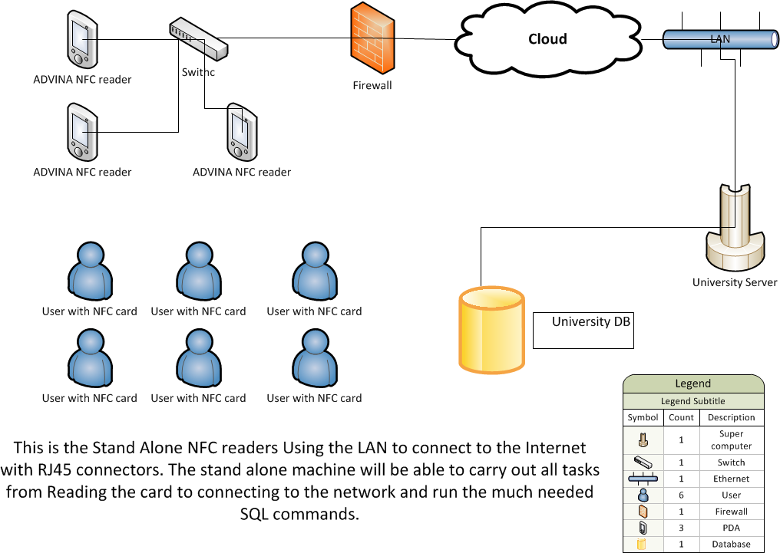
LAN Stand alone Version

Slide 11
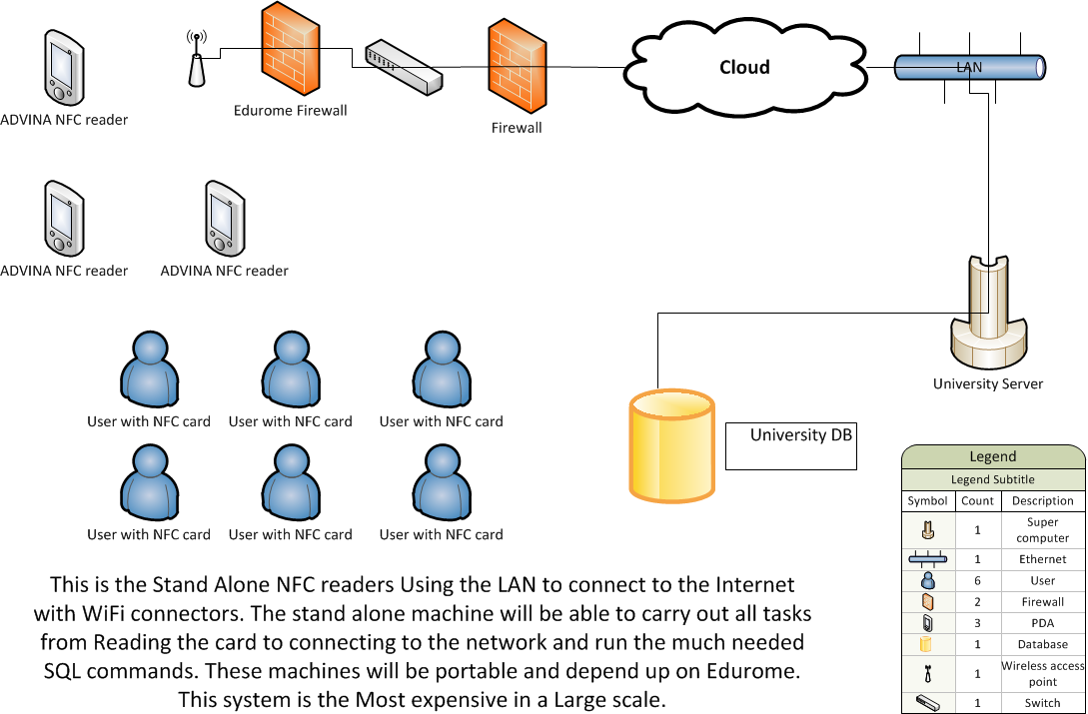
Stand Alone WIFI Version

Slide 12
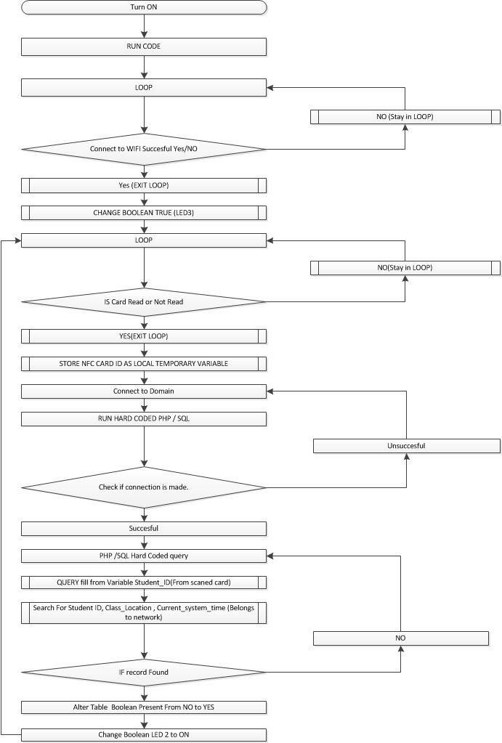
Flow chart

Slide 13
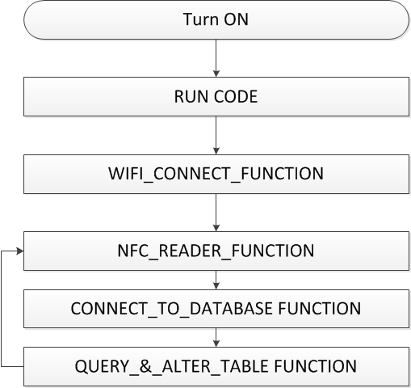
Flow Chart Simplified

Slide 14
Questionnaire
An online questionnaire has been prepared. This will be emailed out to faculty members to get their feedback on the old system and also how their experiences using the TouchReg system.
By utilising an online questionnaire we are able to turn the feedback into data to better assess and analyse.
Our Survey:
http://www.smartsurvey.co.uk/s/136505HILCM?preview=true

Slide 15
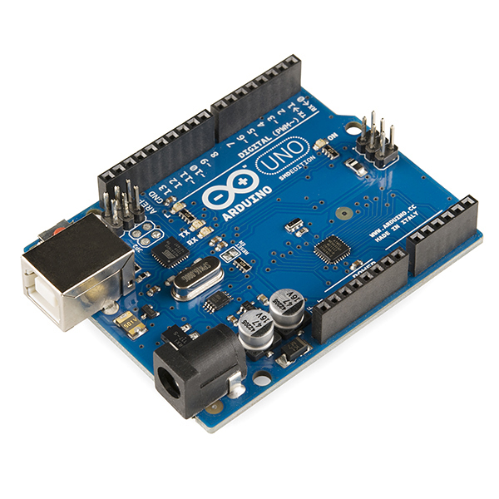
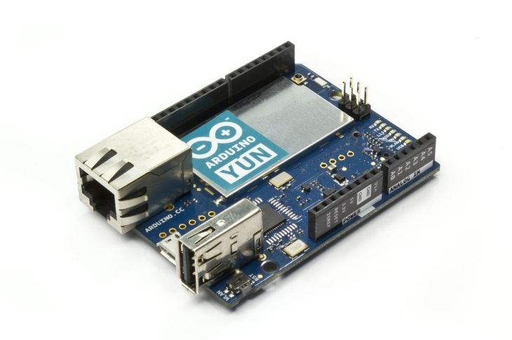

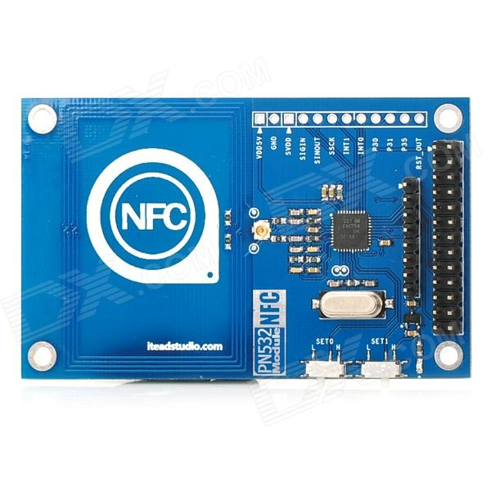
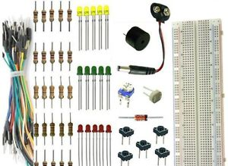
Hardware
Arduino yun
NFC communication shield for arduino
Small LEDs, resistors and wires
Arduino Uno

Slide 16
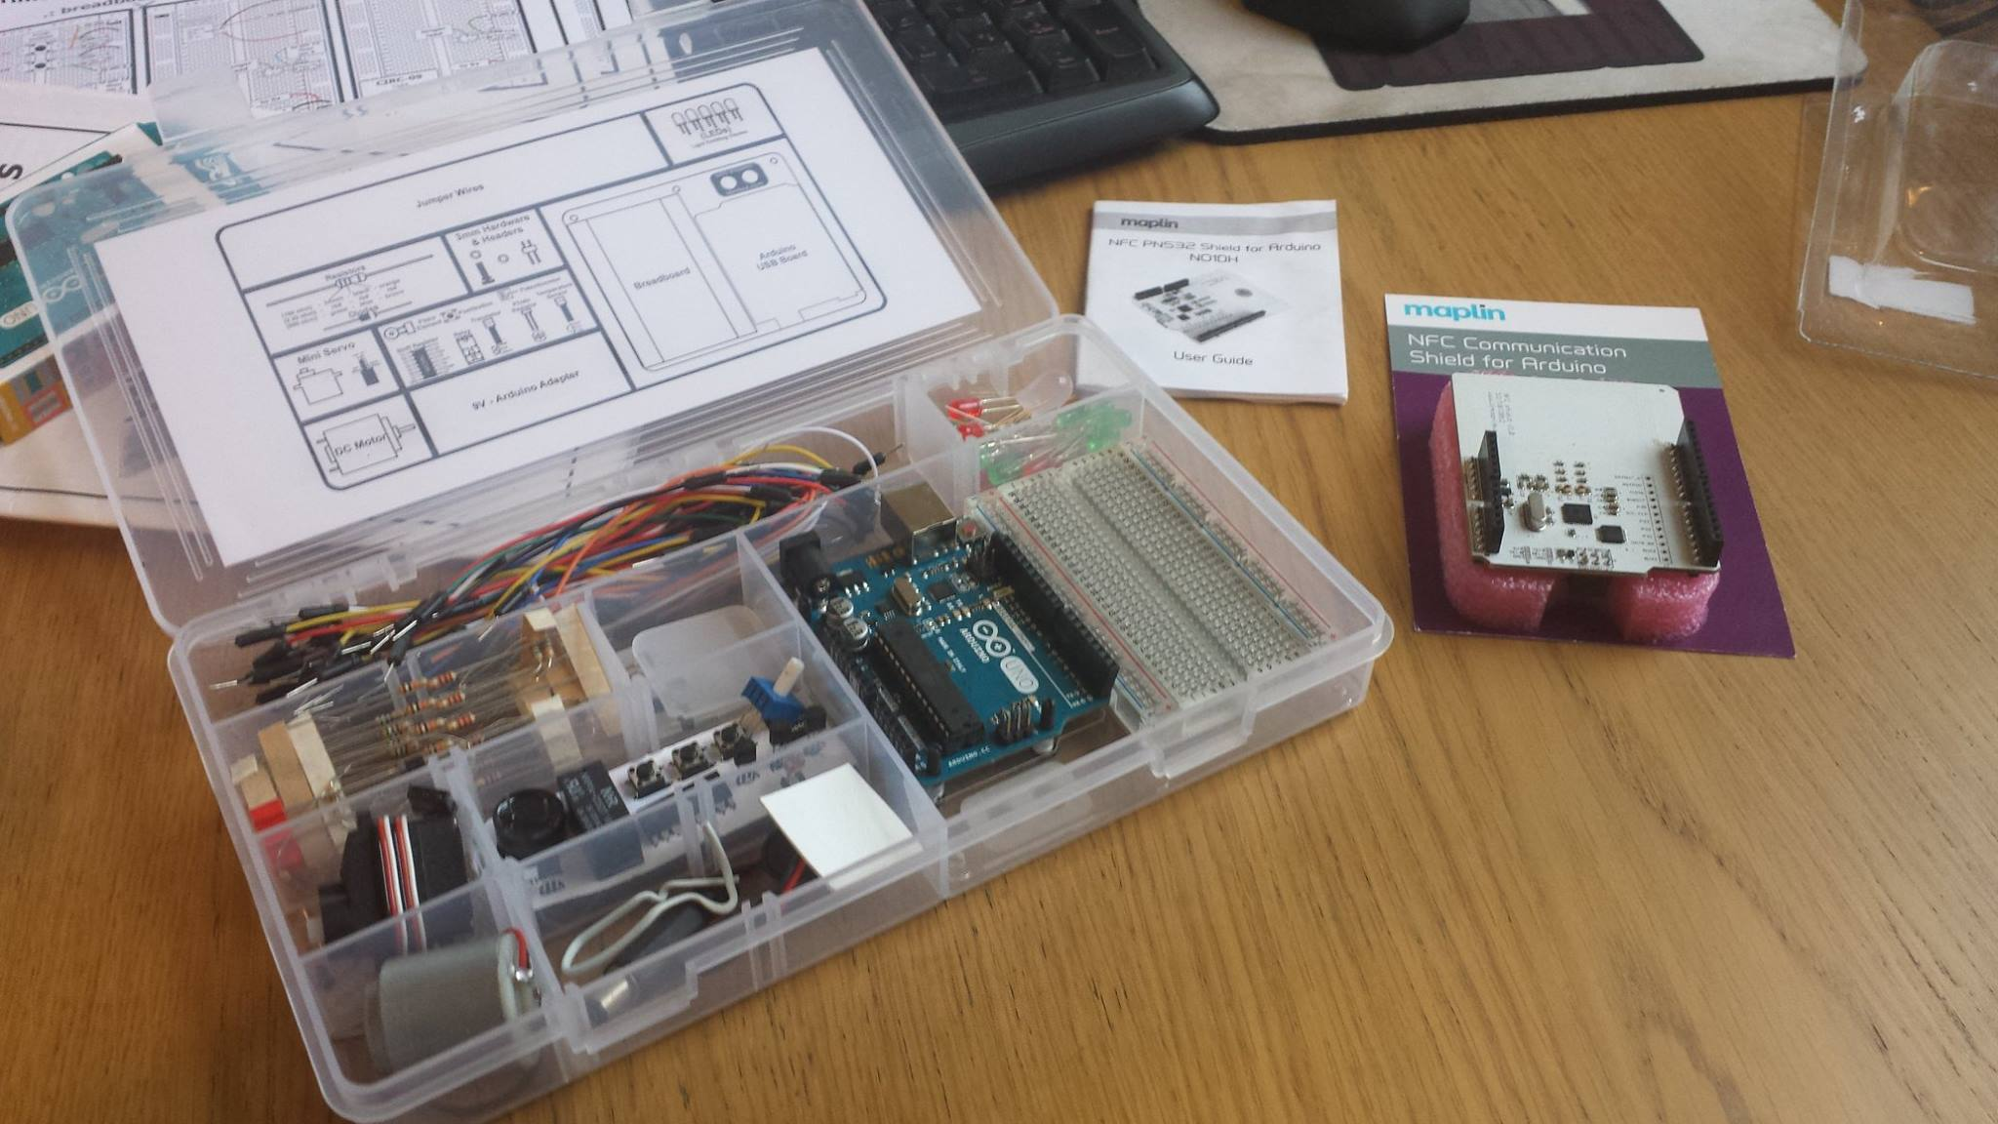
Hardware

Slide 17
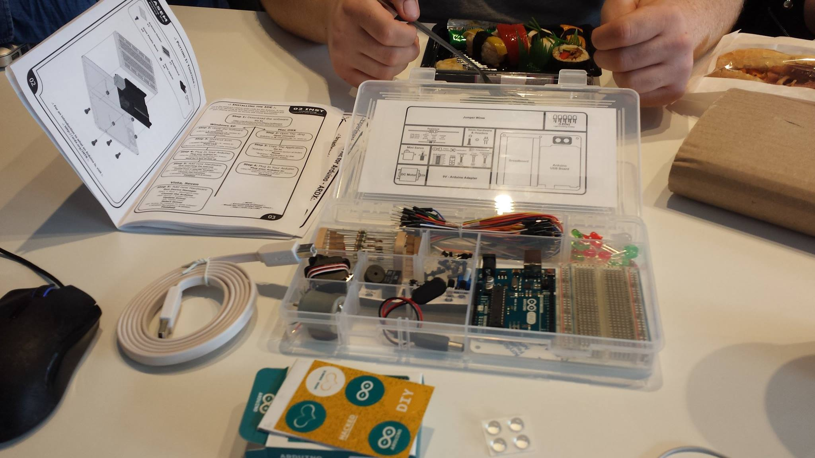
Hardware

Slide 18
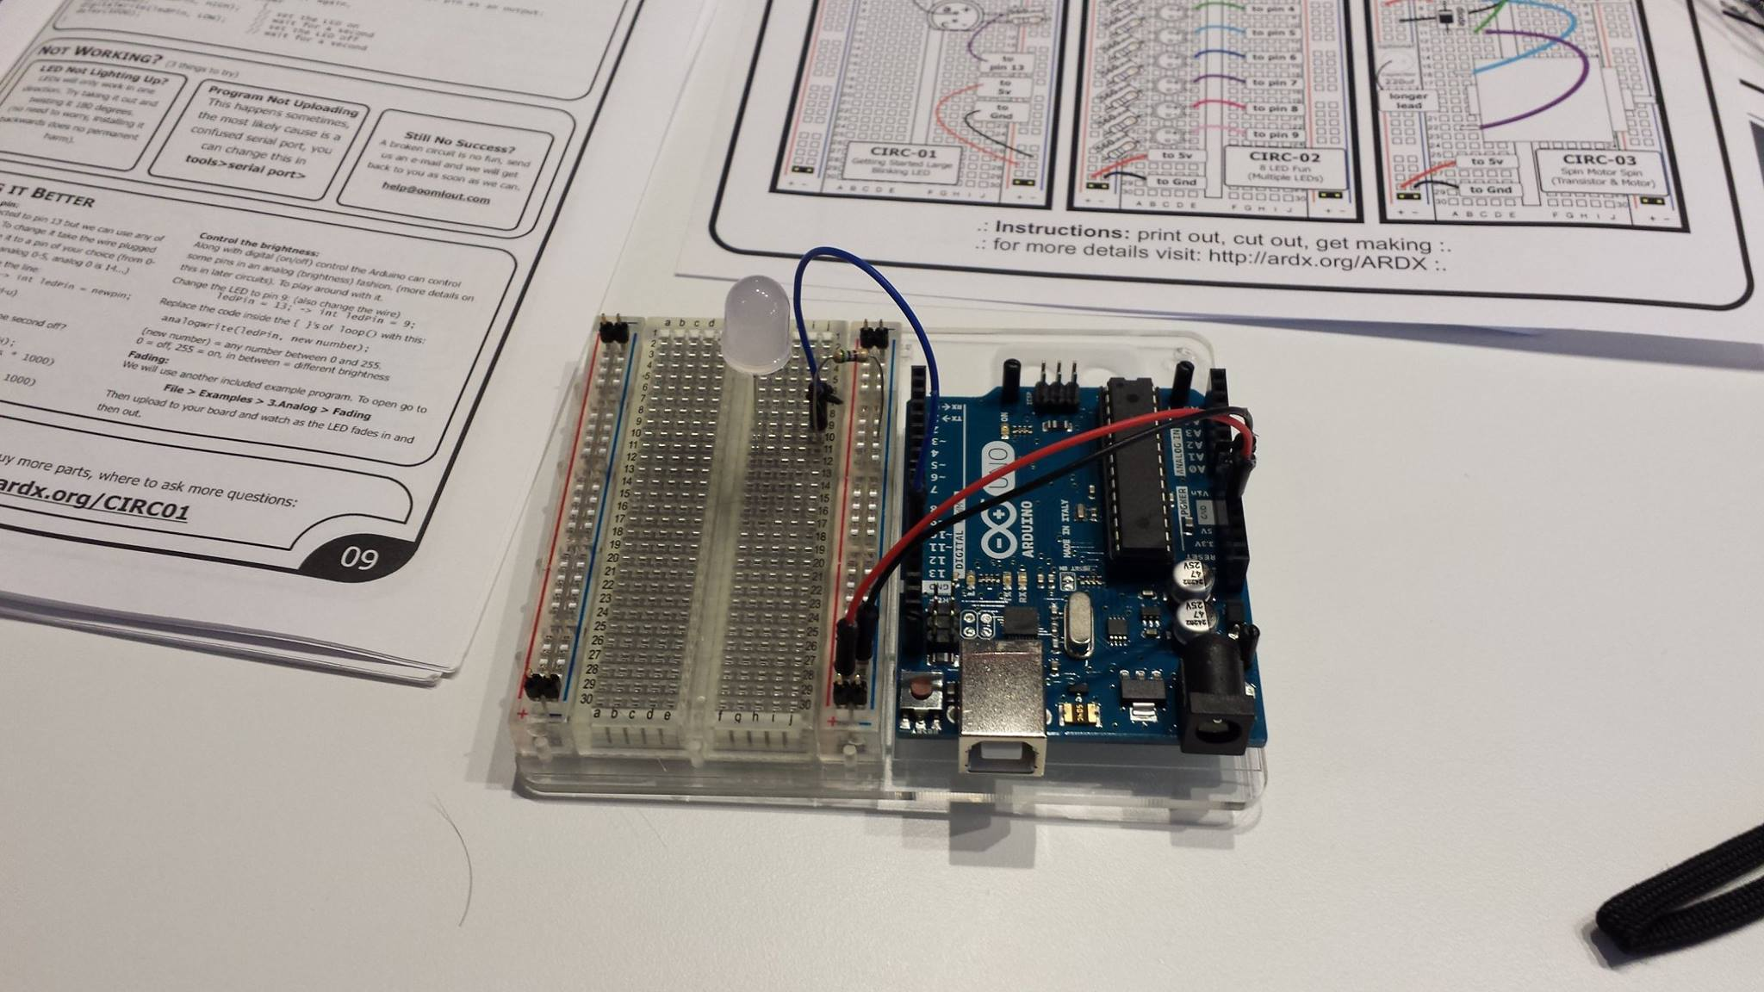
Hardware

Slide 19
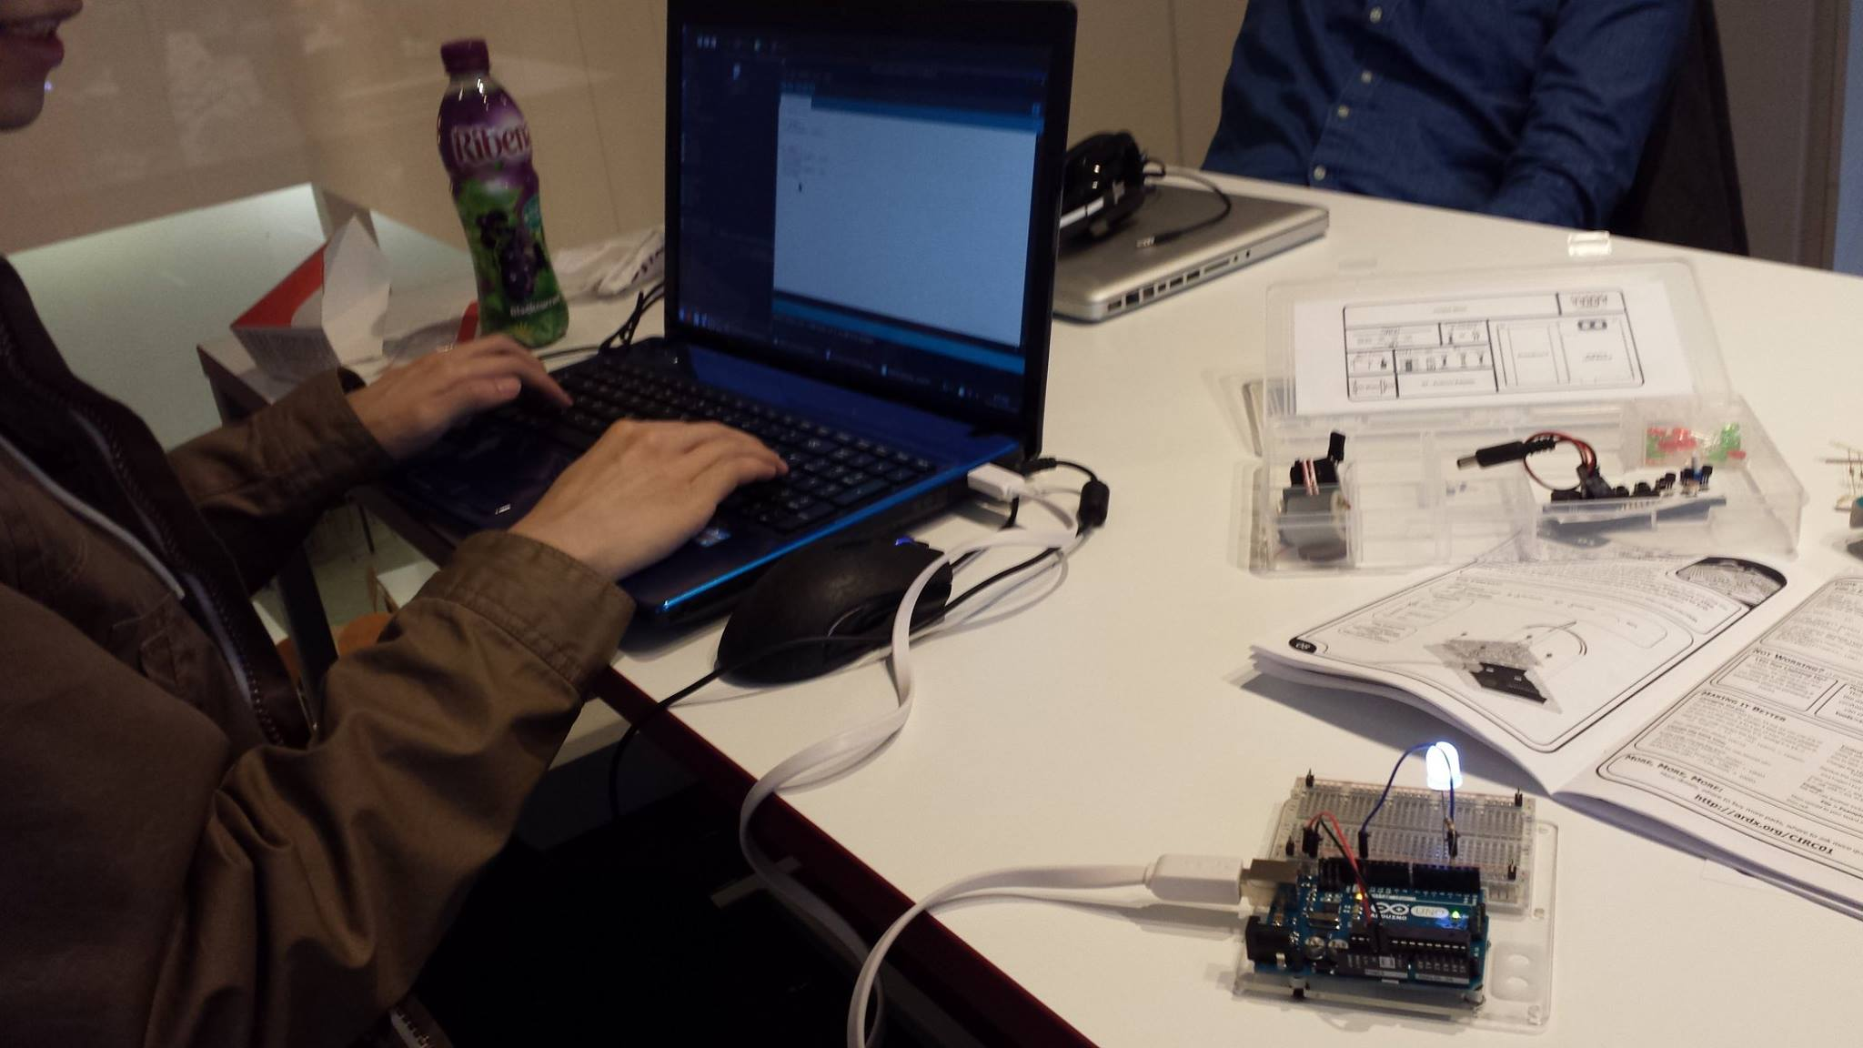
Hardware

Slide 20
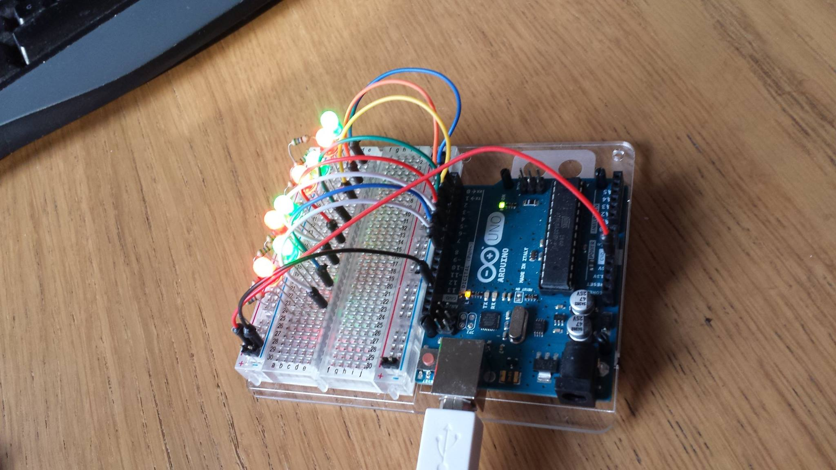
Hardware

Slide 21
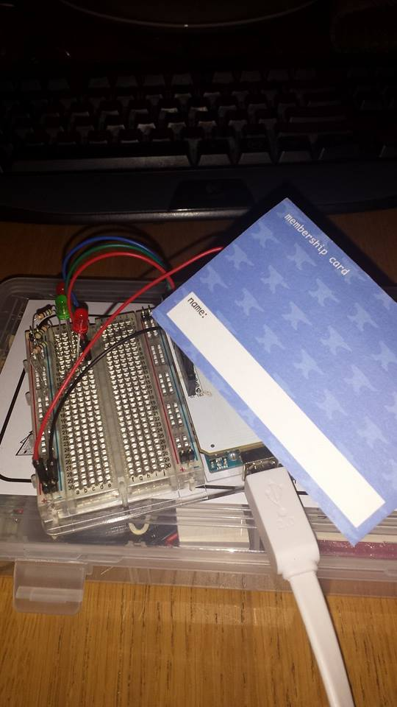
The Process

Slide 22
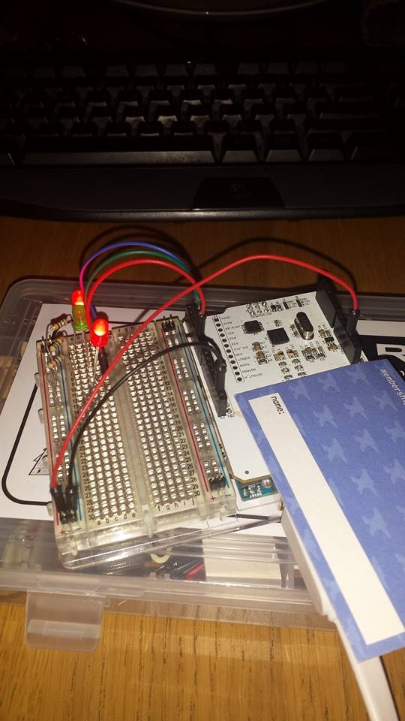
The Process

Slide 23
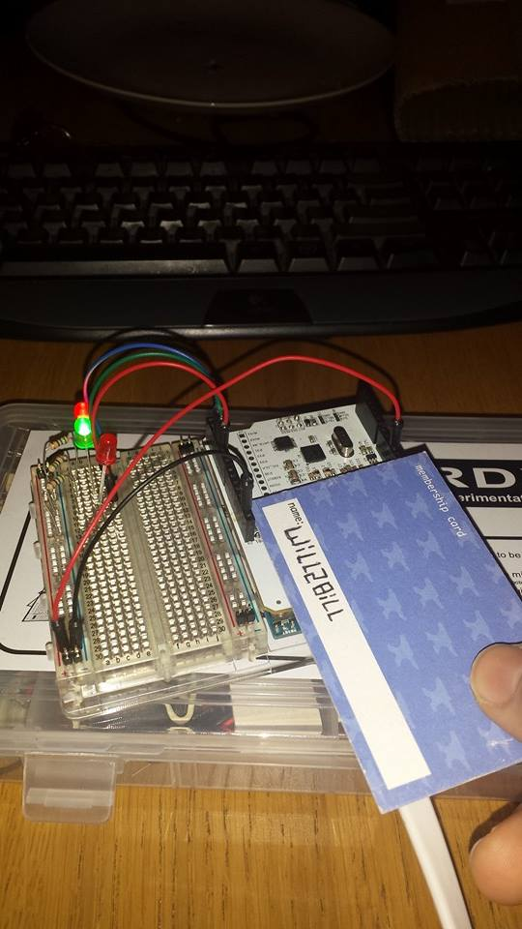
The Process

Slide 24
Thank you for Listening any questions?

