Slide 1
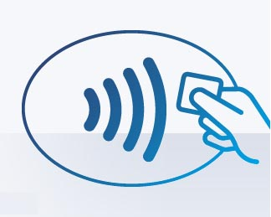
TouchReg
An NFC Card Reader Classroom Attendance System

Slide 2
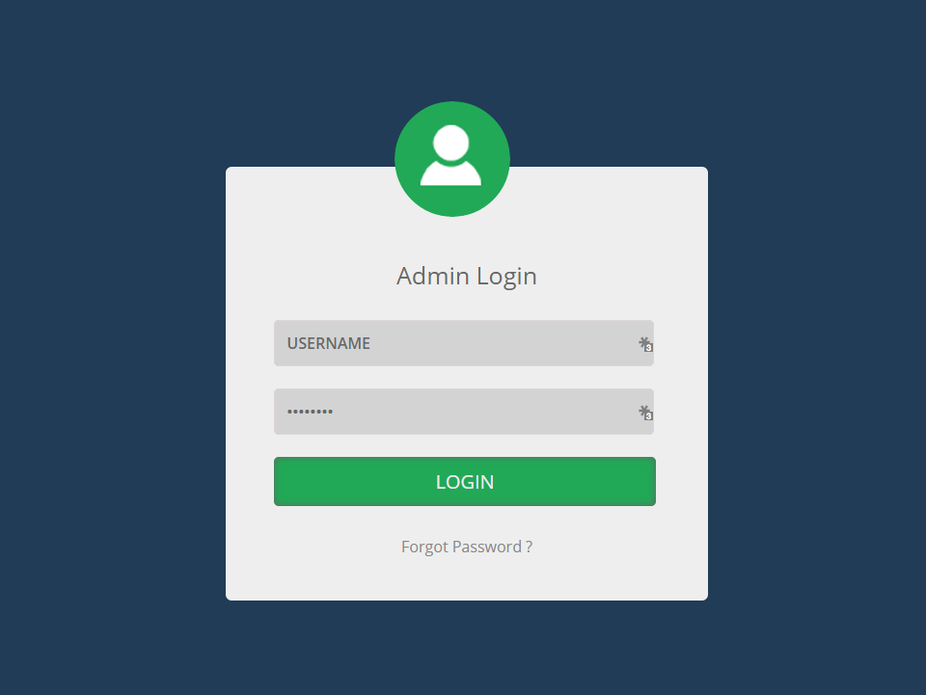
Website

Slide 3
Database
ADD DIAGRAM HERE

Slide 4
Arduino
Finished program to write Student IDs onto the NFC Cards
Main program accurately reads Student IDs
Created PHP script that the Arduino activates
PHP Script updates a database
Next:
Combine card reading and online component
Connect PHP scripts with the main database
User interface to streamline writing student ID

Slide 5
User Testing
Hand out 5-10 NFC cards to CS students
Set up reader before each lecture
Students sign in when they arrive
Do same for Games Programming to test different lectures and rooms
Hand out a survey to the users to ask about their experience
Send a Survey to lecturers asking about the current system

Slide 6
Still to Come…
User Testing
More data and Graphs on the website
Connect Arduino to the database

