Slide 1
Technical Writing for Computer Engineers
(Adapted from material developed by Roger Kieckhafer
& Sharad Seth)
[Gol96, Sch99]

Slide 2
Lecture Overview
Introduction and Motivation
General Tips on Default Style
Tips on Individual Parts of the Paper
  Abstract
  Introduction
  Main Body
  Figures and Tables
  Appendices
  References and Citations
Tips on Prose Style
References List

Slide 3
Purpose of Technical Writing
Present a new idea, product or result
  to an audience that can make use of it
  in a level of detail appropriate for that audience
Types of results
  Algorithm
  System component (hardware, software, protocol)
  Performance eval. (analytical, simulated, measured)
  Theoretical framework (theorems, lemmas, etc)
  System model (way of looking at an object)

Slide 4
Many Types of Technical Documents
Journal Article or Conference Paper
  Tends to be very formal and precise style (3rd person)
  Novelty of results is of interest to a large audience
Review Papers/Tutorials
  Like above
  Synthesize existing results for researchers or students
Technical Report
  Often precedes formal publication; also formal and precise
  Results may be of interest only “in-house”
Grant Proposal
  More proactive, positive style (1st person)
  Must “sell” the idea on its technical merits

Slide 5
Technical Content
Statement of the problem
  explain the significance of the problem
  give a level of detail appropriate to the audience
Background and previous work
  demonstrate that you understand the state-of-the-art
  ensure the reader understands the state-of-the-art
Your approach to the problem
  in sufficient detail to establish its validity
  what is new or different about your approach?

Slide 6
Technical Content
Statement of your results
  What is new or different?
  What is the significance of the results?
  How do these results compare to previous results?
  Stick to the facts (this is not a commercial)
Future work
  Where can we go from here?
  What new avenues, questions, approaches have been opened up by this work?

Slide 7
Typical Paper Outline
Abstract
Introduction (Section 1)
Main Body of the paper (Sections 2, 3, ...)
  background
  approach and results
  conclusions and future work
Acknowledgements (a few, if appropriate)
References
Appendices (if needed)

Slide 8
General Advice
Read the pub’s instructions to authors (!!!)
  Also, look at recent issues of the target pub.
  incorrect style may ⇒ it is rejected without being read
    especially true for grants & more competitive pubs
    no reviewer wants to read single-spaced 10-pt. font
Visual Presentation
  should be clear, clean, professional
  Company Logo and nice formatting is O.K.
  avoid “cutsy”, “artsy”, or overly distracting cosmetics

Slide 9
Default Style (unless otherwise directed)
8.5 x 11 inch or A4 paper
  If single-sided, no garbage on the back side
  Double-sided OK to conserve paper
One inch margins all around
Single-column format
Professional looking font
  e.g. Times New Roman or LaTeX \rm font
  12-point for normal text
  Dark, black, letter quality print (no dot matrix)

Slide 10
Default Style (unless otherwise directed)
Double-space or 1.5-space
  much easier to read
  allows room for reviewers’ comments
Paragraphs
  Use some!
  Leave a blank line between paragraphs
  Indenting the 1st line is optional
Bind only in a 3-ring binder
  On-line submission even better

Slide 11
Default Style (unless otherwise directed)
Numbering pages, figures, tables
  all numbers must be globally unique
  all must be in lexicographically increasing order, e.g.
    1, 2, 3, 4
    I-1, I-2, I-3, … II-1, II-2, II-3 (for very long reports)
Numbering Chapters, Sections, Subsections
  must be globally unique and hierarchical, e.g.
  1.3 Gnus and Gnats I.C Gnus and Gnats
  1.3.1 Gnus I.C.a Gnus
  1.3.2 Gnats I.C.b Gnats

Slide 12
Abstract
Must be clear and concise (typ. 50 - 200 words)
  Reader must be able to quickly identify content
  Helps reader decide whether to read the paper
Briefly summarize
  problem
  significance
  approach
  results
Do not cite references (abstract may be published alone)

Slide 13
Introduction
Let the reader know what the paper is about
  Define and motivate the problem
  Overview limitations of state-of-the-art
  Overview your approach
  Overview your results
Get to the point quickly
Know your audience
Do not refer to or depend on the Abstract
Final paragraph should outline organization of paper

Slide 14
Main Body
Background
  expand on problem statement
  explain state-of-the-art and its limitations
Approach
  describe in sufficient detail for the audience
  clearly state applicability and limitations
  compare to state-of-the-art, if appropriate
    Highlight the differences
  examples can help a lot

Slide 15
Main Body
Results
  clearly state what they are
  clearly compare to other benchmarks, e.g.
    state-of-the-art alternatives
    optimal solutions (if known)
    naïve solutions (e.g. random guessing)
  clearly state your comparison criteria, e.g.
    accuracy
    complexity or time
    cost

Slide 16
Main Body
Conclusions and future work
  drive the results home clearly and concisely
    restate your main results
    restate their significance
  a reviewer or reader may start by reading the Introduction and Conclusions first
  Clearly state where we can go from here
    shows the work has a future
    invites participation from the readers

Slide 17
Figures and Tables
Try to embed figures and tables in the main text
  if necessary, insert special section after “References”
Use graphical software if at all possible
  use hand-drawn figures only as a last resort
Must be numbered & referred to by number in the text
  Locate figure after paragraph containing 1st reference
  Do not refer to “the following figure” (they may move)
All figures and tables need a short numbered caption,
  e.g., “Figure 1: 1998 Gnu-to-Gnat Population Ratios”
  Generally located under a figure but above a table

Slide 18
Figures and Tables
All objects and fonts must be clearly readable
  if a figure is too big, break it into smaller figures
  add a figure to hierarchically decompose it
All must be accompanied by explanatory text
  walk the reader through the figure or table
  clearly state the results you want the reader to see
  clearly state the relationships between related figures
Know what you want each figure to illustrate
  one good figure really is worth a thousand words
  a thousand bad figures are worth nothing

Slide 19
Appendices
Use for long complex data of peripheral interest
  Data that would disrupt the flow of the main text,
  Data the “casual” reader does not need, e.g.
    Huge figures
    Large tables of raw data
    Complete source code listings
Limit each appendix to 1 major topic
Each must be lettered, and cited in the text by letter
Remember, page numbers must be globally unique

Slide 20
References and Citations
References are listed in the References section
  Do not use footnotes for references
  Footnotes are used for parenthetical comments
Options for order of the reference list:
  Alphabetical by last name of first author
  In order of citation in the paper
Must have a consistent mapping
  All references in the list must be cited in the text
  All references cited in the text must be listed

Slide 21
Referencing Papers and Articles
Format:
  Authors in-order (1st-init. Last-init. Lastname),
    do not use “et al.” (unless > 5 authors)
  “Title of Article” in quotes (this can vary),
  Title of Journal or Conference in Italics,
    Do not excessively abbreviate
  Journal volume & number,
  Article page numbers,
  Month & year.

Slide 22
Referencing Papers and Articles
Examples:
  F. J. Meyer, D.K. Pradhan, “Consensus with Dual Failure Modes”, Proc. 17th Fault-Tolerant Computing Symp. (FTCS-17), pp. 48-54, Jul. 1987.
  C. M. Krishna, K. G. Shin, R.W. Butler, “Ensuring Fault-Tolerance of Phase-Locked Clocks”, IEEE Trans. Computers, V. C-34, No. 8, pp. 752-756, Aug. 1985.
Notes:
  all fields separated by commas
  entry terminated by period
  “and” before final author seems to be optional

Slide 23
Referencing Books
Format:
  Authors in-order (use the data they use),
    do not use “et al.” (unless > 5 authors)
  Title of Book, and Edition in Italics,
    Do not abbreviate
  Location:
  Publisher,
  year of cited edition,
  page numbers (if a specific citation).

Slide 24
Referencing Books
Example:
  William Stallings, Computer Organization and Architecture: designing for Performance, 5th Ed., Upper Saddle Hill, NJ: Prentice Hall, 1999, pp. 349-357.
Notes:
  “location:” is often omitted,
  Companies and government agencies often omit names of authors
    In that case list the company or agency as author

Slide 25
Referencing Web Sites
Format:
  There is no agreed-upon format.
  Recommendation:
    Authors if known
    Title in italics,
    Modified: Date/time,
    (In Netscape click: View → Page Info)
    Complete URL (including protocol)

Slide 26
Referencing Web Sites
Example
  Henning Schulzrinne, Checklist for Articles, http://www.cs.columbia.edu/~hgs/etc/writing-style.html Modified: Dec. 22, 1999, 1:59:40 PM, GMT.
Notes:
  Web pages are considered weak references because
    They have not survived peer review and editing
    Their contents are very volatile
  If you got a published paper or book from the web,
  then list it as a paper or book,
  although you may append “available at: full-URL”.

Slide 27
Citation Styles
Numbered Citations (e.g. IEEE Transactions)
  The reference list must be numbered
  All citations refer to the reference by number
    may add more detail if needed
  Citation may be square-bracketed [1] or superscript¹
    brackets are preferred by IEEE
  Examples:
    … has already been proven [12].
    … has already been demonstrated [12, Fig. 4].

Slide 28
Citation Styles
Full Last Names (APA Style)
  All citations list in parentheses:
    Authors,
    year.
  Use et al. If there are 3 or more authors
  Examples:
    … already been proven (Smith and Jones, 1999).
    … already been demonstrated (Jagger et al., 1967, Fig. 4).

Slide 29
Citation Styles
Abbreviated name (some conferences, less popular)
  Concatenate in square brackets
    1st 3 letters of primary author,
    last 2 digits of year.
  Examples:
    … has already been proven [Smi99]
    … has already been demonstrated [Jag67, Fig. 4].
  If author has more than one pub/year, append a letter
    [Jag67], [Jag67a], [Jag67b]

Slide 30
Citation Advice
Citation is less disruptive to flow at end of sentence,
  However, that location may alter the interpretation
Don’t use a citation as a noun, e.g.
  BAD: … been proven in [12].
  GOOD: … been proven [12].
  GOOD: … been proven by Smith and Jones [12].
List Multiple citations in same brackets, e.g. [1,2,5]
Cite the source of a figure or table in the caption, e.g.
  Table 1: Gnu vs. Gnat Basketball Scores [12, Table 3].

Slide 31
Plagiarism
The use of someone else’s “intellectual property” without proper citation of the source.
Includes:
  Text: direct quotes or very close paraphrasing
  Ideas: concepts, definitions, observations, results, data, facts, claims, recommendations, etc.
  Figures or Tables: even if you redraw them
When in doubt, cite the source!

Slide 32
Prose Style
Generally use the third person
  Draws attention to the topic, not the author
  Passive voice is quite common,
    e.g. “the intermediate results are then passed from the ALU to the register bank”
    heavy use of forms of “to be” flags passive voice
  Active voice can be clearer and shorter
    e.g. The ALU then passes the intermediate results to the register bank”
    Just beware of anthropromorphizations

Slide 33
Prose Style
Use the First Person to identify your contributions
    “A gnus is defined as…” leaves doubt
    “We define a gnu as…” leaves no doubt
Generally Avoid Explicit Second Person:
  Readers don’t like being given orders.
  Exceptions:
    Paper navigation: “Recall from Subsection 3.3…”
    Tutorials

Slide 34
Prose Style
Use consistent verb tense
  Present tense = default
  Past tense:
    referring to previous work
    backwards references in the paper,
  Future tense:
    Forward references in the paper
Do not use contractions in formal writing

Slide 35
Prose Style
When used in-line, numbers ≤ 10 are spelled out
Avoid excessive mathematics in-line
Equations need some explanatory text
Always define an abbreviation at its first use
  e.g. “… the Command and Control Bus (CCB) …”
  exceptions: universal terms (RAM, ROM, CPU)
    Again, know your audience (e.g. ATM)
  If you have not used a term for several pages,
  then redefine it when it is reintroduced.

Slide 36
Prose Style
Be absolutely consistent with important terms
Use variation in the little grammatical stuff, e.g.
  “e.g.,” = “for example” = “such as”
Be careful with pronouns,
  their meaning can get lost easily
Pay attention to your sentence structures
  Short clear sentences = good,
  Long convoluted sentences = bad,
  Incomplete sentences = worse.

Slide 37
Prose Style
Use parenthetical remarks sparingly (as they tend to interrupt the flow of the sentence)
  keep them short,
  find the least disruptive place to put them in the sentence,
Use footnotes for longer supplementary remarks,
  Less disruptive than a parenthetical remark
  Still, use footnotes sparingly
    no more than 1 or 2 on a given page
    no more than a handful in the whole paper

Slide 38
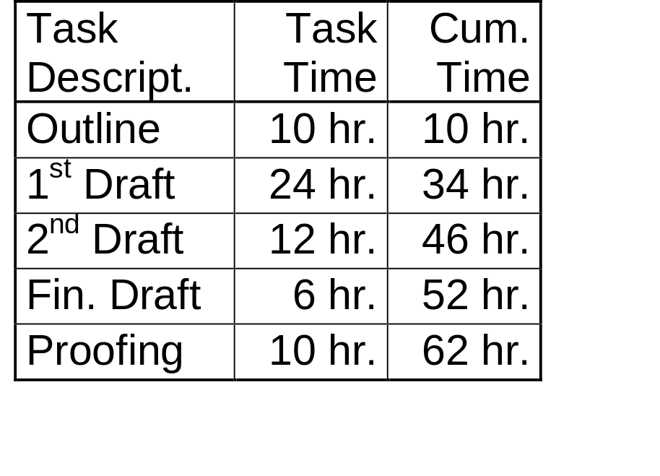
Budgeting Your Time
Time allocation for a 15-page paper
  I don’t know who originated these numbers
  But they are pretty accurate
  Note: Don’t scrimp on the “outline” time

Slide 39
Closing Comments
When in doubt, follow publisher’s instructions
When in doubt, cite the source
Spelling and Grammar checkers:
  Use them, but don’t trust them implicitly
Outside proofreaders:
  use one
  pick one whose English is better than yours
Remember, the reviewer doesn’t really want to read this paper. Don’t give him/her an excuse to quit.

Slide 40
Blank

Slide 41
References
[Gol96] O. Goldreich, How not to write a paper, unpublished,
Dec. 21, 1996, available at:
http://www.wisdom.weizmann.ac.il/home/oded/
public_html/writing.html.
[IEE97] IEEE, Information for IEEE Transactions, Journals, and
Letters Authors, 1997, available at: http://www.ieee.org/
organizations/pubs/transactions/information.htm
[IEE99] IEEE-CS, CS Style-Guide - References
http://www.computer.org/author/style/refer.htm
Modified: Dec. 06, 1999 9:24:10 PM GMT

Slide 42
References
[Sch99] Henning Schulzrinne, Checklist for Articles,
http://www.cs.columbia.edu/~hgs/etc/writing-style.html
Modified: Dec. 22, 1999, 1:59:40 PM, GMT.
[Str79] William Strunk Jr., and E.B.White, The Elements of
Style, 3rd Ed., New York: Allyn & Bacon, 1995.

