Slide 1
Manufacturing Task Tracker Modifications
Task Search page - Replaced Task Item Listing with Multi-Task Edit page
Simple list interface page (RI, Outage, MOC) – Replaced with Multi-Task Edit page

Slide 2
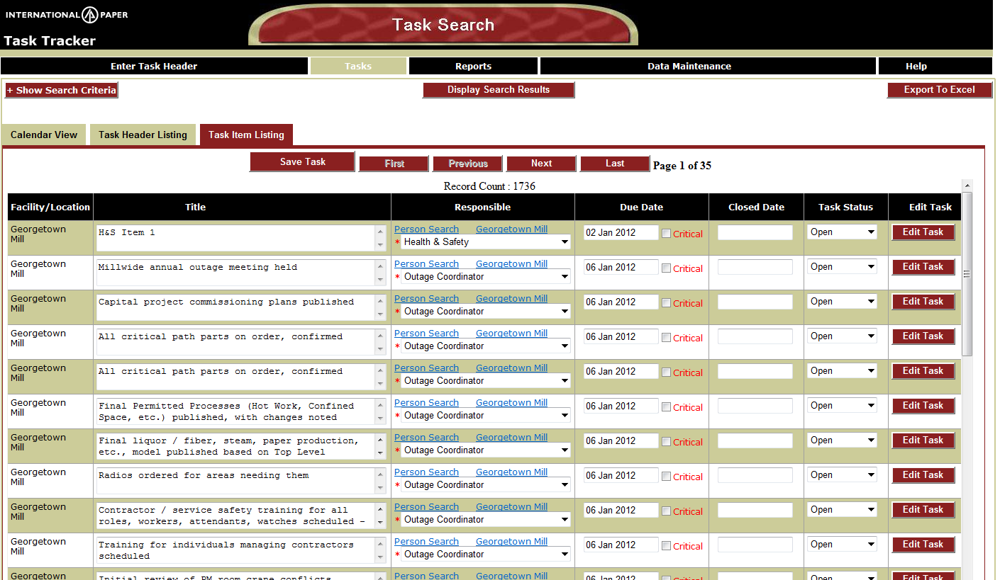
Click on Task Item Listing tab from Task Search page to display multi-task edit page
Title, Responsible, Due Date, Closed Date, and Task Status are editable
Once all edits are complete for a page, Click Save Task to save all changes
Save Task must be clicked on each page where updates are made or changes will be lost
Click First, Previous, Next, Last to navigate to next page of tasks (each page display limited to 50 tasks)
When a task is completed, fields will be redisplayed as read only except for Closed Date or Task Status – a task
can be re-opened from this page also
Click Edit Task button (last button on right) to navigate to the Task Detail page for the associated row in order to update
other task data not on this page (i.e. Comments, Recurrences, Documents, etc.)

Slide 3
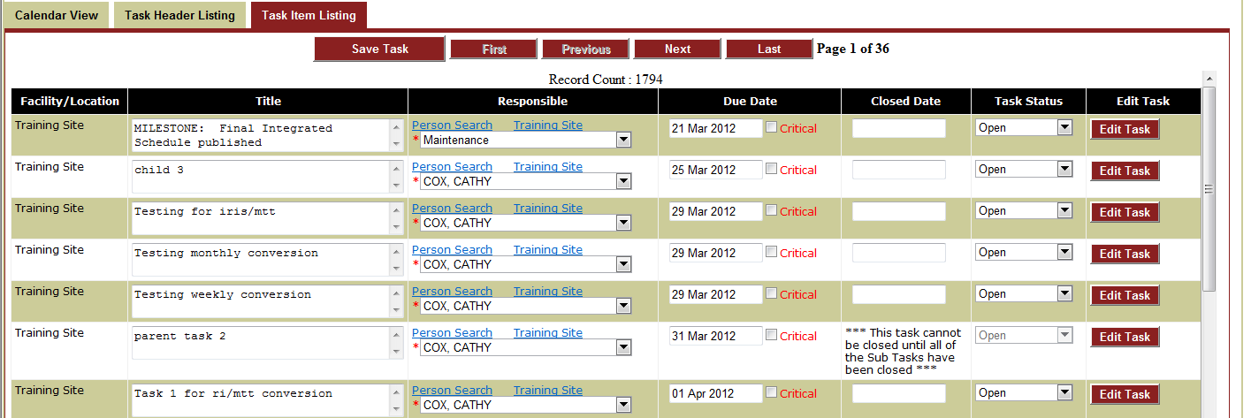
Sub Task Processing for Multi-Task Edit page
For tasks which have sub tasks, if all subtasks are not complete then the above message
will be displayed and the parent task will be blocked from being completed.

Slide 4
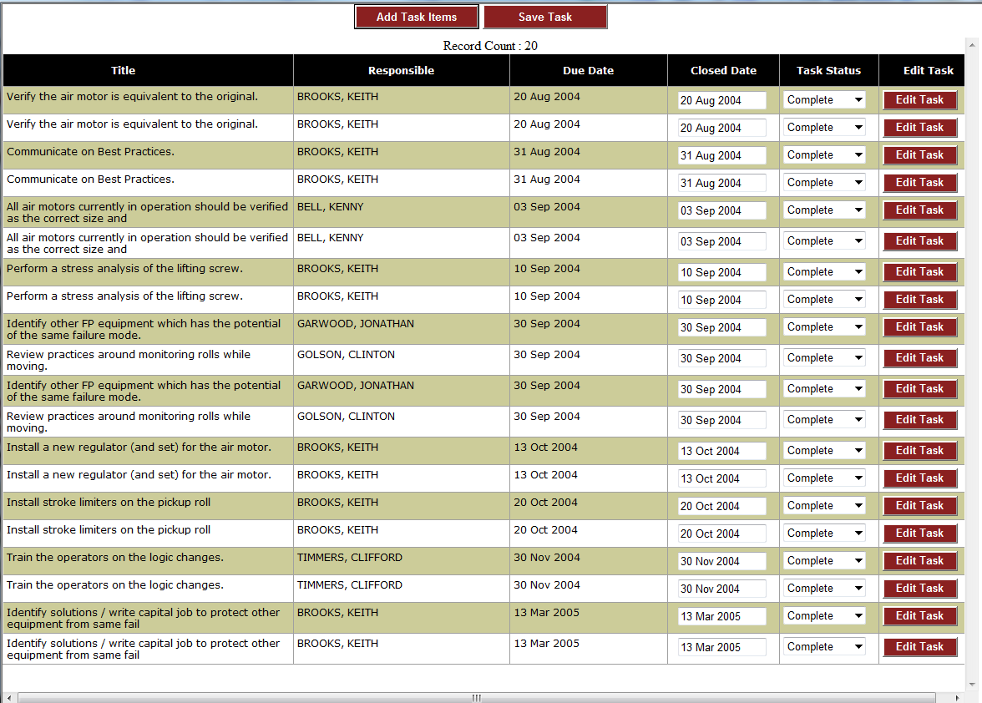
Interface page for RI, MOC, and Outage
All updating guidelines are the same as on previous multitask edit page
Add Task Items button will navigate to the Task Detail page where more tasks can be
added to current RI, MOC, or Outage record

Slide 5
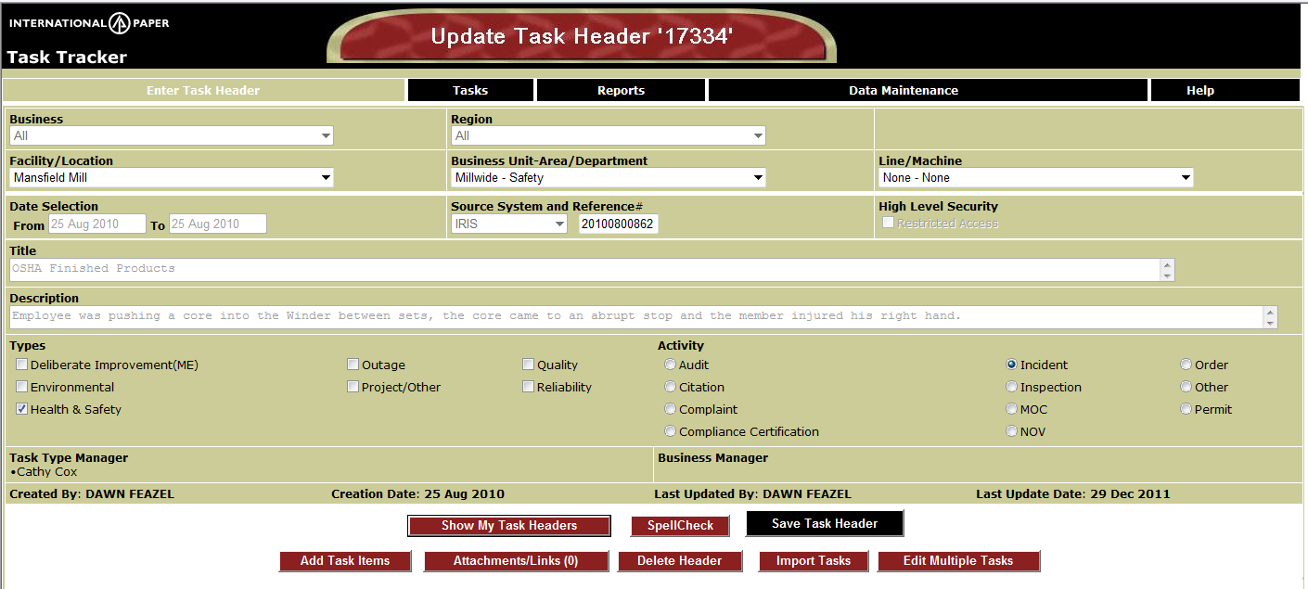
Edit Multiple Tasks button (circled in red) - New button added to Update Task Header page
Will navigate back to Task Item Listing and allow updates for all tasks associated
with the current header record only

