Slide 1
Task Tracker Training

Slide 2
Agenda
Task Tracker Usage
Task Tracker Overview
Task Tracker Usage
Weekly Email
Finding and Updating Task
Adding Comments
Adding/Removing Documents and/or Links
Completing Tasks
Searching Functions

Slide 3
Task Tracker Database
Database used to house tasks on specified headers
Provides a way to manage task planning in various source systems
Generates automatic emails to update task owners of status and upcoming tasks
Reporting functions help manage overall planning status

Slide 4
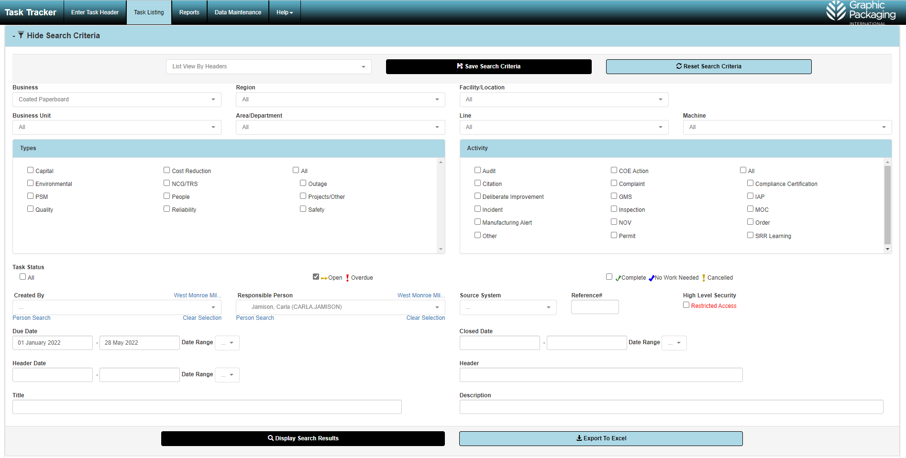
Task Tracker Database
Link to database: http://gpitasktracker.graphicpkg.com/

Slide 5
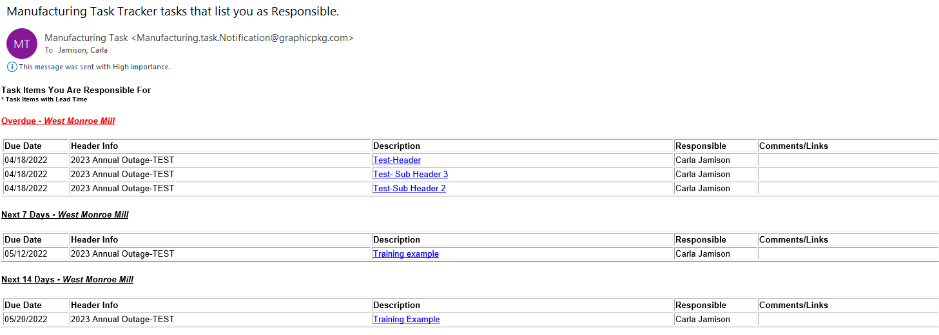
Weekly Emails
Initial email will have all AO tasks assigned to you
Weekly email will auto-generate every Monday morning indicating any overdue tasks and any tasks due in the next 14 days.

Slide 6
Updating Tasks in Task Tracker
Accessing/Updating Tasks:
Email-EASIEST WAY!!!
1. Click on the task/link

Slide 7
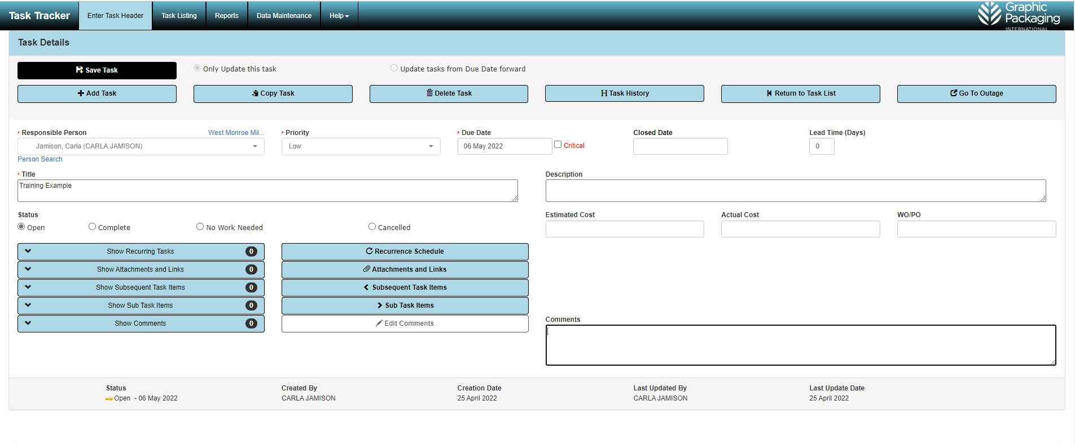
Updating Tasks in Task Tracker
Task Detail Screen
2. Add any comments

Slide 8
Updating Tasks in Task Tracker
3. Select button to attach documents and/or links to the task

Slide 9
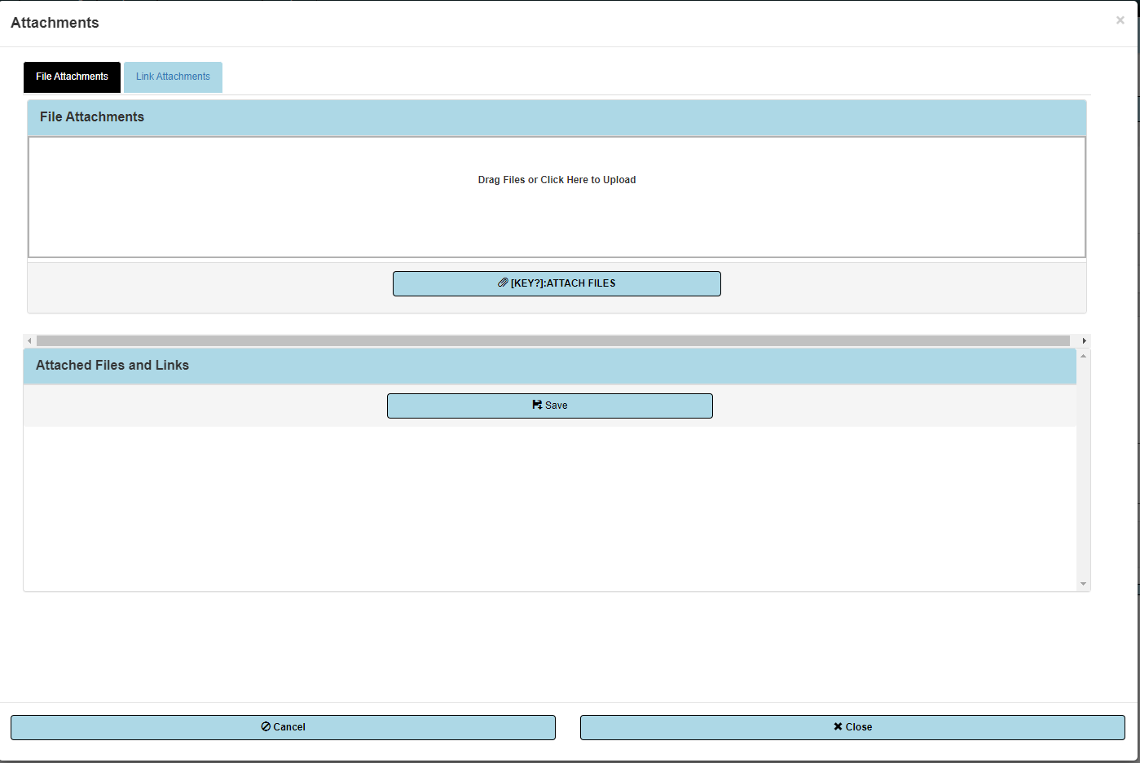
Updating Tasks in Task Tracker
3a. Select tab at top to either attach files or links
3b (files). Drag and drop files OR Select files to upload

Slide 10
Updating Tasks in Task Tracker
3a. Select tab at top to either to attach files or links

Slide 11
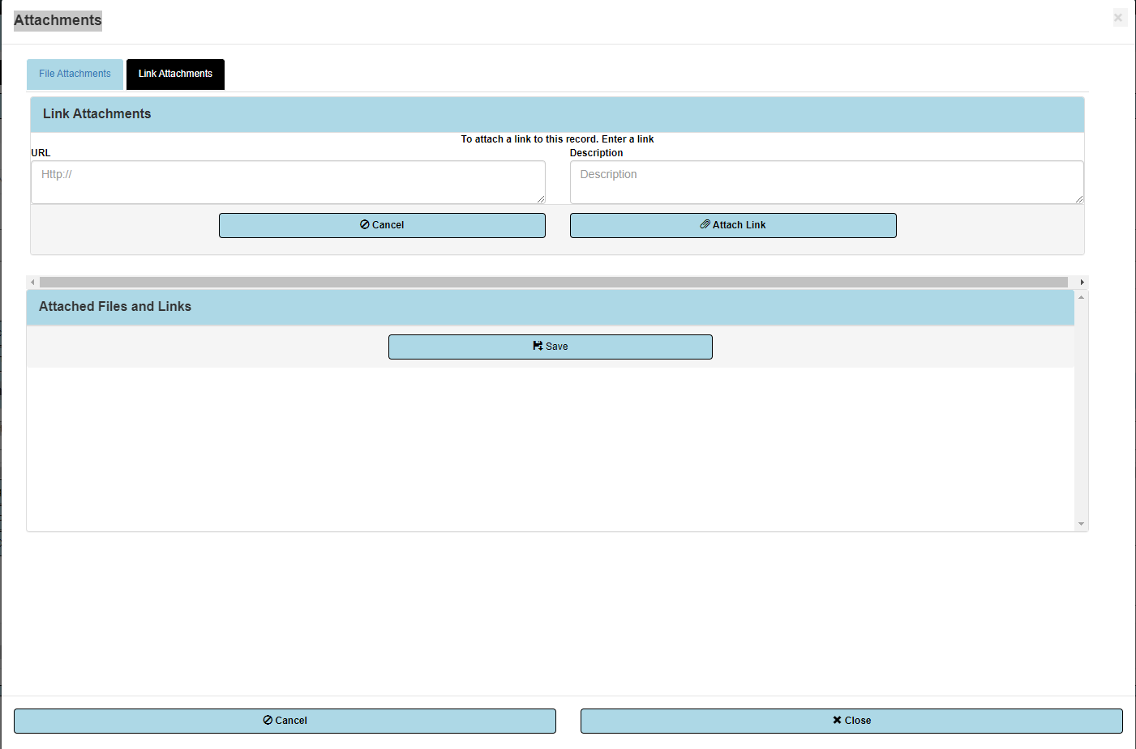
Updating Tasks in Task Tracker
3b (links). Enter the link

Slide 12
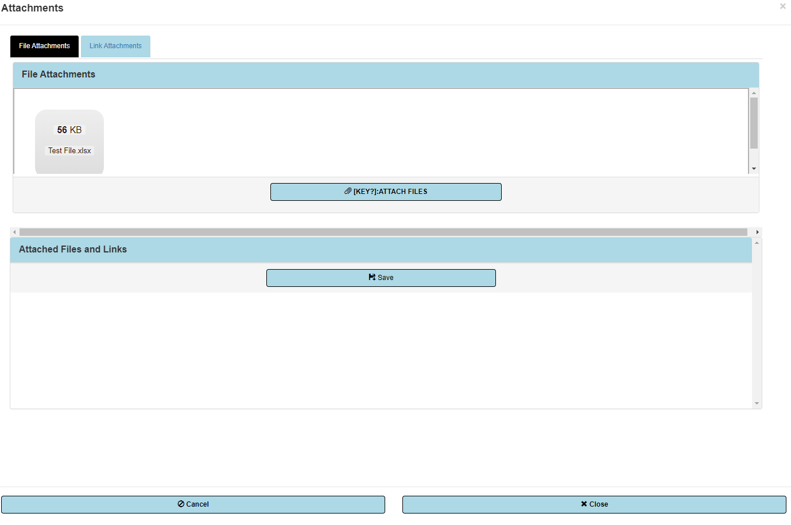
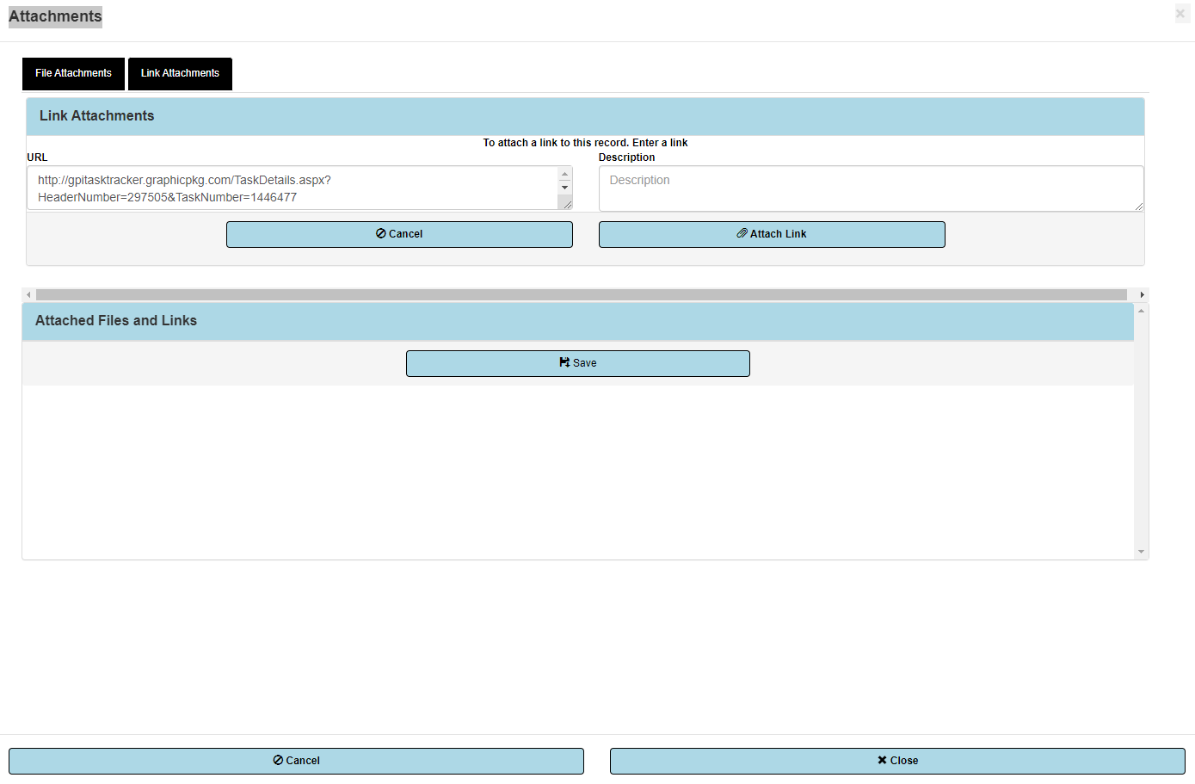
Updating Tasks in Task Tracker
3c. Once uploaded, select the attach files or link button

Slide 13
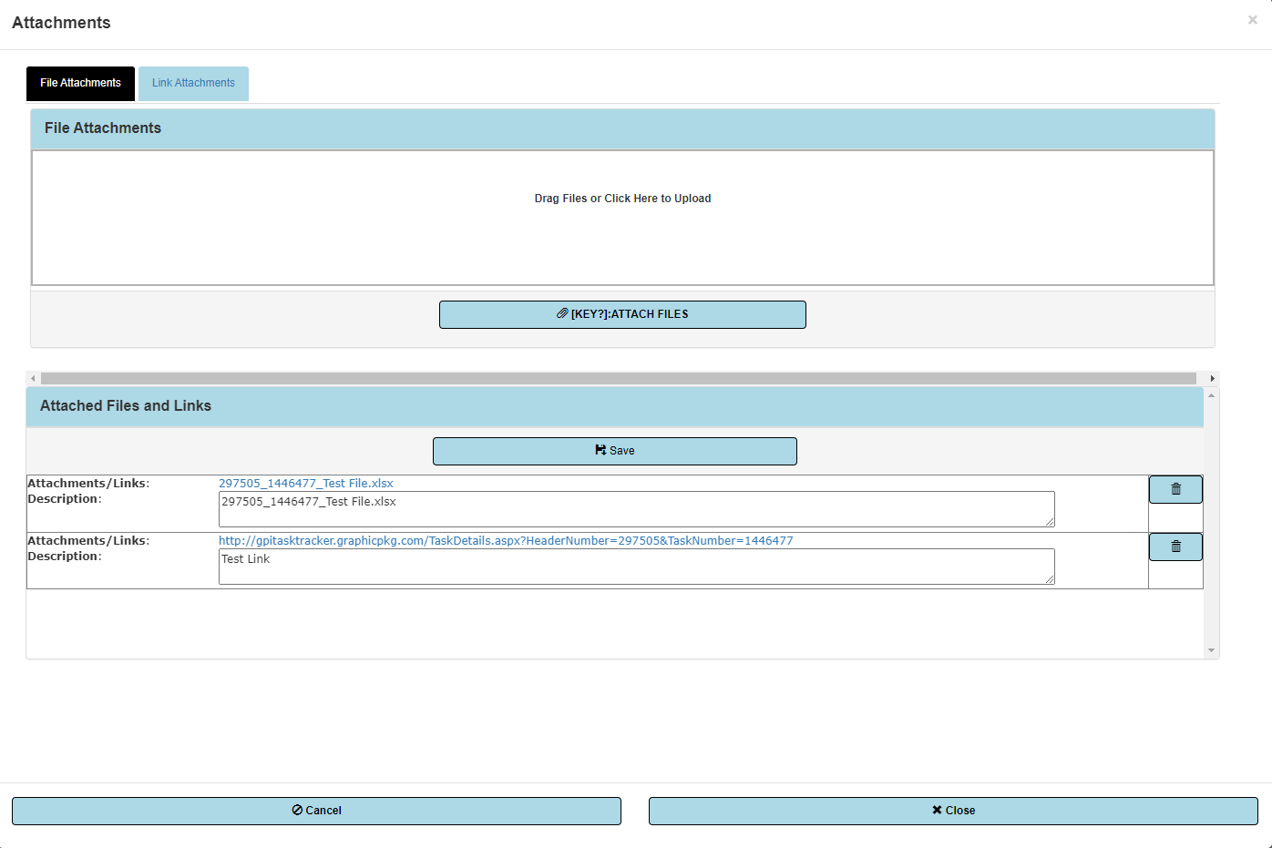
Updating Tasks in Task Tracker
3d. File will appear in the Attached Files and Links area.

Slide 14
Updating Tasks in Task Tracker
3e. Select Save and then Close

Slide 15
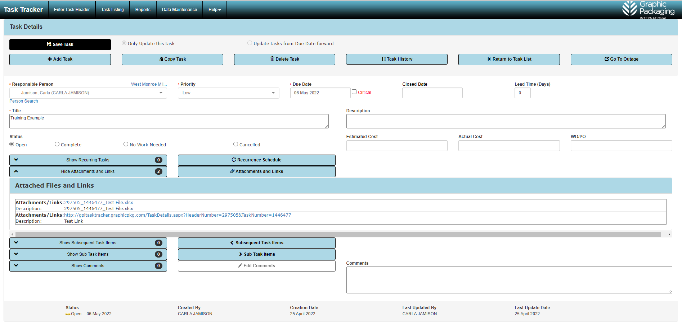
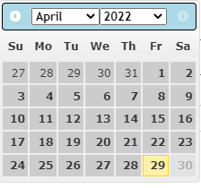
Updating Tasks in Task Tracker
4. Complete Task
Select the Complete radio button which will put the current date in the Closed Date Field
Select the Closed Date Field
Choose the completion date you want from the pop up calendar

Slide 16
Updating Tasks in Task Tracker
5. System should auto save task updates but can select save task to make sure

Slide 17
Updating Tasks in Task Tracker
Accessing/Updating Tasks:
Another way……
Go to the tasktracker data base: http://gpitasktracker.graphicpkg.com

Slide 18
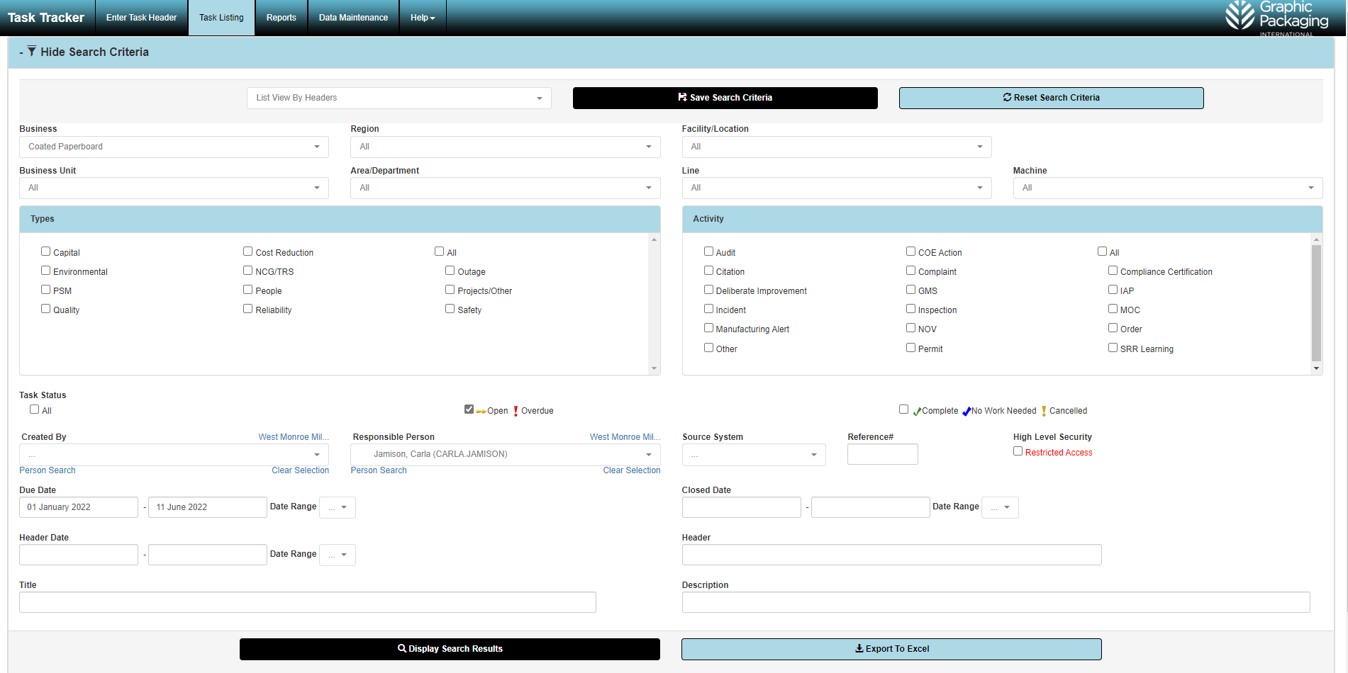
Updating Tasks in Task Tracker
Main Screen

Slide 19

Updating Tasks in Task Tracker
1. Select Task Listing Tab at top of page
2. Select Simple View Task

Slide 20
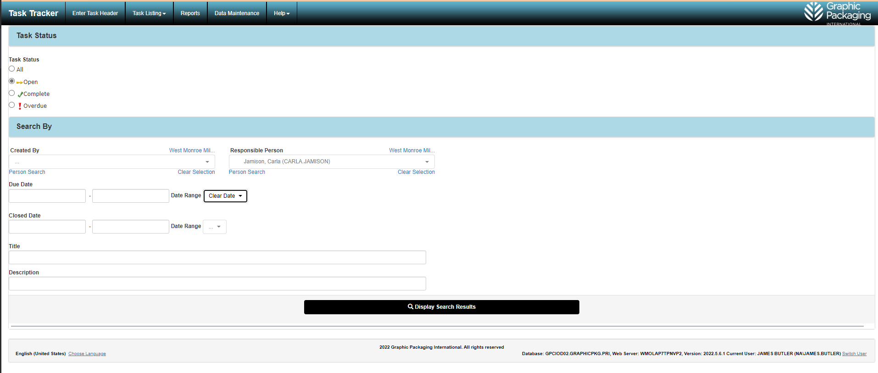
Updating Tasks in Task Tracker
3. Select Task Status (Defaults to Open)
4. Select Responsible Person
5. Select date range interested in
6. Hit Search Button

Slide 21
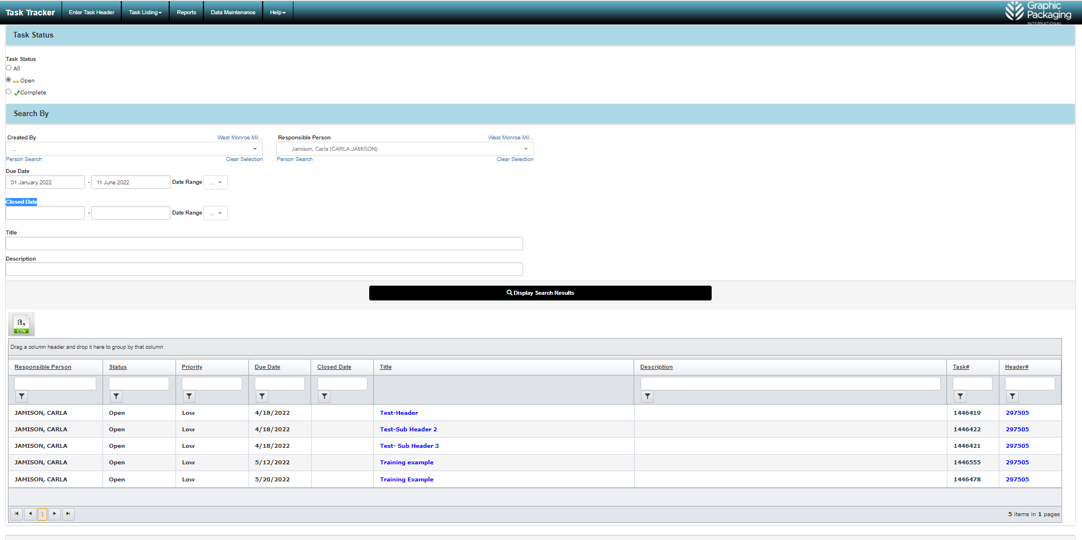
Updating Tasks in Task Tracker
7. Click on the task to be updated

Slide 22
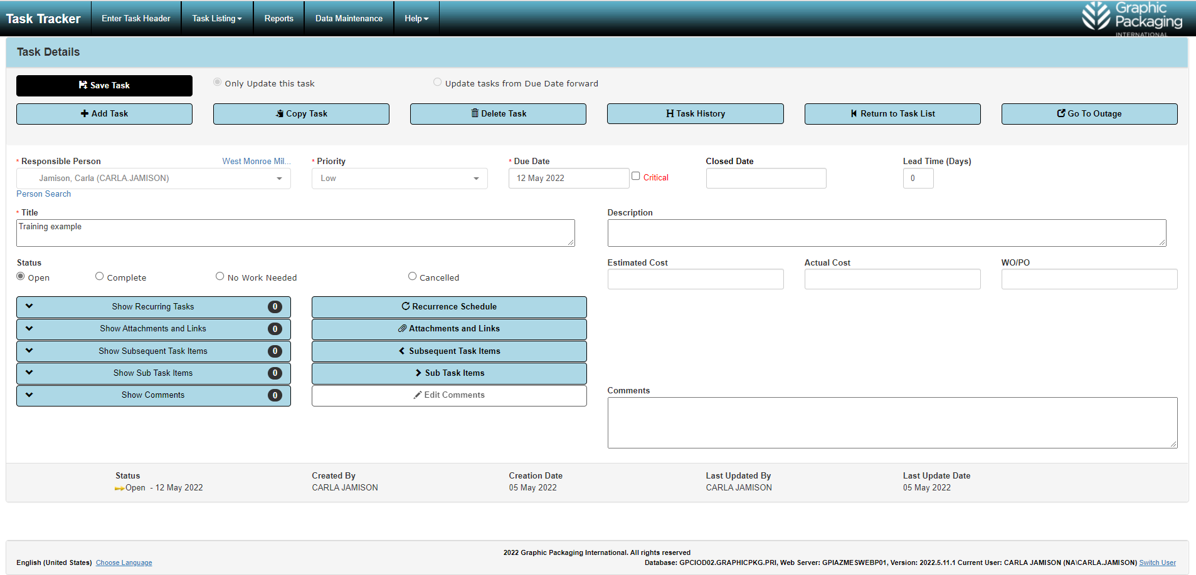
Updating Tasks in Task Tracker
Task Detail Screen

Slide 23
Updating Tasks in Task Tracker
Download to excel
If want to see ALL tasks associated with the header regardless of responsible person, click header number
Filter on columns

Slide 24
Updating Tasks in Task Tracker
Task Detail Screen
Accessing/Updating Tasks:
Final way (and most difficult)……
Go to the tasktracker data base: http://gpitasktracker.graphicpkg.com

Slide 25
Updating Tasks in Task Tracker
1. Select Task Listing Tab at top of page
2. Select View Task

Slide 26

Updating Tasks-By Responsible Person
3. Select Facility/Location
4. Select Responsible Person
5. Select Date Range
6. Click on Display Search Results

Slide 27
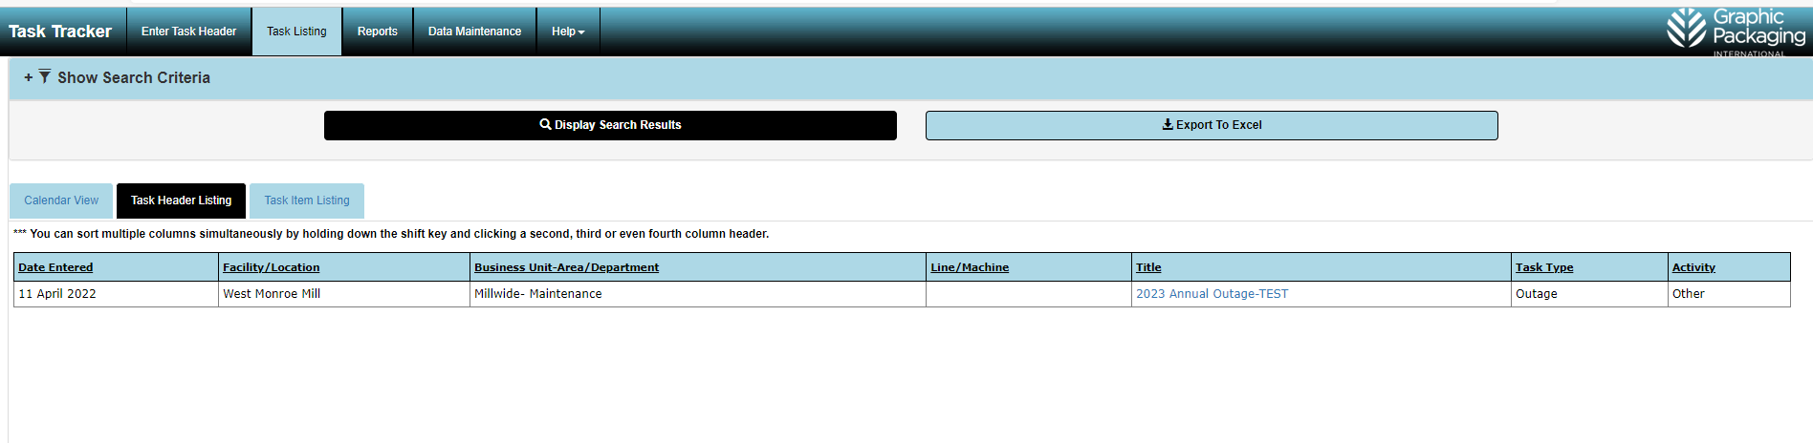
Updating Tasks in Task Tracker
7. Select Task Item Listing

Slide 28
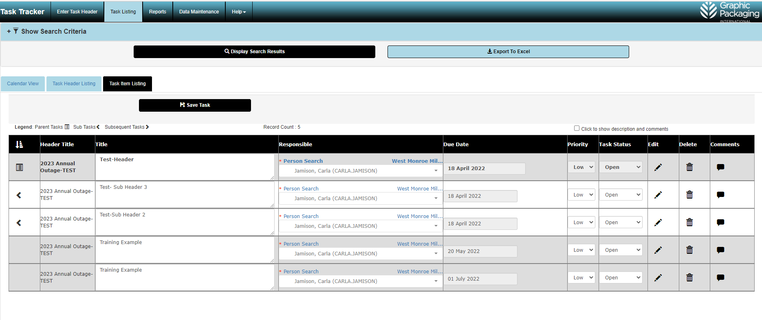
Updating Tasks in Task Tracker
8. Click the pencil icon in the edit column to open the task. Then you can update comments, attach documents/links, and/or complete the task.

