Slide 1
Adaptive Dialogs
#1 - Concepts
https://www.youtube.com/playlist?list=PLgF-CyaX1p3FCppxNbtdp6uTFgT8D0Jsk

Slide 2
Recognizers
Extract intent + entities from utterance
LUIS, RegEx
Generators
Language generation - e.g. response variants ‘hi’, ‘hello’ etc.
Triggers
A response to an event - e.g. OnIntent event emitted by recognizer
Actions
Define what the conversation does - e.g. control flow, run arbitrary code, send response back to user
Input
Collect information from user in-flow and load into memory – e.g. TextInput, DateTimeInput etc.

Slide 3
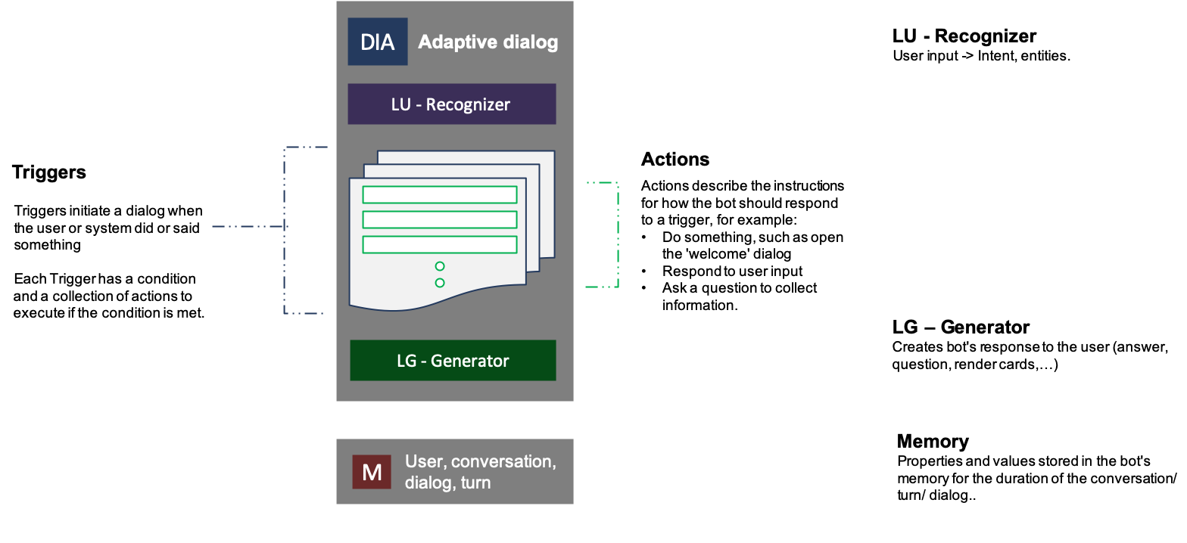
https://github.com/microsoft/BotBuilder-Samples/blob/master/experimental/adaptive-dialog/docs/anatomy-and-runtime-behavior.md

