Slide 1

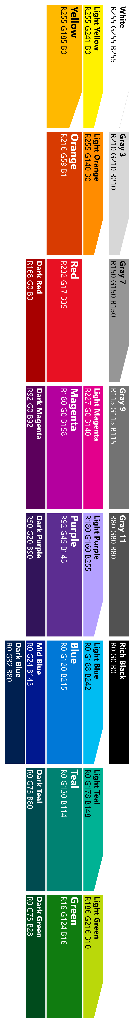
Modelling your conversation
Roll your own
state management etc
Multi layered conversations
Bespoke
Dialogs
Data capture,
“Web forms” scenarios
Flexibility
FormFlow
Questions and answers (FaQ),
Command and control
QnA
Effort to implement

Slide 2

Dialogs
@jamesemann

Slide 3
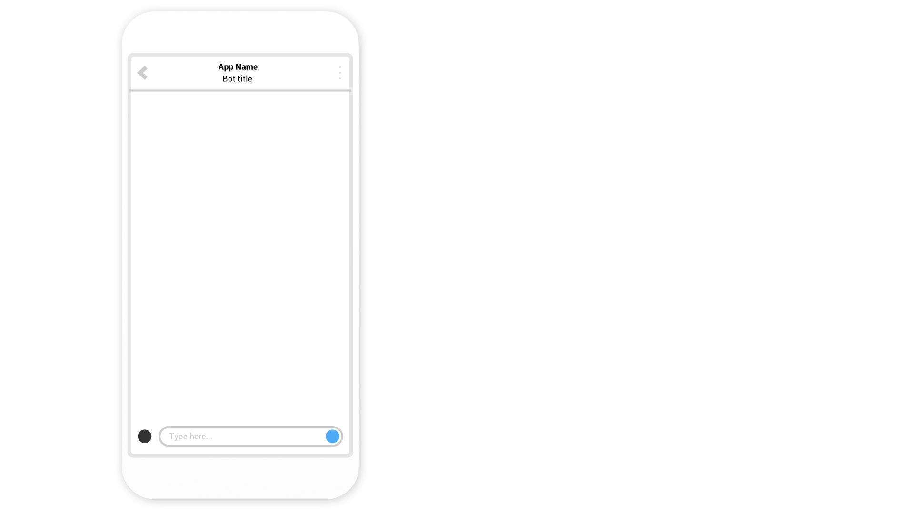
Conversational banking

Slide 5
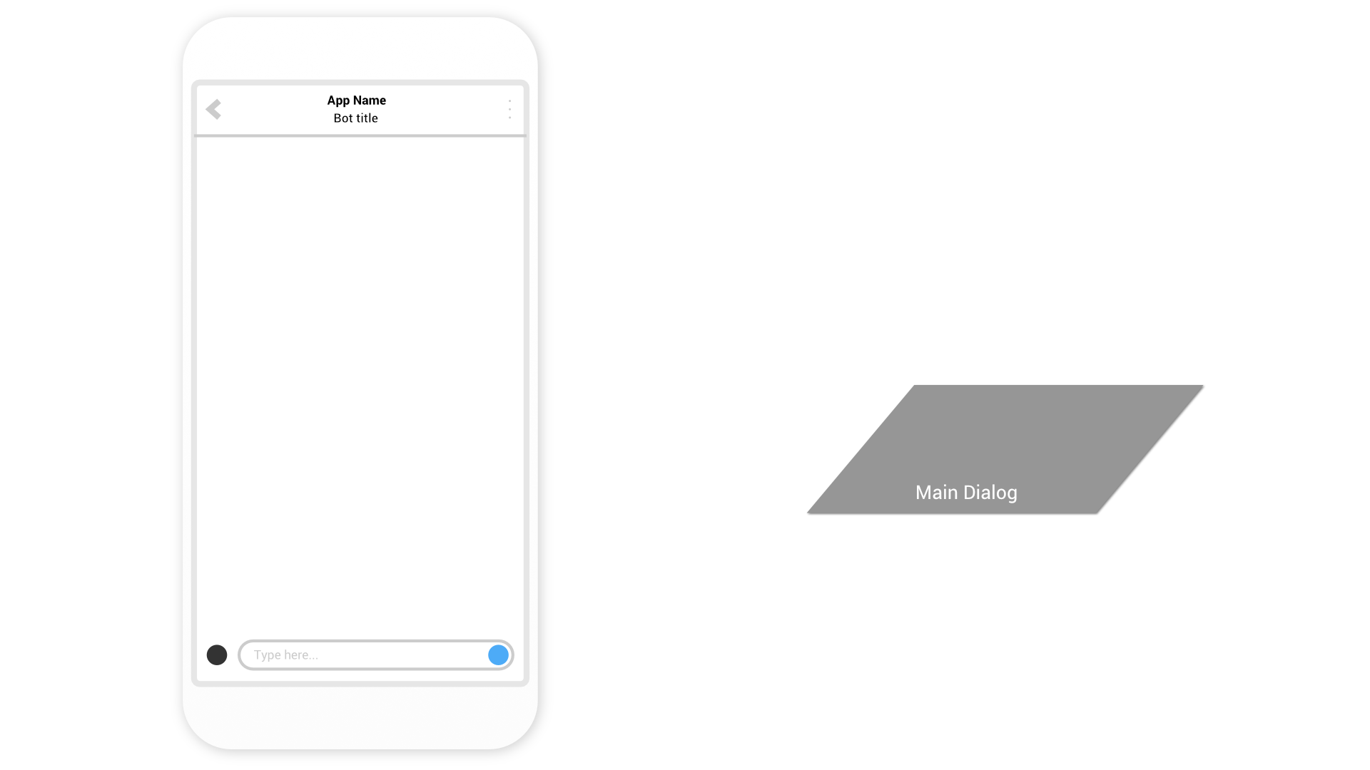

Slide 6


Slide 7
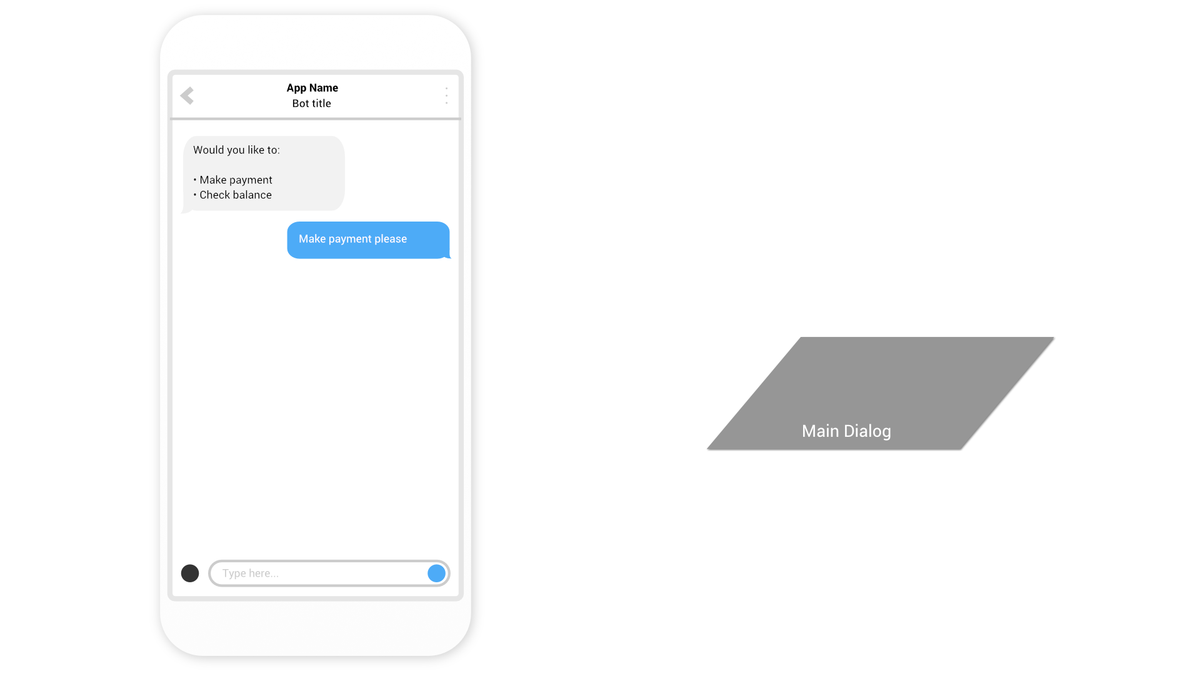

Slide 8
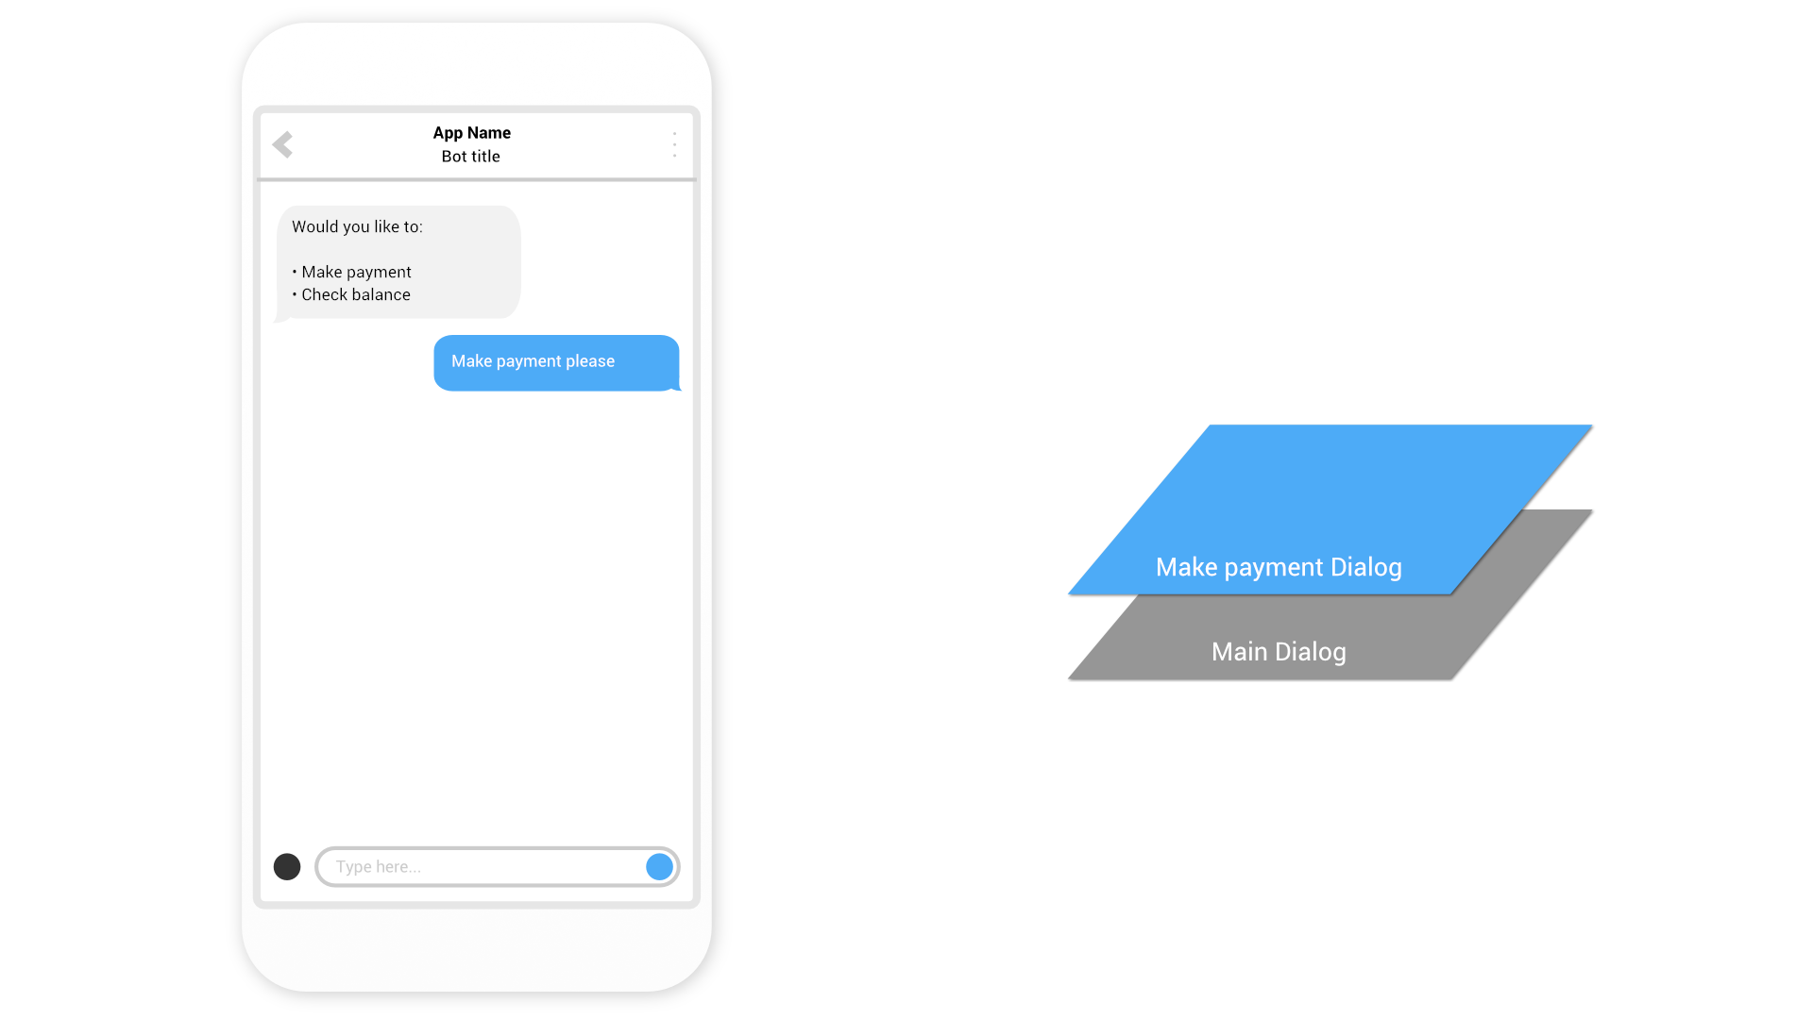

Slide 9


Slide 10
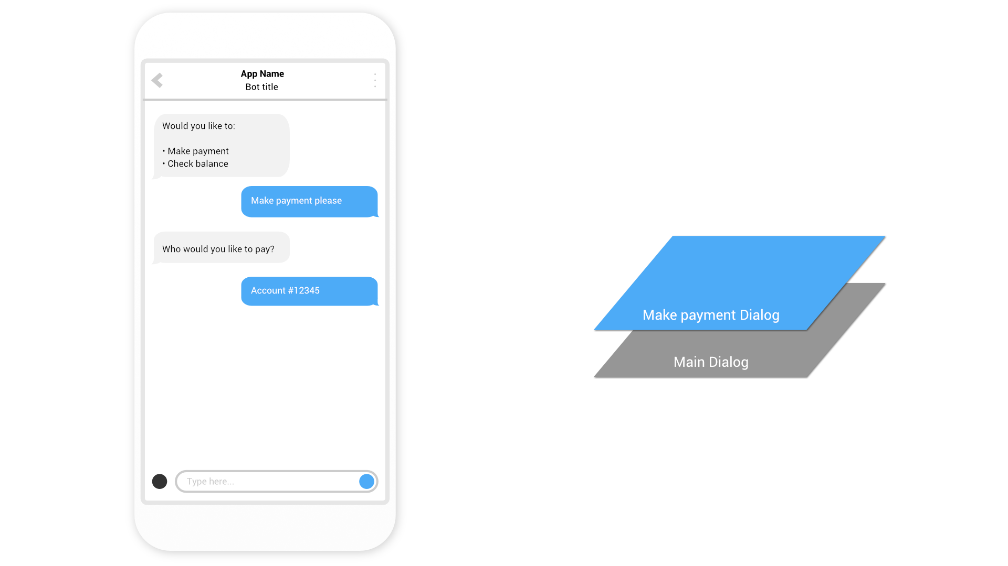

Slide 11


Slide 12
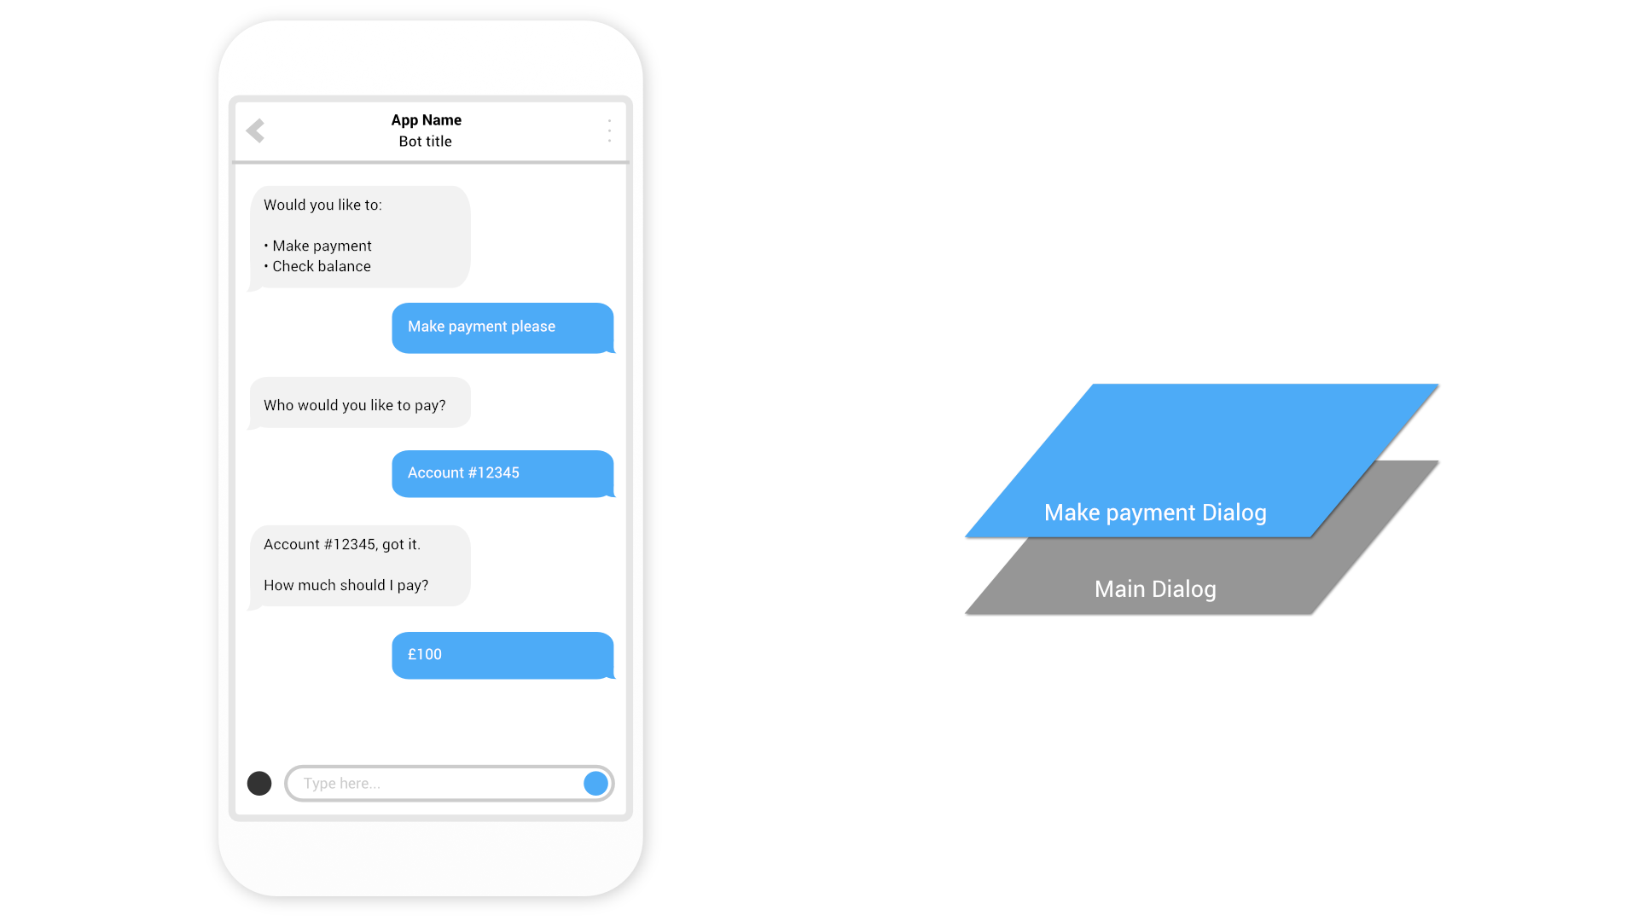

Slide 13
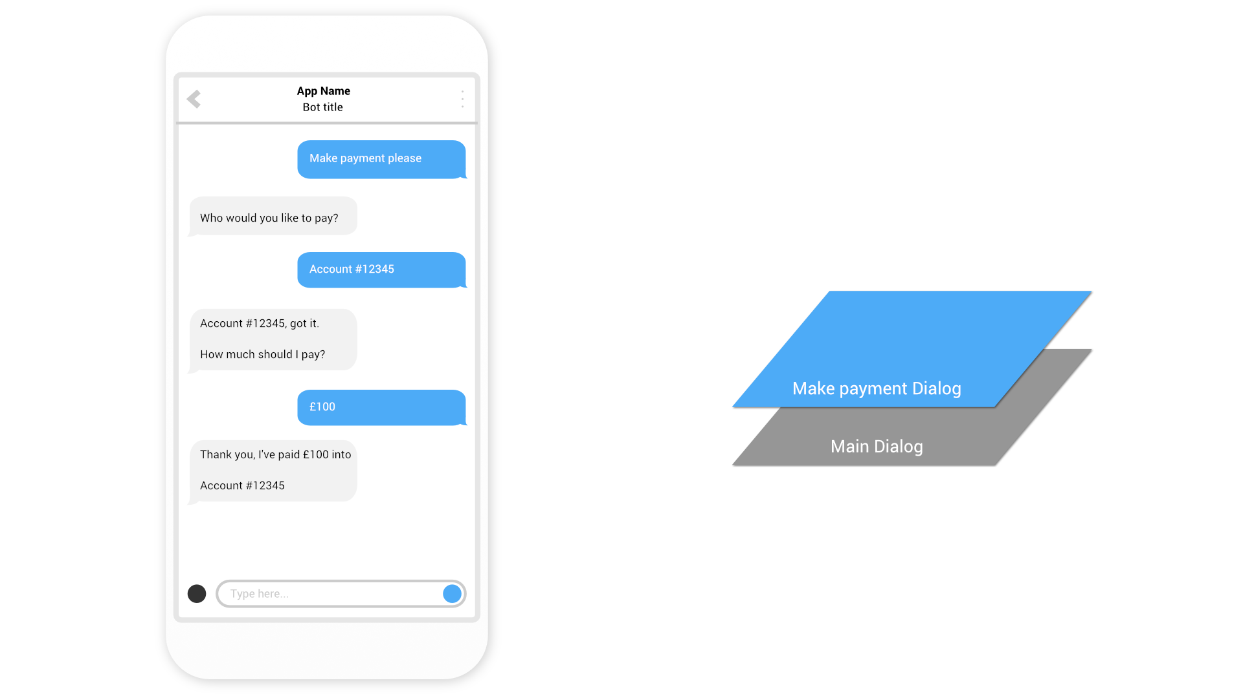

Slide 14
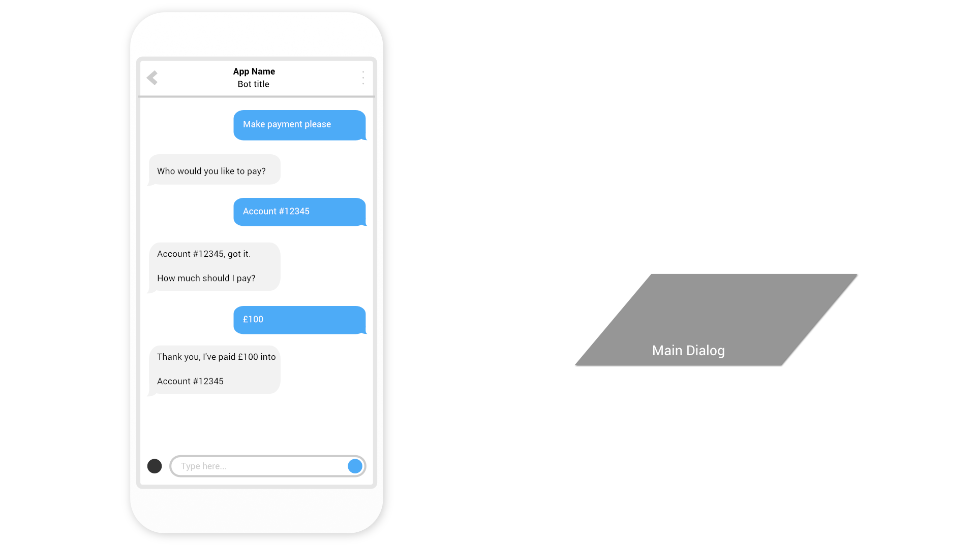

Slide 15
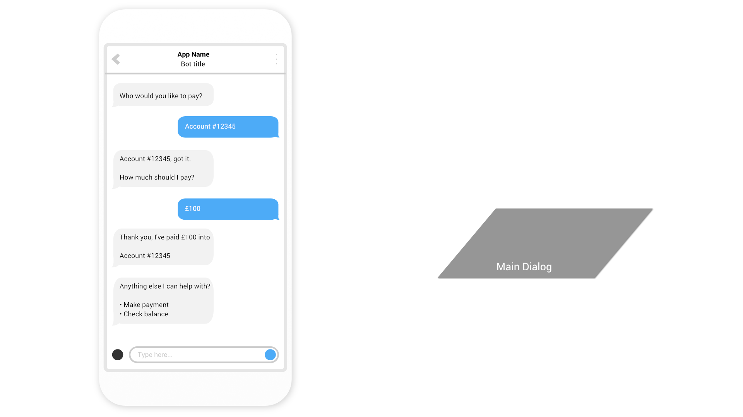

Slide 16
Dialog transitions
Context.Wait()
Wait for a user to send a message in the same Dialog
Context.Call() & Context.Forward()
Call another Dialog, adding it to the top of the stack, with or without passing a message to the child Dialog.
Context.Done()
Complete the current Dialog, removing it from the stack

Slide 17
Demo
Banking Bot using Dialogs
@jamesemann

Slide 18
Form Flow
@jamesemann

Slide 19
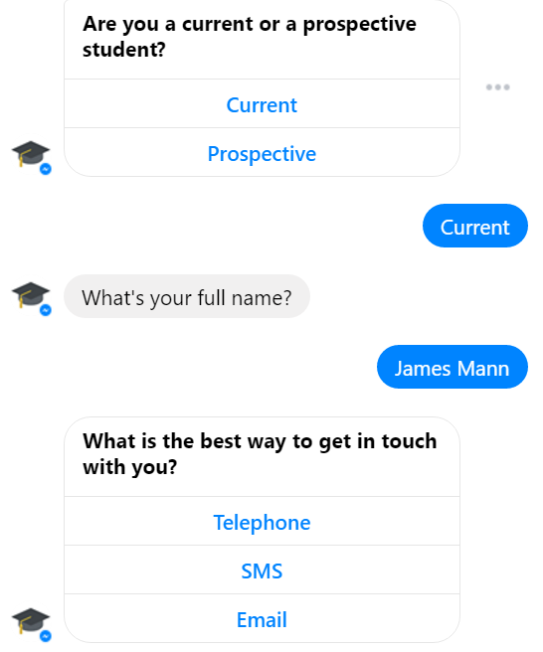
Form Flow
Form Flows are suited to data capture
Similar to a form in a traditional web page
Very simple to implement

Slide 20
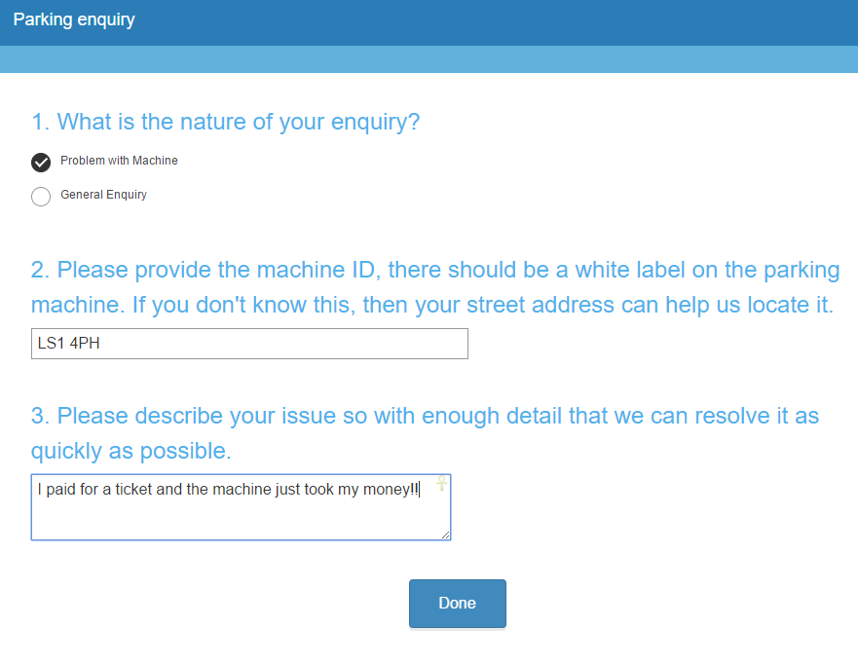
Parking enquiry chatbot

Slide 21
Demo
Form Flow chatbot
@jamesemann

