Slide 1
BCPR283 Best Programming in Practices in .Net
Presentation for assignment 1
James Gabiana
Filer

Slide 2
Objective of achievements for 1st iteration
Read from String.
First stage compression
Write a switch case
Case “.___” = ‘H’
Case “. ” = ‘D’
Case “ ” = ‘S’
Case “| ” = ‘V’
Case “ X ” = ‘X’
Case “| X ” = ‘C’
Case “ T ” = ‘T’
Case “| T ” = ‘Y’
Case “ M ” = ‘M’
Case “| M ” = ‘K’
default = ‘ ’
Second stage compression
Compress identical single characters which repeat continuously after another. eg. ‘5A’ which is ‘AAAA’
Do not put brackets
Third stage compression
Compress identical set of characters which repeat continuously after another. e.g. 5[ab3[cd]]
Keep trying to compress until it’s not compressible anymore.
Put brackets on them
First stage decompression
First iteration look for brackets and expand them 5[ab3[cd]]
Look again for brackets
Keep looking and trying until there are no brackets left on the String.
Now look for single characters and expand them e.g. 5A
Second Stage decompression
Write a switch case
Case ‘H’ = “.___”
Case ‘D’ = “. ”
Case ‘S’ = “ ”
Case ‘V’ = “| ”
Case ‘X’ = “ X ”
Case ‘C’ = “| X ”
Case ‘T’ = “ T ”
Case ‘Y’ = “| T ”
Case ‘M’ = “ M ”
Case ‘K’ = “| M ”
default = ‘ ’
Load map from text file.
Save map to text file
Write string to text file.
Read file and convert to string.
Prompt for file location.
Error handler (try to load a wrong file).
Exception case features
If several Theseus and/or Minotaur on map then “Multiple Actors Exception”
If unknown Char e.g. ”G” which is not in the list then “unknown Symbol exception”
If no Actors (“T” or “M”) then raise “no Actors exception”
If no Exit “X” then raise “game complete exception”
If opening and closing brackets are not equal then raise” Not equal brackets”
If closing bracket is found before opening bracket then raise “Closing bracket found before opening bracket”
File does not exist
Error handler (try to load a wrong file).
Display string file.

Slide 3
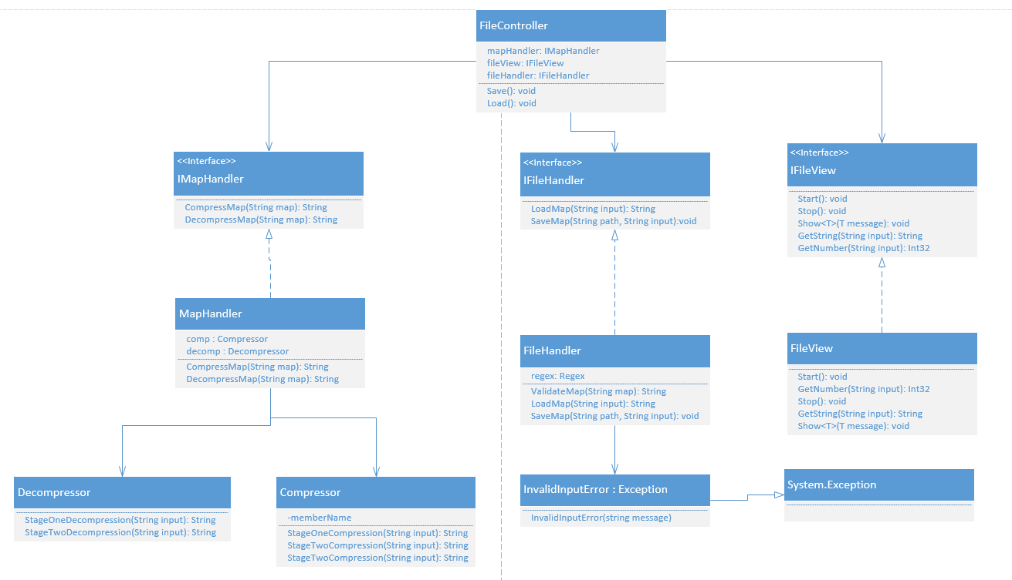
Design Level Diagram

Slide 4
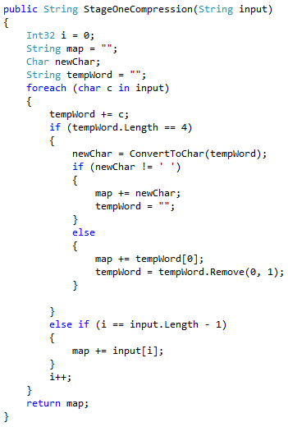
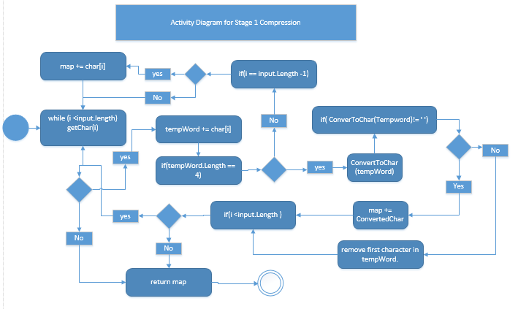
Activity Diagram for Stage 1 Compression

Slide 5
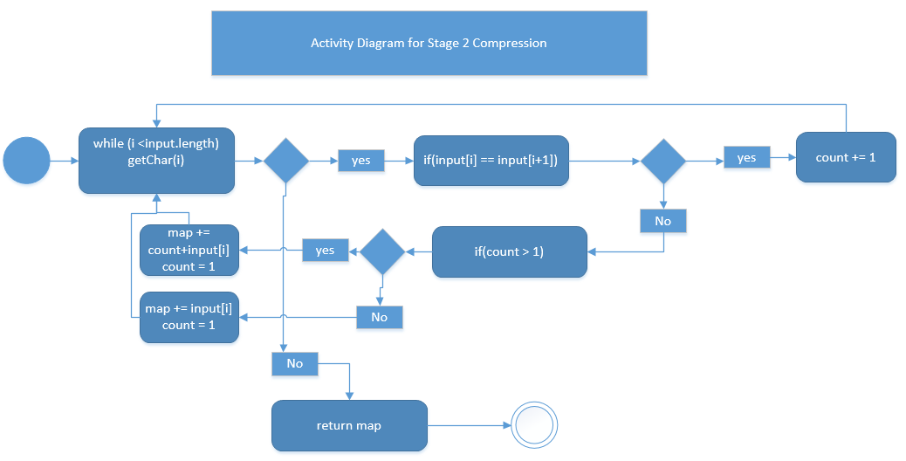
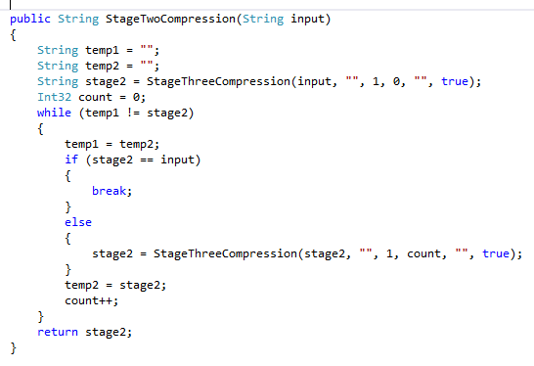
Activity Diagram for Stage 2 Compression

Slide 6
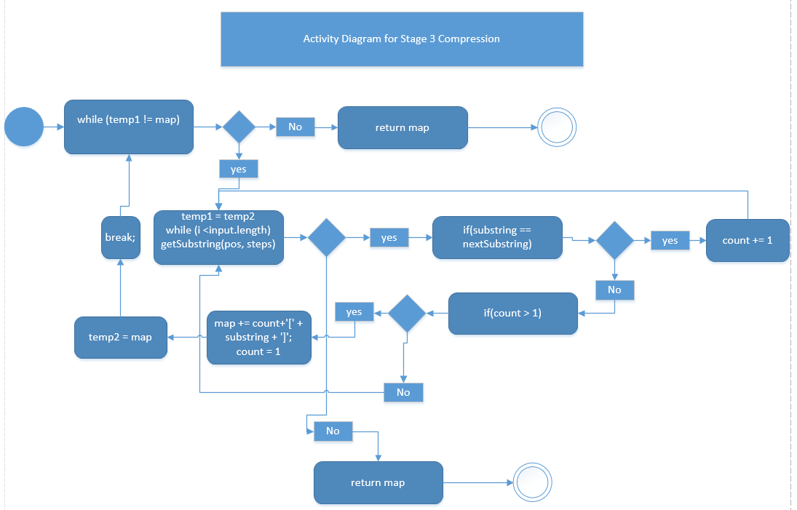
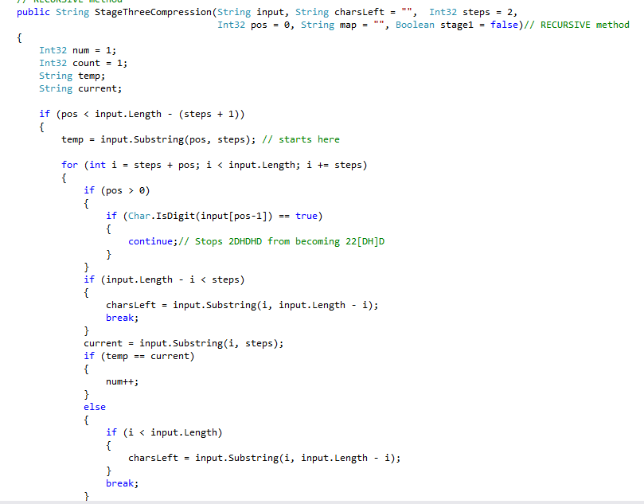
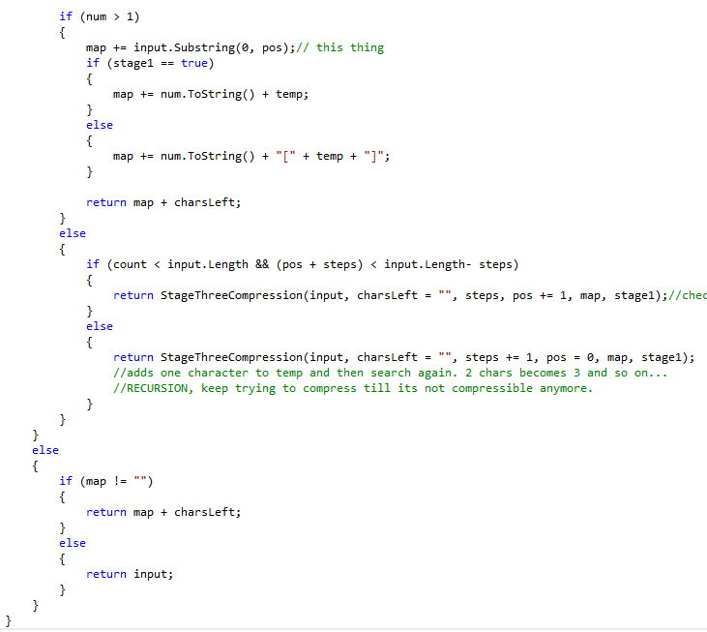
Activity Diagram for Stage 3 Compression

Slide 7
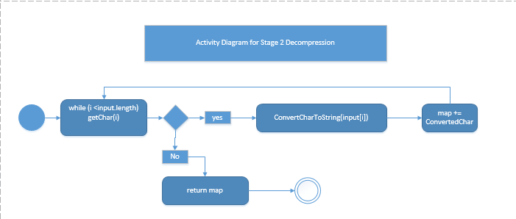
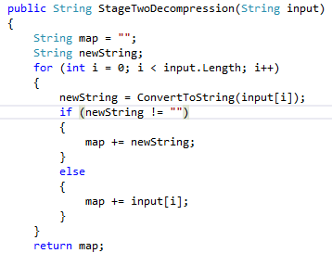
Activity Diagram for Stage 2 Decompression

Slide 8
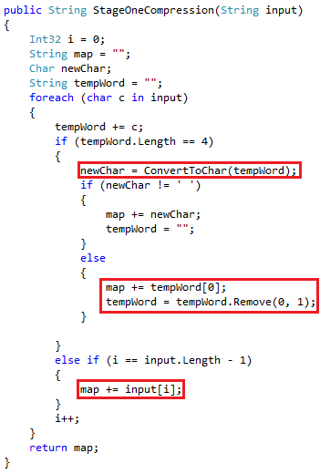
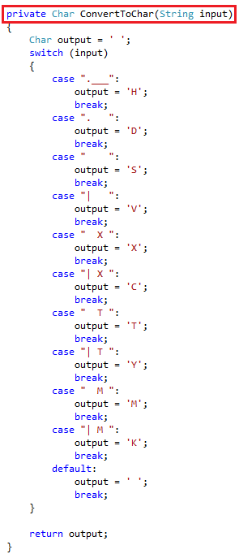
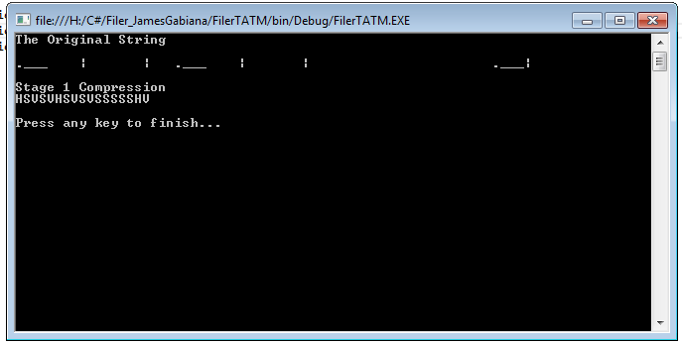
Stage 1 Compression
HSVSVHSVSVSSSSSHV
Notes:
This the stage one compression. This is where 4 characters are converted to one characters, for example “.___” will be converted to char ‘H’.
First the method will take a String input and then loop through all characters on the string input and try to match a substring called tempword with 4 characters at a time.
Match the tempWord with its equivalent one character using the method ConvertToChar().
If tempWord has a match then add that character to the return output called map, and then empty the tempWord and get the next 4 characters on the String input.
Else if it does tempWord not match, then add the first character of the tempWord to the map and then add a new character to the tempWord which is the next character on the foreach loop.
Else if the loop is at the end and no match, then add the last character to the map.

Slide 9
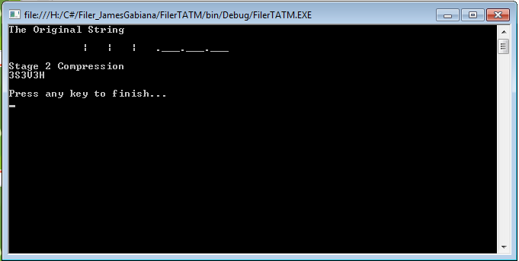
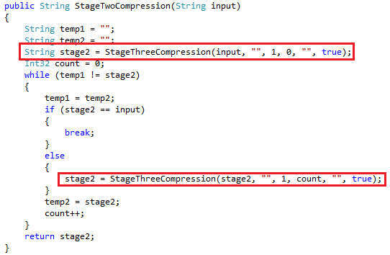
Stage 2 Compression
3S3V3H
Notes:
This is the Stage 2 Decompression which focusses only one character which repeats continuously. For Example “| | | ” which is VVV becomes 3V. It does not encapsulate the V in brackets ‘[]’ because it is more conservative.
For example, the string “2[V]” would be longer than “VV”, so 2V is more conservative for repeating single characters.
The method will take a String input, and then it will do a trial which will then be stored on String stage2 variable, and then the loop will execute, if no change then the loop will break because the map cannot be compress any further.
Else Keep trying to Compress until all repeating single characters has been compressed.

Slide 10
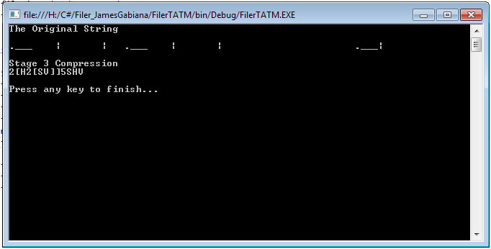
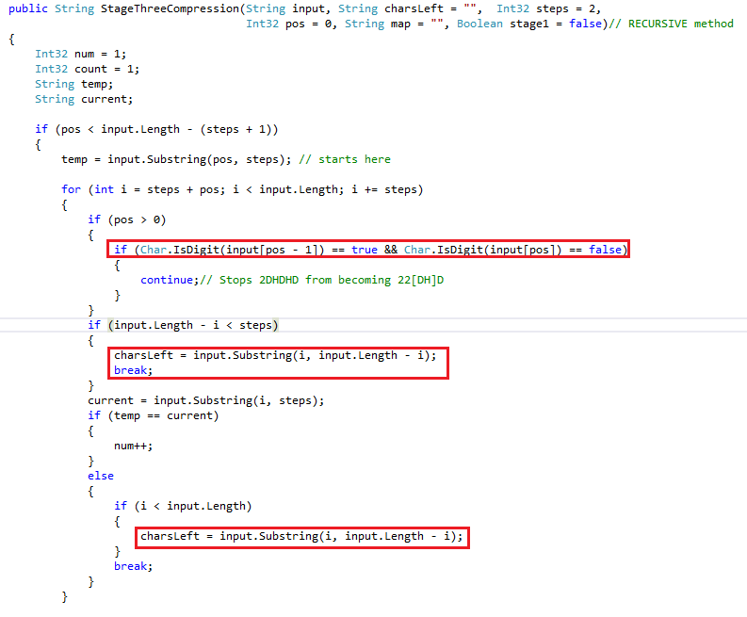
Stage 3 Compression
2[H2[SV]]5SHV
Notes:
This is the Stage 3 Compression. This method is recursive, this is the hardest part of the Filer program.
First, the method will take an multiple arguments, String input, String charsLeft, int steps, int pos, String map, Boolean stage1.
String pos is where the first character of the new word to be match with other characters.
For example, HSVSV, pos = 0 which is H and then Steps which is 1 is V, so the match we are currently looking for is “HS”, the loop will then try and see if it matches the next two characters which is “VS”, which will return false and move to the next characters, but in this case there is only one character left which is “V” so the loop will then break. The method will then invoke itself (Recursion), and add += 1 to pos but not to step.
This time, pos = 1 and step is still one so the new current word to be match with other word will now be “SV”, and the next two characters is also SV so value of num will now increase by 1.

Slide 11
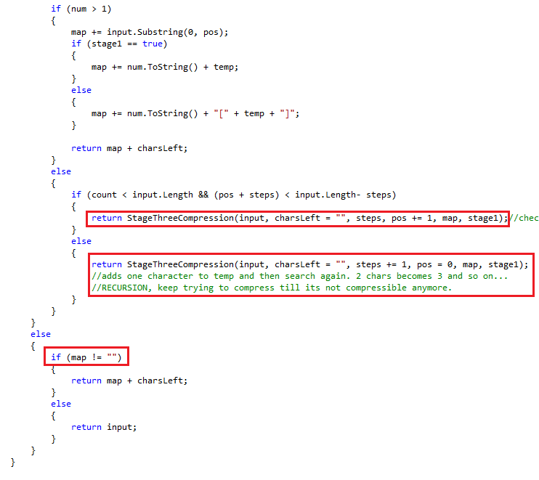
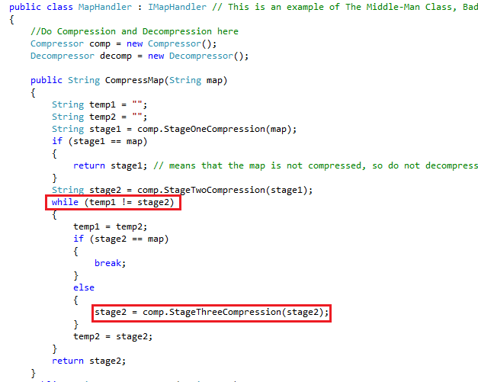
Stage 3 Compression Continues…
Notes:
It will now go and add that value of variable “num” to map followed by the two chracters “SV”, and it will also add the characters before that which on this case is char “H” and if there are uncompressed characters it will also add them to the return map.
MapHandler class is an example of the Middle class which is a bad smell. It uses methods from Compressor and Decompressor classes to do a task. It acts just like a Controller class.
I could have rewrite my code so that one method do all the Compressions but the method would become very complex and very long. So I broken them down to different stages and created the class MapHandler to make it little bit more readable.
The method Compressmap() in MapHandler will keep running StageThreeCompression() method compress the map as much as possible.

Slide 12
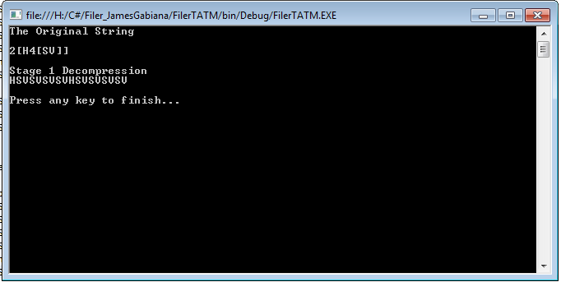
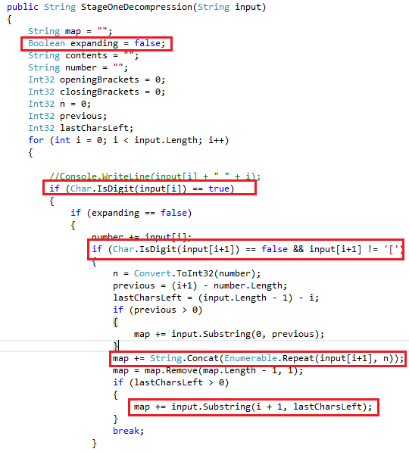
Stage 1 Decompression
Notes:
This is the Stage1 Decompression. The responsibility of this method is to Expand all the characters and to fully prepare it for the Stage2 Decompression which is to convert each characters to its equivalent String.
First the method takes a String input. The method will then loop through all the characters of the input and look for numbers and brackets.
It then needs to know if the current character is a number or not. If it is a number then it will then needs to know what the next character is, if the next character is not a number and not an opening bracket, that means it’s a number followed by a character which is repeating, For example ‘3V’ will be expanded as “VVV”.

Slide 13
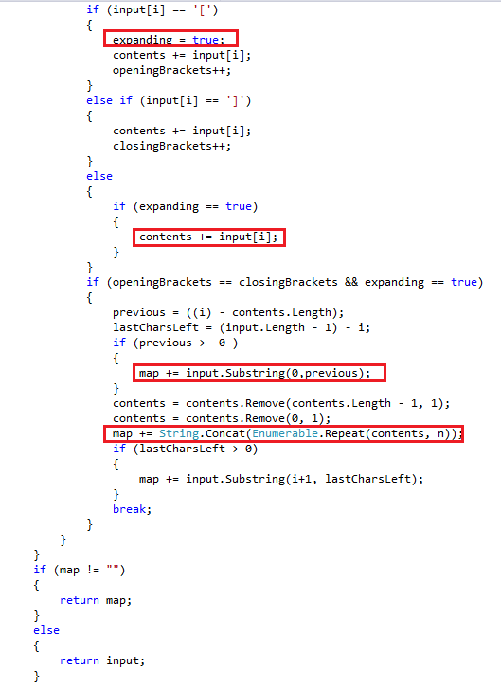
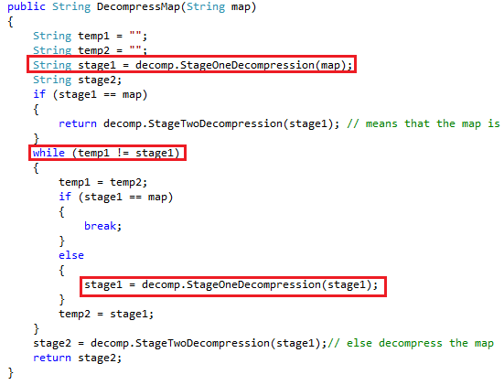
Stage 1 Decompression Continues…
Notes:
If the current character is a number and the next character is an opening bracket “[”, it will set the Boolean expanding to true and begin the expansion, the Boolean will let the program know that any numbers it will encounter, it must not attempt to convert that number. It will then count the number of opening brackets and closing brackets, if opening brackets become equal to closing brackets then stop putting characters on the string Content and then multiply the string content base on the number acquired.
The MapHandler class will keep running the StageTwoDecompression method until all brackets and numbers are gone.

Slide 14
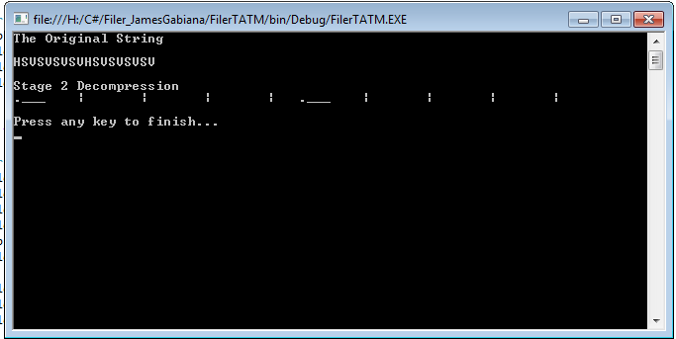
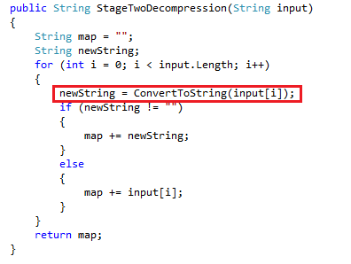
Stage 2 Decompression
Notes:
The responsibility of this method is to convert all single characters to its equivalent String.
It will loop through all the characters of the String input and then add the equivalent string to the String map.
And then return the String map.

Slide 15
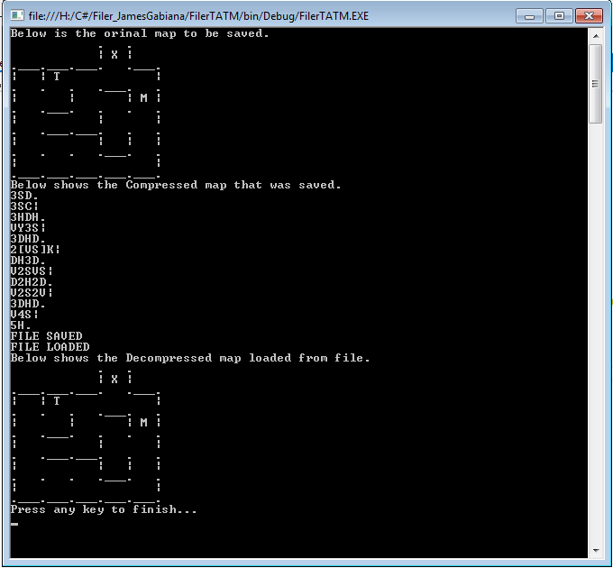
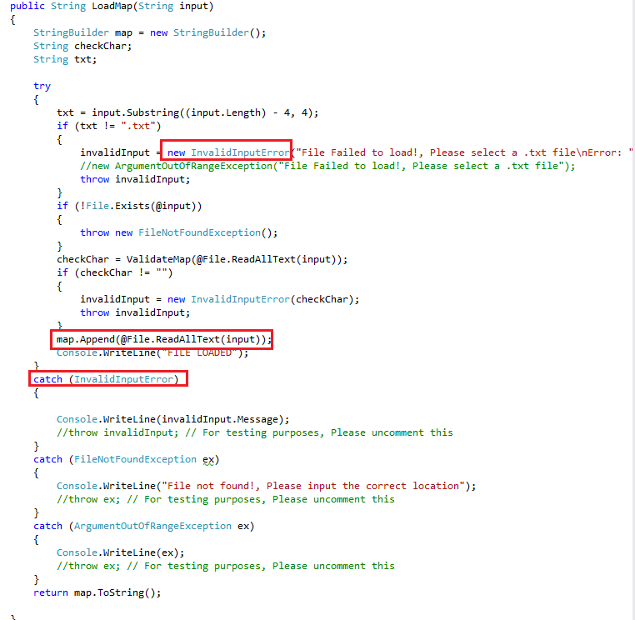
Loading Map
Notes:
The responsibility of the FileHandler class is to save or load map, and shield the MapHandler from invalid data. Since all maps go through the FileHandler class before being saved or load, I figure, catch all the invalid inputs on the FileHandler class to protect the MapHandler class from producing errors later on.
For example the .txt file has an invalid character “A” or something like “@#$%65qw37”, the FileHandler class will detect the invalid characters and throw an exception which is my own custom Exception class InvalidInputError.
The responsibility of the LoadMap() method is to get data from a text file. That data will then be used by MapHandler Class to expand and turn compressed string to a map.
The loadMap() method will take a String input which is the location of the file. For example the input would be "H:\\C#\\FilerDocuments\\Level_1_Map.txt“.

Slide 16
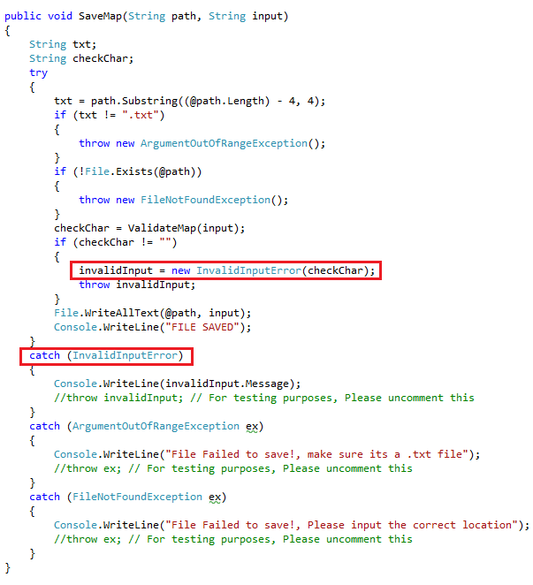
Saving Map
Notes:
The responsibility of the SaveMap() method is to write the data of map to a .txt file.
The save map will take String path which is the location of the file to be created, the String input is the data from map.
The same principle as the LoadMap() method. The SaveMap() method will also catch invalid inputs like “@#$567%^&” and throw exceptions which is my custom exception InvalidInputError class.

Slide 17
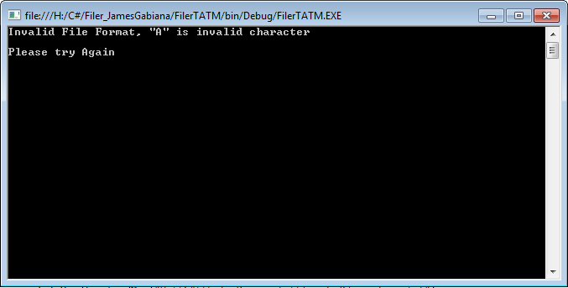
Exeption Case Features
Exception case features
If several Theseus and/or Minotaur on map then “Multiple Actors Exception”
If unknown Char e.g. ”G” which is not in the list then “unknown Symbol exception”
If no Actors (“T” or “M”) then raise “no Actors exception”
If no Exit “X” then raise “game complete exception”
If opening and closing brackets are not equal then raise” Not equal brackets”
If closing bracket is found before opening bracket then raise “Closing bracket found before opening bracket”
Error handler (try to load a wrong file).

Slide 18
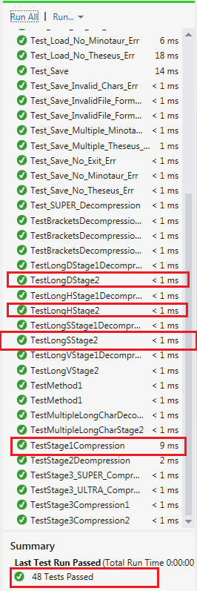
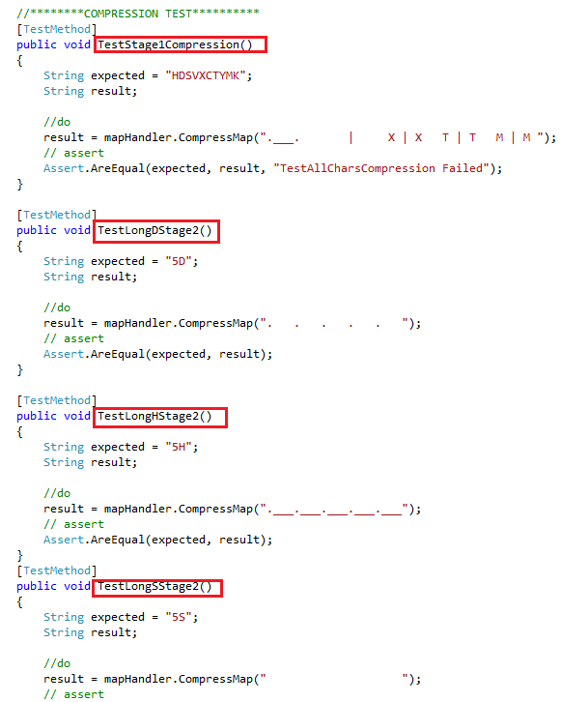
Happy days test: Compression

Slide 19
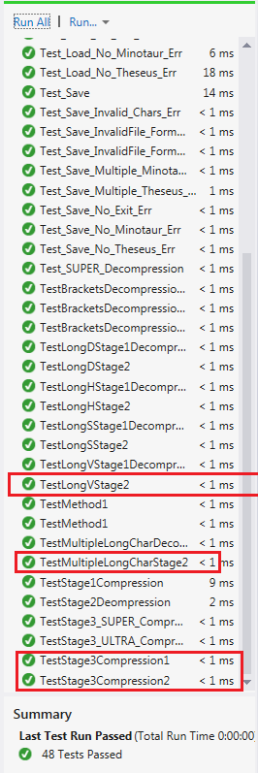
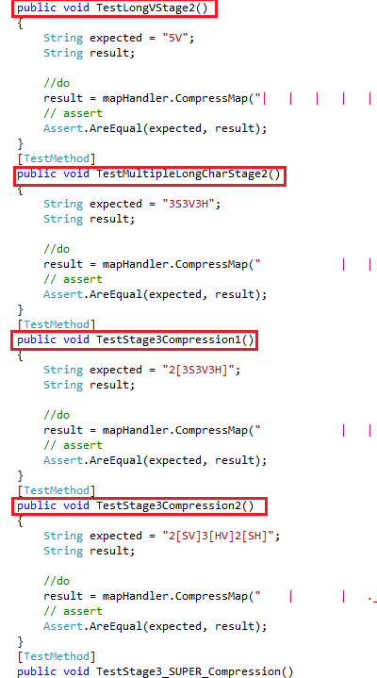
Happy days test: Compression

Slide 20
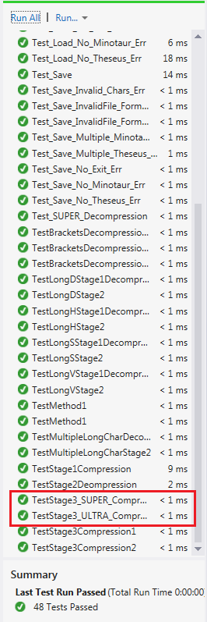
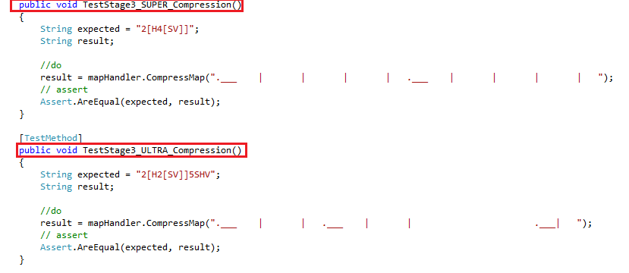
Happy days test: Compression

Slide 21
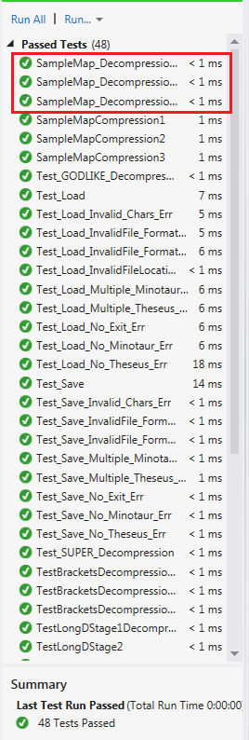
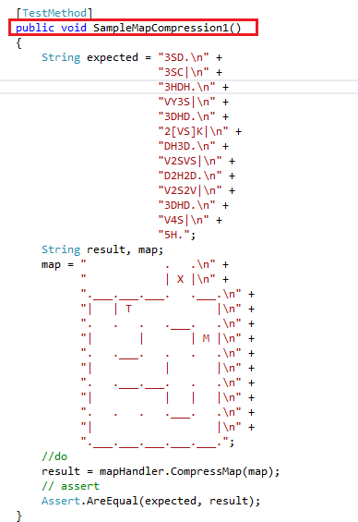
Happy days test: Compression

Slide 22
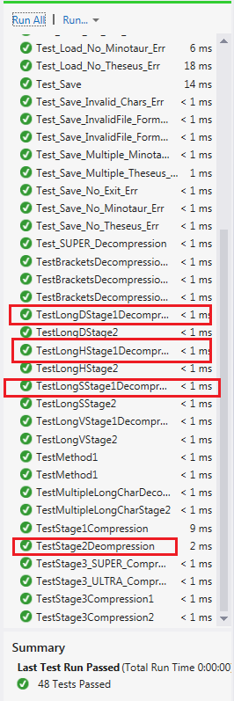
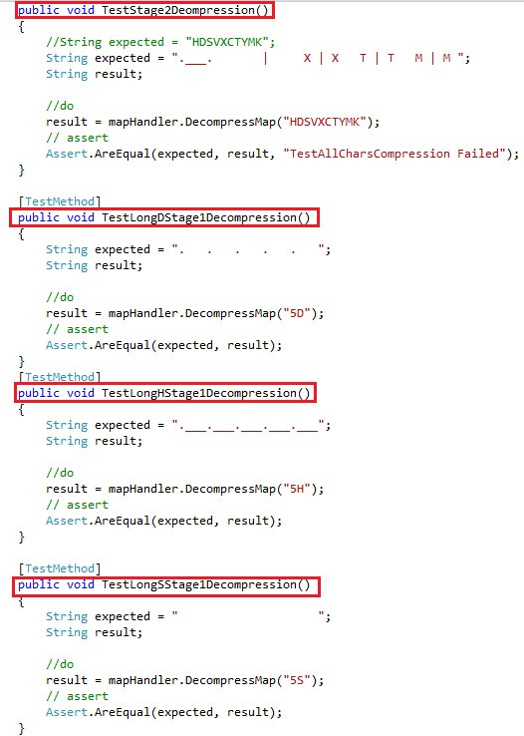
Happy days test: Decompression

Slide 23
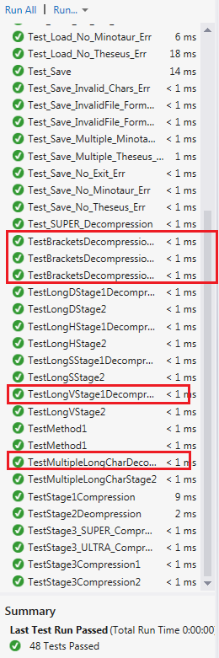
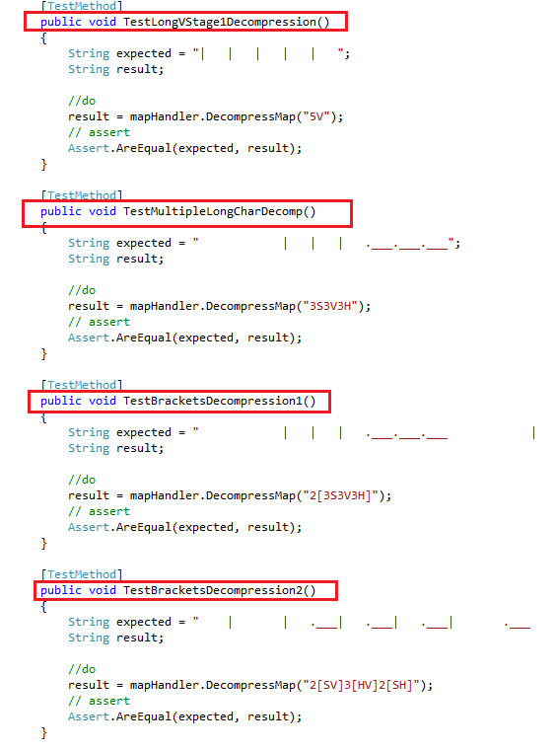
Happy days test: Decompression

Slide 24
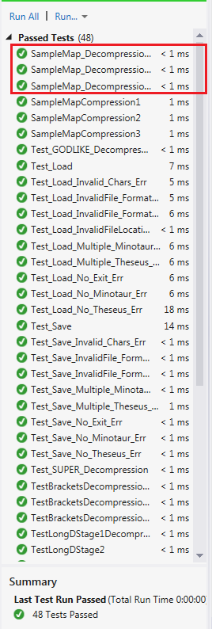
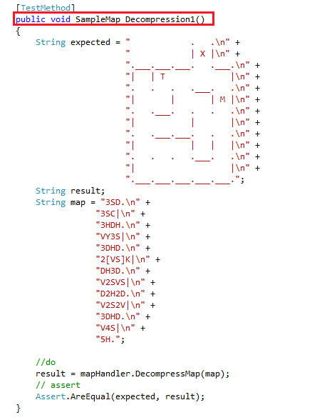
Happy days test: Decompression

Slide 25
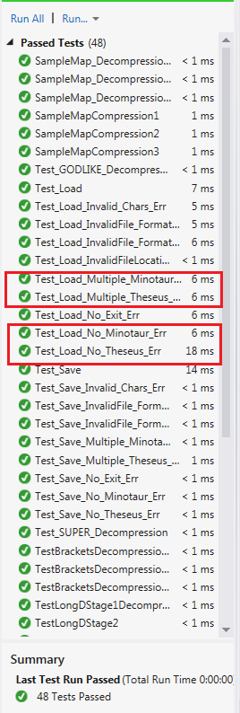
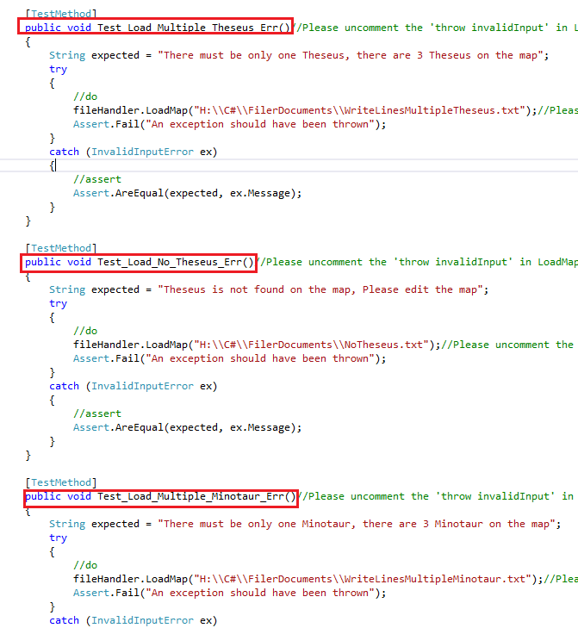
Bad days test
If several Theseus and/or Minotaur on map then “Multiple Actors Exception”
If no Actors (“T” or “M”) then raise “no Actors exception”

Slide 26
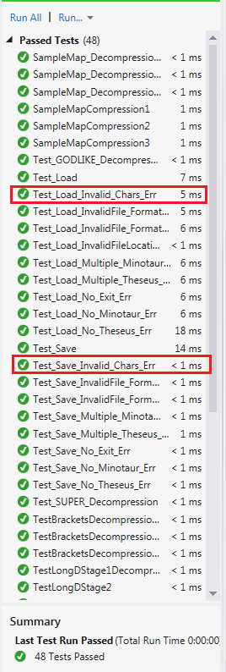
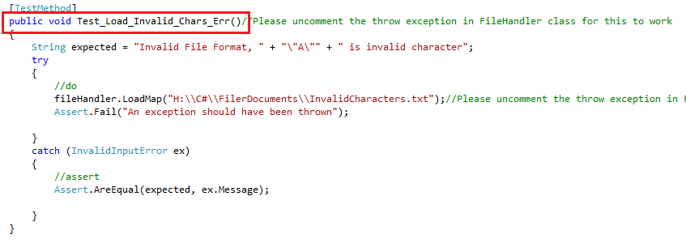
Bad days test
If unknown Char e.g. ”A” which is not in the list then “unknown Symbol exception”

Slide 27
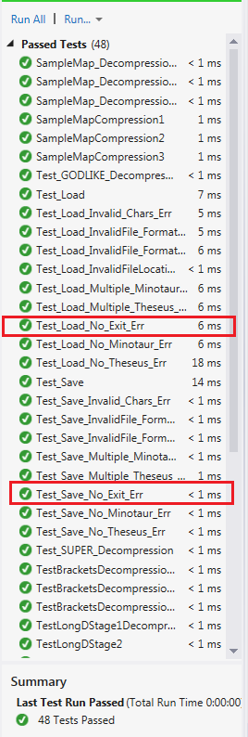
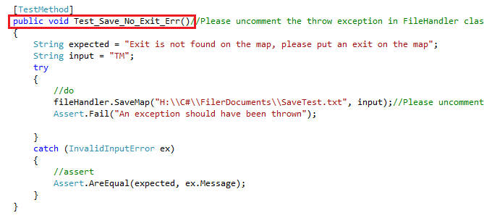
Bad days test
If no Exit “X” then raise “game complete exception”

Slide 28
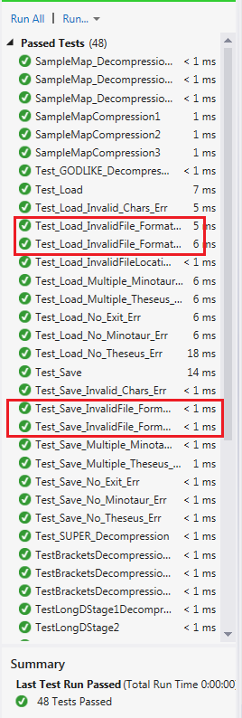

Bad days test
If opening and closing brackets are not equal then raise” Not equal brackets”

