Slide 1
Numerical Methods Laboratory Activity
Series and Limits Convergence
Section A | Complete Python Implementation & Results

Slide 2
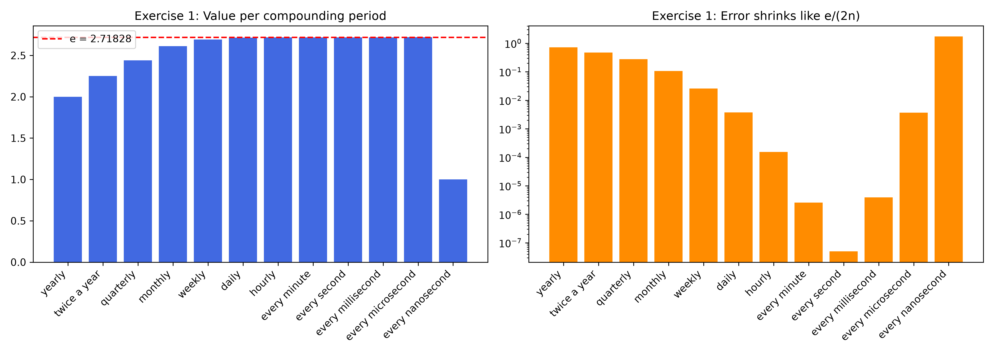
Exercise 1: Convergence to e

Slide 3
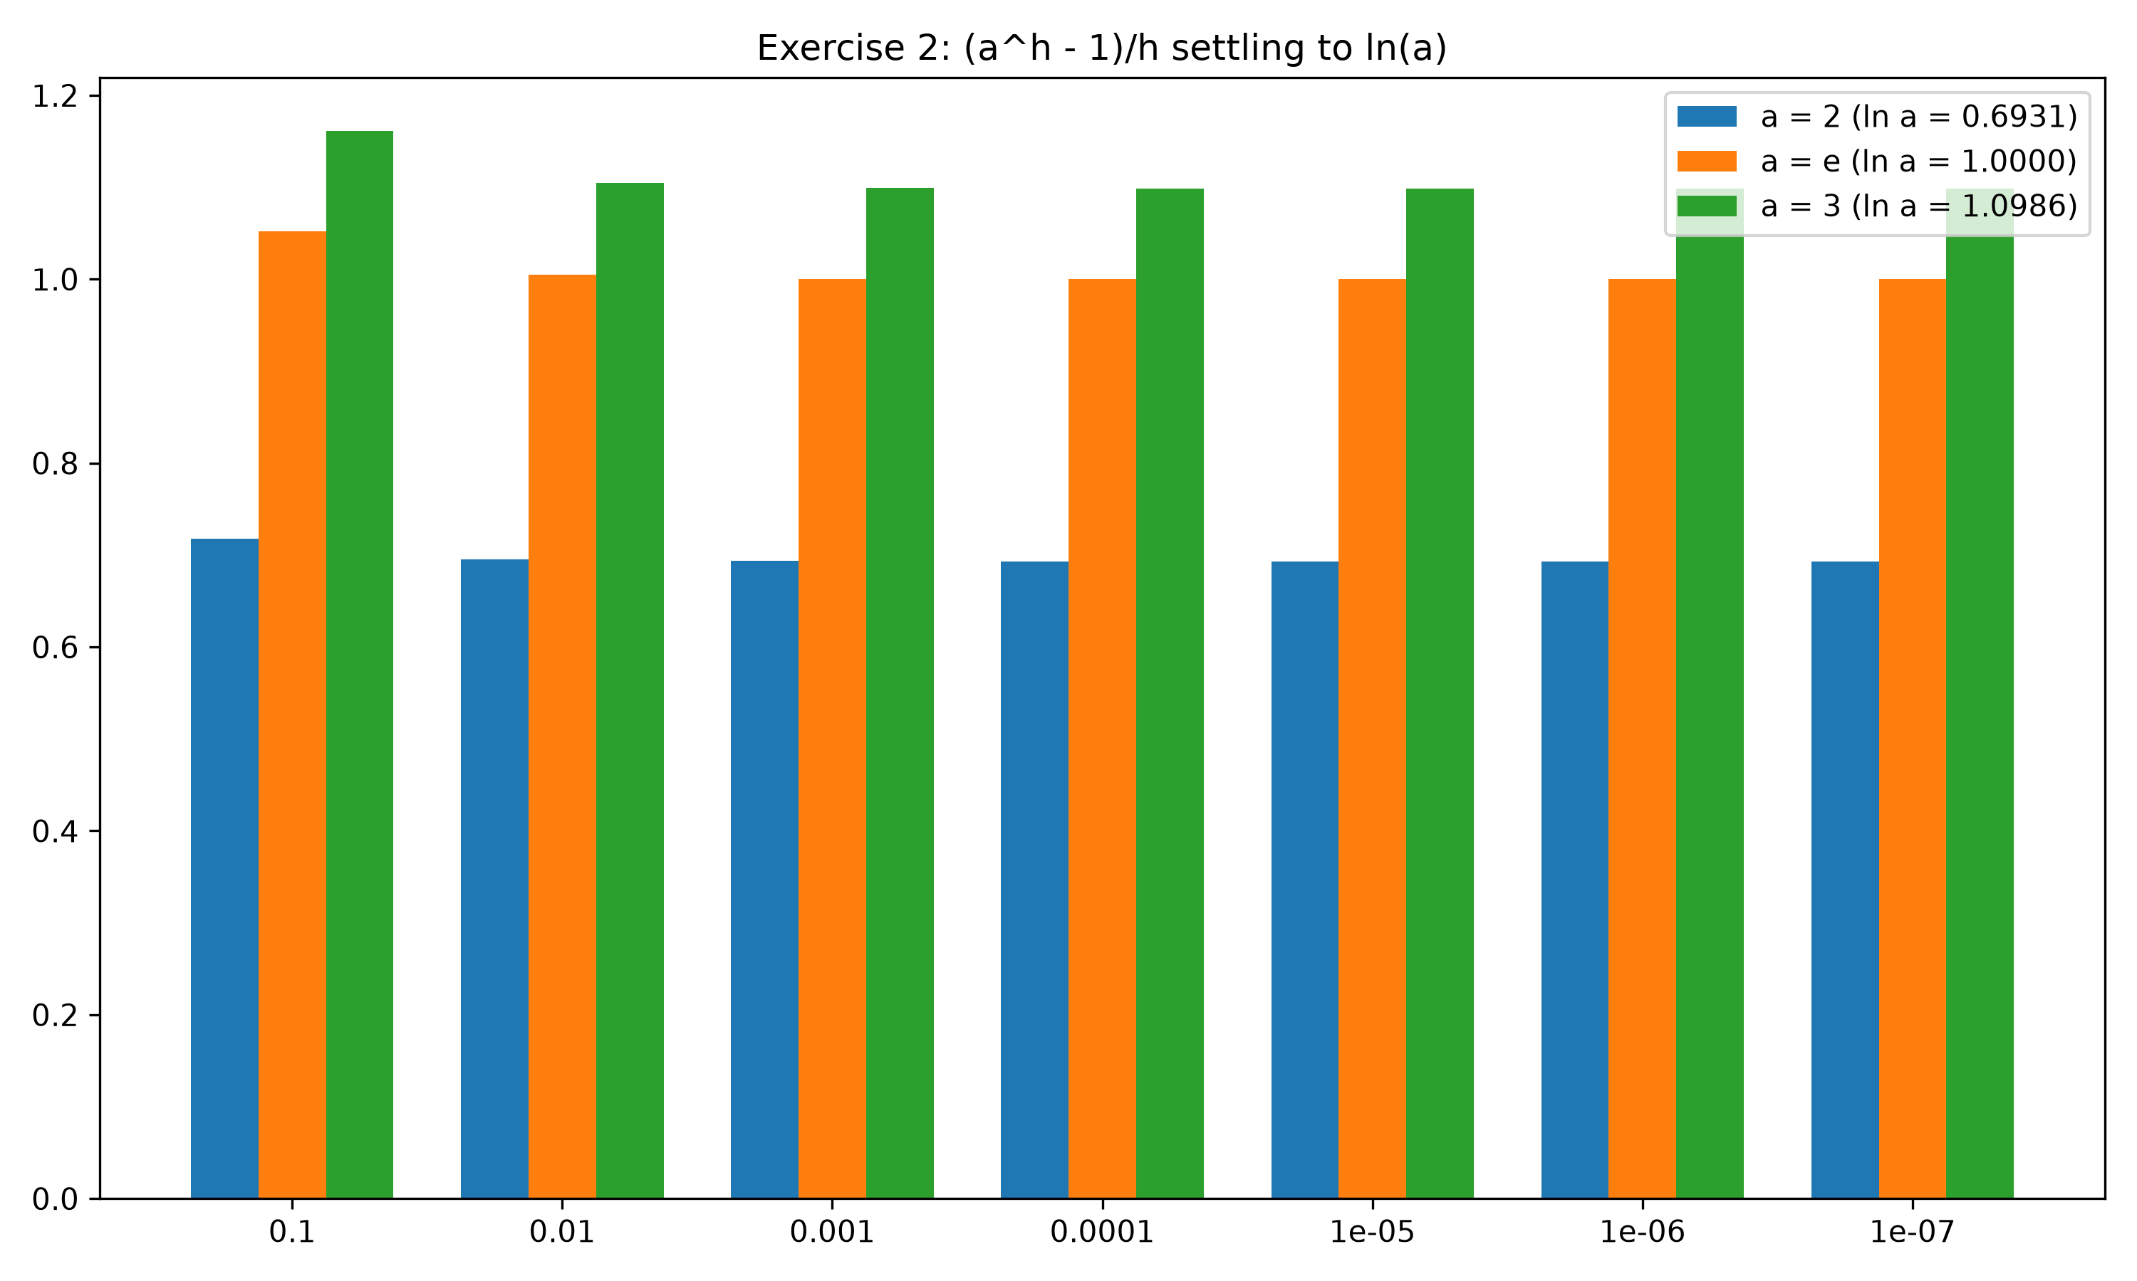
Exercise 2: Difference Quotient Settling

Slide 4
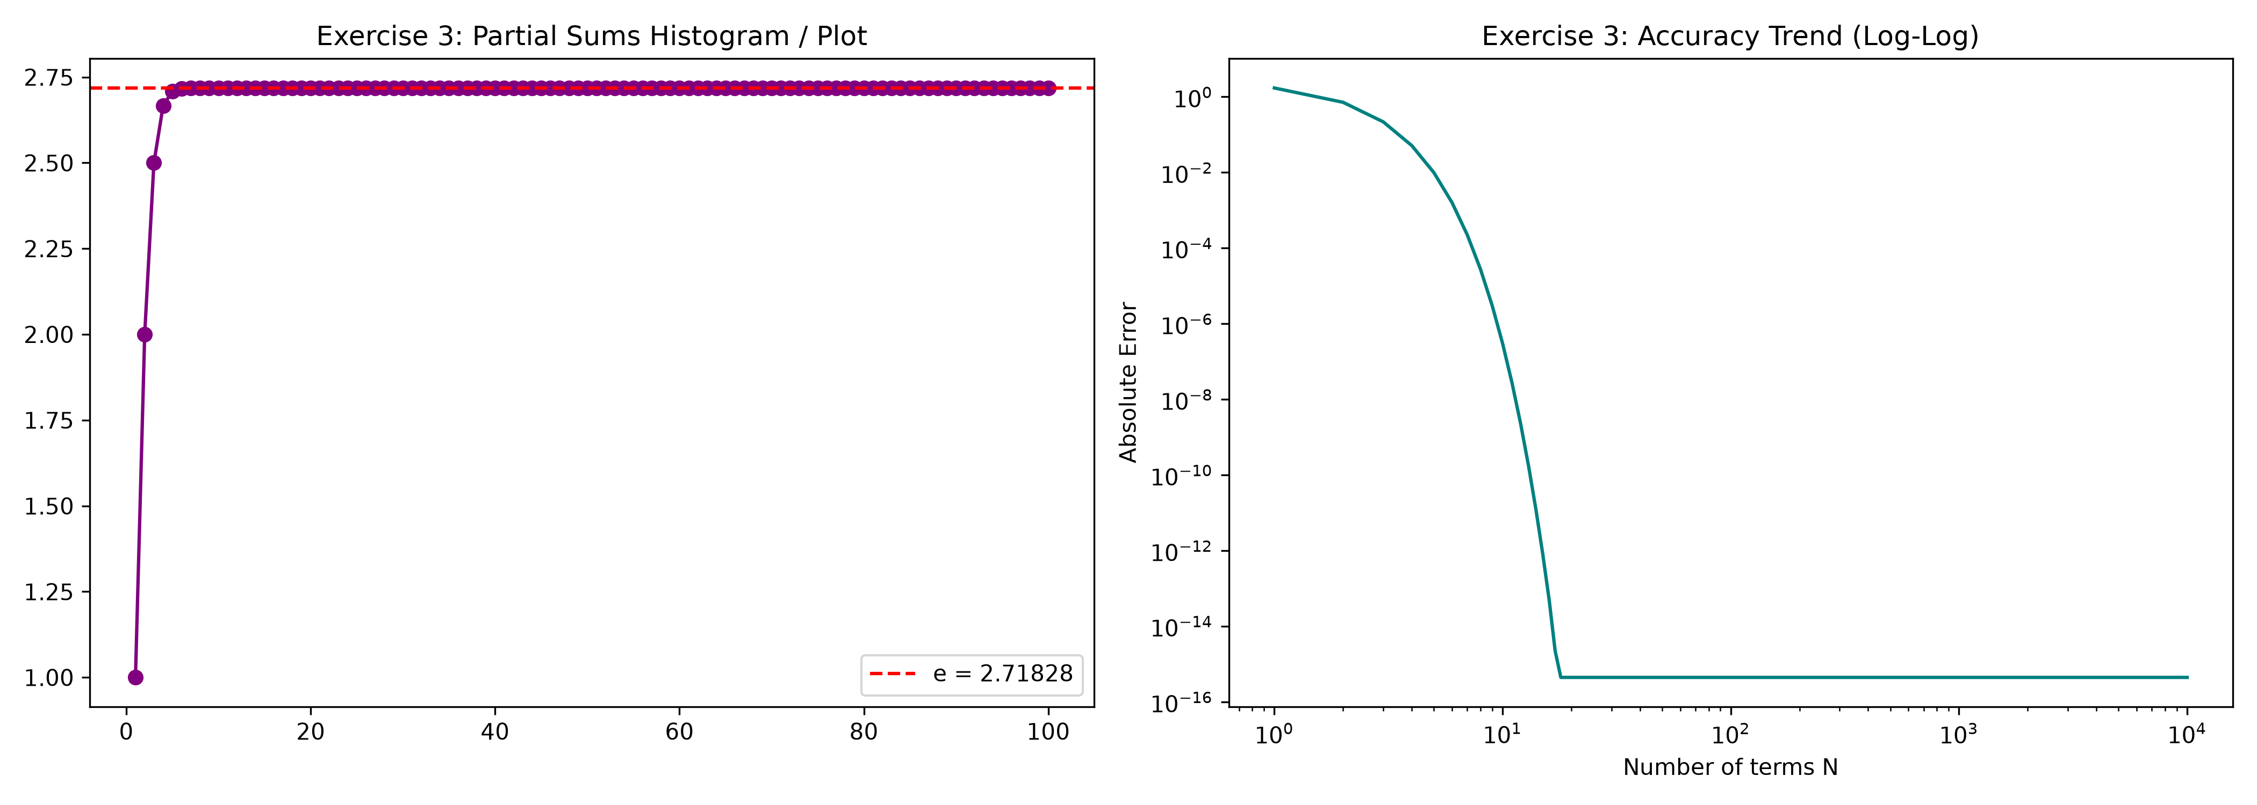
Exercise 3: Taylor Series Expansion

