Slide 1
Rap is
life

Slide 2


Slide 3
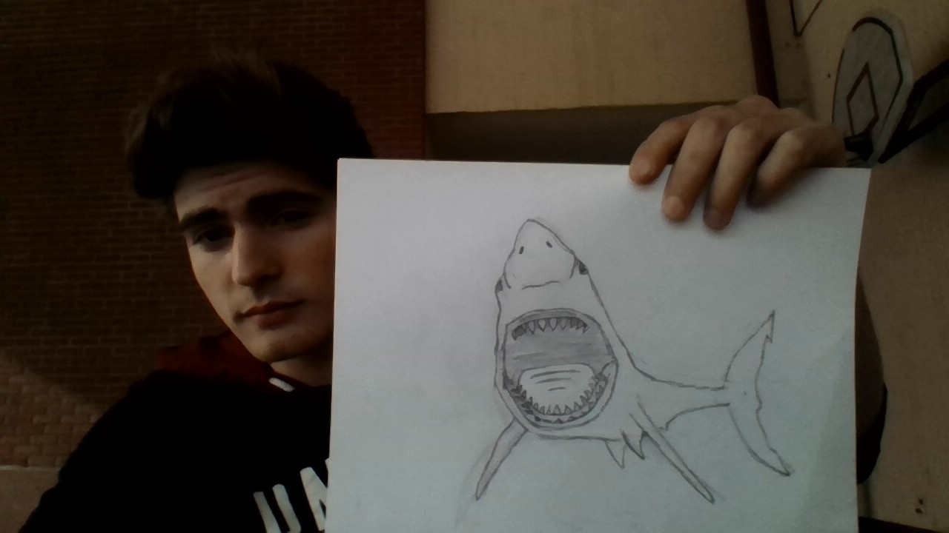
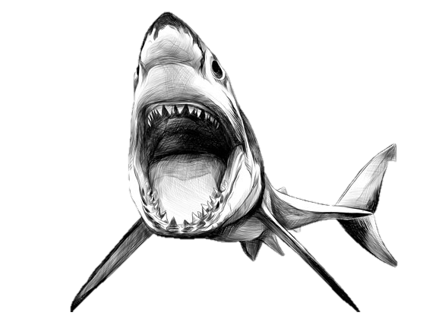

Slide 4

R

Slide 5
