Slide 1

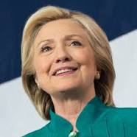
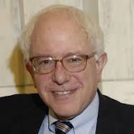
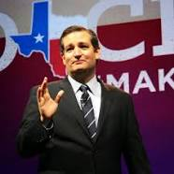

Big Data Analysis of the 2016 Presidential Candidates Berkeley MIDS W251 Final Project | April 19, 2016
Dhaval Bhatt, James Gray, Tuhin Mahmud

Slide 2
Key Focus - 2016 Presidential Candidates
What can we learn about the 2016 Presidential candidates through data?
Who has the highest volume of interest on Reddit? How has that changed over the years?
What keywords, nouns and adjectives relate to these candidates?
What is the social media sentiment for each candidate and what events are influencing their reputation?

Slide 3
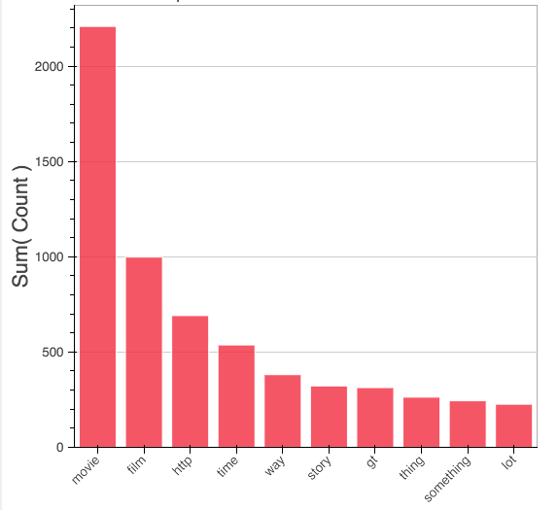




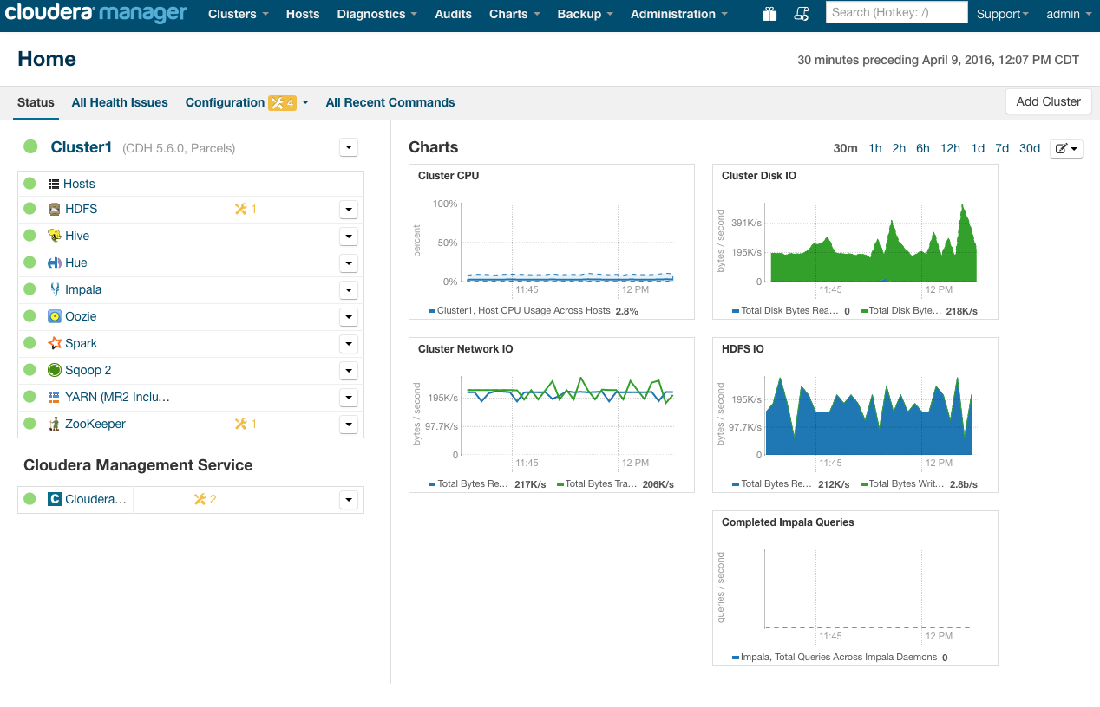
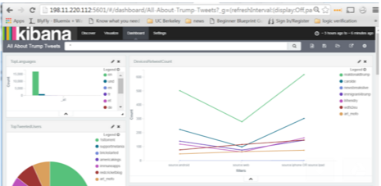
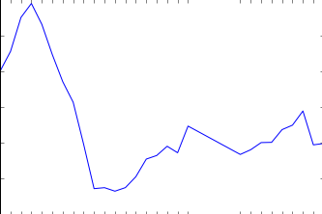
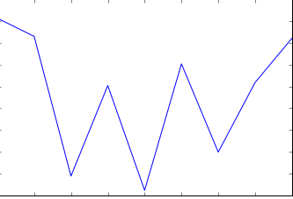
1
batch layer
Python, Dask Distributed
Anaconda Cluster Management
Cloudera Hadoop Distribution
1TB JSON
(2007-2015)
Spark
Amazon S3
blaze-data/reddit
HDFS
client
(Dallas05 datacenter)
Head node1
169.55.6.180
Compute node2
169.44.83.67
Compute node3
169.55.6.169
Compute node4
169.44.57.137
Cloudera Manager
2
speed layer
1 day Twitter analysis
Twitter API
Indexing
(Logstash)
Storage & Search
(Elasticsearch)
Web UI
(Kibana)
IBM Softlayer
Node 1
Alchemy API
sentiment analysis
Twitter API
Spark Streaming
Data extraction
Sentiment Analysis
HDFS
3
4 Nodes
IBM Softlayer

Slide 4
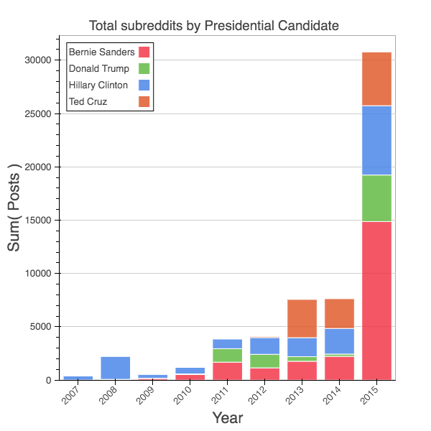
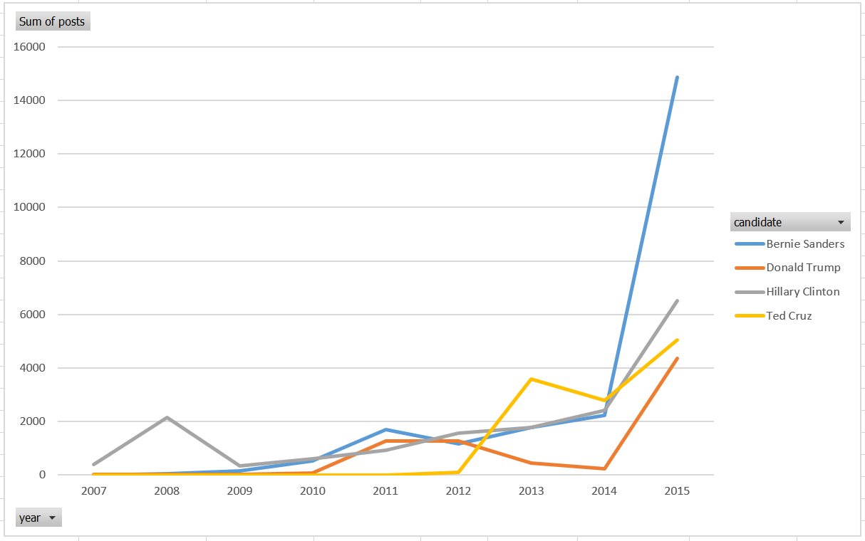
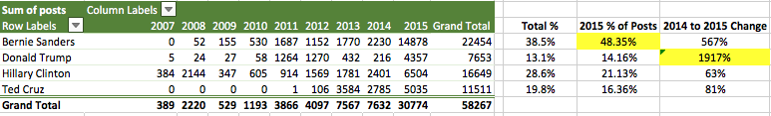
Reddit Data Processing and Analysis (Batch Layer)
Interest in Bernie Sanders surged
48% of all 2015 posts
567% increase from 2014
Post volume increased significantly leading into the 2016 election year and much greater than the 2008 election.
The number of posts including Hillary Clinton has remained fairly constant over the last few years while Donald Trump and Bernie Sanders surged 1917% and 567% respectively from 2014 to 2015.
Bernie Sanders was referenced in 48% of the 2015 posts and over 38% of the posts from 2007-2015. The 2015 surge suggests a growing interest in Bernie Sanders as a viable presidential candidate (blue line).
Ted Cruz appeared on Reddit radar starting in 2012 but at a slower rise when compared to Sanders, Clinton and Trump.

Slide 5
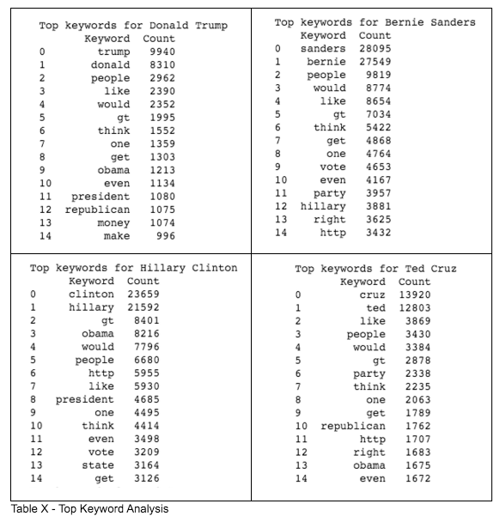
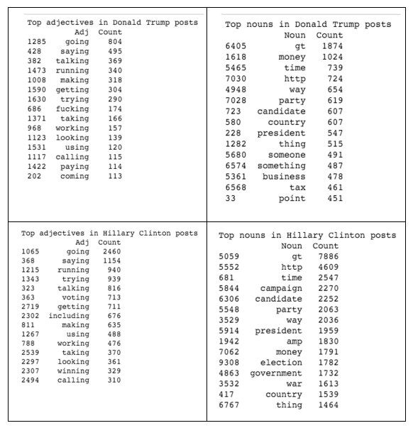
NLP Analysis of Reddit Posts for Each Candidate

Slide 6
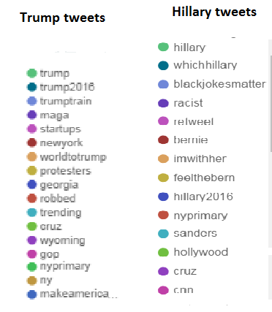
Real-Time Twitter Analysis
Real-time analysis of tweets about candidates
Servers hosted for 2 candidates
Real Time Analysis contains:
Popular Hashtags every hour for a day (Trends)
Top Twittter users
Count of tweets
Unique Hastags counts
Unique users commenting on candidates
Real-Time Twittter Analyis Dashboard
Hillary
http://50.97.205.234:5601/#/dashboard/All-about-Hilary-tweet
Donald Trump
http://198.11.220.112:5601/#/dashboard/All-About-Trump-Tweets

Slide 7
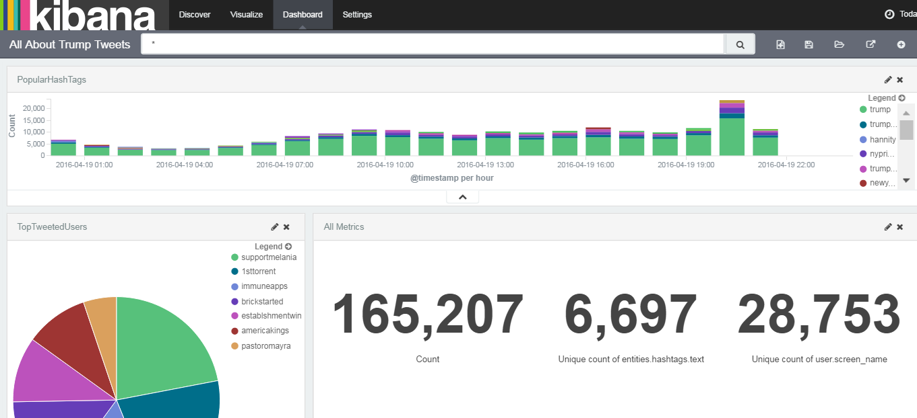
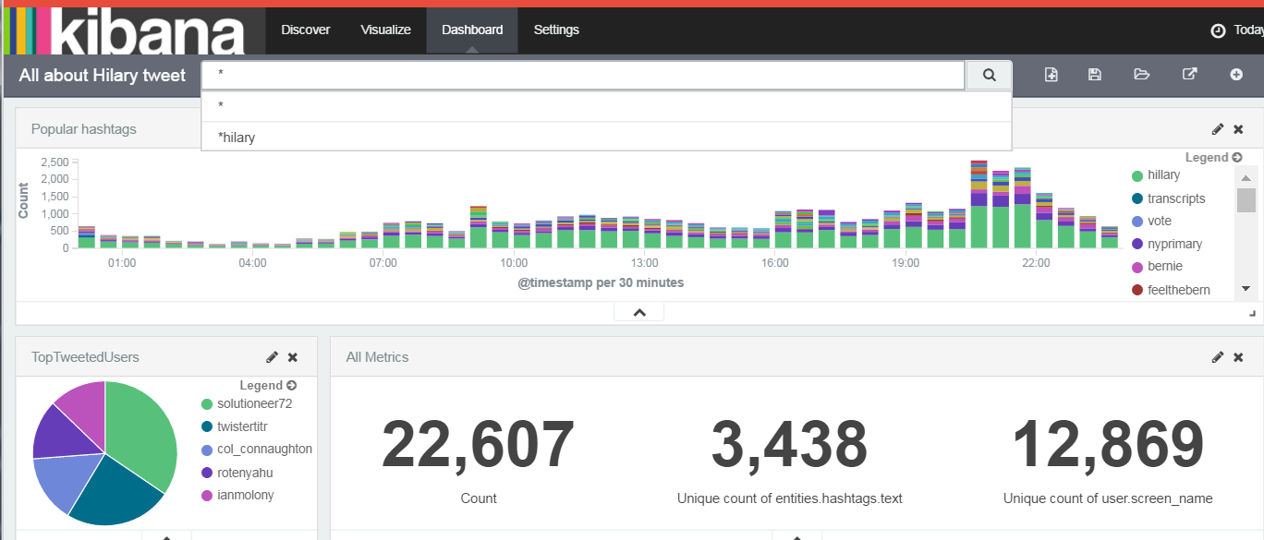
Realtime Twitter Analysis Dashboard
Searchable index
Shows top hashtags for the day and number of active users tweeting
on April 19th during new york primary some observations .
top hastags on tweets for hillary were
#transcript, #vote, #nyprimary #bern,#imwithher
top hastags on tweets for donald trump were
#trump2016, #nyvalues, #nyprimary, #primaryday, #ny
Some observations about Different Metrics on tweets :
Count of unique users for Donald Trump is about double that of hillary but the tweet count for Donald is about 5 times that of hillary.This is perhaps showing social media engagement and enthusiasm gap.
Both had #nyprimary as hashtags during the primaryday. Showing important event related to the candidate on that day..
These are snapshot observations for the day , but gives some insight to ongoing events and trends.

Slide 8
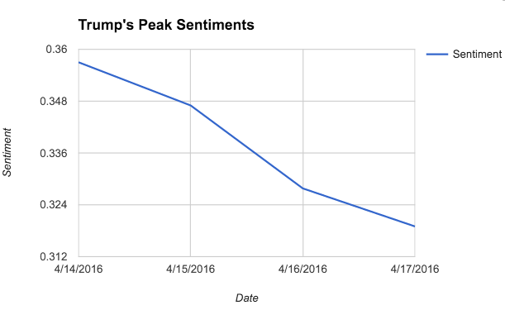
Twitter Sentiment Analysis
Positive Sentiment Peaks

Slide 9
Twitter Sentiment Analysis
4 Softlayer virtual servers, each with 16GB of RAM, 4 vCPUs and two disks of 100GB each
Used alchemyAPI to perform sentiment analysis on top 40 tweets obtained in the current analysis window
Batch size of 1 seconds, that is, tweets are gathered every second, and sliding window duration of 1 hour and analysis window duration of 1 hour

Slide 10
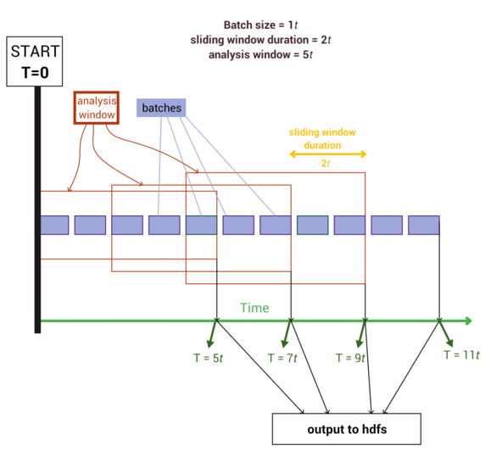
Twitter Sentiment Analysis

Slide 11
Conclusions and Future Work
BATCH LAYER
Majority of time spent on infrastructure setup and operationalizing data processing pipelines -> this limited the time to produce deep insights.
1 TB Reddit data processing consumed significant memory for both Spark and Dask -> increase cluster RAM, number of nodes, modularize code by year, persist objects in memory or HDFS, pre-process JSON files.
Cloudera was a very efficient method for installing/modifying Hadoop services and monitoring performance, health, services, disk usage.
Dask provided a comparable approach to Spark for distributed processing using pure Python. Anaconda Cluster Mgmt simplified Python library deployment across nodes.
Keywork and POS natural language processing provided limited insights about each candidate -> increase keyword size, filter common words
SPEED LAYER
Data Insights
Noticed a major spike in sentiments when the program was running on April 14th. This was a day after the Town Hall Debate was conducted.
Trump’s campaign experienced a major dip in sentiment on April 17. This may have to do with negative news stories from InfoWars (hypothesizing based on corresponding hashtags)
Architectural Insights
Spark cluster failed twice because of memory issues resulting from poorly designed garbage collection in Scala code. In future, scala code written for this could be improved for better garbage collection.

Slide 12
APPENDIX

Slide 13



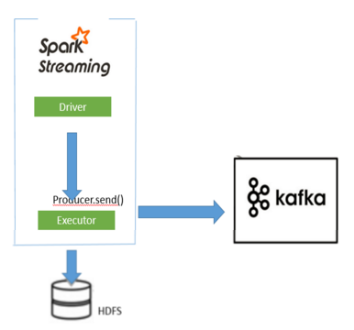



Speed Layer
Batch Layer
HDFS file ETL for batch processing
Twitter
ELT Stack
Indexing
(Logstash)
Storage & Search
(Elasticsearch)
http://abouttrump.stage1.mybluemix.net
Queries
Web UI
(Kibana)

Slide 14
