Slide 1
CIRCLE-AI Circular Innovation Recycling Classification & Learning Engine
LNIP rulez
Subash Ale Magar, Christoph Hartmann, Barbara Aghanenu, James Gray.
Generative AI World Cup 2024: So you think you can hack
Hosted by
Databricks

Slide 2
Problem
Sustainable Innovation at Risk The race for emerging technologies is driving unprecedented demand for specialized materials
🔍 Limited visibility into:
Material composition of new innovations
Recyclability / end-of-life considerations of materials used in emerging tech
⚠️ Critical challenges:
Circular economy goals compromised
Potential environmental impact of new materials
Missed opportunities for sustainable innovation early on in a product life-cycle

Slide 3
Solution
CIRCLE-AI
🤖 Harnesses Advanced AI:
Automated patent analysis
Material identification
Recyclability assessment
📑 Extracts Insights from Patent Data:
Emerging technology development
Material composition patterns
Recyclability methods
🎯 Serves Key Users:
Technology Companies (R&D)
Materials Manufacturers
Recycling Companies
Research Institutions

Slide 4
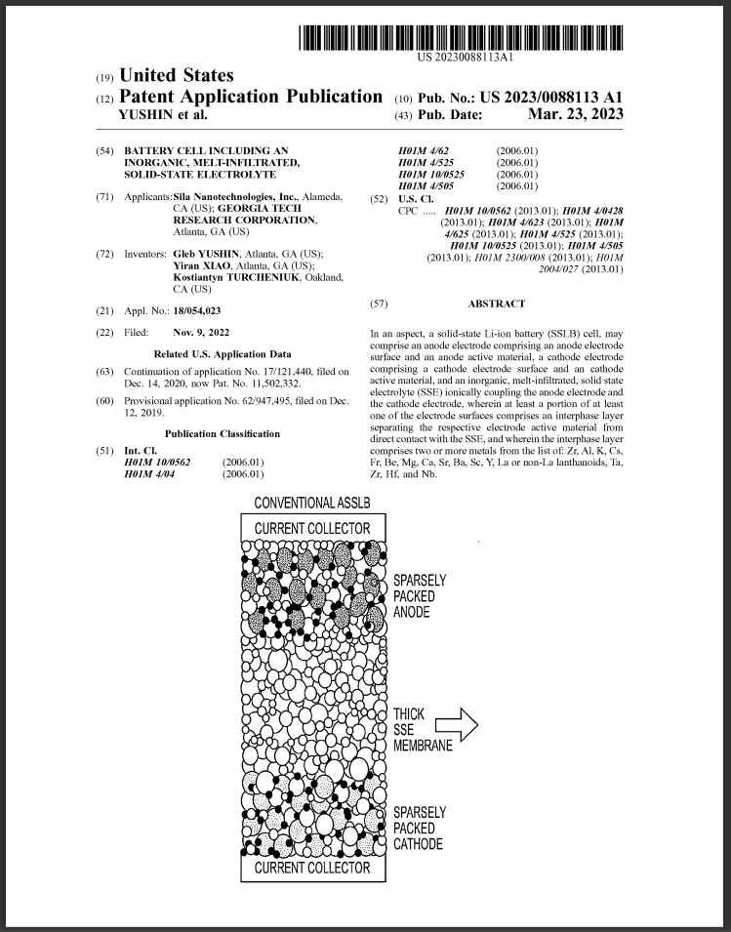

Case Study Solid-State Batteries
Replaces liquid electrolytes with solid materials.
Offers higher energy density, enhanced safety, faster charging.
Currently in development with limited commercial use.
Demo:
CIRCLE-AI Dashboard

Slide 5









Workflow
Databricks Dashboard for Analytics
AI Functions on Databricks
Patent Filtering
US Patent and Trademark Office (USPTO)
Material recyclability Scoring
(LLM 70B)
Filter Patents on CPC codes
Technology classification
(LLM 7B)
CPC codes for hierarchical patent classification

Slide 6

Battery Patent Classification Prompt databricks-mixtral-8x7b-instruct
BATTERY PATENT CLASSIFICATION
Analyze the patent text to determine if it pertains to solid-state batteries, traditional lithium-ion batteries, or if it's an unrelated patent. Look out for the following key indicators in the patent text.
**Key Indicators:**
**Solid-State Batteries:**
- Clear mention of solid electrolytes (ceramic or polymer)
- No separate separator present
- Specific architectures like thin films or bulk solid-state designs- Mention of materials such as LLZO, LAGP, or solid polymer electrolytes
**Traditional Li-ion Batteries:**
- Clear presence of liquid or gel electrolytes
- Mention of separators or membranes
- Reference to anodes, cathodes, or current collectors
- Focus on liquid solvents or polyethylene/polypropylene separators
**Important Notes:**
- Look for explicit and unambiguous mentions of battery type.
- Some patents may discuss hybrid systems; classify as 'unclear' if it's not definitively one type.
- If the patent does not relate to batteries or their components, please classify as 'unrelated'.
- Use all of your evidence at hand to provide a confidence rating of high, medium or low.
**Output JSON Format:**
{
"classification": "solid-state battery" | "traditional lithium-ion battery" | "unclear" | "unrelated",
"confidence": "high" | "medium" | "low"
}
Please strictly adhere to this JSON format and do not provide any additional information.

Slide 7
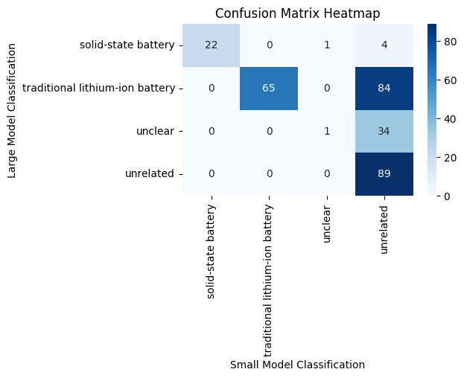
Evaluation Large model: databricks-meta-llama-3-1-405b-instruct Small model: databricks-mixtral-8x7b-instruct

Slide 8
Material Extraction and Recyclability Scoring Prompt databricks-meta-llama-3-1-70b-instruct
The following patent paragraph describes a solid-state battery and its materials. Please identify and extract all materials mentioned that are specifically part of the solid-state battery. Ignore any materials that do not belong to the solid-state battery.
For each solid-state battery material, generate a key-value structure as JSON, with the following fields and just give json response only.
Key: 'material_name'
Value: The name of the material.
Key: 'material_recycle_score'
Value: Rate the general ability to recycle this material on a scale of 0 to 10. A score of 0 means this material is usually not recycled and is discarded, 5 means about 50% of this material is typically recycled, and 10 means nearly all of this material is generally recycled.
Key: 'material_recycle_score_reason'
Value: Explain the rationale for the assigned recycling score based on general recycling trends or challenges related to this material.
Key: 'patent_recycle_score'
Value: Rate the specific recycling methods or procedures described in the patent for this material, on a scale of 0 to 10. A score of 0 means no recycling methods are mentioned, 5 means an established method is described, and 10 means a new or innovative recycling method is presented.
Key: 'patent_recycle_score_reason'
Value: Explain why you gave the patent recycling score, referencing how the material's recycling is handled in the patent.

Slide 9

What’s next? CIRCLE-AI Future Plans
Standardise materials (remove duplicates/typos) to facilitate a robust analysis of outlier (rare) recyclable materials.
Identify alternative materials (recyclable for low/non-recyclable).
Conduct an in-depth analysis of innovative recycling methods.
Analyse the co-occurrence of materials (what materials are often patented together) to reveal those that might need co-recycling solutions.
Expand patent data coverage to include a longer period for tracking the trend of emerging technologies, such as solid-state batteries.
Compare technologies by authority, country, or company (currently, China is leading in battery technology).
Identify companies that consistently achieve high recyclability scores and those that regularly publish patents on innovative recyclable materials or recycling methods.

Slide 10
Thank You https://github.com/jamesgray0353/CIRCLE-AI

