Slide 1
dPlay
Powered by Deezer and Sony Xperia
James Hanson | Pontus Johansen | Robert Helmbro

Slide 2
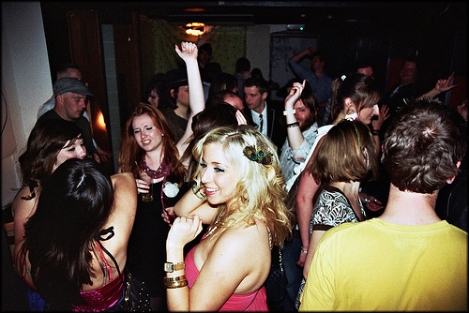

Slide 3
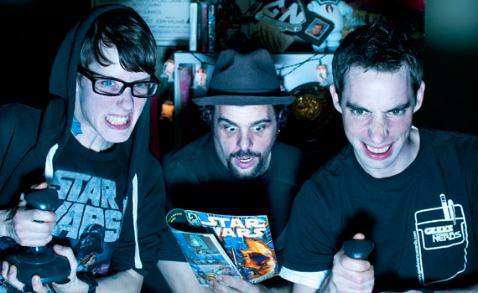

Slide 4
- One single playlist
- Everybody can add songs
- Everybody can vote
- The song with mosts votes is played next
- If only one song is added
It is played on repeat
dPlay

Slide 5
tinyurl.com/dplays
dPlay

Slide 6
dPlay
Powered by Deezer and Sony Xperia
James Hanson | Pontus Johansen | Robert Helmbro

