Slide 1
IU Group Update
Doug Edmonds (Co-PI) & Jake Gearon (PhD Candidate)
Feb 15, 2024

Slide 2
Goal: assess levee elevation profiles from 2 data sources
NLD: National Levee Databse, profiles available on website -> likely from initial construction (but unconfirmed!)
3DEP: USGS 1m contiguous bare-earth lidar product.
Method: get profile data from NLD API -> sample at every point from the original profile and compare profiles

Slide 3
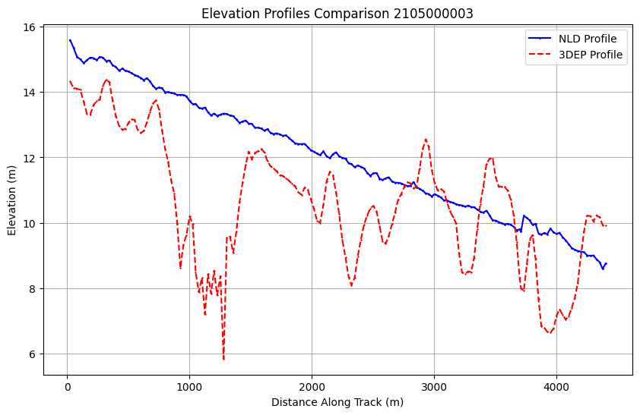
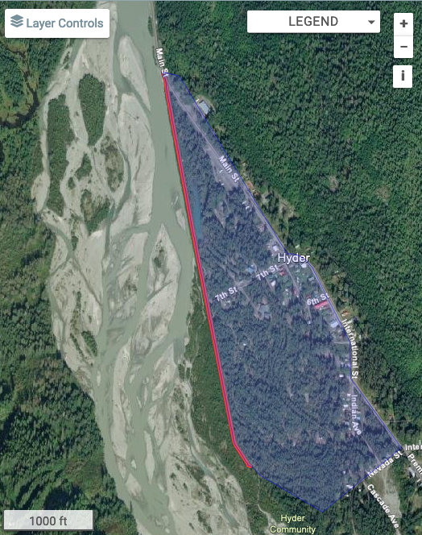
Hyder, AK. Salmon River Levee: Alaska District. Built 1962
“…This quick moving water has historically damaged the levee by eroding the side slopes and displacing the protective rock on the river side. The population of Hyder is approximately 40 people. The levee does not tie into high ground, and as a result, shallow flood waters would likely flow around the levee before overtopping it…”

Slide 4
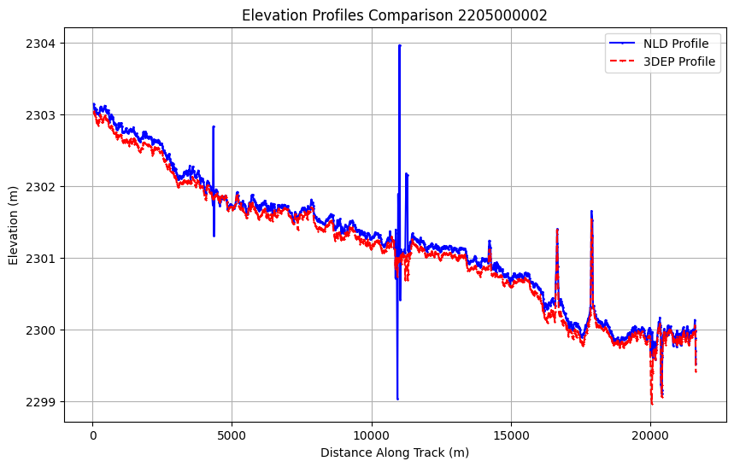
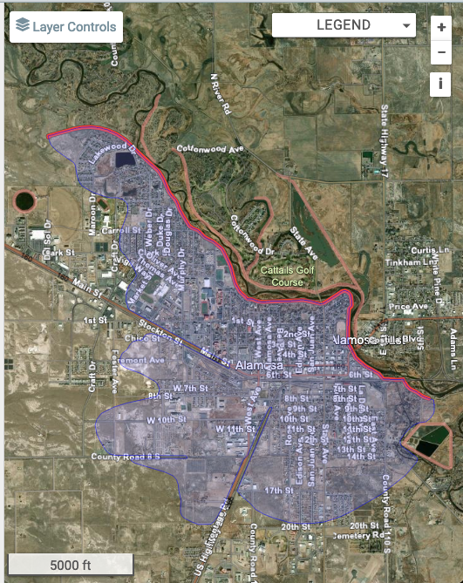
Alamosa, CO. Alamosa Levees, Rio Grande. Right Levee: Albuquerque District. Built 1998
“…The levee is not anticipated to perform well under a full flood loading event due to concerns with embankment seepage, stability, and unpermitted encroachments. The primary issues are related to the presence of non-compliant large woody vegetation, animal burrows, and limited dedicated access for flood fighting. The levee has been historically loaded to about 25% of the levee, which presents some uncertainty as to how the levee will perform under a full flood load…”
2205000002

Slide 5
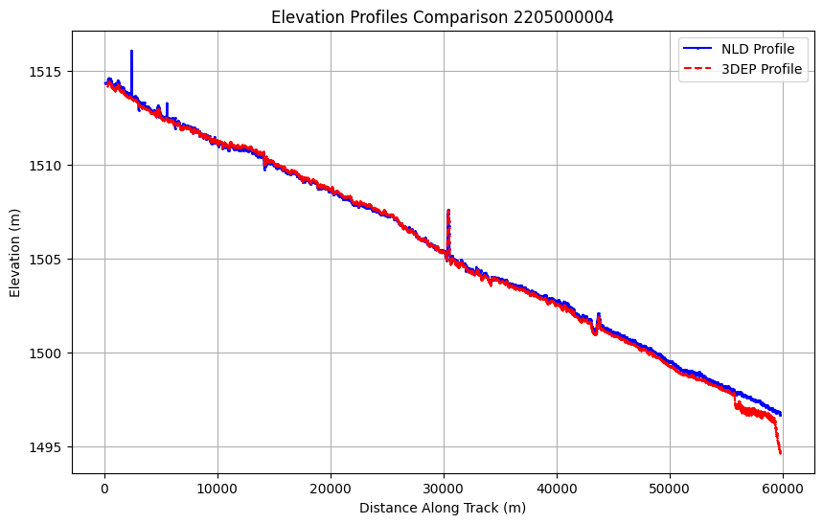
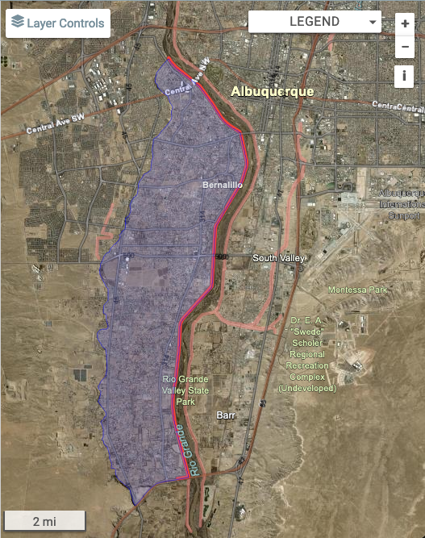
Albuquerque, NM. Alb. Middle Rio Grande, West Levee,. Albuquerque District. Built 1956
the risk … is considered to be Moderate for Prior to Overtopping and Low for Overtopping. Estimated life loss numbers are 18 and 30 for Overtopping and Breach Prior to Overtopping events respectively, with potential economic consequences estimated to be over $2 Billion.

Slide 6
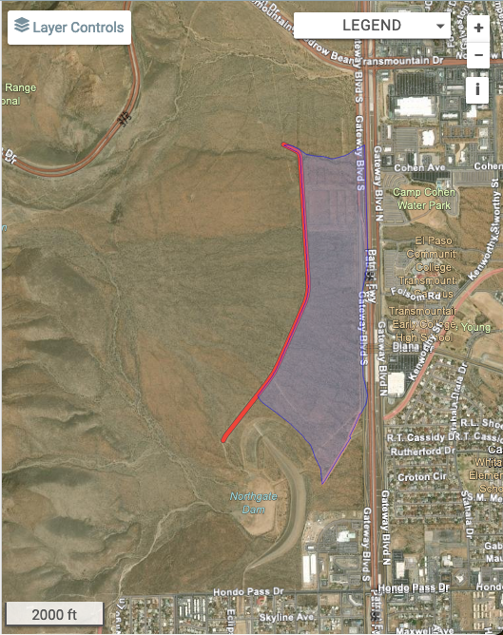
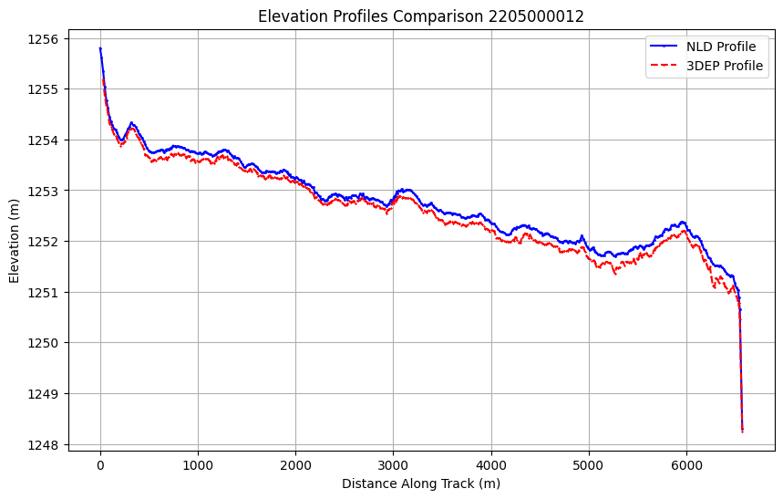


El Paso, TX. Central El Paso Northgate Interceptor Ch Levee. Albuquerque District. Built 1973
Alluvial fan
… unexploded ordinances have washed down from The Ft Bliss Military Reservation into the arroyos that feed the channel, the city has not been able to perform maintenance since 2011 and the Corps has not inspected since 2010…” !!!!

Slide 7
Moving forward
We want to contact a geodesist to inquire about possible datum/geoid mismatches.
Also want to contact someone at NLD or Army Corps who has information on when NLD profiles were generated
Once we have figured the above out: all USACE levees can be investigated. We will automate change detection to spot levees where damage has occurred between the time of the original profile and the 3DEP data (2010 –present)

