Slide 1
Inputs
Bootstrap
Message
Contacts
Nickname
Cloud Prep
Build
Inputs become parameters
Create cloud-based networks, routes, public IP addresses, etc
Create VM-Series firewall
Bootstrap VM-Series firewall
Telemetry
Observe deployment
Observe VM-Series firewall status
Report back
etc

Slide 2
Project
Network
Internet Subnetwork
Web Subnetwork
Database Subnetwork
Storage Bucket
Trust NIC
Untrust NIC
Untrust Public IP
Mgmt NIC
Mgmt Public IP
Bootstrap Config
VM-300

Slide 3
Subscription
VNET(s)
Subnet(s)
VM-Series
Resource Groups
Network Interface(s)
Public IP(s)
Storage Account

Slide 4


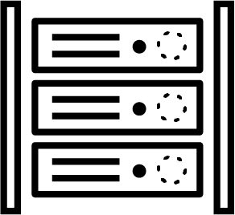



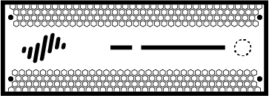






Panorama
Database
Web Server
Request
Bootstrap
Automation
& Templates

