Slide 1
Application of ANCOVA in Analyzing Profitability Between Market Industries
James Hopham

Slide 2
Background
Financial Markets
Sectors
Basic Materials, Communication Services, Consumer Staples, Healthcare, Information Technology, Financials, Real Estate, Consumer Discretionary, Industrials, Utilities, Energy
Industries
Stocks
Shares
ETF
Market Capitalization: (stock price)(#shares outstanding)

Slide 3




Slide 4

Project Data
FIN 425 - Student Investment Fund
Capital IQ
Large-Cap
X > $14.5 billion
Mid-Cap
$5.2 billion < X < $14.5 billion
Small-Cap
$850 million < X < $5.2 billion
Publicly Traded
Operating
Major U.S. Exchanges
Sectors: Information Technology and Healthcare

Slide 5
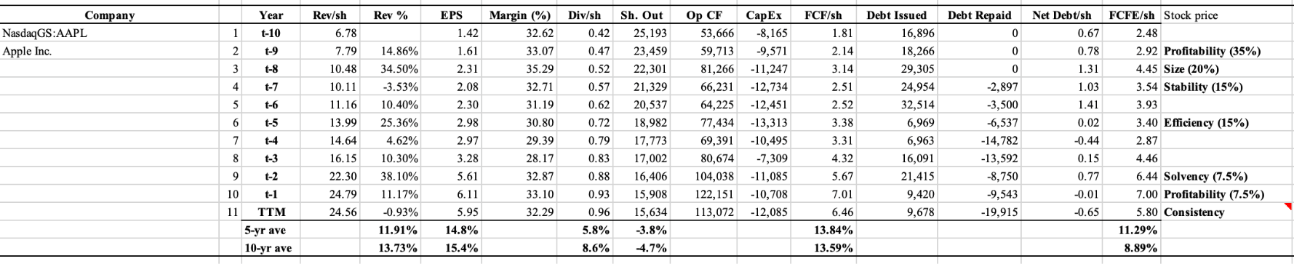
Dataset

Slide 6
Dataset
Relative Valuation
EPS = (Earnings) / (Shares Outstanding)
PE = (Stock Price)/(EPS)
Based on capital expenditures
Net Income (e.g. Earnings)
Retained Earnings
Dividends or Stock Buyback
Issue: includes both cash and non-cash items
E.g. Misrepresentation of income with interpretation of timing of AR and AP, and depreciation/amortization

Slide 7
Dataset
Operating Cash Flow
Net Income + (Non-Cash Expenses) - (Non-Cash Revenue)
Excludes non-cash items for both tangible and intangible assets
Depreciation
Amortization
AR, AP
Free Cash Flow
(Operating Cash Flow) - (Full Value of Capital Expenditures)
E.g. all leftover cash
Does not get influenced by non-cash item manipulation
Value will be high at early stages of a company
FCFE = (FCFE) / (shares outstanding)
E.g. we will use average of 6 years for (stock price)/FCFE

Slide 8
Dataset
Enterprise Value
(Value of Equity) +(Debt) - Cash
Some people use EV/EBITDA
Stability:
(Value of Next Year Dividend) / ( (Constant Cost of Equity Capital) - (Constant Growth Rate in Perpetuity) )
Efficiency
Earnings Conversion
(6-year Average EPS) / (6-year Average Revenue)
True ROA
(6-year Average FCFE) / (Tangible Assets)
Margin
Debt Load
(6-year Average Net Debt) / (6-year Average FCFE)

Slide 9
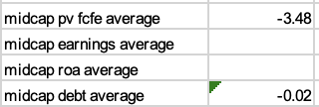
Data Wrangling
Original Dataset: 534 rows and 30 columns
Final Dataset: 487 rows and 6 columns
Missing Data
Drop rows missing too much data
Small Cap
Take local averages of companies in same market cap size

Slide 10
Data Wrangling
Drop EV/EBITDA
Too hard to evaluate between market caps bc of variability in small caps so better to consider profitability using p/fcfe
Drop 10-year margin
Too many issues

Slide 11
Initial Model
H₀: There is no difference in means of profitability among the different market industries
Response Variable:
Profitability
Terminal P/FCFE
Main Effect
Primary Industry
Blocking Factor
Market Cap
H_{a}: There exists a difference in means of the profitability of a company among the different market industries
Covariates:
Solvency
Debt Load
(6-year Average Net-Debt)/(6-year Average FCFE)
Efficiency:
Earnings Conversion
(6-year Average EPS) / (6-year Average Revenue)
True ROA
(6-year Average FCFE) / (Tangible Assets)

Slide 12
Summary Statistics
 | Hardware | Health Care Equipment and Services | Pharmaceuticals, Biotechnology and Life Sciences | Semiconductors | Software
Counts | 66 | 103 | 127 | 54 | 137
Unbalanced

Slide 13
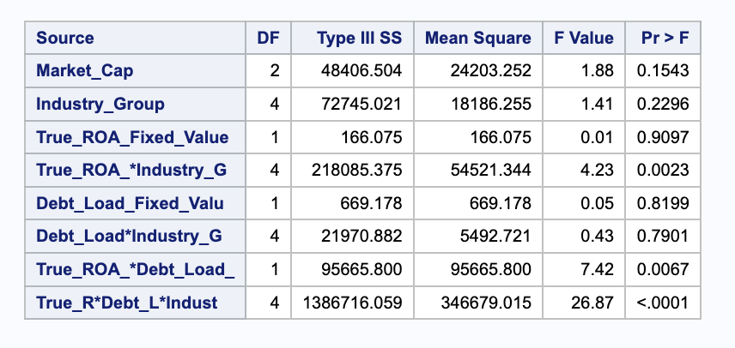
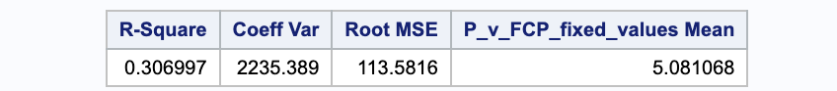
Results

Slide 14
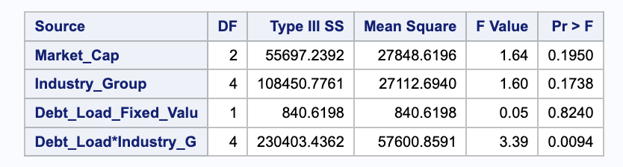
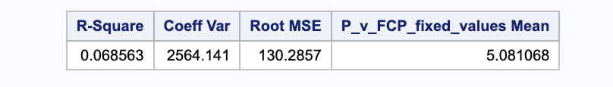
Results
Remove True ROA

Slide 15
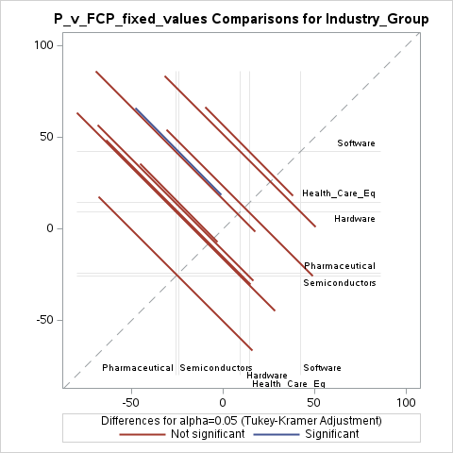
Results

Slide 16
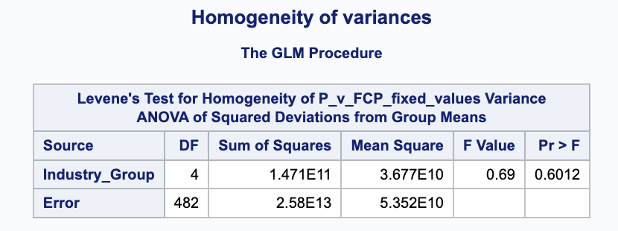
Testing Assumptions

Slide 17
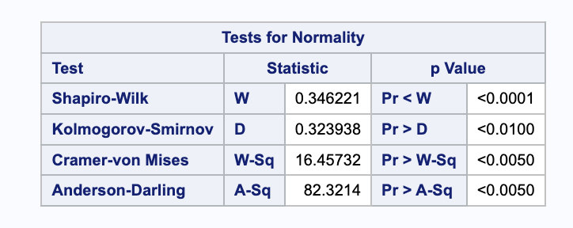
Testing Assumptions

Slide 18
Interpretation/Further Study
Fail to reject the null; there is no significant difference in profitability among the individual sectors
Further Study for Stock Strategies
Portfolio Optimization
Black-Scholes Model
New Metrics
Time-Series
Markov Chains

Slide 19
Works Cited
https://www.investopedia.com/terms/c/costofequity.asp
https://www.bench.co/blog/tax-tips/depreciation
https://www.techtarget.com/whatis/definition/CAPEX-capital-expenditure#:~:text=A%20capital%20expenditure%2C%20or%20Capex,to%20foster%20its%20future%20growth.
https://corporatefinanceinstitute.com/resources/accounting/capital-expenditures/
https://www.capitaliq.com/ciqdotnet/login-sso.aspx?bmctx=05D50DFC1A22D156FEC7A630EB2EFA98&enablePersistentLogin=true&OAUTH_SSO_ENC_KEY=C57DBB5C08DA42B6E90C86AF0C895A9B1C0828BB0FD48E2881852858161950DE&password=secure_string&OAUTH_TOKEN_RESPONSE=header&contextType=external&IS_OAUTH_OAM_SSO_LINK_ENABLED=true&OAUTH_SSO_ID_DOMAIN=SPGLBDomain&IS_OAUTH_USER_ASSERTION_ENABLED=true&OverrideRetryLimit=0&env=WAM12C&username=string&challenge_url=https%3A%2F%2Fwww.capitaliq.com%2Fciqdotnet%2Flogin-sso.aspx&request_id=8857730127184226432&authn_try_count=0&locale=en_US&resource_url=https%253A%252F%252Fwww.capitaliq.com%252FCIQDotNet%252Flogin.aspx

