Slide 1
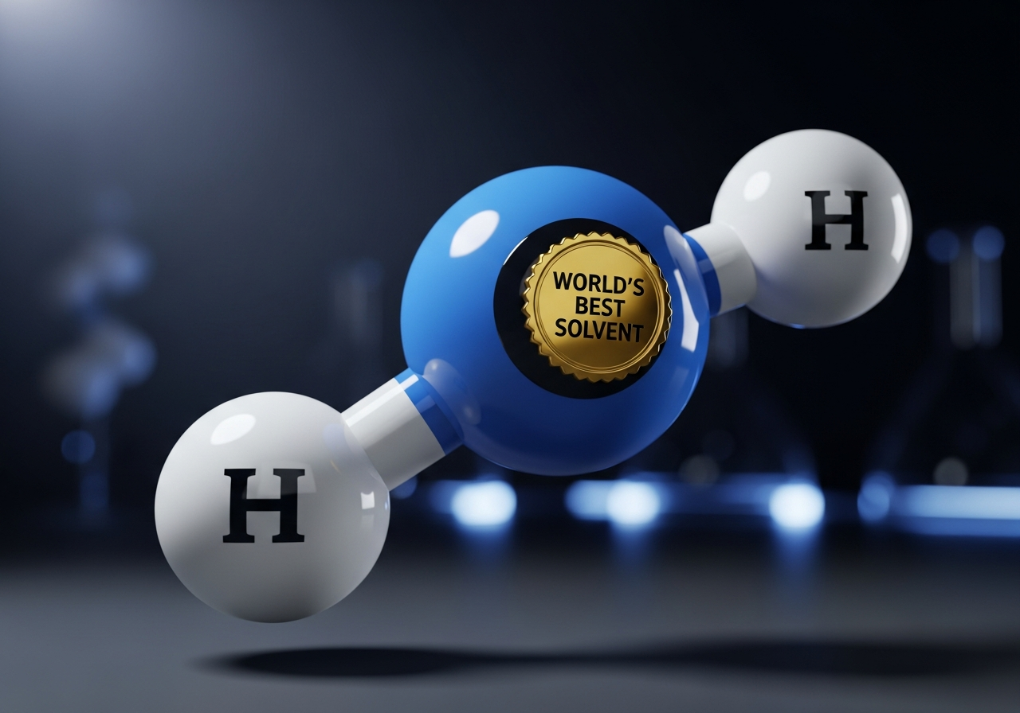
Water: Life's High-Energy, High-Drama Solvent
You are 70% water, 100% curious, and about to discover why the most common molecule on Earth is actually a physical anomaly.

