Slide 1
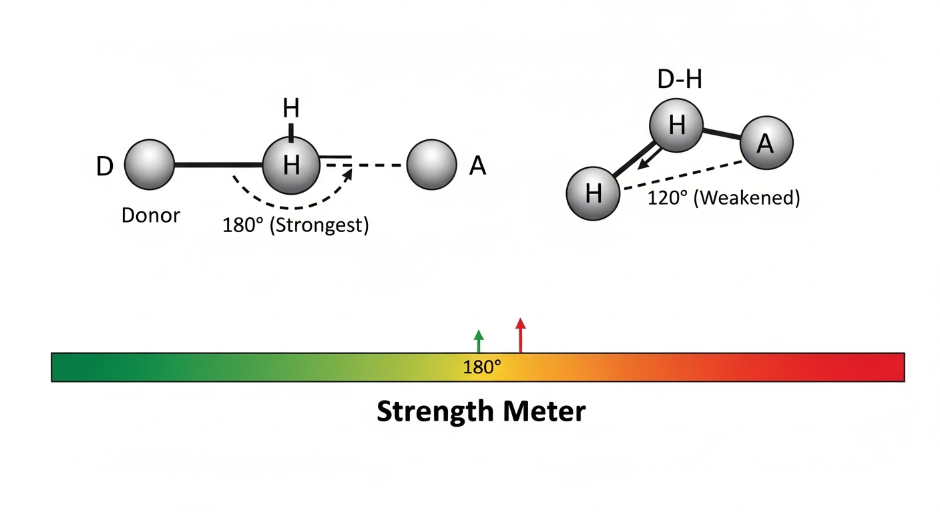
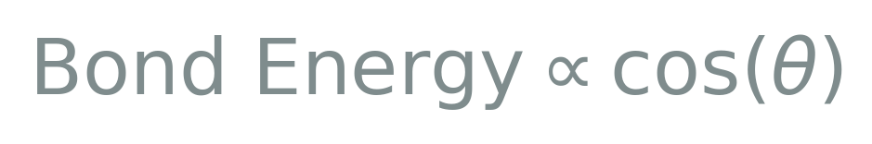
Directionality: The 180° Rule
H-bonds are geometric perfectionists. Maximum strength occurs only when the Donor-H-Acceptor alignment is collinear.

