Slide 1
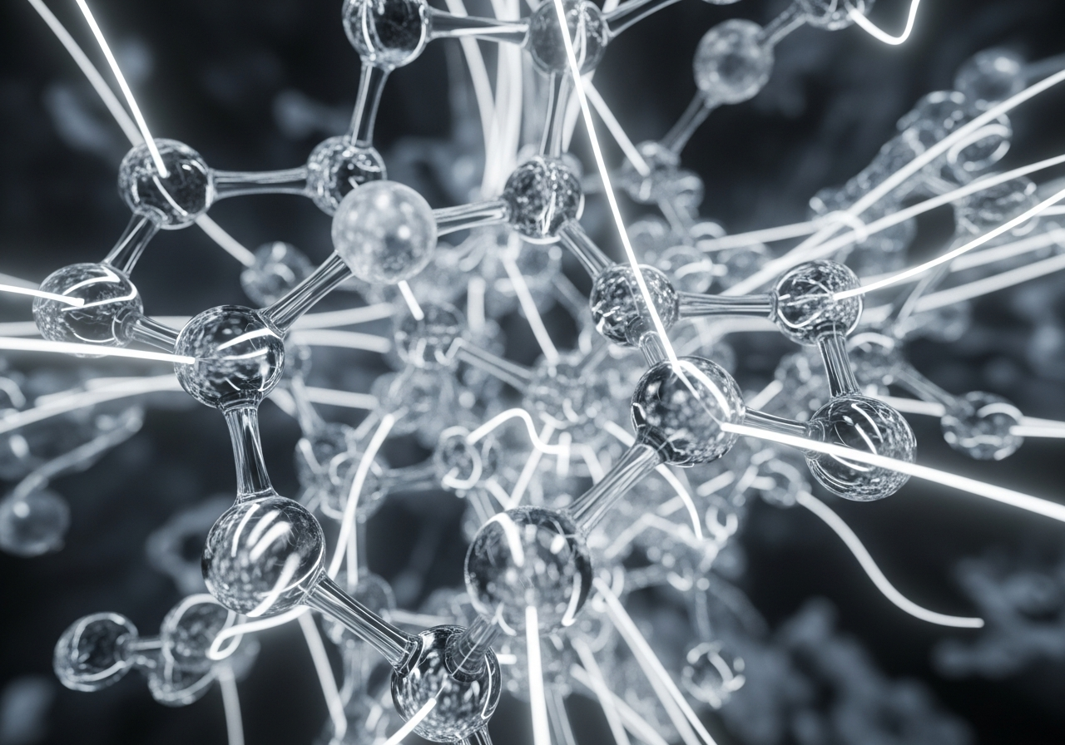
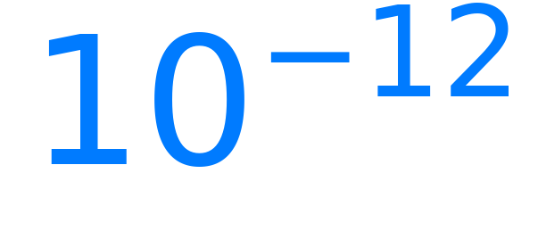
The Picosecond Lifetime
Liquid water is a series of short-term commitments. Bonds break and reform every...
...seconds in a constant molecular shuffle.
FAST FORWARD
▶▶

