Slide 1
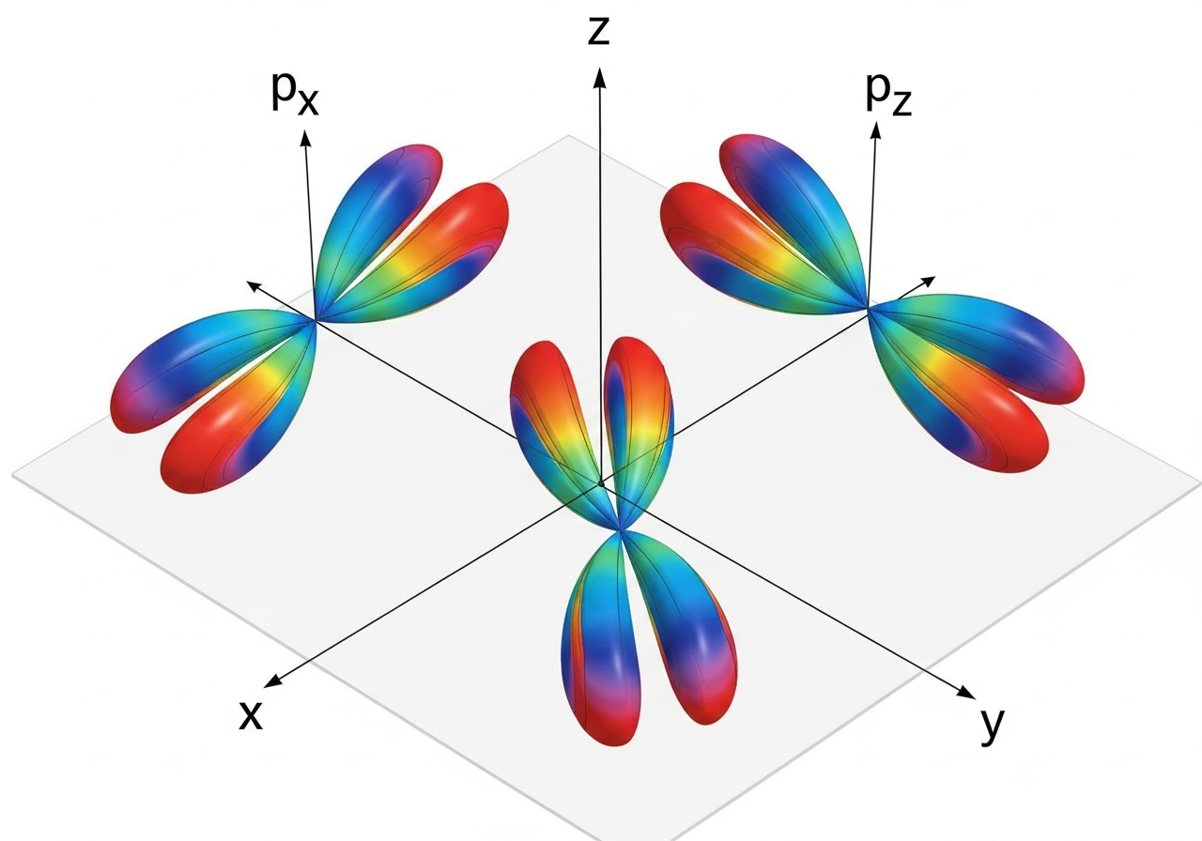
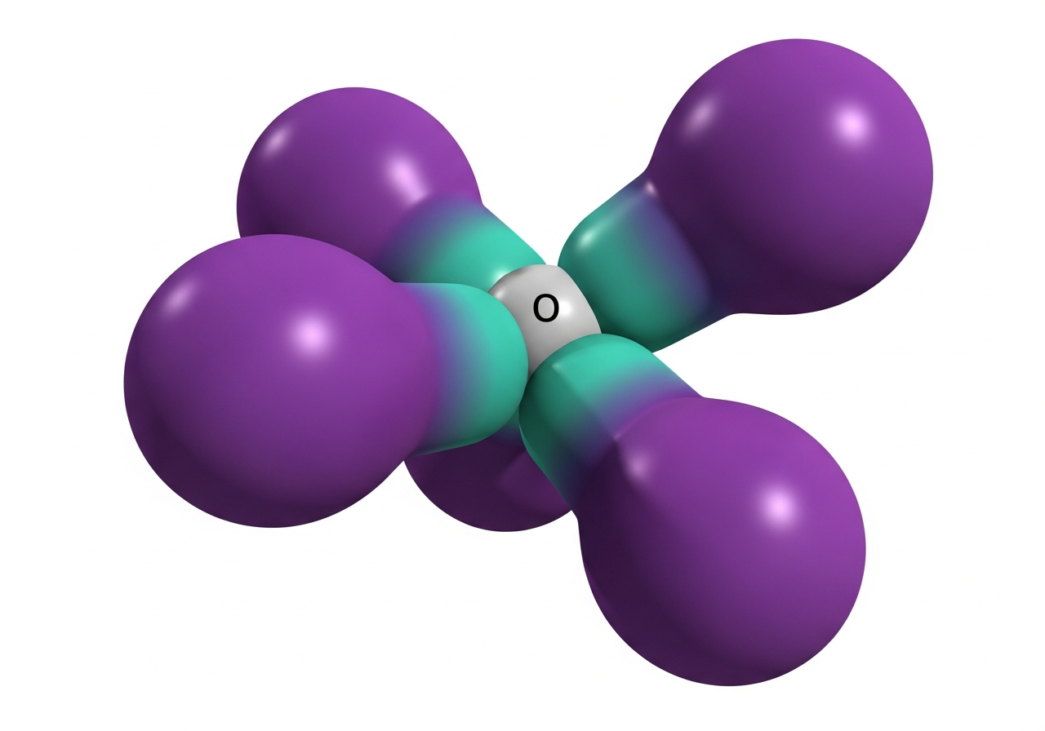
Beyond the Basics: sp3 Hybridization
Oxygen's 1s² 2s² 2p⁴ configuration doesn't stay in its lane; it hybridizes into four sp³ lobes to prepare for molecular bonding.
Standard Atomic P-Orbitals
Tetrahedral sp3 Hybridized Lobes

