Slide 1
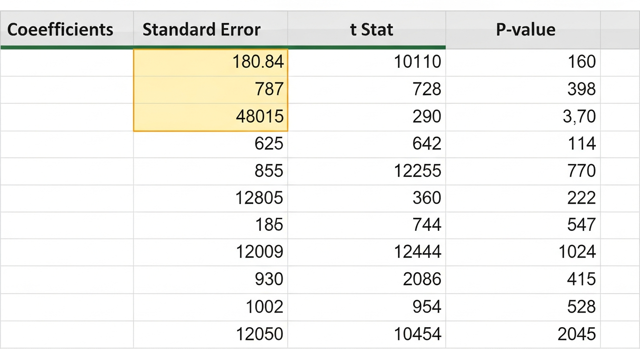
Spotting the Slope in Excel
• Ignore the scatterplot; focus on the 'Coefficients' table. • Identify the row corresponding to your specific input variable. • The value in the Coefficient column is your slope.

