Slide 1
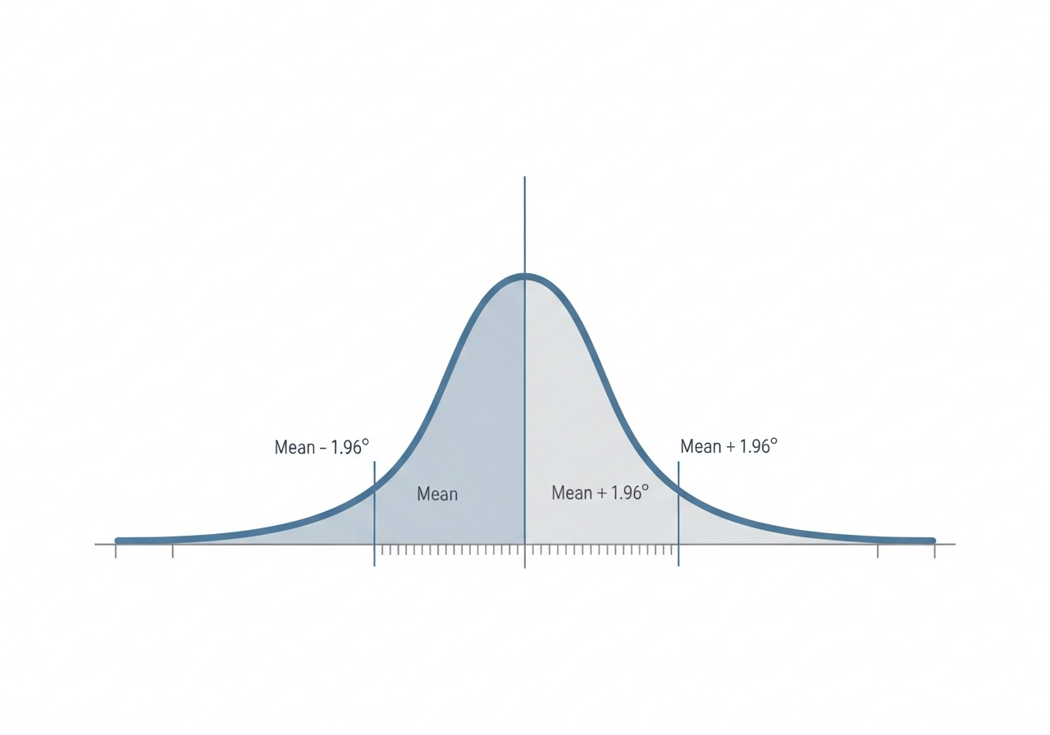
The Confidence Interval: An Error Margin
• Regression results are estimates, not absolute truth • Confidence Interval is a 'Range of Reliability' • Think of it like a weather forecast range

