Slide 1
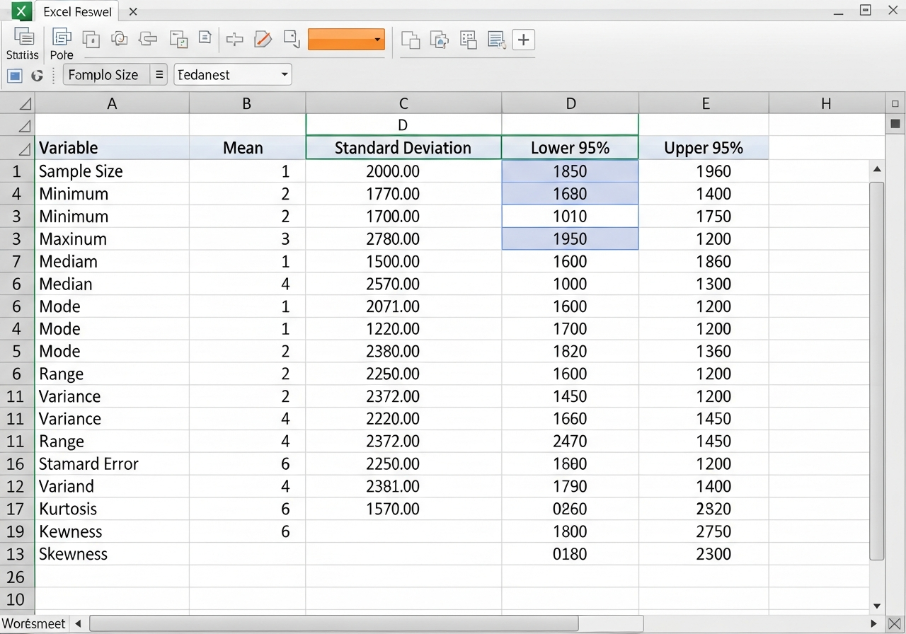
Reading Bounds from Software
1. Locate the 'Lower 95%' and 'Upper 95%' columns. 2. Follow the row of your chosen variable. 3. Extract the boundary values for your report.

