Slide 1
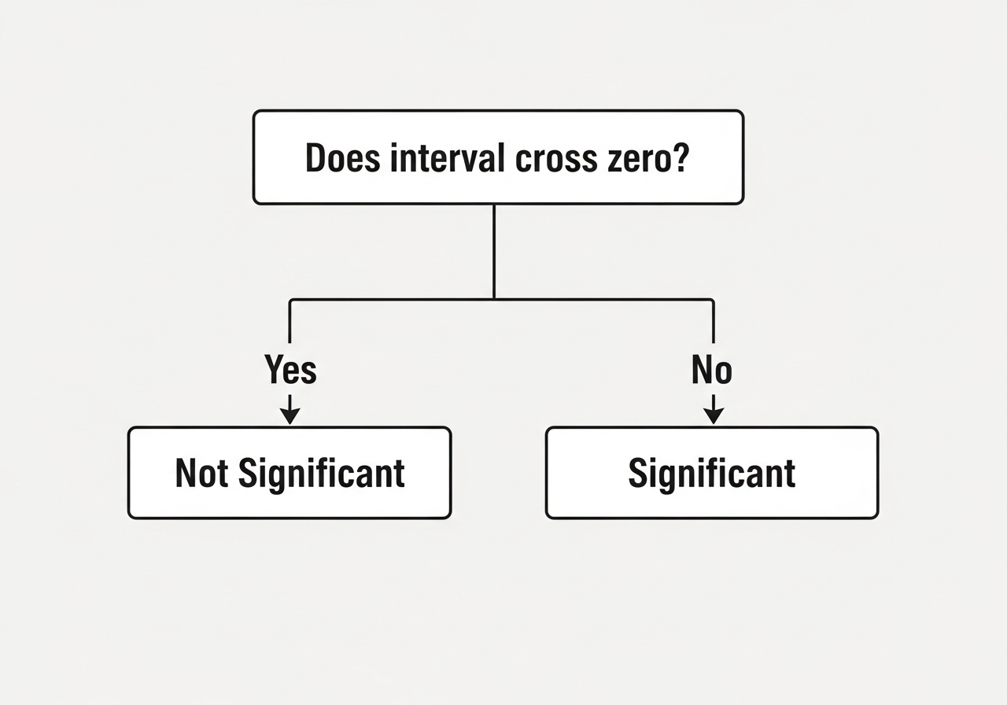
The Zero Rule
• Zero represents 'No Effect' • If the interval includes zero, the variable is likely just noise • If it stays positive or negative, the relationship is statistically significant

