Slide 1
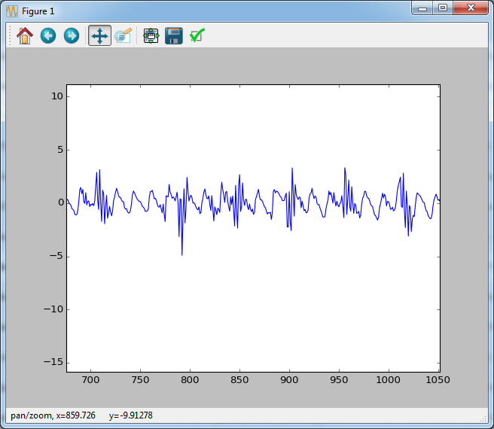
Example ICP signal
PUT THIS SLIDE AROUND WHERE WE TALK ABOUT THE DATA!

Slide 2
Your paper:
Regression analysis for peak designation in pulsatile pressure signals !!!!!
I have been doing symbolic regression with Genetic Programming
- A type of machine learning/AI where the algorithm writes its own algorithms to solve a problem.

Slide 3
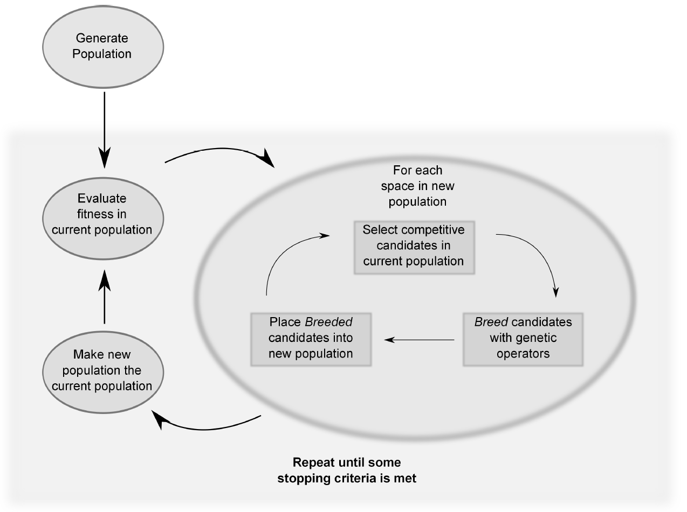
Generate a population of random solutions to a problem
See how fit they are
Pick reasonably good solutions and breed them together (keep doing this until we replace the population)
Goto 2.

Slide 4
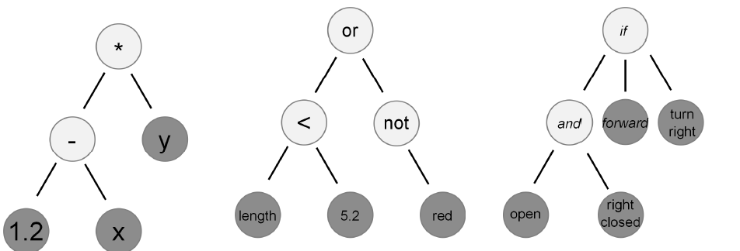

Slide 5
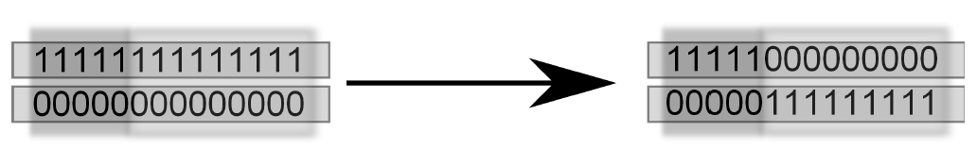
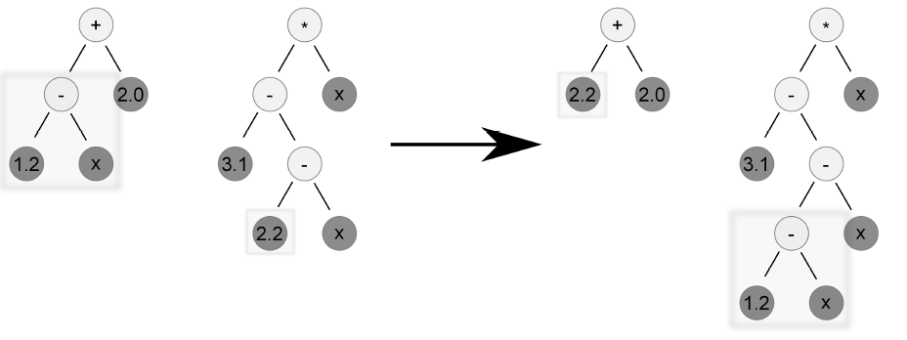

Slide 6
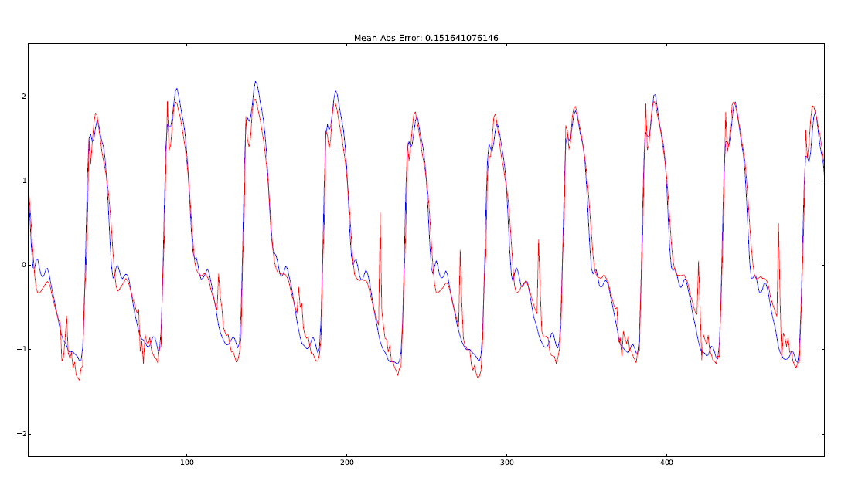

Slide 7
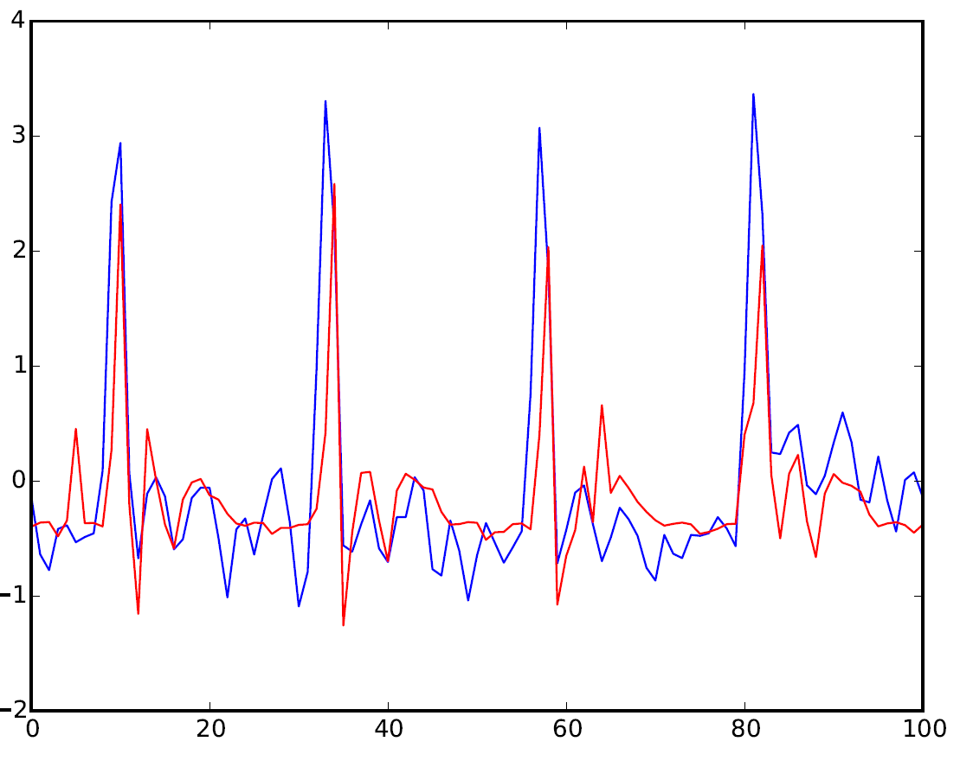

Slide 8
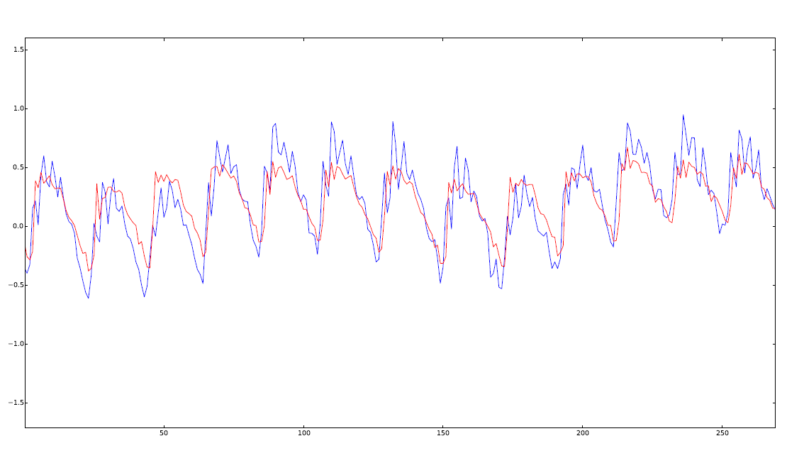
Mind the low frequency noise here too

Slide 9
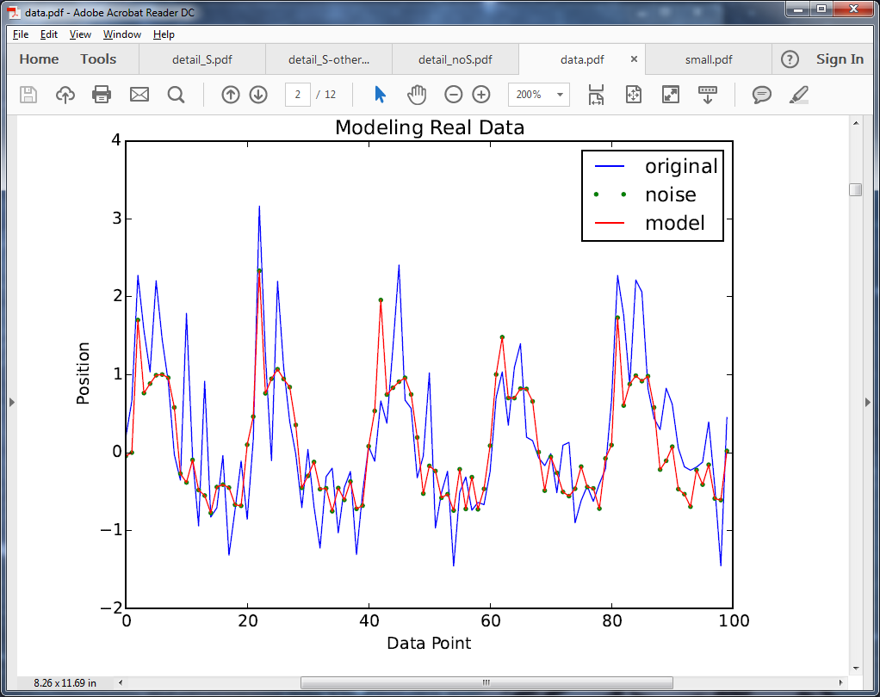
Overfitting?

Slide 10
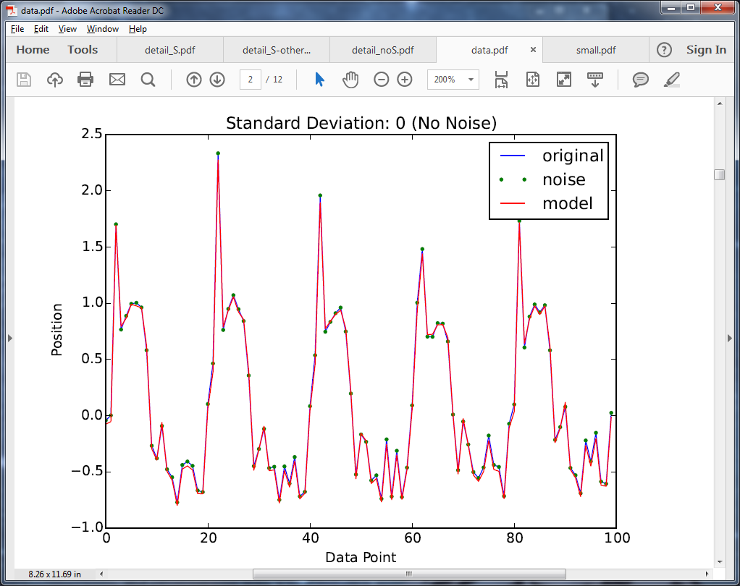
Overfitting?

Slide 11
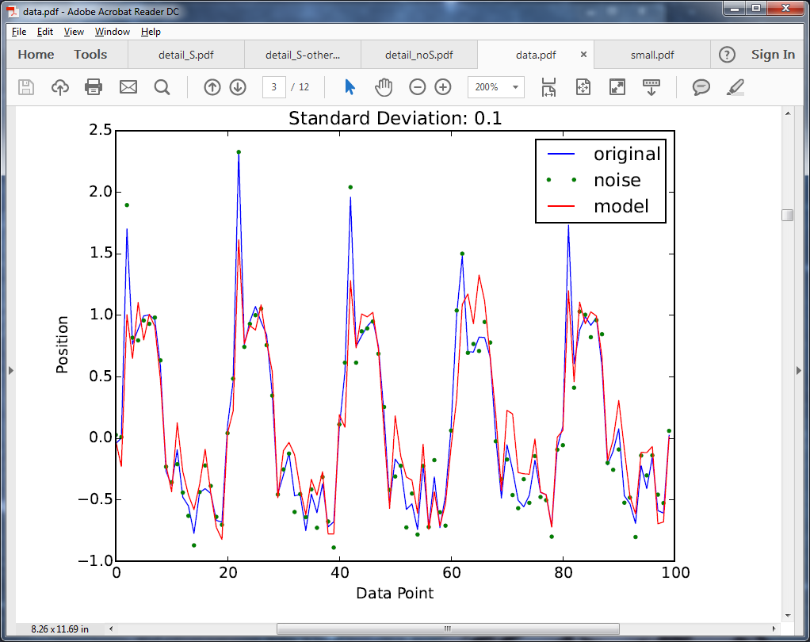
Overfitting?

Slide 12
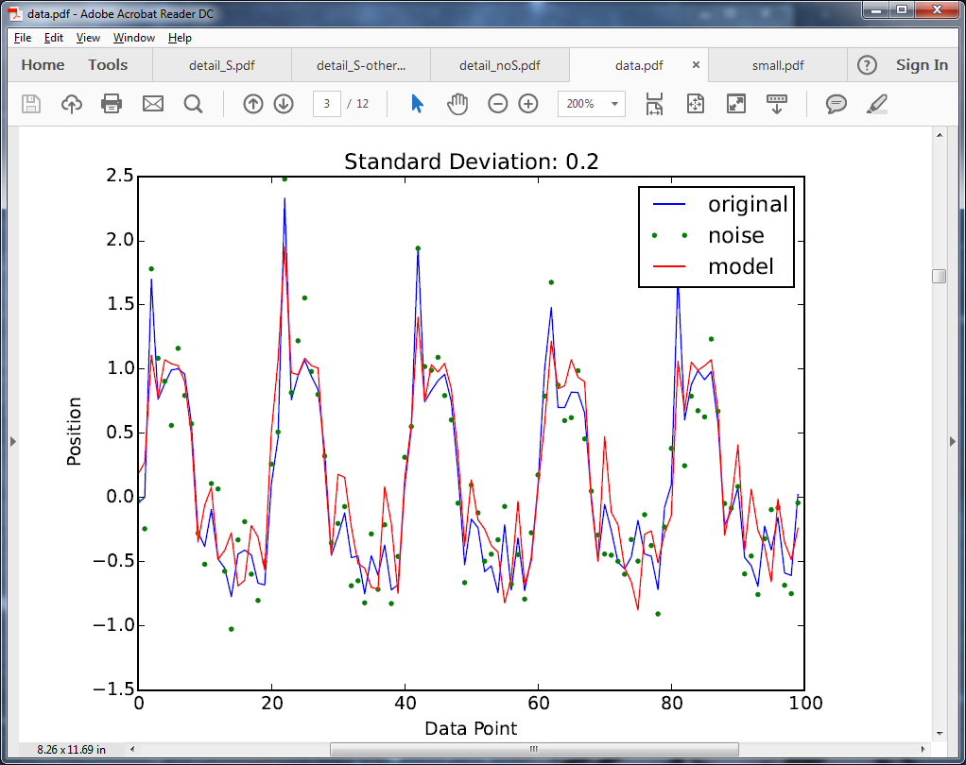
Overfitting?

Slide 13
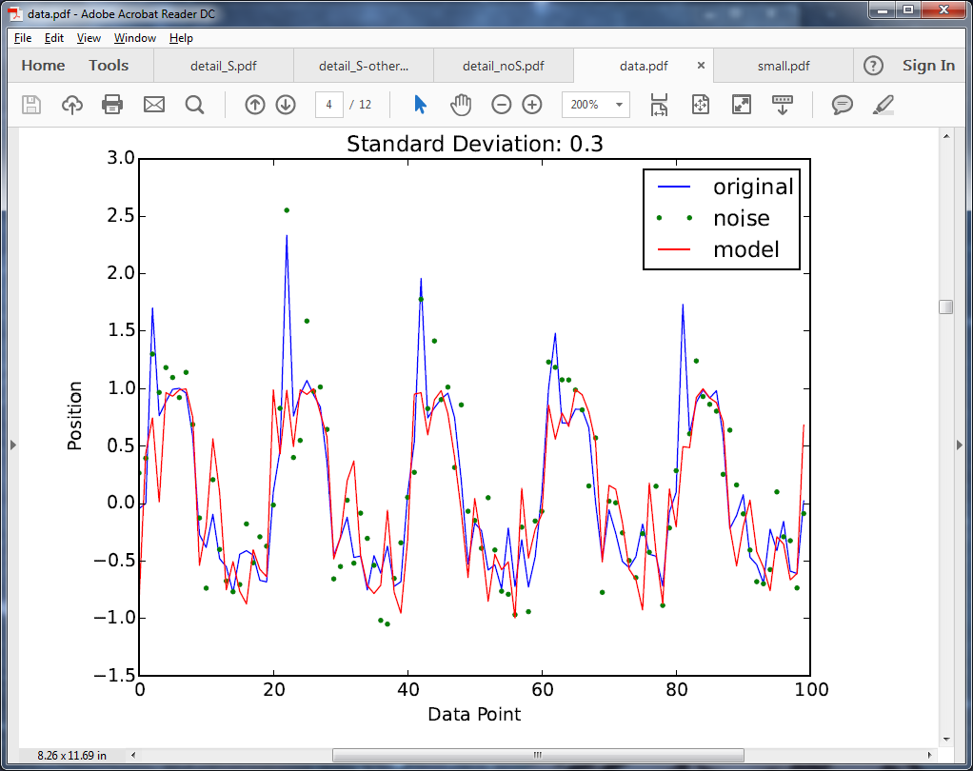
Overfitting?

Slide 14
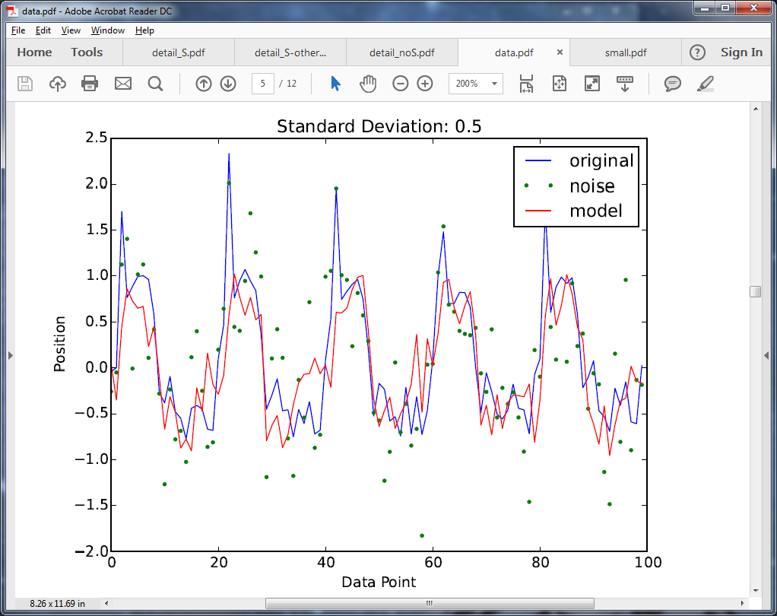
Overfitting?

Slide 15
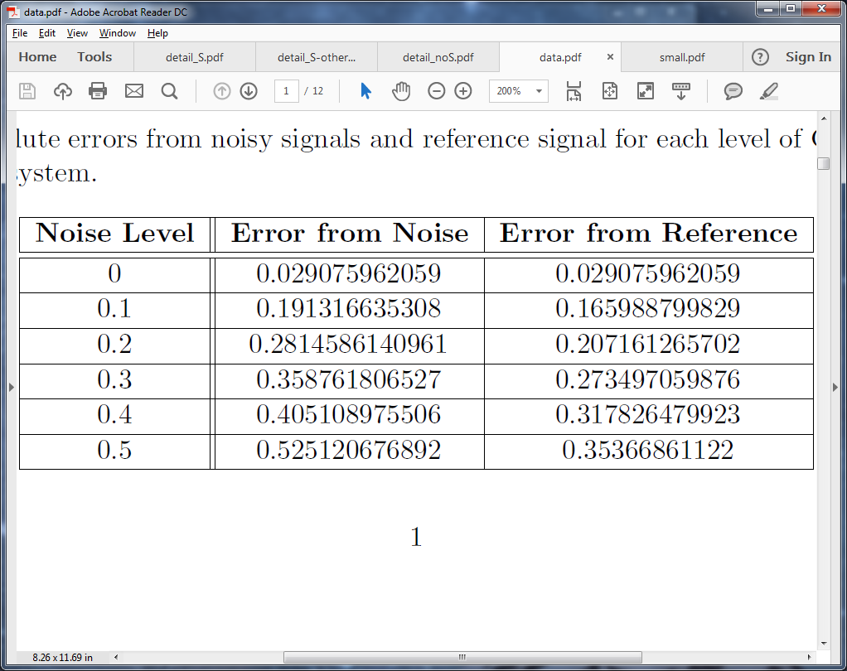
Overfitting?

Slide 16
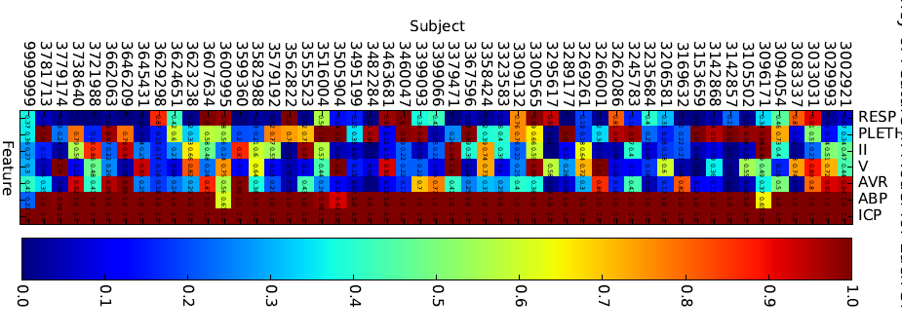
Features

Slide 17
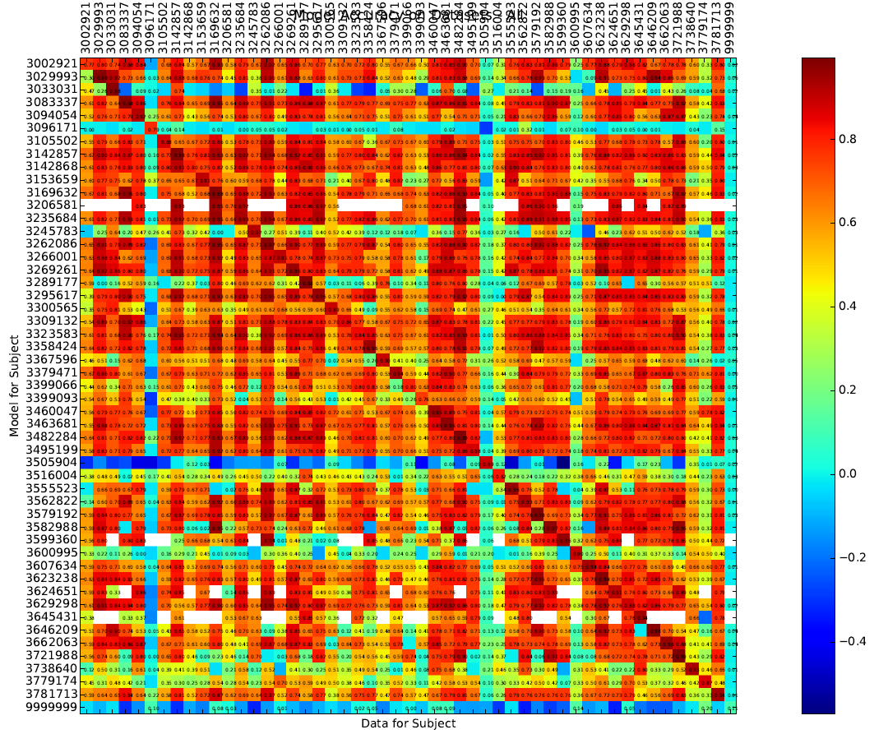

Slide 18
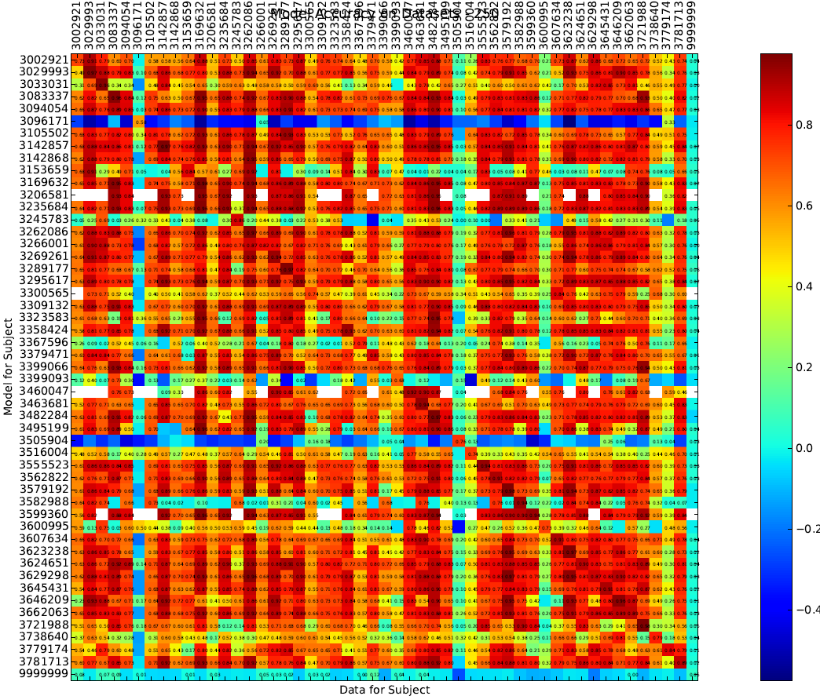
Also did some on subsets of data to see how well the models would generalize. Seemed to work.
This was 250 time points only

Slide 19
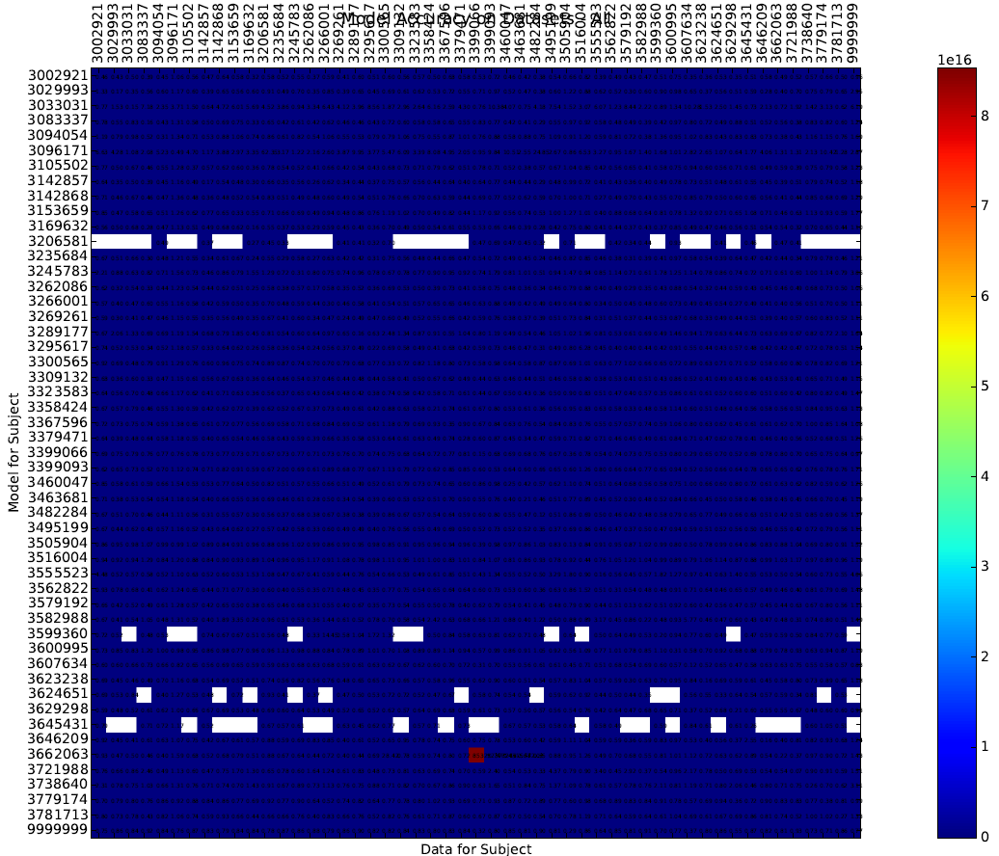
Same as before, but instead it was Mean Absolute (maybe squared, I don’t remember) Error instead of correlation.
I did have a version of these where I just cut out the really bad ones, but I seemed to have misplaced them.

