Slide 1
Nine 2 Nine
We open when they close
Hugh Graham, Dawit Gelan, Victoria Summers

Slide 2
Products and Services
Coffee: very caffeinated, lightly caffeinated and decaf
Tea
Cookies/Brownies
Soup/Sandwiches
Breakfast food: Muffins, Pastries, and Coffee Cake
Study Items: Notebooks, Pencils, Pens
Novelty Items: Mugs, T-shirts

Slide 3
Products and Services Cont.
Free Wireless Internet
10 Desktop Computers
Open 9 pm to 9 am
Two Sections
Study Area – Computers, Desks, and Well Lit
Night Owl Area – Tables and Chairs, Couches, Coffee Tables, and TVs

Slide 4
Online Products and Services
Coffee and Tea Products For Sale
Novelty Items for Sale – Mugs, T-shirts, and Baseball Hats
Online Events Bulletin Board – It is a information exchange area about upcoming events, meetings and other events.

Slide 5
Target Customers Storefront
Students: Crammers and Late Night Studiers
Night Shift Workers: Example Nurses, Police
Early Risers
Night Owls

Slide 6
Target Customers Online
Coffee Enthusiasts
Novelty Item Shoppers

Slide 7
Marketing Strategy Storefront
Rewards Card – Frequent/loyal customers who receive one free cup of coffee for every ten purchased.
Fliers – informational advertisements that include items, such as the menu, hours of operation, and services.
Near Campus Location – Business location within walking distance of campus (within a mile radius).
Discounted Refill Prices on Specialty Drinks – Specialty drinks receive a 10% discount on refills.

Slide 8
Marketing Strategy Online
Online Advertisement – Advertise our company on other websites (ex. Facebook)
Online Coupons – First time online buyers receive a 10% discount on purchases on 30 dollars or more.
Online Rewards Program – Frequent buyers receive a free novelty item for every 100 dollars spent.
Mass Customization of Coffee Blends – Customers have an option of creating their own blends of coffee from choices available.
Review Our Business Page – Customers can post reviews about online or storefront products and services.

Slide 9
Online Metrics
Visit: Stickiness – Measures the length of time that visitors spend on the website.
Page Exposures – The number of times a web page is viewed by visitors in a given time period.
Click-Stream Data Metrics - Number of registrations filled out per 100 visitors.

Slide 10
Web 2.0 Technologies
Gripe – Word of Mouth Power
ZiXXo – Web-Based Coupon Creation
PopFeedBack – Popup Short Survey

Slide 11
Web 2.0 Technologies
“Gripe harnesses your word of mouth power to get complaints with any business or service provider heard and resolved, likely on the spot.”
We plan on using this technology to field customer complaints or praise, and use this information to better our company.
http://www.go2web20.net/site/?a=gripe
“ZiXXo creates a web based coupon creation, management and syndication network that enables businesses to reward favorable behavior by local customers.”
We plan to create an online coupon that customers can receive and use discount coupon for visiting our website.
http://www.go2web20.net/site/?a=zixxo

Slide 12
Web 2.0 Technologies
Popup Feedback allows the user to learn about customers by placing a one question survey on any page of their website. This allows the business to obtain valuable information while making the survey convenient and easy for the customer to respond to.
We plan on using this technology to create two, one question survey to ask customers which coffee blend they like best, and how good the customer service is on a scale of one to ten.
http://www.go2web20.net/site/?a=popfeedback

Slide 13
CRM Software
Name of Product: Sage SalesLogix CRM
Name of Company: Sage
Award-winning Sage SalesLogix is the CRM solution that enables businesses to acquire, retain, and develop profitable customer relationships by increasing sales and marketing performance and maximizing customer satisfaction and loyalty

Slide 14
Sage Features:
Sage Features
Campaign Management
Marketing Automation
Segmentation & Groups
Lead Management
Web Lead Capture
Lead Qualification
Workflow Automation
E-mail Marketing
Campaign Response Tracking
Campaign Task Management
Budget & Revenue Tracking
Campaign Reporting (ROI)
Marketing Resource Library
Windows & Web Access

Slide 15
PROS:
Perfect for small to medium-sized businesses
Sage SalesLogix provides organizations with the Freedom of Choice to select the access methods (Windows, Web, and /or Mobile) best suited for their teams, without sacrificing functionality, usability, or robust customization capabilities.
Middle market pricing – not too expensive
Extremely customizable
Straight forward integration
This web-based customer relationship management software can be accessed by any computer or wireless handheld device, making it the most convenient and useful tool used by companies across the nation and around the world.
CONS:
Doesn’t work well with internet explorer
Scalability – working on improving it

Slide 16
Companies Using Sage ABC Bus Companies INC Avnet BlueCross BlueShield of Tennessee Blue River Technologies Conferon Grant Thomton Harbor Capital Advisors INC Heritage Log Homes LEGOLAND® California NuStone Distribution Co. Octane Fitness SEI Investments The Seattle Times Co. USCO

Slide 17
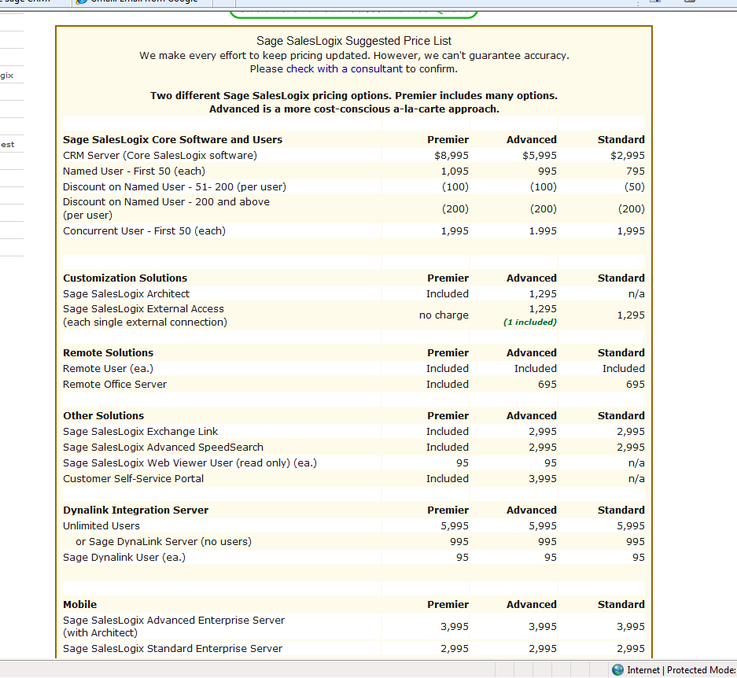
Pricing for Sage Software

Slide 18
Intended Use:
Forecast and monitor sales
E-mail marketing: send advertisements and buying incentives
Resolve customer issues efficiently and effectively
Use dashboards to obtain valuable information about the company so that it can improve upon its weaknesses and customer relations
Business alerts used to notify employees and management on business decisions and changes.
Budget and revenue tracking
Use metrics to evaluate company’s performance, customer needs and satisfaction, and respond accordingly

Slide 19
References
Baltzan, P., & Phillips , A. (2010). Information Systems. New York: McGraw - Hill Irwin.
(2010). Retrieved October 5, 2010, from Pop Feedback: http://www.go2web20.net/site/?a=popfeedback
(2010). Retrieved October 5, 2010, from gripe beta word-of- mouth is powerful: http://www.go2web20.net/site/?a=gripe
(2010). Retrieved October 5, 2010, from ZiXXo beta : http://www.go2web20.net/site/?a=zixxo
Sage SalesLogix Review. (2010). Retrieved November 5, 2010, from Compare CRM: http://www.comparecrm.com/crm-vendors/sage/sage- crm.php
Why Choose Sage CRM. (2010). Retrieved November 5, 2010, from Cornerstone Consulting: http://www.cornerstone1.com/index.cfm?meter=590
Sage SalesLogix Price List. (n.d.). Retrieved November 5, 2010, from Blytheco: http://www.blytheco.com/saleslogix/price.asp

