Slide 1
Horoscopes
And Pop culture

Slide 2
overview
Description
Zodiac signs/Horoscope diagram
Where in pop culture do we find horoscopes
Difference between everyday horoscopes and astrology horoscopes

Slide 3
What are Horoscopes
An astrological forecast of a person's future.
a diagram of the positions of the planets and signs of the zodiac at a particular time and place.

Slide 4
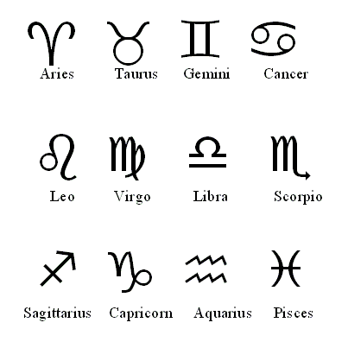
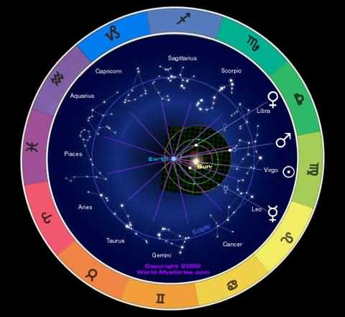
Horoscope Diagram and signs

Slide 5
Horoscopes in pop culture
Magazines
Newspaper
Internet
Celebrities
T.V. shows and movies
Notes:
Give examples for each…

Slide 6
Everyday Horoscopes Vs. Astrology Horoscopes

Slide 7
Everyday horoscopes
Everyday
Found in news papers and magazines
Very broad
Sometimes just made up

Slide 8
Astrology Horoscopes
Astrology
A reading of the planets and stars under which you were born.
Usually very specific

Slide 9



People, countries and Maths as seen by Class V

Slide 10
Average height and weight of pupils across the classes (in cm and kg respectively)

Slide 11
Distribution of boys and girls across the involved classes

Slide 12

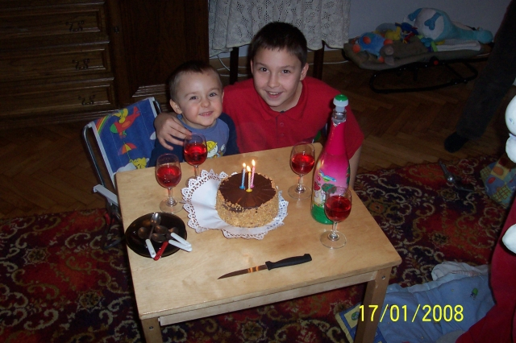
Name: Jedrek
Zodiac sign: Aries
Height: 142 cm
Weight: 38 kg
People, countries and Maths
Hello!
My name is Jedrek. I'm 12 years old and I'm in class 5. My favourite singer is "Crazy Frog".
I like football, volleyball, swimming. My favourite food is chicken, chips, hamburgers and pizza. I don't like fish, spinach and tomato juice. I'm interested in films. My favourite film is "The Lord of the Rings''. I have got a guinea pig. I call it Fredek.

Slide 13
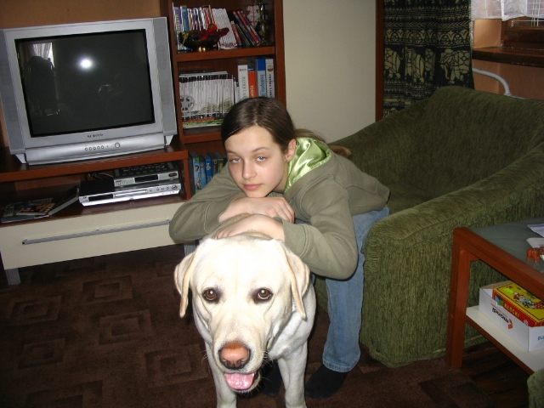
Name: Julka
Zodiac sign: Gemini
Height: 156 cm
Weight: 35 kg
People, countries and Maths
Hello!
My name is Julia. I’m 12. I live in Warsaw/Poland. I like basketball, swimming, skiing, snowboarding, karate and skating. I love animals and music. Pop, R and B as well as Rap are my favourite music genres. I’ve got a dog Nero. My favourite school subject is English. I hate classical music, riding books, Maths and people who are bad for animals. I’m scared of spiders. My e-mail is simensa50@wp.pl.
Cheers!

Slide 14
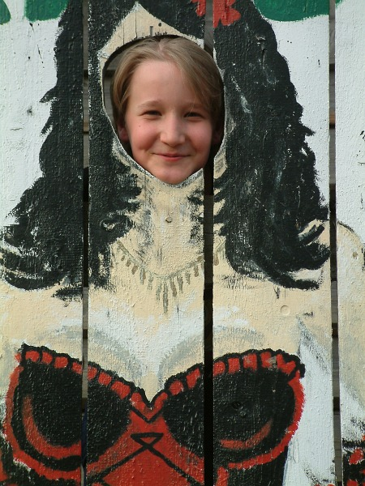
Name: Mikolaj
Zodiac sign: Scorpio
Height: 150 cm
Weight: 50 kg
People, countries and Maths
Hello!
My name is Mikolaj.
I’m from Poland. I’m 12 years old and I’m in class 5.
My hobby is collecting stamps. My favourite sport is football.

Slide 15
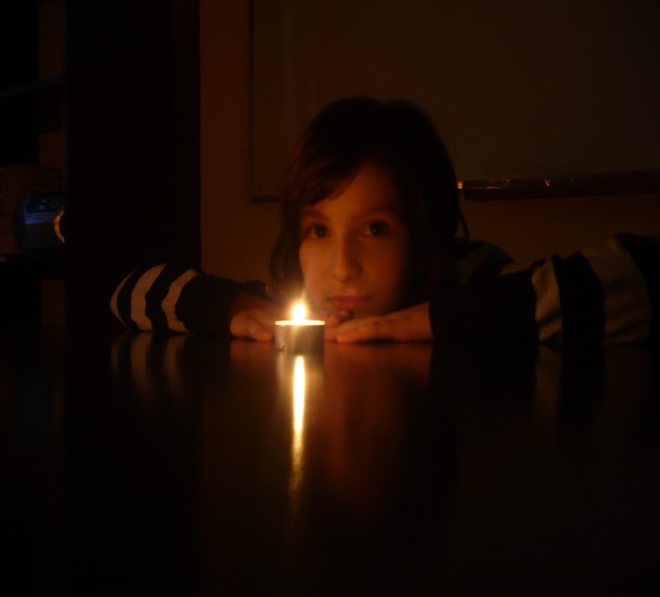
Name: Paulina
Zodiac sign: Scorpio
Height: 140 cm
Weight: 32 kg
People, countries and Maths
Hello!
My name Is Paulina. I live in Warsaw. I like animals and sports. I have two dogs and two cats.
My favourite school subject is English. I’m crazy about clothes and roller blades. I’m not very keen on Maths. I hate raisins!
My favourite food is sushi.
Drop me a line at paulinawb@op.pl
Skype : paulina.wb
Cheers!!! ☺ ☺ ☺

Slide 16
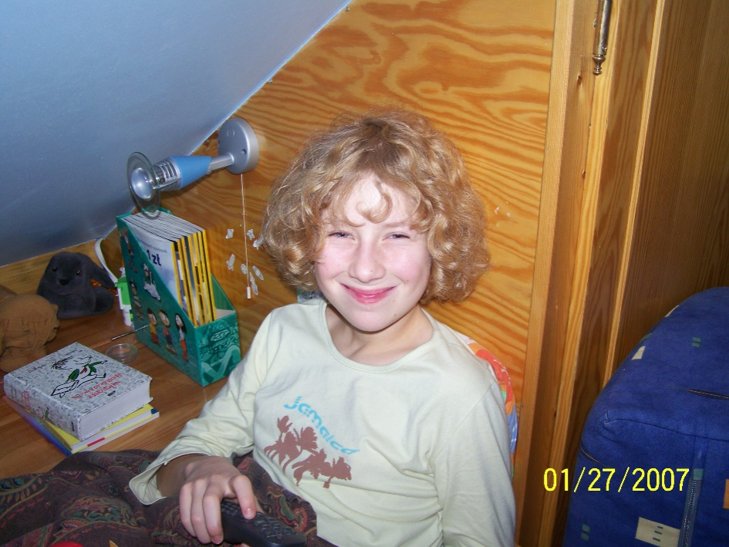
Name: Marianna
Zodiac sign: Aries
Height: 154 cm
Weight: 39 kg
People, countries and Maths
Hi!
My name is Mania. I’m 12 years old.
I love playing tennis and computer games. I’ve got a pet Puma and Kacperek. My cats love eating and sleeping.
I’m crazy about peanuts in chocolate. I’m not very keen on raisins and icing. I’m not a huge fan of our IT teacher. I have a lot of friends.
Drop me a line at gufo69@interia.pl
Cheers!

Slide 17
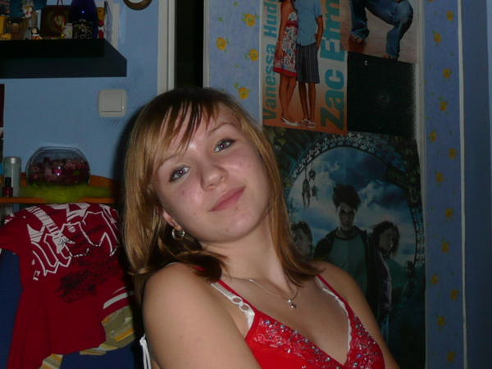
Name: Justyna
Zodiac sign: Gemini
Height: 164 cm
Weight: 55 kg
People, countries and Maths
Hi!
My name is Justyna. I’m 12 years old. I live in Warsaw, Poland. My favourite sport is swimming.
I love it! I’m crazy about clothes. I’m not very keen on football.
I like singing and dancing.
Drop me a line at Justa.j@onet.eu
Skype: rudamurzynka
Cheers!

Slide 18
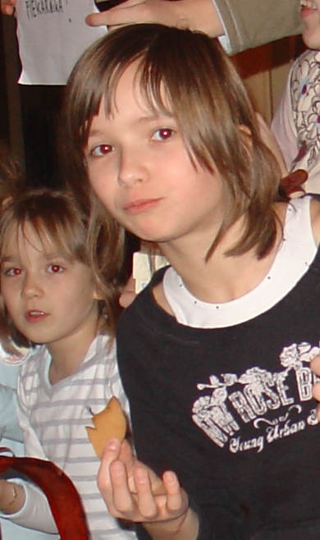
Name: Karolina
Zodiac sign: Virgo
Height: 151 cm
Weight: 37 kg
People, countries and Maths
Hi!
My name is Karolina. I`m 11. I live in Warsaw/Poland. My hobby is skiing and snowboarding. My favourite colours are black and green. My favourite subject is Science. My favourite countries are England and Spain. My favourite clothes are jeans and T-shirts. My favourite food is fast food and my favourite drink is Coke. I like raisins. I like my hamster Nela. I`m not very keen on school.
Drop me a line at ranczowilkowyje1@wp.pl
Cheers! ☺

Slide 19
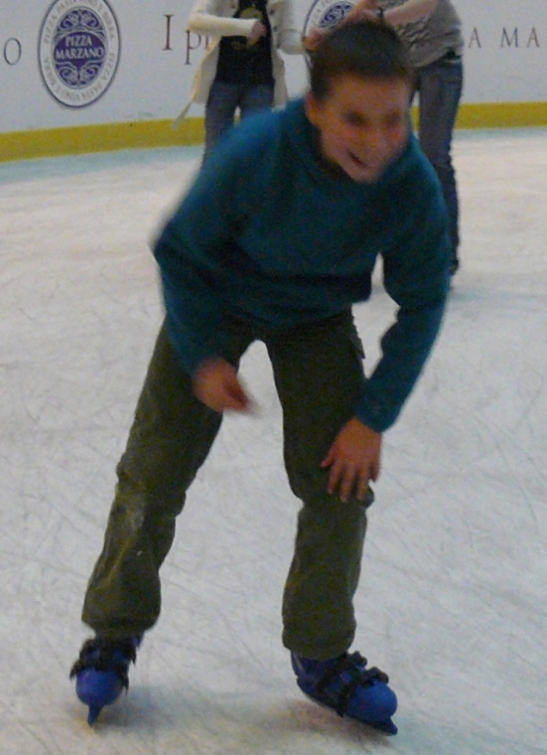
Name: Marcin
Zodiac sign: Leo
Height: 150 cm
Weight: 46 kg
People, countries and Maths
Hi!
My name is Marcin. I'm 11 years old. My favourite sport is fotball and I play for a school team. I live in Warsaw, Poland. My favourite colour is black.
I have two dogs. I'm not wery keen on Maths. I'm intrested in sports.
I like swimming. I swim for a school team. My favourite school subject is English.
My e-mail address is lampard0@autograf.pl
Cheers.

Slide 20
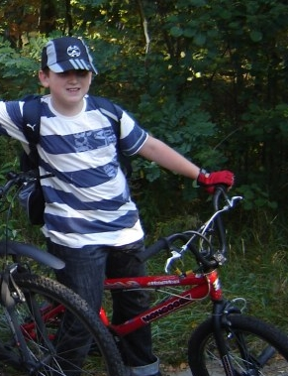
Name: Adam
Zodiac sign: Libra
Height: 155 cm
Weight: 52 kg
People, countries and Maths
Hi!
My name is Adam. I live in Warsaw/Poland and Southfields/England. I'm 11 years old. My favourite hobby is sport and photographyclasses with a teacher Thomas. I've got two dogs called Roksa and Raper and I have a guinea pig named Kaoru. I'm crazy about raisins in chocolate.
Drop me a line at Fidler523@wp.pl
Hope to see you soon ;)

