Slide 1
Learning resource aware planning strategies for continuous wireless monitoring
James Long
PhD Candidate
Department of Civil and Environmental Engineering
Massachusetts Institute of Technology

Slide 2
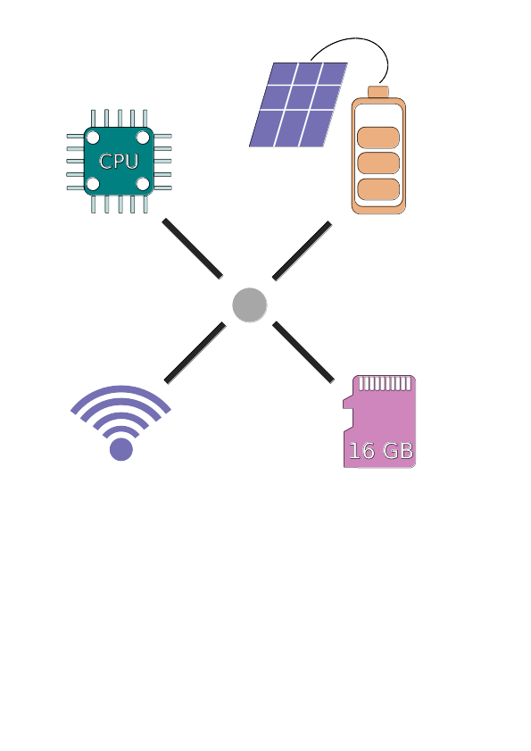
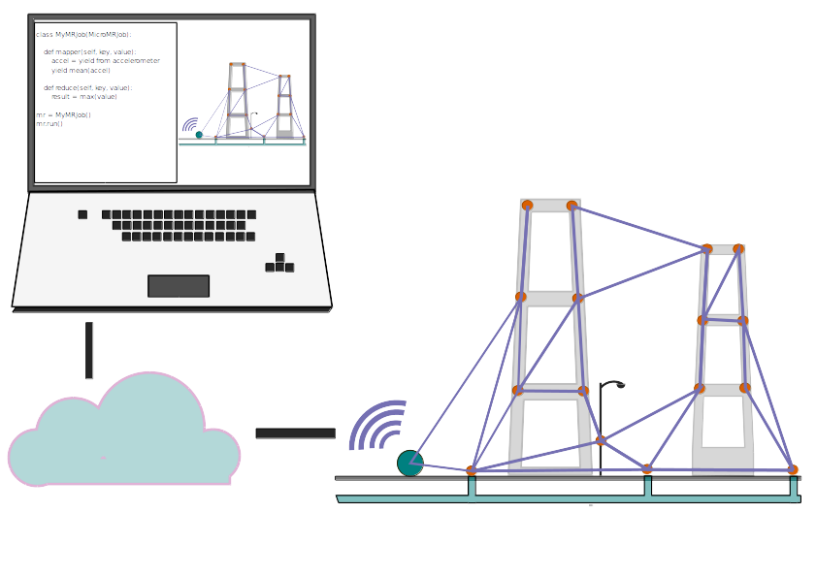
Resource aware continuous wireless monitoring Background
2 AA batteries: 2500mAh capacity
Sensor node operating: 100mAh
Sensor node sleep: 0.5mAh
Mini solar panel: 100 - 330 mA max

Slide 3
Resource aware continuous wireless monitoring Problem Statement
Example application: Trigger system wide collect of data on reaching threshold acceleration
Continuous monitoring requires a subset of nodes to be fully on while others await signal to awake.
Without load balancing, these nodes eventually must sleep, putting the system offline

Slide 4

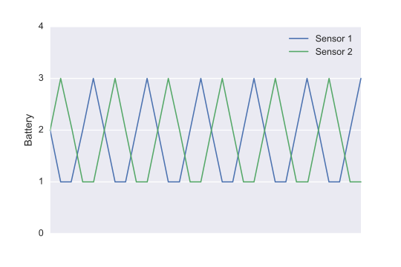
Resource aware continuous wireless monitoring Reinforcement learning
Simulated 3 node network with independent learning
0% downtime

Slide 5
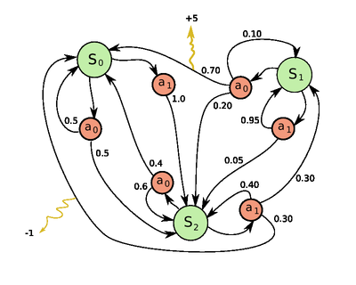
Resource aware continuous wireless monitoring Markov Decision Process
Markov decision process for
sequential decision making under
uncertainty, canonically:
Input:
S: States
A: Actions
R(s,s'): Rewards
Ta(s,s'): Transition
γ: Discount factor
Output:
π(s): Optimal action for each S
Problem 1:
How do we know T?
Problem 2:
Optimising system utility
requires network wide state

Slide 6
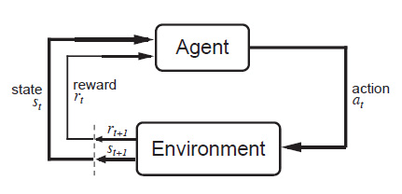
Resource aware continuous wireless monitoring Reinforcement learning
Problem 1: How do we know transition probabilities?
Reinforcement learning:Instead learn value of each action in each state through experience: Converges to MDP solution in the limit.

Slide 7
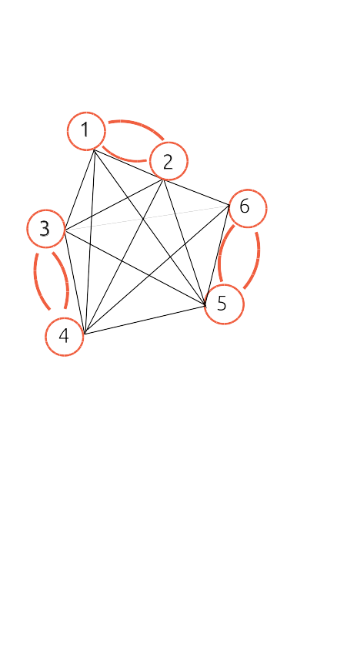
Resource aware continuous wireless monitoring Reinforcement learning
Problem 2: Exploding state space?
Cooperative learning by pairwise state-sharing

Slide 8
Resource aware continuous wireless monitoring Reinforcement learning
Simulated 3 node network with cooperative learning
0% downtime

