Slide 1
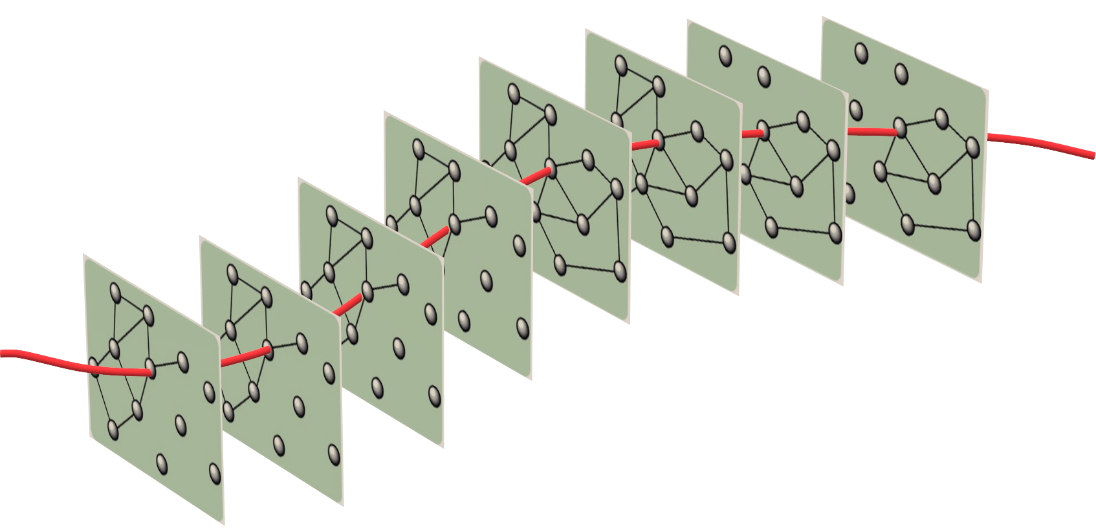
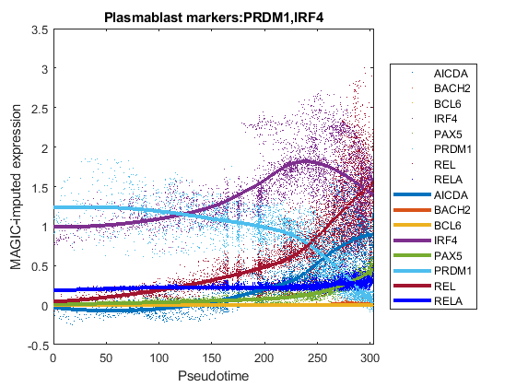
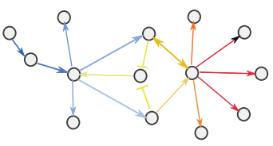
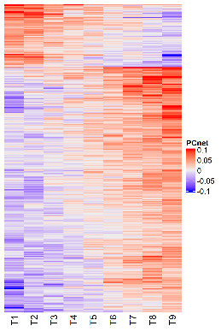
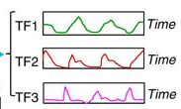
network inference
gene regulatory network
sc_qc sc_norm
scRNA-seq data
sc_pcnet
run_genie3
dimensionality reduction
sc_tsne run_ump run_phate
C
sc_pcnetpar
A
3d embedding
pseudotime series gene regulatory networks
trajectory analysis
sc_tscan
sc_trajectory
plot_pseudotime
D
parameter optimization
pseudotime series
dynamic network
activation inhibition
Edges
B
E
Time

