Slide 1
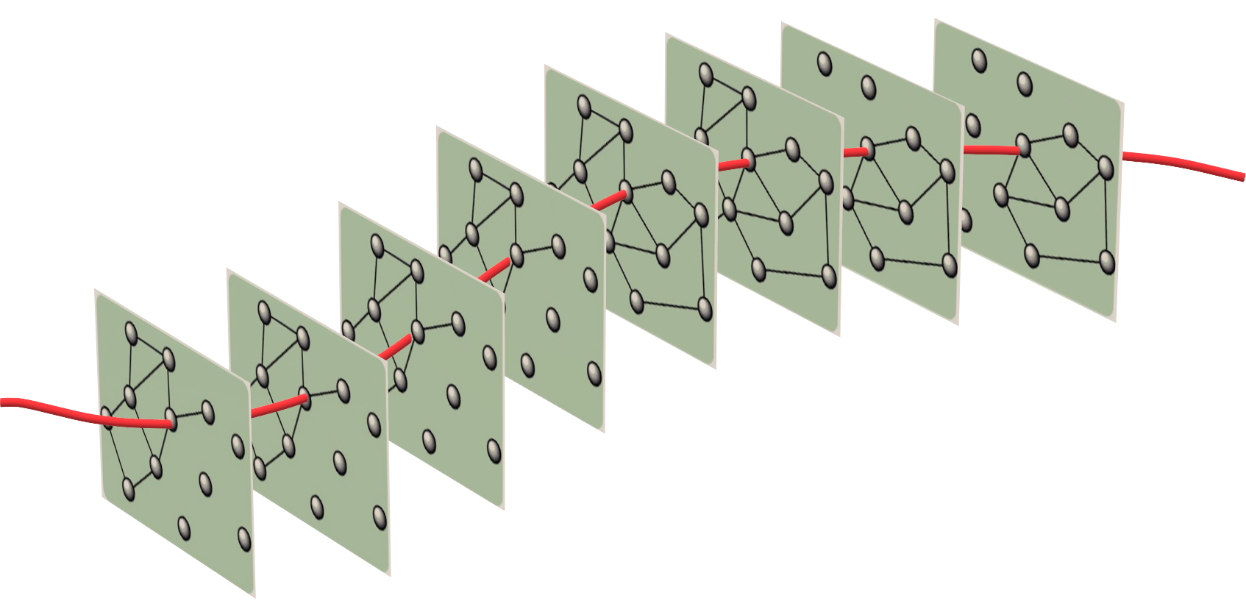
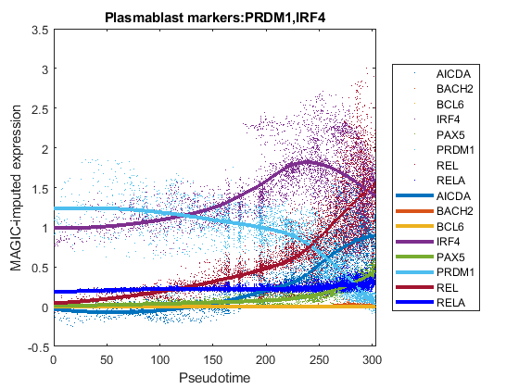
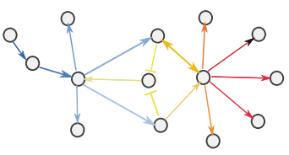
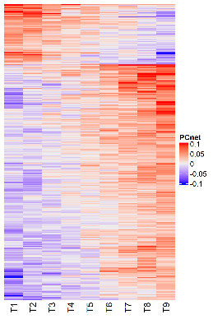
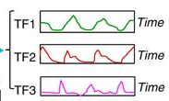
network inference
gene regulatory network
sc_qc sc_norm
scRNA-seq data
sc_pcnet
run_genie3
dimensionality reduction
sc_tsne run_ump run_phate
C
sc_pcnetpar
A
3d embedding
pseudotime series gene regulatory networks
trajectory analysis
sc_tscan
sc_trajectory
plot_pseudotime
D
parameter optimization
pseudotime series
dynamic network
activation inhibition
Edges
B
E
Time

Slide 2
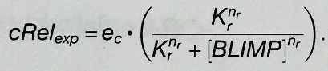
network inference
gene regulatory network
sc_qc sc_norm
scRNA-seq data
sc_pcnet
run_genie3
dimensionality reduction
sc_tsne run_ump run_phate
C
sc_pcnetpar
A
3d embedding
pseudotime series gene regulatory networks
D
trajectory analysis
sc_tscan
sc_trajectory
plot_pseudotime
D→data, M→ODE model, θ→parameters
parameter optimization
pseudotime series
SBEToolbox_lite
dynamic network
activation inhibition
Edges
B
E
Time

Slide 3
network inference
gene regulatory network
scRNA-seq data
GENIE3
dna::PCnet
dimensionality reduction
tSNE UMAP PHATE
C
A
3d embedding
pseudotime series gene regulatory networks
D
trajectory analysis
Wanderlust
Monocle
splinefit
D→data, M→ODE model, θ→parameters
inferenceSnapshot dynGENIE3, SCODE
parameter optimization
pseudotime series
dynamic network
activation inhibition
Edges
B
E
Time

Slide 4
Fig. 3
CELL TYPE
DISEASE STATUS
delta
Normal (alpha)
gamma
Normal (beta)
beta
T2D
(alpha)
T2D (beta)
alpha
AHR
NQO1
NFE2L2 (NRF2)
KAT2B

Slide 7
delta
gamma
alpha
gamma
beta
delta
alpha
beta

Slide 8
Normal
T2D
Normal
T2D

Slide 9
AHR

Slide 10
NQO1

Slide 11
NFE2L2 (NRF2)

Slide 12
KAT2B

Slide 13
CELL TYPE
DISEASE STATUS
delta
gamma
Normal
beta
alpha
T2D
AHR
NQO1
NFE2L2 (NRF2)
KAT2B

Slide 14
F

