Slide 1
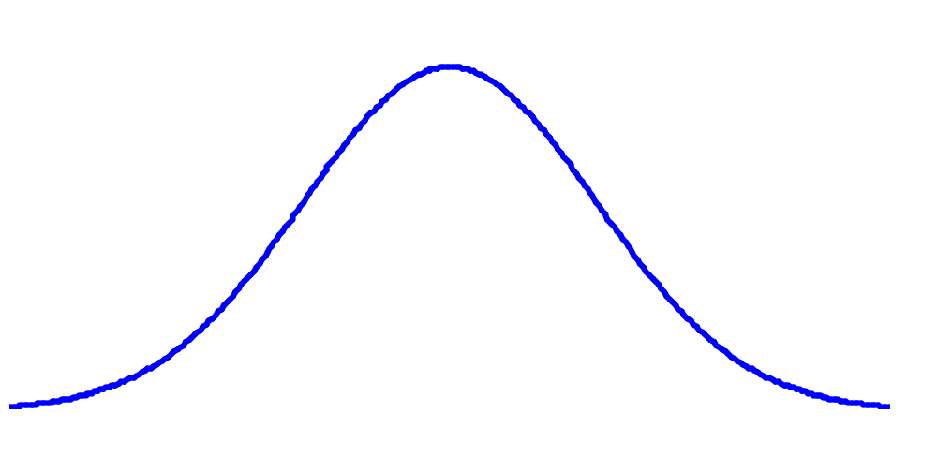
Introduction to mixed models
Ulf Olsson
Unit of Applied
Statistics and Mathematics

Slide 2
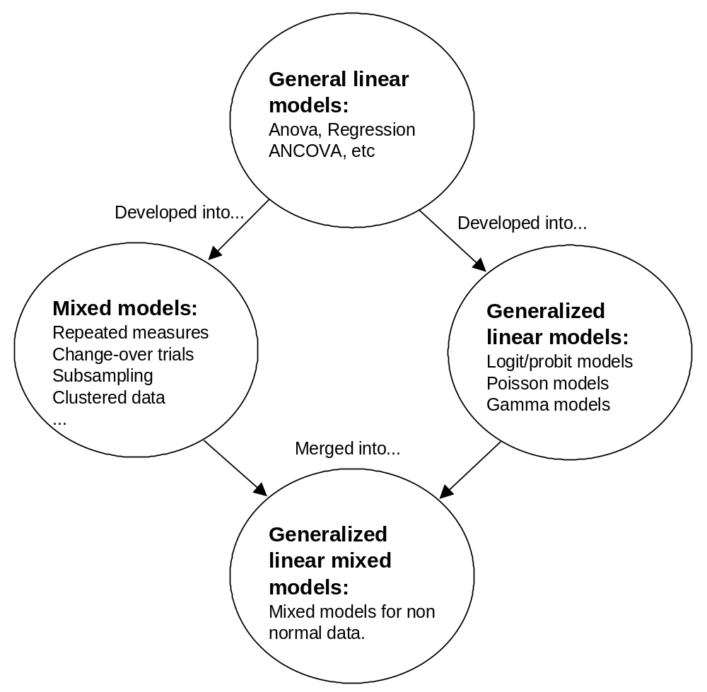
1. Introduction

Slide 3

2. General linear models (GLM)
But ... I'm not using any model. I'm only doing a few t tests.

Slide 4
GLM (cont.)
Data: Response variable y for n ”individuals”
Some type of design (+ possibly covariates)
Linear model:
y = f(design, covariates) + e
y = XB+e

Slide 5
GLM (cont.)
Examples of GLM:
(Multiple) linear regression
Analysis of Variance (ANOVA, including t test)
Analysis of covariance (ANCOVA)

Slide 6
GLM (cont.)
Parameters are estimated using either the Least squares, or Maximum Likelihood methods
Possible to test statistical hypotheses, for example to test if different treatments give the same mean values
Assumption: The residuals e_{i} are independent, normally distributed and have constant variance.

Slide 7
GLM (cont): some definitions
Factor: e.g. treatments, or properties such as sex
  Levels
  Example : Facor: type of fertilizer
  Levels: Low Medium High level of N
Experimental unit: The smallest unit that is given an individual treatment
Replication: To repeat the same treatments on new experimental units

Slide 8
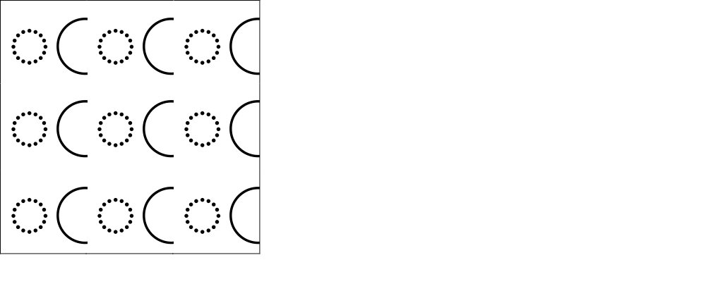
Experimetal unit
Pupils Class
Chicken Box
Plants Bench
Trees Plot

Slide 9
3. “Mixed models”:
Fixed and random factors
Fixed factor: those who planned the experiment decided which levels to use
Random factor: The levels are (or may be regarded as) a sample from a population of levels

Slide 10
Fixed and random factors
Example: 40 forest stands. In each stand, one plot fertilized with A and one with B.
Response variable: e.g. diameter of 5 trees on each plot
Fixed factor: fertilizer, 2 levels (A and B)
Experimental unit: the plot (NOT the tree!)
Replication on 40 stands
”Stand” may be regarded as a random factor

Slide 11
Mixed models (cont.)
Examples of random factors
”Block” in some designs
”Individual”(when several measurements are made on each individual)
”School class” (in experiments with teaching methods: then exp. unit is the class)
…i.e. in situations when many measurements are made on the same experimental unit.

Slide 12
Mixed models (cont.)
Mixed models are models that include both fixed and random factors.
Programs for mixed models can also analyze models with only fixed, or only random, factors.

Slide 13
Mixed models: formally
y = XB + Zu + e
y is a vector of responses
XB is the fixed part of the model
X: design matrix
B: parameter matrix
Zu is the random part of the model
e is a vector of residuals
y = f(fixed part) + g(random part) + e

Slide 14
Parameters to estimate
Fixed effects: the parameters in B
Ramdom effects:
  the variances and covariances of the random effects in u: Var(u)=G
  ”G-side random effects”
  The variances and covariances of the residual effects: Var(e)=R
  ”R-side random effects”

Slide 15
To formulate a mixed model you might
Decide the design matrix X for fixed effects
Decide the design matrix Z for random effefcts
In some types of models:
Decide the structure of the covariance matrices G or, more commonly, R.

Slide 16
Example 1
Two-factor model with one random factor
Treatments: two mosquito repellants A₁ and A₂
(Schwartz, 2005)
24 volonteeers divided into three groups
4 in each group apply A₁, 4 apply A₂
Each group visits one of three different areas
y=number of bites after 2 hours

Slide 17
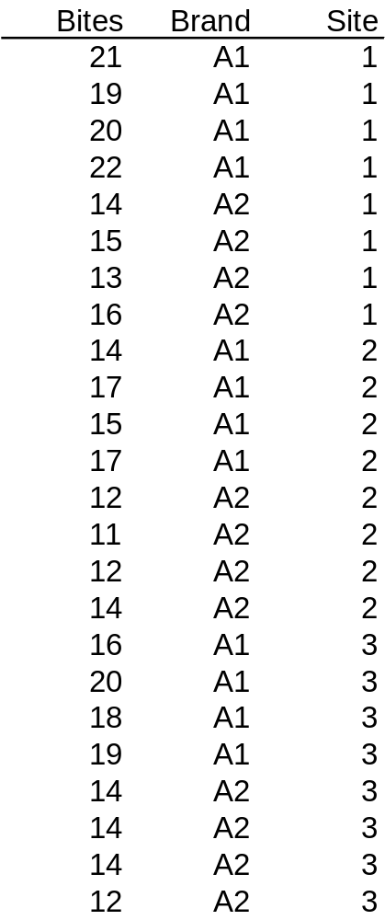
Ex 1: data

Slide 18
Ex 1: Model
y_{ijk}=μ+α_{i}+b_{j}+ab_{ij}+e_{ijk}
_{Where}
is a general mean value,
α_{i} is the effect of brand i
b_{j} is the random effect of site j
ab_{ij} is the interaction between factors a and b
e_{ijk} is a random residual
b_{j}~ N(o, σ²_{b})
e_{ijk}~ N(o, σ²_{e})

Slide 19
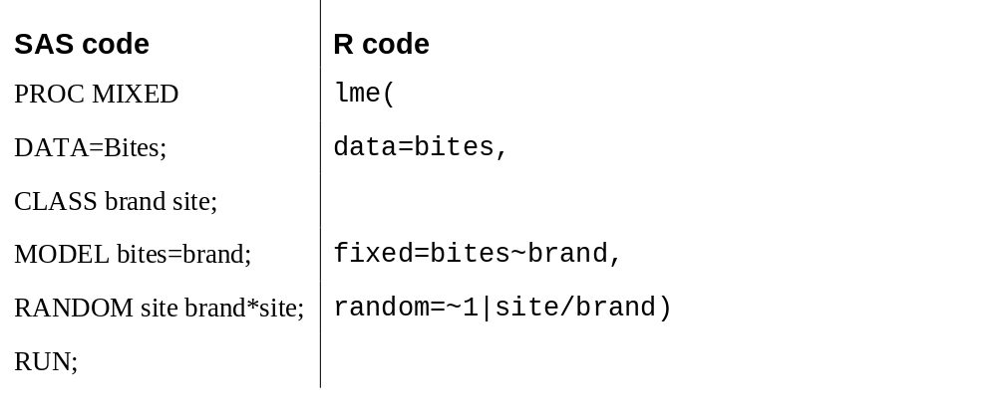
Ex 1: Program

Slide 20

Ex 1, results

Slide 21
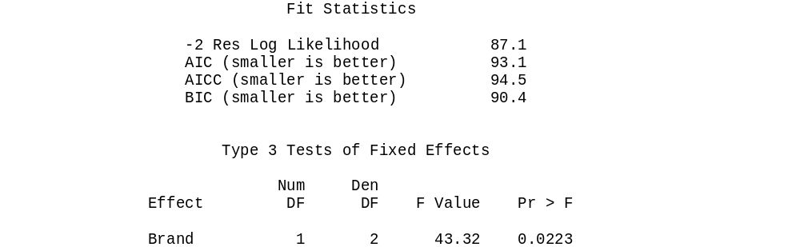
Ex 1, results

Slide 22
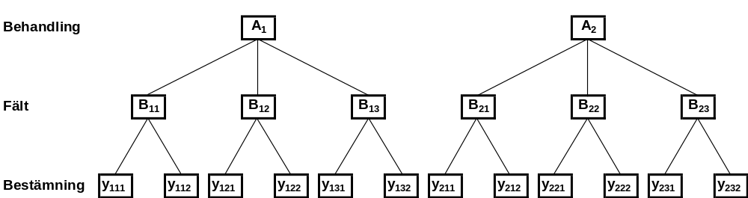
Example 2: Subsampling
Two treatments
Three experimental units per treatment
Two measurements on each experimental unit

Slide 23
Ex 2
An example of this type:
3 different fertilizers
4 plots with each fertilizer
2 mangold plants harvested from each plot
y = iron content

Slide 24
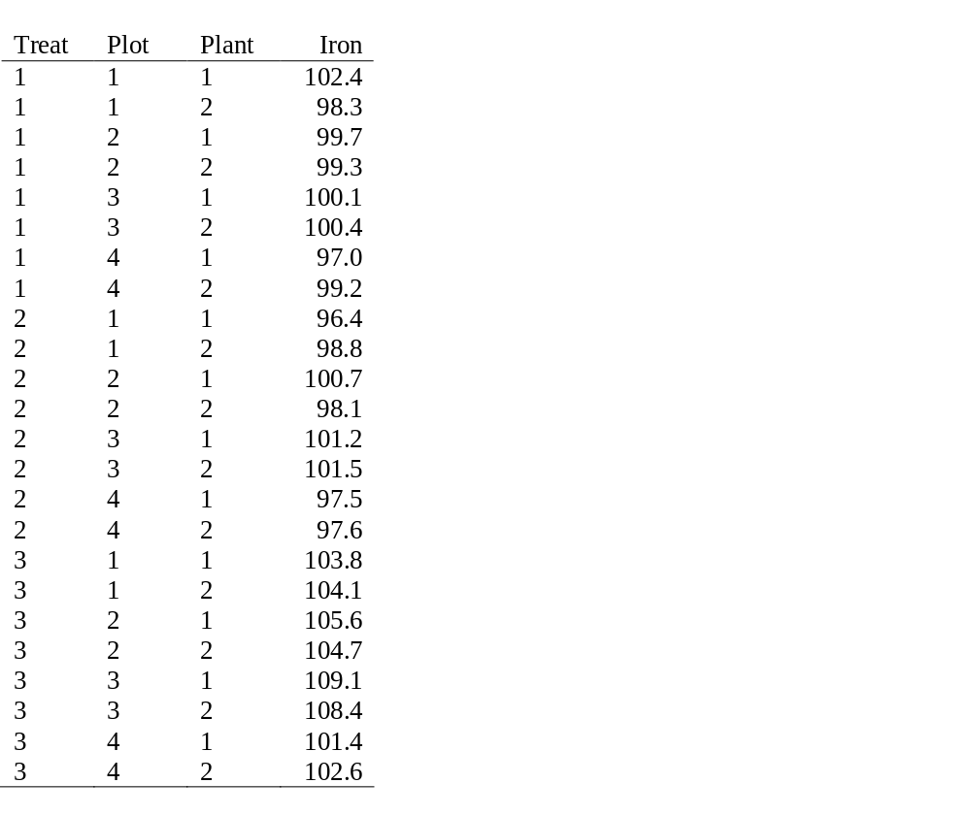
Ex 2: data

Slide 25
Ex 2: model
y_{ij}=μ+α_{i} + b_{ij} + e_{ijk}
α_{i} Fixed effect of treatment i
b_{ij} Random effect of plot j within treatment i
e_{ijk} Random residual
Note: Fixed effects – Greek letters
Random effecvts – Latin letters

Slide 26


Ex 2: results

Slide 27
Example 3: ”Split-plot models”
Models with several error terms
y=The dry weight yield of grass
Cultivar, levels A and B.
Bacterial inoculation, levels, C, L, D
Four replications in blocks.

Slide 28
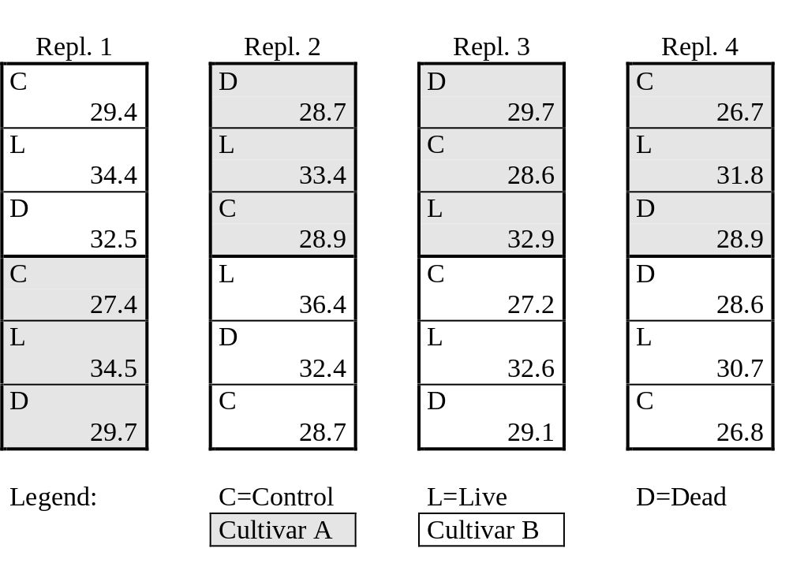
Ex 3: design

Slide 29

Ex 3
Block and Block*cult used as random factors.
Results for random factors:

Slide 30

Ex 3
Results for fixed factiors

Slide 31
Example 4: repeated measures
4 treatments
9 dogs per treatment
Each dog measured at several time points

Slide 32
Ex 4: data structure
treat dog t y
1 1 1 4.0
1 1 3 4.0
1 1 5 4.1
1 1 7 3.6
1 1 9 3.6
1 1 11 3.8
1 1 13 3.1

Slide 33
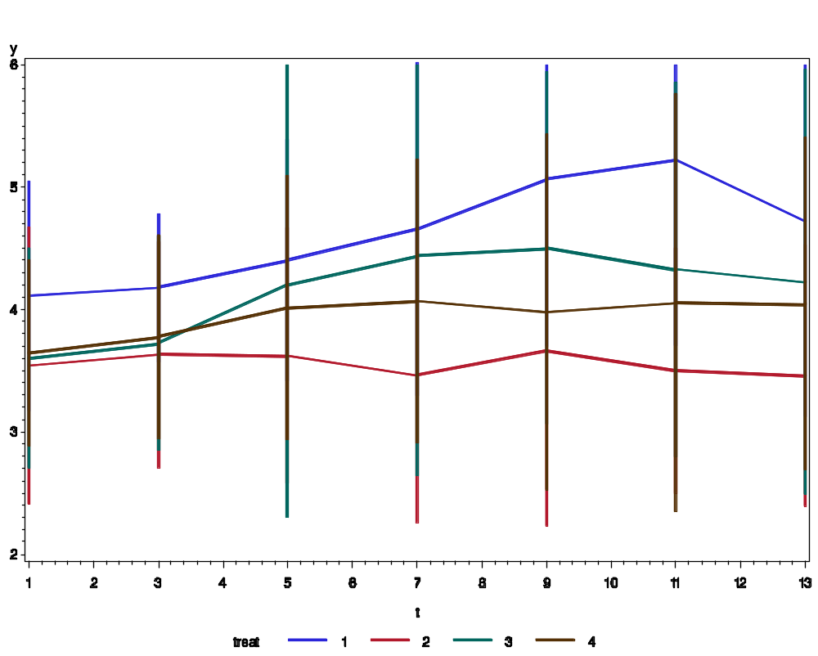
Ex 4: plot

Slide 34
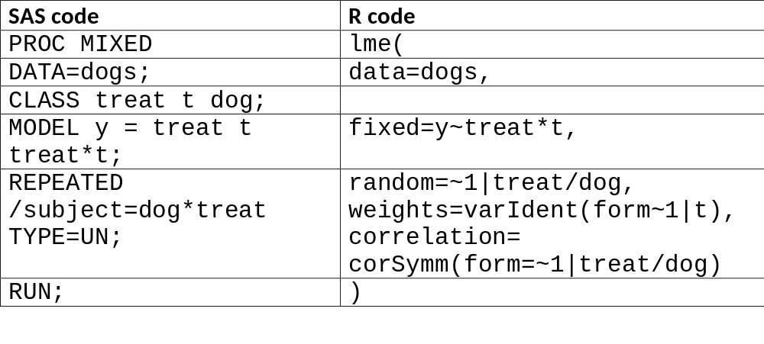
Ex 4: program

Slide 35

Ex 4, results

Slide 36
Covariance structures for repeated-measurses data
Model: y = XB + Zu + e
The residuals e (”R-side random effects”) are correlateded over time, correlation matrix R.
If R is left free (unstructured) this gives tx(t-1)/2 parameters to estimate (t=# of time points).
If n is small and t is large, we might run into peoblems (non-vonvergence, negative definite Hessian matrix).

Slide 37
Covariance structure
One solution: Apply some structure on R to reduce the number of parameters.

Slide 38
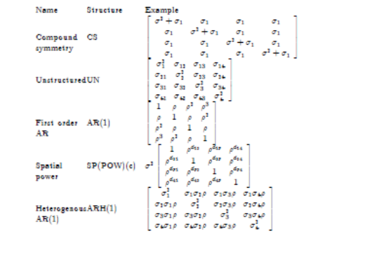
Covariance structure

Slide 39
Analysis strategy
Baseline model: Time as a ”class” variable
MODEL treatment time treatment*time;
”Repeated” part: First try UN. Simplify if needed:
AR(1) for equidistant time points, else SP(POW)
CS is only a last resort!
To simplify the fixed part: Polynomials in time can be used. Or other known functions.

Slide 40
Other tricks
Comparisons between models:
Akaike’s Information Criterion (AIC)
Denominator degrees of freedom for tests:
Use the method by Kenward and Roger (1997)
Normal distribution?
Make diagnostic plots! Transformations?
Robust (”sandwich”) estimators can be used
-or Generalized Linear Mixed Models…

Slide 41
Not covered…
Models with spatial variation
  Lecture by Johannes Forkman
Models with non-normal responses
  (Generalized Linear Mixed Models)
  Jan-Eric’s talk; Computer session tromorrow
…and much more

Slide 42
Summary

Slide 43

”All models are wrong…
…but some are useful.” (G. E. P. Box)

Slide 44
References
Fitzmaurice, G. M., Laird, N. M. and Ware, J. H. (2004): Applied longitudinal analysis. New York, Wiley
Littell, R., Milliken, G., Stroup, W. Wolfinger, R. and and Schabenberger O. (2006): SAS for mixed models, second ed. Cary, N. C., SAS Institute Inc.
(R solutions to this can be found on the net)
Ulf Olsson: Generalized linear models: an applied approach. Lund, Student­litteratur, 2002
Ulf Olsson (2011):Statistics for Life Science 1. Lund, Studentlitteratur
Ulf Olsson (2011):Statistics for Life Science 2. Lund, Studentlitteratur

