Slide 1
Polygenic methods in analysis of complex trait genetics
Matthew Keller
Luke Evans
University of Colorado at Boulder

Slide 2
Polygenicity in complex traits
The sum of R² of significantly associated SNPs of complex traits typically < 10%, despite twin/family h² ~ .5 +/-.2. Why?
One possibility: large number of small-effect (~ the 'infinitesimal model'; Fisher, 1918) causal variants (CVs) that failed to reach genome-wide significance (many type-II errors)
Growing consensus: 100s to 1000s of CVs contribute to the genetic variation of traits like schizophrenia, each with small effects (OR < 1.3), often in unpredicted loci

Slide 3
Should we continue to do candidate gene research on complex traits?

Slide 4
Should we continue to do candidate gene research on complex traits?
NO

Slide 5
Outline
Estimating prediction accuracy of polygenic risk scores (PRS) from GWAS
  history
  how it works
  interpretations, uses, & pitfalls
Estimating V_{A} explained by all SNPs using genetic similarity at SNPs
  how it works - HE-regression example
  walk through of GREML approach
  practical issues – SNP & individual QC

Slide 6
Outline
Estimating prediction accuracy of polygenic risk scores (PRS) from GWAS
  history
  how it works
  interpretations, uses, & pitfalls
Estimating V_{A} explained by all SNPs using genetic similarity at SNPs
  how it works - HE-regression example
  walk through of GREML approach
  practical issues – SNP & individual QC

Slide 7
  History of PRS
In the dark ages of complex trait genetics (04-09), many geneticists had lost all hope of finding a way to get their N=3k GWAS samples published.

Slide 8



  History of PRS
In the dark ages of complex trait genetics (04-09), many geneticists had lost all hope of finding a way to get their N=3k GWAS samples published.
Then, in 2009, a giant in our field, Sean Purcell, decided to look at the conglomerate effects of thousands of SNPs on a trait and found signals. The floodgates opened.

Slide 9
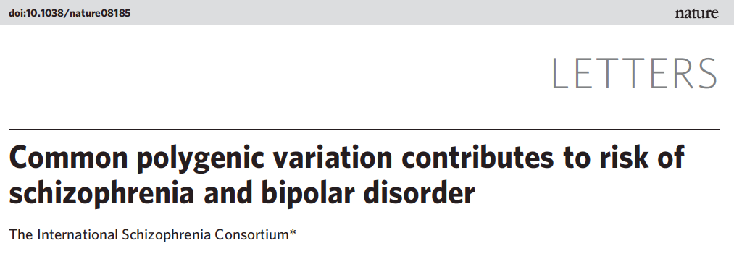
  History of PRS

Slide 10
  History of PRS
Polygenic Risk Score (PRS) – aka – the “Purcell” approach

Slide 11
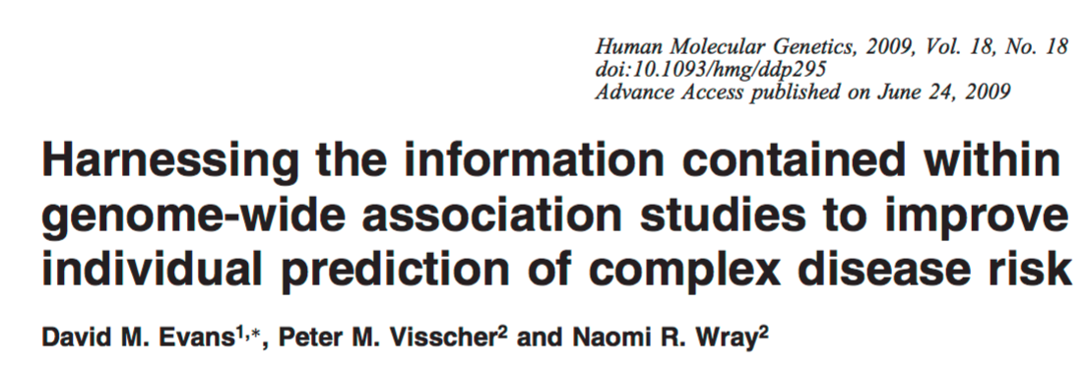
  History of PRS
Polygenic Risk Score (PRS) – aka – the “Purcell” approach

Slide 12
  History of PRS
Polygenic Risk Score (PRS) – aka – the “Purcell” approach
aka – the David Evans Polygenic Risk Score Ingenious (DEPRSING) Approach

Slide 13
Polygenic Risk Score (PRS) Steps
  Obtain GWAS summary statistics (p-values and β’s) in largest possible discovery sample
  Obtain independent target sample with genomewide data
  Use SNPs in common between the two samples.
  (Optional) Deal with association redundancy due to LD.
  Restrict to SNPs with p < various thresholds (1e-5,1e-4…0.5...1.0).
  Construct PRS = sum of risk alleles weighted by β from regression.
  Regress trait in target sample onto PRS. Evaluate strength of this association (r² or h² in liability threshold model).

Slide 14
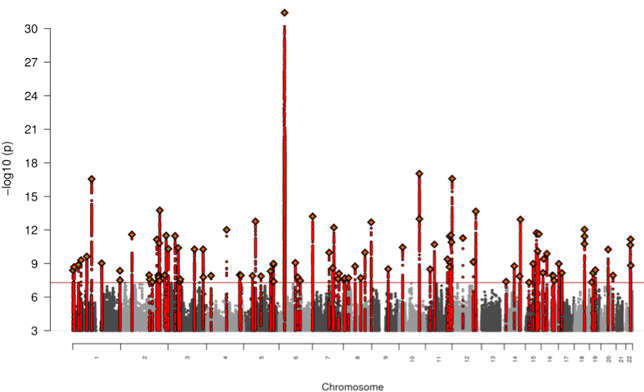
  Step 1–GWAS in discovery sample
Psychiatric Genomics Consortium, Nature, 2014

Slide 15
Polygenic Risk Score (PRS) Steps
  Obtain GWAS summary statistics (p-values and β’s) in largest possible discovery sample
  Obtain independent target sample with genomewide data
  Use SNPs in common between the two samples.
  (Optional) Deal with association redundancy due to LD.
  Restrict to SNPs with p < various thresholds (1e-5,1e-4…0.5...1.0).
  Construct PRS = sum of risk alleles weighted by β from regression.
  Regress trait in target sample onto PRS. Evaluate strength of this association (r² or h² in liability threshold model).

Slide 16
  Step 2 – Crucial: target & discovery samples are independent
If non-independence between discovery & target, r2_{target} will be overestimated
  If some of the same people are in both
  If there are close relatives between the two
  If you preselect most significant SNPs in target + discovery sample first, then follow the normal PRS procedures

Slide 17
  Why non-independence inflates r²
If null true, E(r²_{discovery}) ≅ 1/N.
(This is also E[r²_{target}] if no PRS association)
m unassociated, uncorrelated SNPs, E(r²_{discovery}) ≅ m/N
If choose the m most associated SNPs of 100K, the problem is even worse.

Slide 18
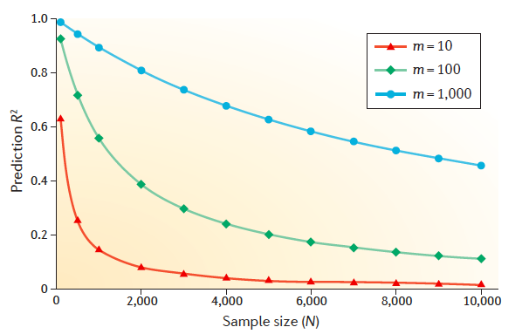
  Why non-independence inflates r²
If null true, E(r²_{discovery}) ≅ 1/N.
(This is also E[r²_{target}] if no PRS association)
m unassociated, uncorrelated SNPs, E(r²_{discovery}) ≅ m/N
If choose the m most associated SNPs of 100K, the problem is even worse.
E(r²_{discovery}) =
Wray et al, 2013. Pitfalls of predicting complex traits from SNPs.

Slide 19
  Why non-independence inflates r²
If null true, E(r²_{discovery}) ≅ 1/N.
(This is also E[r²_{target}] if no PRS association)
m unassociated, uncorrelated SNPs, E(r²_{discovery}) ≅ m/N
If choose the m most associated SNPs of 100K, the problem is even worse.
E.g., N_{discovery}=10k. E(r²_{discovery}) ≅ .10 if choose m=1k randomly, but E(r²_{discovery}) ≅ .60 if choose m=1k biggest

Slide 20
  Why non-independence inflates r²
If null true, E(r²_{discovery}) ≅ 1/N.
(This is also E[r²_{target}] if no PRS association)
m unassociated, uncorrelated SNPs, E(r²_{discovery}) ≅ m/N
If choose the m most associated SNPs of 100K, the problem is even worse.
E.g., N_{discovery}=10k. E(r²_{discovery}) ≅ .10 if choose m=1k randomly, but E(r²_{discovery}) ≅ .60 if choose m=1k biggest
If q proportion of target sample that overlaps, E(r²) in that part of sample is same as in discovery sample.
Thus under null:
E(r²_{target}) ≅ q*r²_{discovery} + (1-q)*1/N_{target}

Slide 21
Polygenic Risk Score (PRS) Steps
  Obtain GWAS summary statistics (p-values and β’s) in largest possible discovery sample
  Obtain independent target sample with genomewide data
  Use SNPs in common between the two samples.
  (Optional) Deal with association redundancy due to LD.
  Restrict to SNPs with p < various thresholds (1e-5,1e-4…0.5...1.0).
  Construct PRS = sum of risk alleles weighted by β from regression.
  Regress trait in target sample onto PRS. Evaluate strength of this association (r² or h² in liability threshold model).

Slide 22
  Step 3 – Use SNPs in common
Array Data
Imputed Data
Illumina 1M
Affy Axiom
If discovery & target on different arrays,
use imputed data to maximize overlap

Slide 23
Polygenic Risk Score (PRS) Steps
  Obtain GWAS summary statistics (p-values and β’s) in largest possible discovery sample
  Obtain independent target sample with genomewide data
  Use SNPs in common between the two samples.
  (Optional) Deal with association redundancy due to LD.
  Restrict to SNPs with p < various thresholds (1e-5,1e-4…0.5...1.0).
  Construct PRS = sum of risk alleles weighted by β from regression.
  Regress trait in target sample onto PRS. Evaluate strength of this association (r² or h² in liability threshold model).

Slide 24
  Step 4 – Account for LD
CVs inflate associations of nearby SNPs they are in LD with ➔ redundant signals. Thus:
  r²_{target} depends strongly on distribution of SNPs
  Diminishes genomewide signal interpretation
Typically, people account for LD (worst to best):
  LD prune – but can lose strongest signals
  LD clumping – preferentially leave in strongest signals, prune out weaker ones in LD
  Model LD – LDpred (Vihjalmsson et al, AJHG, 2015)

Slide 25
Polygenic Risk Score (PRS) Steps
  Obtain GWAS summary statistics (p-values and β’s) in largest possible discovery sample
  Obtain independent target sample with genomewide data
  Use SNPs in common between the two samples.
  (Optional) Deal with association redundancy due to LD.
  Restrict to SNPs with p < various thresholds (1e-5,1e-4…0.5...1.0).
  Construct PRS = sum of risk alleles weighted by β from regression.
  Regress trait in target sample onto PRS. Evaluate strength of this association (r² or h² in liability threshold model).

Slide 26
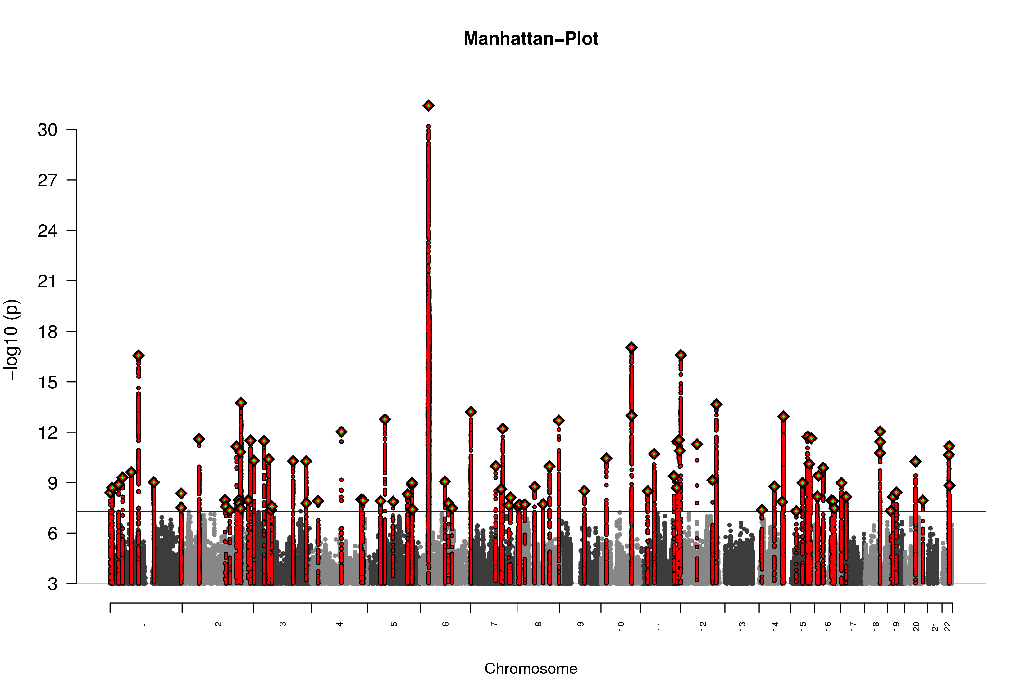
  Step 5 – Use various p thresholds
Use p-thresholds from 5e-8,1e-7,…0.5...0.
Report results from all thresholds

Slide 27
Polygenic Risk Score (PRS) Steps
  Obtain GWAS summary statistics (p-values and β’s) in largest possible discovery sample
  Obtain independent target sample with genomewide data
  Use SNPs in common between the two samples.
  (Optional) Deal with association redundancy due to LD.
  Restrict to SNPs with p < various thresholds (1e-5,1e-4…0.5...1.0).
  Construct PRS = sum of risk alleles weighted by β from regression.
  Regress trait in target sample onto PRS. Evaluate strength of this association (r² or h² in liability threshold model).

Slide 28
  Step 6: Construct PRS
PRS_{j} = Σ [β_{i,discovery} * SNP_{ij}]
β_{i,discovery} = effect size in discovery sample from OLS (continuous trait) or logistic reg (binary trait; β = log(OR))
SNP_{ij} = # alleles (0,1,2) for SNP i of person j in target sample
In PLINK, --score.

Slide 29
Polygenic Risk Score (PRS) Steps
  Obtain GWAS summary statistics (p-values and β’s) in largest possible discovery sample
  Obtain independent target sample with genomewide data
  Use SNPs in common between the two samples.
  (Optional) Deal with association redundancy due to LD.
  Restrict to SNPs with p < various thresholds (1e-5,1e-4…0.5...1.0).
  Construct PRS = sum of risk alleles weighted by β from regression.
  Regress trait in target sample onto PRS. Evaluate strength of this association (r² or h² in liability threshold model).

Slide 30
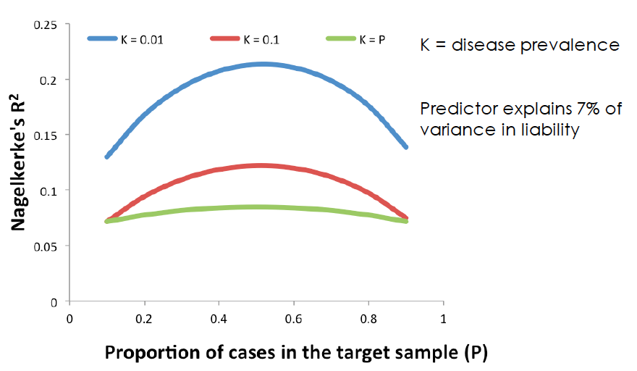
  Step 7: Evaluation of PRS
For continuous traits, this is simply the r² from an OLS regressing continuous trait ~ PRS in target.
Trickier for binary (e.g., case-control) data.
  Nagelkerke’s R² often used. But it has unfortunate property of depending on disease prevalence & proportion of cases:
Wray et al, 2013. Pitfalls of predicting complex traits from SNPs.

Slide 31
  Step 7: Evaluation of PRS
For continuous traits, this is simply the r² from an OLS regressing continuous trait ~ PRS in target.
Trickier for binary (e.g., case-control) data.
  Nagelkerke’s R² often used. But it has unfortunate property of depending on disease prevalence & proportion of cases.
  Not comparable to h² as usually estimated
  Better alternative = h² on the liability scale§, which can be found by converting r² from an OLS regression of binary trait ~ PRS to h².
  §see Lee et el., 2012. Genetic Epidemiology. A better coefficient of determination for genetic profile analysis.

Slide 32
  Interpretation of r² from PRS
r²_{target} is an estimate of how well one can predict a trait. But prediction accuracy is lower than estimation accuracy.
Variance of PRS is a sum of two components per SNP:
  true component – often 0 or close to 0
  error component ≅ V(SNP) * V(Y)/[2*p*q*N] = V(Y)/N
Unless N very large (e.g., millions), error swamps true component, and PRS is mostly noise.
Thus, PRS r² is a (typically severely) downwardly biased estimate of SNP-h²
As N ➔ ∞, PRS r² ➔ SNP-h²

Slide 33
  PRS applications
Discovery & target samples are… | Research purpose
Same disorder | Demonstrate polygenicity; predict risk
Different disorders | Demonstrate genetic overlap
Target is a subtype of disorder | Demonstrate heterogeneity of disorder
Target sample has environmental risk data | Demonstrate GxE

Slide 34
  Power & accuracy of PRS’s
⬆N_{discovery} ➔ ⬆E[r²_{target}]
⬆N_{target} no influence E[r²_{target}]
⬆N_{discovery} ➔ ⬆power[r²_{target}]
⬆N_{target} ➔ ⬆power[r²_{target}]
For large N_{discovery} (>>10k), typically sufficient power to detect PRS relationship at α=.05 with N_{target} >1k.
Optimal split of N_{discovery} vs. N_{target}:
  To maximize power, split discovery & target equally
  To maximize prediction accuracy, maximize N_{discovery}
Dudbridge (2013). PLoS Gen. Power and predictive accuracy of polygenic risk scores

Slide 35
Outline
Estimating prediction accuracy of polygenic risk scores (PRS) from GWAS
  history
  how it works
  interpretations, uses, & pitfalls
Estimating V_{A} explained by all SNPs using genetic similarity at SNPs
  how it works - HE-regression example
  walk through of GREML approach
  practical issues – SNP & individual QC

Slide 36
Using genetic similarity at SNPs to estimate V_{A}
Determine extent to which genetic similarity at SNPs is related to phenotypic similarity
Multiple approaches to derive unbiased estimate of V_{A} captured by measured (common) SNPs
  Regression (Haseman-Elston)
  Mixed effects models (GREML)
  Bayesian (e.g., Bayes-R)
  LD-score regression

Slide 37
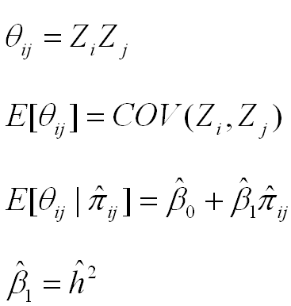
Regression estimates of h²
product of centered scores (here, z-scores)
(the slope of the regression is an estimate of h²)

Slide 38
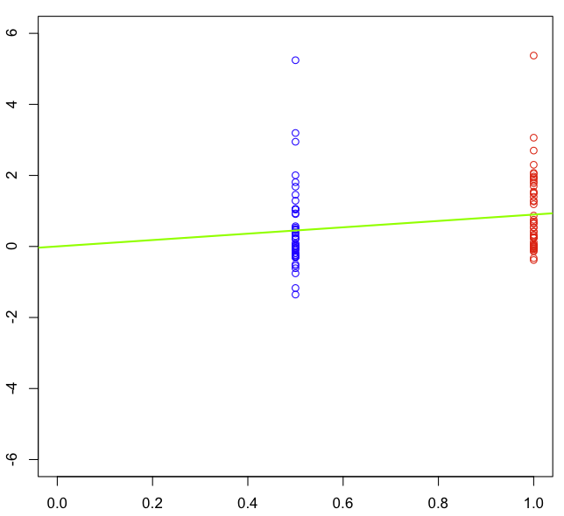


Regression estimates of h²
(the slope of the regression is an estimate of h²)

Slide 39
Regression estimates of h²
COR(MZ)
(the slope of the regression is an estimate of h²)

Slide 40
Regression estimates of h²
COR(DZ)
(the slope of the regression is an estimate of h²)

Slide 41
Regression estimates of h²
2*[COR(MZ)-COR(DZ)]
= h² = slope
(the slope of the regression is an estimate of h²)

Slide 42
Regression estimates of h²
(the slope of the regression is an estimate of h²)

Slide 43
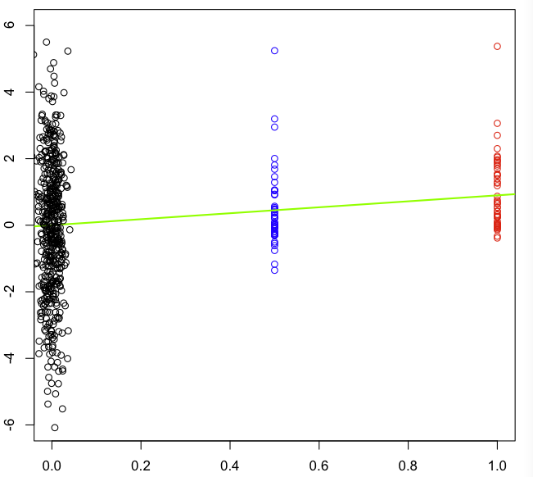
Regression estimates of h²
(the slope of the regression is an estimate of h²)

Slide 44
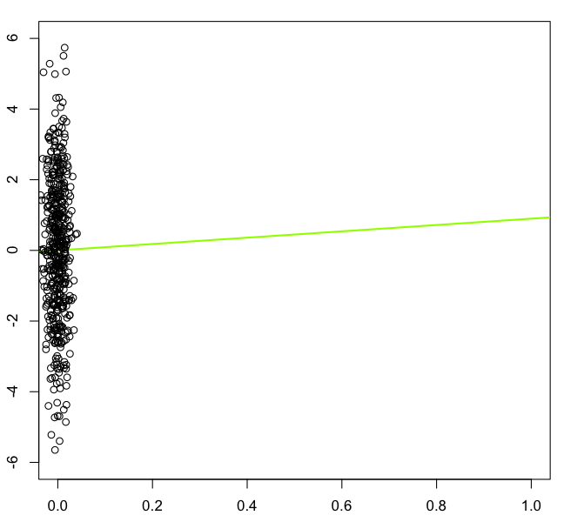
Regression estimates of h²_{snp}
(the slope of the regression is an estimate of h²)

Slide 45
Interpreting h² estimated from SNPs (h²_{snp})
If close relatives included (e.g., sibs), h²_{snp} ≅ h² estimated from a family-based method, because great influence of extreme pihats. Interpret h²_{snp} as from these designs.
If use ‘unrelateds’ (e.g., pihat < .05):
  h²_{snp} = proportion of V_{P} due to V_{A} captured by SNPs. Upper bound % V_{P} GWAS can detect
  Gives idea of the aggregate importance of CVs tagged by SNPs
  By not using relatives who also share environmental effects: (a) V_{A} estimate 'uncontaminated' by V_{C} & V_{NA;} (b) does not rely on family study assumptions (e.g., r(MZ) > r(DZ) for only genetic reasons)

Slide 46
Comparison of approaches for estimating h²_{snp}
APPROACH (METHOD) | ADVANTAGES | DISADVANTAGES
HE-regression | Fast. Point estimates usually unbiased | Large SEs (~30% larger than REML). SE estimates biased. Limited model building.

Slide 47

Comparison of approaches for estimating h²_{snp}
APPROACH (METHOD) | ADVANTAGES | DISADVANTAGES
HE-regression | Fast. Point estimates usually unbiased | Large SEs (~30% larger than REML). SE estimates biased. Limited model building.
GREML (e.g., GCTA) | Point estimates & SEs usually unbiased. Well maintained & easy to use. | Limited model-building (e.g., no nonlinear constraints).

Slide 48
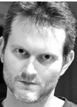
Comparison of approaches for estimating h²_{snp}
APPROACH (METHOD) | ADVANTAGES | DISADVANTAGES
HE-regression | Fast. Point estimates usually unbiased | Large SEs (~30% larger than REML). SE estimates biased. Limited model building.
GREML (e.g., GCTA) | Point estimates & SEs usually unbiased. Well maintained & easy to use. | Limited model-building (e.g., no nonlinear constraints).
GREML- SEM | Flexible. Ability to build complex models. | Currently too slow (?) to be feasible for very large datasets.

Slide 49

Comparison of approaches for estimating h²_{snp}
APPROACH (METHOD) | ADVANTAGES | DISADVANTAGES
HE-regression | Fast. Point estimates usually unbiased | Large SEs (~30% larger than REML). SE estimates biased. Limited model building.
GREML (e.g., GCTA) | Point estimates & SEs usually unbiased. Well maintained & easy to use. | Limited model-building (e.g., no nonlinear constraints).
GREML- SEM | Flexible. Ability to build complex models. | Currently too slow (?) to be feasible for very large datasets.
LD-score regression | Requires only summary statistics; mostly robust to stratification/relatedness | Does not give good estimates of variance due to rare CVs

Slide 50




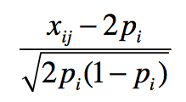
GREML Model
(here, n=3, q=2 fixed effects, m=3 SNPs)
n×m
3
-5
2
-1.2
1 0.8
0.4
1.15 -.58 -1.15
-.58 1.15 .58
-.58 -.58 .58
*
*
=
+
+
observed y
design matrix of fixed effects (intercept & 1 covariate)
fixed effects
design matrix for SNP effects =
SNP effects
residuals

Slide 51

GREML Model
(after removing fixed effects on y)
-.64
-2.58
3.21
1.15 -.58 -1.15
-.58 1.15 .58
-.58 -.58 .58
*
=
+
residuals y
design matrix for SNP effects =
SNP effects
residuals

Slide 52
GREML Model
(after removing fixed effects on y)
-.64
-2.58
3.21
1.15 -.58 -1.15
-.58 1.15 .58
-.58 -.58 .58
*
=
+
residuals y
design matrix for SNP effects =
SNP effects
residuals
We aren’t interested in estimating each u_{i} because m >> n usually, and because such individual estimates would be unreliable. Instead, estimate the variance of u_{i}.

Slide 53


GREML Model
(after removing fixed effects on y)
-.64
-2.58
3.21
1.15 -.58 -1.15
-.58 1.15 .58
-.58 -.58 .58
*
=
+
residuals y
design matrix for SNP effects =
SNP effects
residuals
We assume
and therefore

Slide 54







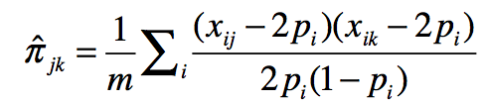
GREML Model
(we treat u as random and estimate and thus )
.41 1.65 -2.05
1.65 6.66 -8.28
-2.05 -8.28 10.3
.99 -.68 -.33
-.68 .67 .00
-.33 .00 .34
0 0
0 1 0
0 0 1
=
+
observed n-by-n var/covar matrix of residuals y
Genomic Relationship Matrix (GRM) at measured SNPs. Each element =
Identity matrix

Slide 55


GREML
.41 1.65 -2.05
1.65 6.66 -8.28
-2.05 -8.28 10.3
.99 -.68 -.33
-.68 .67 .00
-.33 .00 .34
0 0
0 1 0
0 0 1
=
+
observed var/covar
implied var/covar
REML find values of & that maximizes the likelihood of the observed data. Intuitively, this makes the observed and implied var-covar matrices be as similar as possible.

Slide 56
SNP QC
Poor SNP calls can inflate SE and cause downward bias in h²_{snp}
Clean data for
  SNPs missing > ~.05
  HWE p < 10e-6
  MAF < ~.01
  Plate effects:
    Remove plates with extreme average inbreeding coefficients or high average missingness

Slide 57
Individual QC
Remove individuals missing > ~.02
Remove close relatives (e.g., --grm-cutoff 0.05)
  Correlation between pi-hats and shared environment can inflate h²_{snp} estimates
Control for stratification (usually 5 or 10 PCs)
  Different prevalence rates (or ascertainments) between populations can show up as h²_{snp}
Control for plates and other technical artifacts
  Be careful if cases & controls are not randomly placed on plates (can create upward bias in h²_{snp})

Slide 58
Big picture: Using SNPs to estimate h²
Independent approach to estimating h²
    Different assumptions than family models. Increasingly tortuous reasoning to suggest traits aren’t heritable because methodological flaws
When using SNPs with same allele frequency distribution as CVs, provides unbiased estimate of h²
When using common (array) SNPs to estimated relatedness, generally provides downwardly biased estimate of h²
    “Still missing” h² (h²_{family} – h²_{snp}) provides insight into the importance of rare variants, non-additive, or biased h²_{family}.
But not a panacea. Biases still exist. Issues need to be worked out (e.g., assortative mating, etc.).

