Slide 1
Regression-Based Linkage Analysis of General Pedigrees
Pak Sham, Shaun Purcell,
Stacey Cherny, Gonçalo Abecasis

Slide 2
This Session
Quantitative Trait Linkage Analysis
  Variance Components
  Haseman-Elston
An improved regression based method
  General pedigrees
  Non-normal data
Example application
  PEDSTATS
  MERLIN-REGRESS

Slide 3
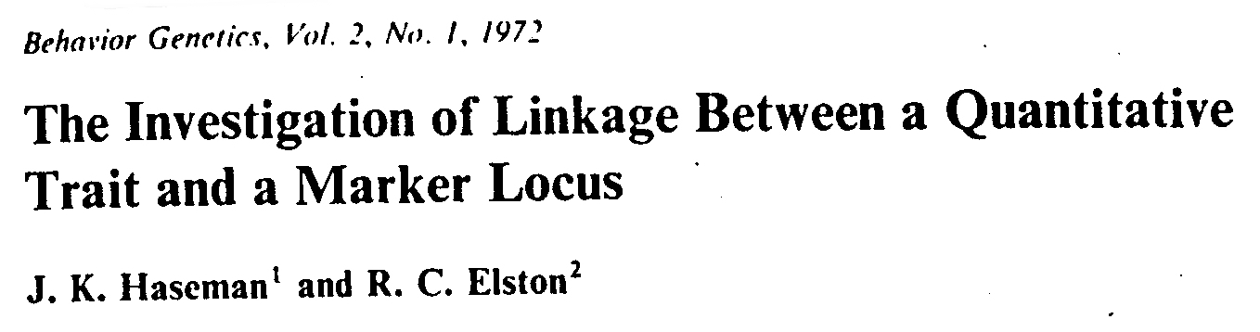
Simple regression-based method
  squared pair trait difference
  proportion of alleles shared identical by descent
^
(X – Y)² = 2(1 – r) – 2Q(π – 0.5) + ε
(HE-SD)

Slide 4
Haseman-Elston regression
(X - Y)²
β = -2Q
IBD
0
1
2

Slide 5
Sums versus differences
Wright (1997), Drigalenko (1998)
  phenotypic difference discards sib-pair QTL linkage information
  squared pair trait sum provides extra information for linkage
    independent of information from HE-SD
^
(X + Y)² = 2(1 + r) + 2Q(π – 0.5) + ε
(HE-SS)

Slide 6
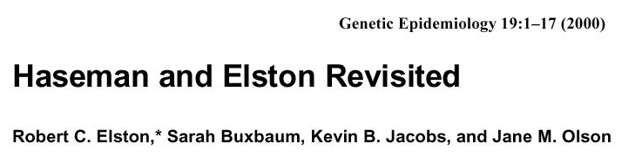
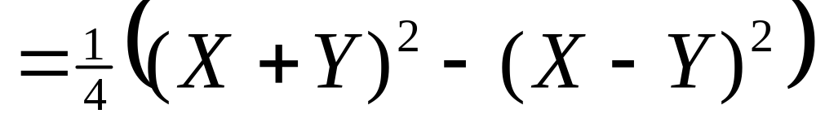
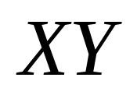
New dependent variable to increase power
  mean corrected cross-product (HE-CP)
But this was found to be less powerful than original HE when sib correlation is high

Slide 7
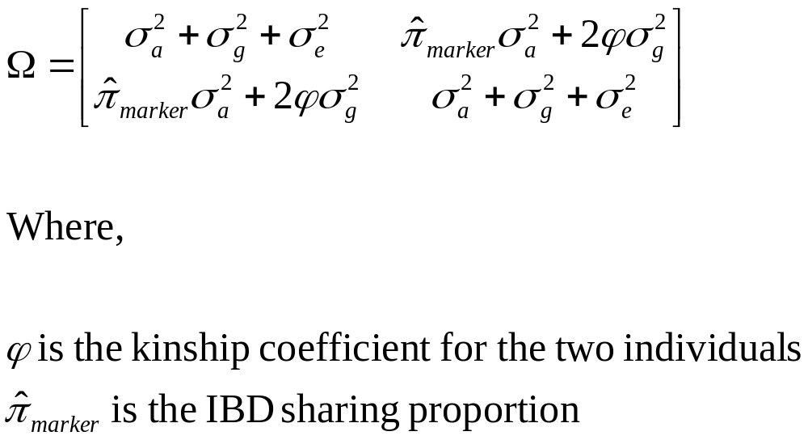
Variance Components Analysis

Slide 8
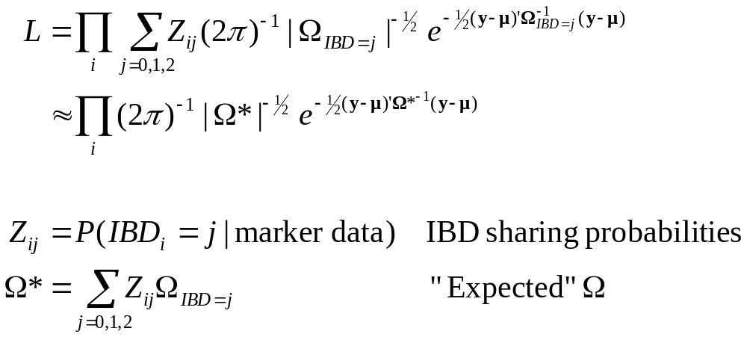
Likelihood function

Slide 9
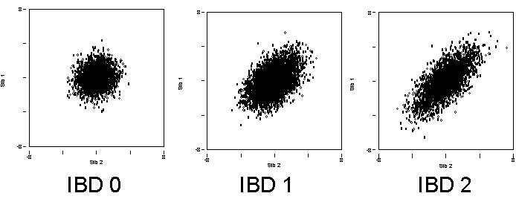
Linkage

Slide 10
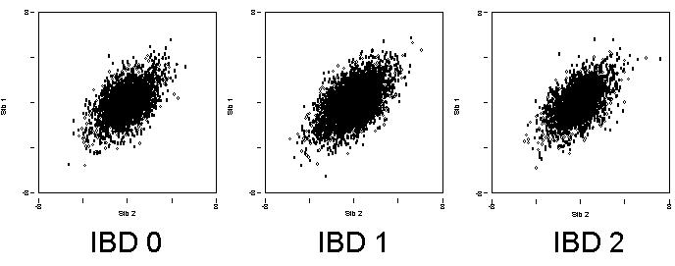
No Linkage

Slide 11
The Problem
Maximum likelihood variance components linkage analysis
  Powerful (Fulker & Cherny 1996) but
    Not robust in selected samples or non-normal traits
    Conditioning on trait values (Sham et al 2000) improves robustness but is computationally challenging
Haseman-Elston regression
  More robust but
    Less powerful
    Applicable only to sib pairs

Slide 12
Aim
To develop a regression-based method that
  Has same power as maximum likelihood variance components, for sib pair data
  Will generalise to general pedigrees

Slide 13
Extension to General Pedigrees
Multivariate Regression Model
Weighted Least Squares Estimation
Weight matrix based on IBD information

Slide 14
Switching Variables
To obtain unbiased estimates in selected samples
  Dependent variables = IBD
  Independent variables = Trait

Slide 15
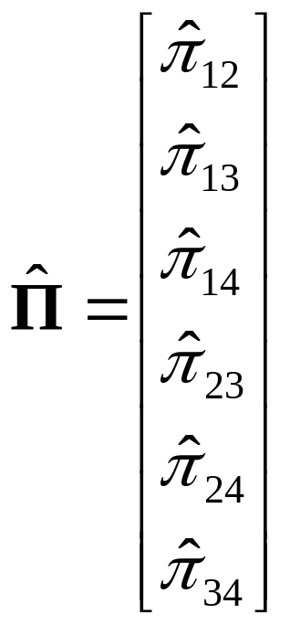
Dependent Variables
Estimated IBD sharing of all pairs of relatives
Example:

Slide 16
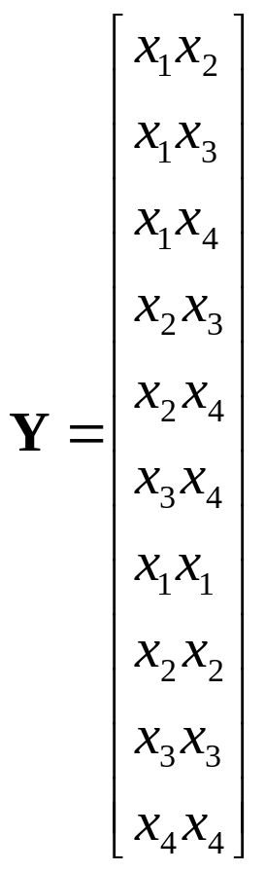
Independent Variables
Squares and cross-products
  (equivalent to non-redundant squared sums and differences)
Example

Slide 17
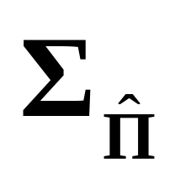
Covariance Matrices
Dependent
Obtained from prior (p) and posterior (q)
IBD distribution given marker genotypes

Slide 18
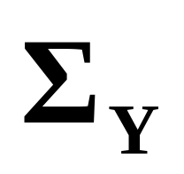
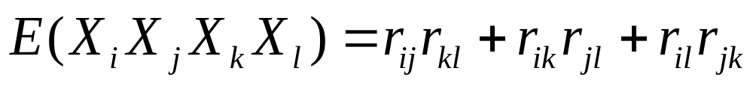
Covariance Matrices
Independent
Obtained from properties of multivariate normal distribution,
under specified mean, variance and correlations
Assuming the trait has mean zero and variance one.
Calculating this matrix requires the correlation between the different relative pairs to be known.

Slide 19
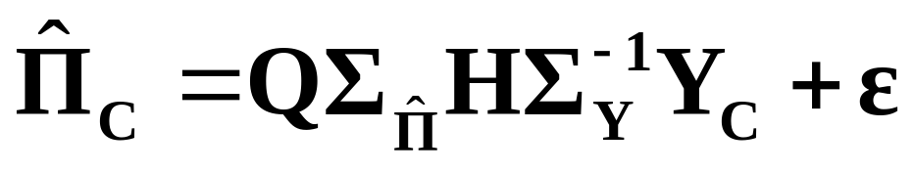
Estimation
For a family, regression model is
Estimate Q by weighted least squares, and obtain sampling variance, family by family
Combine estimates across families, inversely weighted by their variance, to give overall estimate, and its sampling variance

Slide 20
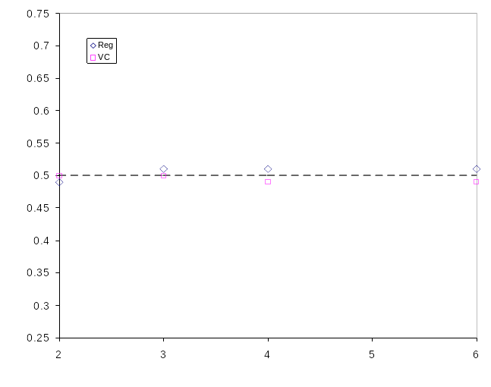
Average chi-squared statistics: fully informative marker NOT linked to 20% QTL
Average chi-square
N=1000 individuals
Heritability=0.5
10,000 simulations
Sibship size

Slide 21
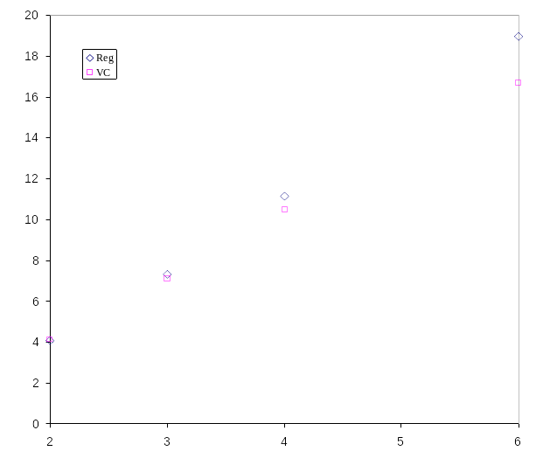
Average chi-squared statistics: fully informative marker linked to 20% QTL
Average chi-square
N=1000 individuals
Heritability=0.5
2000 simulations
Sibship size

Slide 22
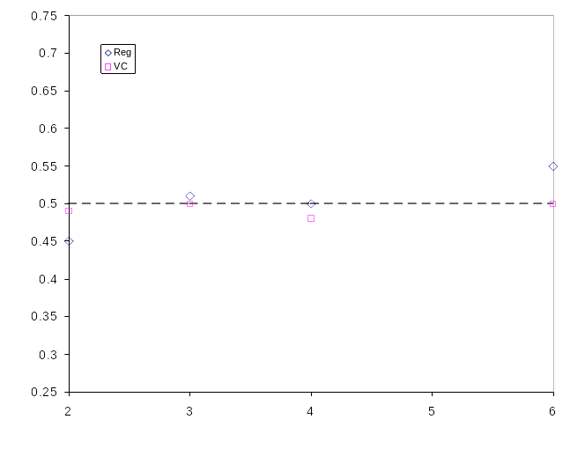
Average chi-squared statistics: poorly informative marker NOT linked to 20% QTL
Average chi-square
N=1000 individuals
Heritability=0.5
10,000 simulations
Sibship size

Slide 23
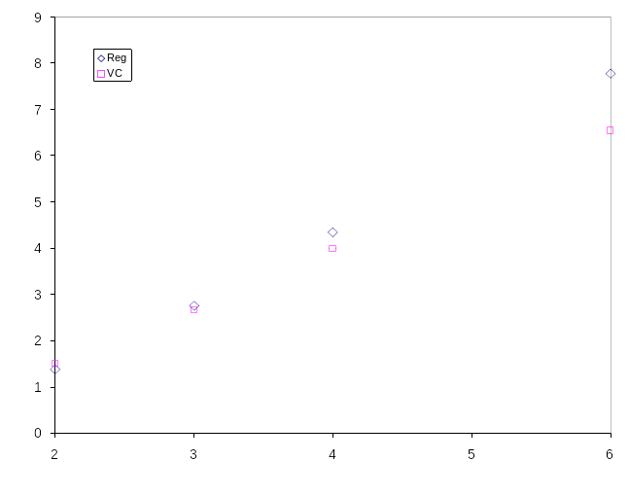
Average chi-squared statistics: poorly informative marker linked to 20% QTL
Average chi-square
N=1000 individuals
Heritability=0.5
2000 simulations
Sibship size

Slide 24
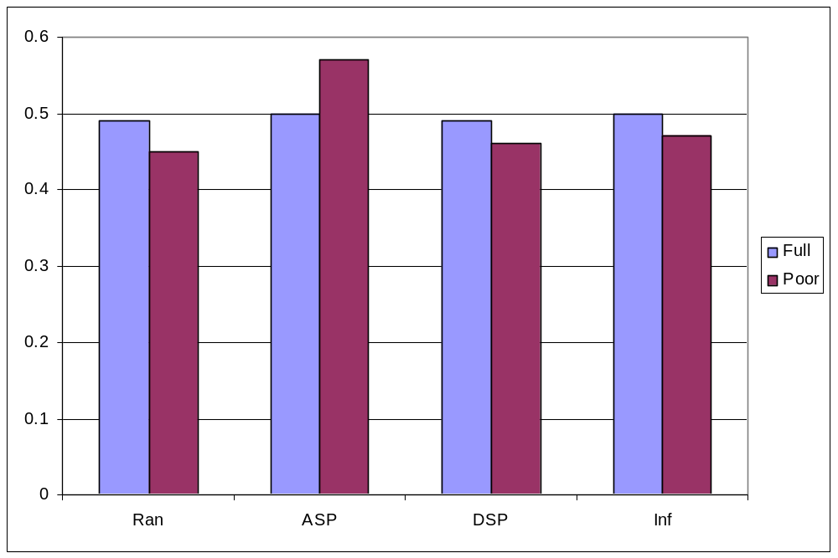
Average chi-squares: selected sib pairs, NOT linked to 20% QTL
20,000 simulations
10% of 5,000 sib pairs selected
Average chi-square
Selection scheme

Slide 25
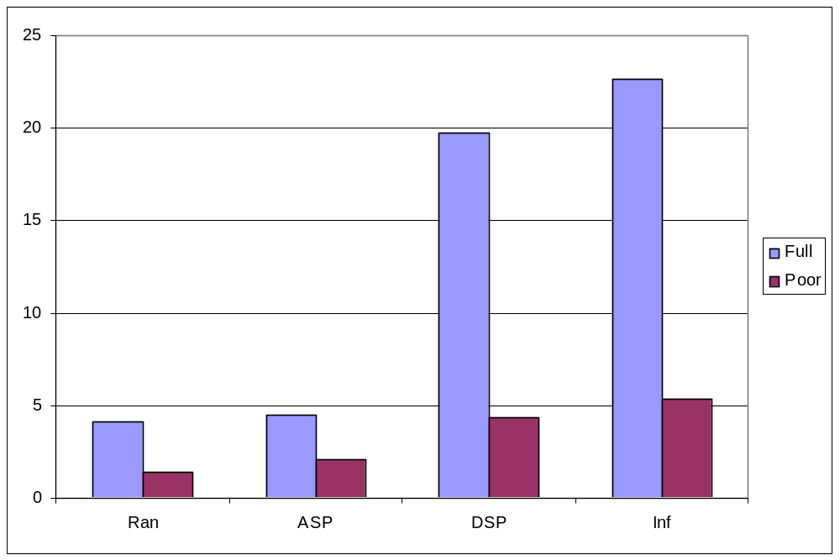
Average chi-squares: selected sib pairs, linkage to 20% QTL
2,000 simulations
10% of 5,000 sib pairs selected
Average chi-square
Selection scheme

Slide 26
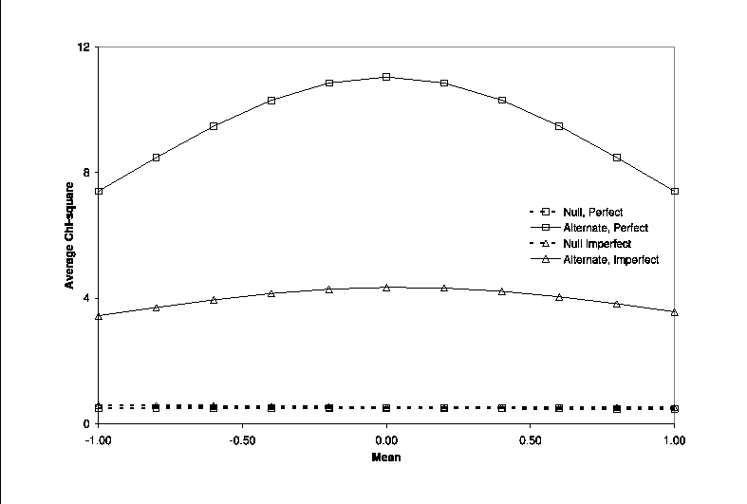
Mis-specification of the mean,
2000 random sib quads, 20% QTL
="Not linked, full"

Slide 27
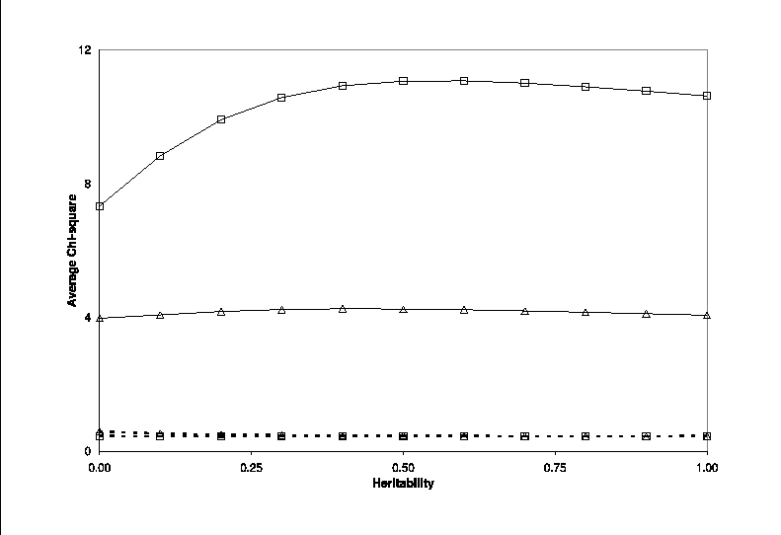
Mis-specification of the covariance,
2000 random sib quads, 20% QTL
="Not linked, full"

Slide 28
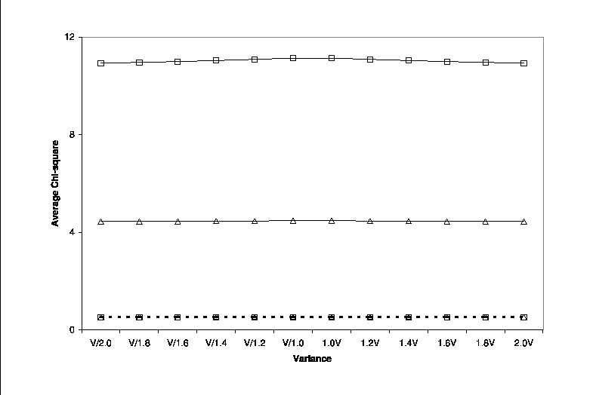
Mis-specification of the variance,
2000 random sib quads, 20% QTL
="Not linked, full"

Slide 29
Cousin pedigree

Slide 30
Average chi-squares for 200 cousin pedigrees, 20% QTL
 | Poor marker information |  | Full marker information
 | REG | VC | REG | VC
Not linked | 0.49 | 0.48 | 0.53 | 0.50
Linked | 4.94 | 4.43 | 13.21 | 12.56

Slide 31
Conclusion
The regression approach
  can be extended to general pedigrees
  is slightly more powerful than maximum likelihood variance components in large sibships
  can handle imperfect IBD information
  is easily applicable to selected samples
  provides unbiased estimate of QTL variance
  provides simple measure of family informativeness
  is robust to minor deviation from normality
But
  assumes knowledge of mean, variance and covariances of trait distribution in population

Slide 32
Example Application:
Angiotensin Converting Enzyme
British population
Circulating ACE levels
  Normalized separately for males / females
10 di-allelic polymorphisms
  26 kb
  Common
  In strong linkage disequilibrium
Keavney et al, HMG, 1998

Slide 33
Check The Data
The input data is in three files:
  keavney.dat
  keavney.ped
  keavney.map
These are text files, so you can peek at their contents, using more or notepad
A better way is to used pedstats …

Slide 34
Pedstats
Checks contents of pedigree and data files
  pedstats –d keavney.dat –p keavney.ped
Useful options:
  --pairStatistics Information about relative pairs
  --pdf Produce graphical summary
  --hardyWeinberg Check markers for HWE
  --minGenos 1 Focus on genotyped individuals
What did you learn about the sample?

Slide 35
Regression Analysis
MERLIN-REGRESS
Requires pedigree (.ped), data (.dat) and map (.map) file as input
Key parameters:
  --mean, --variance
    Used to standardize trait
  --heritability
    Use to predicted correlation between relatives
Heritability for ACE levels is about 0.60

Slide 36
MERLIN-REGRESS
Identify informative families
  --rankFamilies
Customizing models for each trait
  -t models.tbl
  TRAIT, MEAN, VARIANCE, HERITABILITY in each row
Convenient options for unselected samples:
  --randomSample
  --useCovariates
  --inverseNormal

Slide 37
The End

