Slide 1

a taste of…
Quantum Learning
of
Quantum Data
Ryan O’Donnell
Carnegie Mellon University

Slide 2
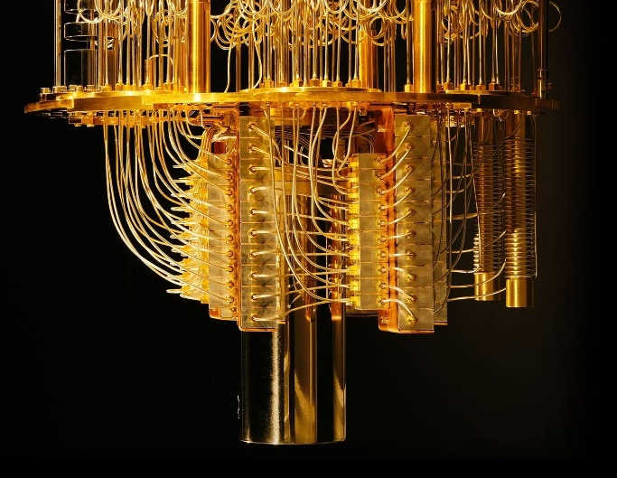

Quantum Learning
of
Quantum Data
classical
output
quantum
data
quantum computer
Goal: Efficiency comparable to the
analogous classical problems
quantum computer image by
Graham Carlow for Quanta Magazine

Slide 3

Quantum Learning
of
Classical Data
[Harrow–Hassidim–Lloyd 2009]
classical
output
classical
data
quantum computer
Goal: Efficiency exponentially better
than classical algorithms
quantum computer image by
Graham Carlow for Quanta Magazine

Slide 4
Quantum Learning
of
Quantum Data
classical
output
quantum
data
quantum computer
This talk: Unsupervised learning /
density estimation
quantum computer image by
Graham Carlow for Quanta Magazine

Slide 5
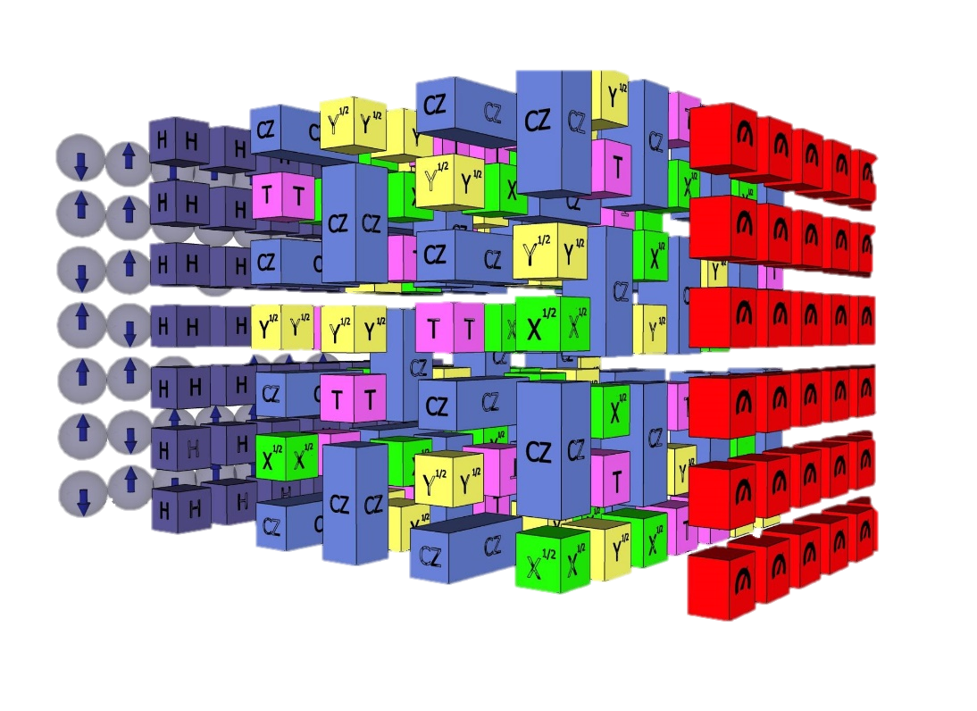
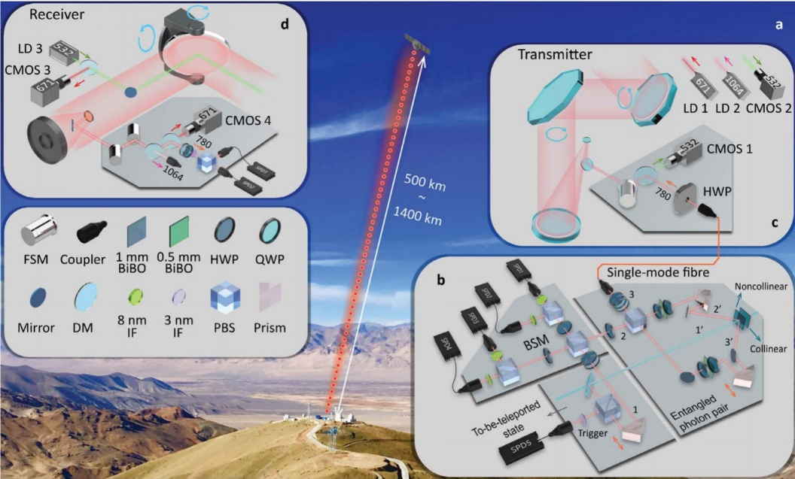
Motivation
Say you build a quantum circuit…
Or perform quantum teleportation…
You’ll want to learn what quantum state is output,
or estimate its distance to a target state.

Slide 6
Quantum Learning
of
Quantum Data
classical
output
quantum
data
quantum computer
Goal: Efficiency comparable to the
analogous classical problems
quantum computer image by
Graham Carlow for Quanta Magazine

Slide 7
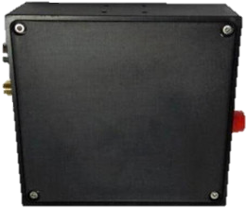
Classical Learning
of
Classical Data
classical
output
classical
data
classical computer
This talk: Unsupervised learning /
density estimation

Slide 8
Classical Density Estimation
Nature draws
from p^{⊗m}
You pay for
m samples
Unknown distribution p
on {1, 2, …, d}
E.g., sample =
2, 1, 3, 3, 1
Algorithm
thinks for a
while about
sample
Sample revealed
to the algorithm
Algorithm outputs
an estimate X
e.g., X could be an estimate of p, of Entropy(p), of dist(p,q) for hypothesis q…

Slide 9
Quantum Density Estimation
log₂d
qubits
Nature draws
from p^{⊗m}
You pay for
m samples
Unknown distribution p
on unknown orthonormal
basis v₁, …, v_{d} of ℂ^{d}
E.g., sample =
v₂, v₁, v₃, v₃, v₁
Algorithm
thinks about
measurement
outcome
Algorithm may apply
a “measurement” to
sample v₂⊗v₁⊗v₃⊗v₃⊗v₁
Algorithm outputs
an estimate X
e.g., X could be an estimate of p, of p and v_{i}’s, of Entropy(p), …

Slide 10
What is a measurement?
Imagine there’s just one sample,
an unknown unit vector v ∈ ℂ^{d}
Algorithm’s “measurement” is an
orthonormal basis b₁, …, b_{d} of its choice
“Measuring” v using basis b₁, …, b_{d} returns
j ∈ {1, …, d} with probability |b_{j}† v|² = v† b_{j} b_{j}† v

Slide 11
What is a measurement?
“Measuring” v using basis b₁, …, b_{d} returns
j ∈ {1, …, d} with probability |b_{j}† v|² = v† b_{j} b_{j}† v
Suppose algorithm outputs X = λ_{j} ∈ ℝ upon receiving outcome j
= ∑ _{j} v† b_{j} b_{j}† v ∙ λ_{j}
= v† (∑ _{j} λ_{j} b_{j} b_{j}†) v
E[output X]
= v† A v, where A = ∑ _{j} λ_{j} b_{j} b_{j}†
(Also: E[X²] = v† A² v.)

Slide 12
What is a measurement?
E[output X]
= v† A v, where A = ∑ _{j} λ_{j} b_{j} b_{j}†
Can forget b_{j}’s and λ_{j}’s, just say:
Algorithm is any self-adjoint matrix (“observable”) A ∈ ℂ^{d×d}
Given sample v, algorithm’s output is a random variable with mean v† A v
(and second moment v† A² v)

Slide 13
Back to Quantum Density Estimation
Algorithm is any self-adjoint matrix A ∈ ℂ^{d×d}
Given sample v, algorithm’s output is a random variable with mean v† A v
But don’t forget, sample v is also random: equals v_{i} with probability p_{i}
And you can pay for m samples

Slide 14
Quantum Density Estimation
log₂d
qubits
Nature draws
from p^{⊗m}
You pay for
m samples
Unknown distribution p
on unknown orthonormal
basis v₁, …, v_{d} of ℂ^{d}
E.g., sample =
v₂, v₁, v₃, v₃, v₁
Algorithm may apply
a “measurement” to
sample v₂⊗v₁⊗v₃⊗v₃⊗v₁
Algorithm outputs
an estimate X
e.g., X could be an estimate of p, of p and v_{i}’s, of Entropy(p), …

Slide 15
Quantum Density Estimation
Algorithm is any self-adjoint matrix A ∈ ℂ^{d×d}
Given sample v, algorithm’s output is a random variable with mean v† A v
But don’t forget, sample v is also random: equals v_{i} with probability p_{i}
And you can pay for m samples
And you can measure the samples jointly

Slide 16
Quantum Density Estimation
And you can measure the samples jointly
Sample (m=5) might be v₂⊗v₁⊗v₃⊗v₃⊗v₁
Algorithm is any self-adjoint operator A on (ℂ^{d})^{⊗5}
Algorithm’s output is a random variable
with mean (v₂⊗v₁⊗v₃⊗v₃⊗v₁)† A (v₂⊗v₁⊗v₃⊗v₃⊗v₁)
Let’s do an example, with m = 2!

Slide 17
Purity Estimation
Let’s do an example, with m = 2!
Algorithm is any self-adjoint operator A on (ℂ^{d})^{⊗2}
Let A be the operator that swaps the 2 tensor components
(Note: this is basis-independent and has eigenvalues ±1)

Slide 18
Purity Estimation
Let’s do an example, with m = 2!
Algorithm is any self-adjoint operator A on (ℂ^{d})^{⊗2}
Let A be the operator that swaps the 2 tensor components
If the sample is v_{j}⊗v_{k}, algorithm’s output is a random variable
with mean (v_{j}⊗v_{k})† A (v_{j}⊗v_{k}) = (v_{j}⊗v_{k})† (v_{k}⊗v_{j}) =
1 if j = k
0 if j ≠ k
overall mean of output is Pr[j = k] = p₁² + p₂² + ∙ ∙ ∙ + p_{d}²

Slide 19
Purity Estimation
We have a 2-sample algorithm,
overall mean of output is Pr[j = k] = p₁² + p₂² + ∙ ∙ ∙ + p_{d}²
“purity” of the state
≈ distance to
“maximally mixed state”

Slide 20
Purity Estimation
We have a 2-sample algorithm,
overall mean of output is Pr[j = k] = p₁² + p₂² + ∙ ∙ ∙ + p_{d}²
“purity” of the state
Exercise: 2nd moment of output is 1. So variance ≤ 1.
.01
Repeat O(d²) times to estimate purity with error ± ―
d
But… there’s a much better algorithm!

Slide 21
Purity Estimation
Say we pay for m > 2 samples
Let A = avg { R(τ) : transpositions τ ∈ S_{m} }
where, in general, R(π) acts on (ℂ^{d})^{⊗m} by
permuting tensor components according to π
Exercise: mean of output is still purity = p₁² + p₂² + ∙ ∙ ∙ + p_{d}²
Calculating variance involves calculating A²… we’ll come back to this
Upshot: Quadratically better, O(d) samples suffice (which is tight)
[O’D–Wright ’15, Bădescu–O’D–Wright ’19]

Slide 22
Let A = avg { R(τ) : transpositions τ ∈ S_{m} }
where, in general, R(π) acts on (ℂ^{d})^{⊗m} by
permuting tensor components according to π
A² = avg { R(σ) R(τ) : transpositions σ, τ ∈ S_{m} }
= avg { R(στ) : transpositions σ, τ ∈ S_{m} }
R : S_{m} → {Matrices acting on (ℂ^{n})^{⊗m}} is a group representation

Slide 23
Let A = avg { R(τ) : transpositions τ ∈ S_{m} }
where, in general, R(π) acts on (ℂ^{d})^{⊗m} by
permuting tensor components according to π
A² = avg { R(σ) R(τ) : transpositions σ, τ ∈ S_{m} }
= avg { R(στ) : transpositions σ, τ ∈ S_{m} }
= + c₁ avg { R(π) : cycleType(π) = (1) }
= + c₂ avg { R(π) : cycleType(π) = (2,2) }
= + c₃ avg { R(π) : cycleType(π) = (3) }
for some not-hard-to-compute coefficients c₁, c₂, c₃

Slide 24
Let A = avg { R(τ) : transpositions τ ∈ S_{m} }
= A₍₂₎
where, in general, R(π) acts on (ℂ^{d})^{⊗m} by
permuting tensor components according to π
A²
= avg { R(σ) R(τ) : transpositions σ, τ ∈ S_{m} }
= avg { R(στ) : transpositions σ, τ ∈ S_{m} }
= + c₁ avg { R(π) : cycleType(π) = (1) }
= + c₂ avg { R(π) : cycleType(π) = (2,2) }
= + c₃ avg { R(π) : cycleType(π) = (3) }
= c₁ A₍₁₎ + c₂ A_{(2,2)} + c₃ A₍₃₎
where A_{T} = avg { R(π) : cycleType(π) = T }

Slide 25
Let A = avg { R(τ) : transpositions τ ∈ S_{m} }
= A₍₂₎
where, in general, R(π) acts on (ℂ^{d})^{⊗m} by
permuting tensor components according to π
A²
= c₁ A₍₁₎ + c₂ A_{(2,2)} + c₃ A₍₃₎
where A_{T} = avg { R(π) : cycleType(π) = T }
Theorem:
Minimum-variance unbiased estimator for
any statistic of {p₁, …, p_{d}} is
a linear combination of the A_{T}’s.
[Childs–Harrow–Wocjan ’06
Bădescu–O’D–Wright ’19]
Proof:
Because representation theory.

Slide 26
Minimum-variance unbiased estimator for
any statistic of {p₁, …, p_{d}} is
a linear combination of the A_{T}’s.
Purity p₁² + p₂² + ∙ ∙ ∙ + p_{d}²
Distance to max. mixed state
|p₁ − 1/d| + ∙ ∙ ∙ + |p_{d} − 1/d|
ϴ(d/ϵ²) samples to test if =0 or >ϵ
[O’D–Wright ’15]
max_{i} {p_{i}}
ϴ(1/ϵ²) samples to estimate to ±ϵ
[O’D–Wright ’16]
Entropy({p_{i}})
ϴ(d²/ϵ + log²d/ϵ²) samples for ±ϵ
[Bavarian–Mehrabian–Wright ’16,
Acharya–Issa–Shende–Wagner ’19]

Slide 27
Representation theory approach to
general quantum learning problems…
O(d²/ϵ²) samples sufficient
[Alicki–Rudnicki–Sadowski ’88, Keyl–Werner ’01,
Hayashi–Matsumoto ’02, Christandl–Mitchison ’06,
O’D–Wright ’15]
Learning all {p₁, …, p_{d}}
Learning the whole state
{p₁, …, p_{d}}, {v₁, …, v_{d}}
ϴ(d²/ϵ²) samples necessary, sufficient
[Haah–Harrow–Ji–Wu–Yu ’16, O’D–Wright ’16, ’17]
Confirming it’s (close to) target
state {q₁, …, q_{d}}, {w₁, …, w_{d}}
ϴ(d/ϵ²) samples necessary, sufficient
[Bădescu–O’D–Wright ’19]

Slide 28
Some final words on practical efficiency

Slide 29
Quantum learning of quantum data
is done experimentally, all the time.
Preparing 8 entangled qubits in a particular state?
Have to estimate fidelity to your target state.
Doing a quantum teleportation experiment?
Have to learn the received state.
Building a small NISQ quantum computer?
Have to estimate what your gates actually do,
estimate the noise model. (Learning a quantum channel.)

Slide 30
Quantum learning of quantum data
is done experimentally, all the time.
Nobody uses any of the algorithms I’ve talked about.
Why not?

Slide 31
Reason 1: Entangled measurements
Implementing a general m-sample measurement A would typically be as hard as building a full-scale quantum computer.
Today it’s only feasible to build 1-sample measurements A. What are the optimal algorithms in this scenario?
ϴ(d³/ϵ²) samples necessary and sufficient for
learning the whole state {p₁, …, p_{d}}, {v₁, …, v_{d}}.
[Kueng–Rauhut–Terstiege ’14, Haah–Harrow–Ji–Wu–Yu ’16]

Slide 32
Reason 2: poly(d) or poly(#qubits)?
For n-qubit systems, d = 2^{n}.
poly(d) algorithms are useless unless n is tiny!
An interesting way around this: “Shadow Tomography”
[Aaronson ’16, Jaynes ’57]

Slide 33
Shadow Tomography
Recall: When state ρ = ({p₁, …, p_{d}}, {v₁, …, v_{d}}) applied to
“observable” A = ∑ _{j} λ_{j} b_{j} b_{j}† , output has mean
E_{j~p}[v_{j}† A v_{j}]
E_{ρ}[A] :=
Suppose we have sample access to unknown ρ,
and fixed observables A₁, A₂, …, A_{t} (with eigenvalues λ in [0,1])
Goal: Learn all E_{ρ}[A_{k}] to accuracy ±ϵ.

Slide 34
Shadow Tomography
Suppose we have sample access to unknown ρ,
and fixed observables A₁, A₂, …, A_{t} (with eigenvalues λ in [0,1])
Goal: Learn all E_{ρ}[A_{k}] to accuracy ±ϵ.
Classical analogue:
Given sample access to unknown p on {1, …, d},
and fixed f₁, f₂, …, f_{t} : {1, …, d} → [0,1],
learn all E_{p}[f_{k}] to accuracy ±ϵ.
O(log(t)/ϵ²)
samples
suffice.

Slide 35
Shadow Tomography
Suppose we have sample access to unknown ρ,
and fixed observables A₁, A₂, …, A_{t} (with eigenvalues λ in [0,1])
Goal: Learn all E_{ρ}[A_{k}] to accuracy ±ϵ.
Quantum challenge: Can’t “reuse” samples!
Idea 1: Estimate E_{ρ}[A₁], … E_{ρ}[A_{t}] separately. O(t/ϵ²) samples.
Idea 2: Learn ρ. O(d²/ϵ²) samples.
# qubits
[Aaronson ’17]: Õ(log⁴(t) log(d) / ϵ⁵) samples.

Slide 36
Shadow Tomography
[Aaronson ’17]: Õ(log⁴(t) log(d) / ϵ⁵) samples
[Aaronson–Chen–Hazan–Nayak ’17, cf.
Brandão–Kalev–Li–Lin–Svore–Wu ’17,
Apeldoorn–Gilyén ’18]
Õ(log⁴(t) log(d) / ϵ⁴) samples
using connection
to online learning
Õ(log²(t) log²(d) / ϵ⁸) samples
[Aaronson–G. Rothblum ’19]
using connection to
Differential Privacy!

Slide 37
Shadow Tomography
Is there an Õ(log(t) log^{C}(d) / ϵ^{C}) sample algorithm?
Is there an Õ(log^{C}(t) / ϵ^{C}) sample algorithm?
Is there an O(log(t) / ϵ²) sample algorithm??

Slide 38
Thanks!
For more: www.cs.cmu.edu/~odonnell/papers/tomography-survey.pdf

