Slide 1
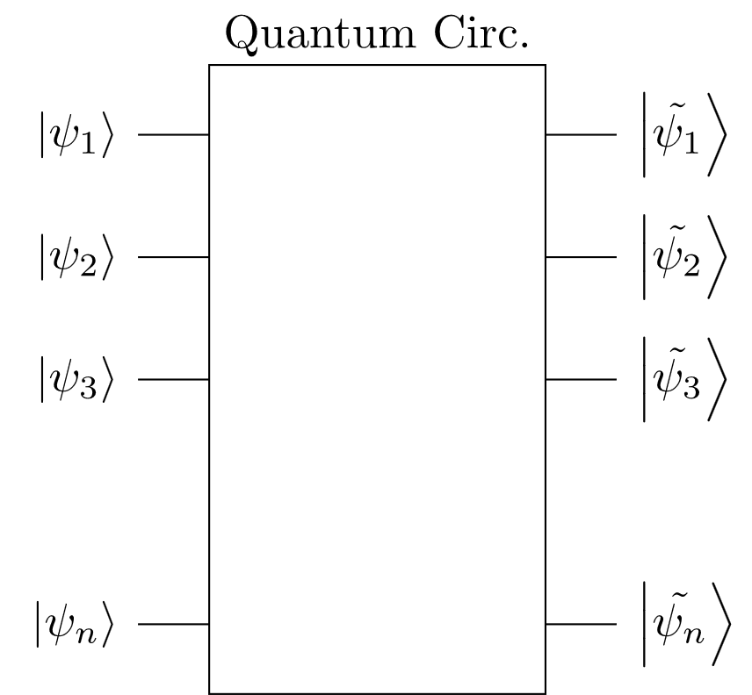
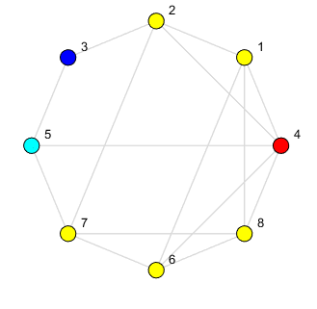
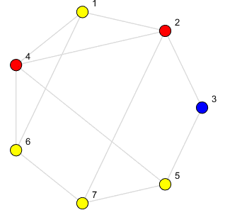
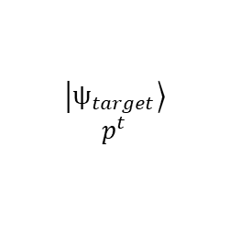
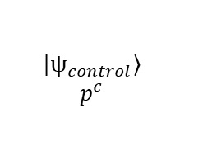


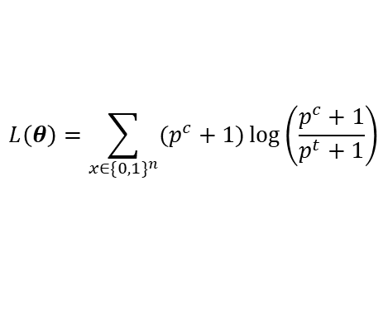



Optimizer – Quantum circuit
Shift-method implemented for gradient approximation
KL-divergence as loss function
$p^{c}$ might look like $p^{c}$ after optimization of $θ$
$$\frac{∂T}{∂θ}= \frac{T\left(θ+∆θ\right)−T\left(θ−∆θ\right)}{2 ∆θ},$$
$\left|\left.\frac{ψ_{target}}{∂θ}\right\rangle \right.=\frac{∂T}{∂θ}$ $\left|\left.ψ_{control}\right\rangle \right.$
$$L\left(θ\right)=\sum_{x∈{\{0,1\}}^{n}}{(p^{c}+1)\log\left(\frac{p^{c}+1}{p^{t}+1}\right)}$$
$\left|\left.ψ_{target}\right\rangle \right.=T(θ)$ $\left|\left.ψ_{control}\right\rangle \right.$
$$T(θ)$$
angles_{c}
angles_{t}
$$\left|\left.ψ_{control}\right\rangle \right.$$
$$p^{c}$$
$$\left|\left.ψ_{target}\right\rangle \right.$$
$$p^{t}$$

Slide 2
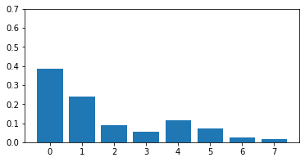
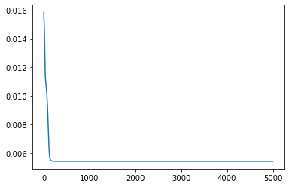
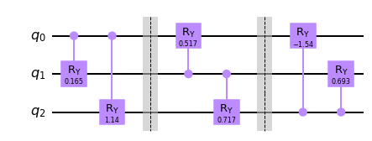
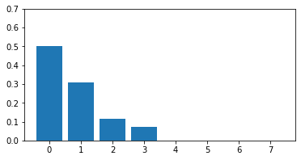
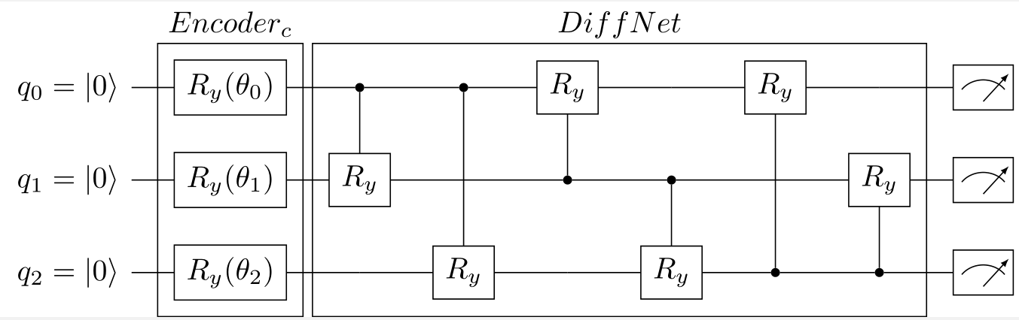
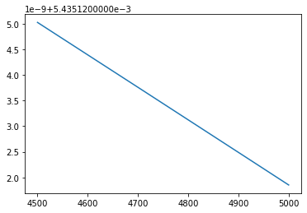
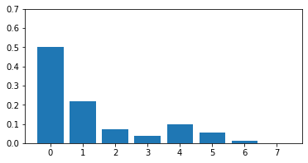
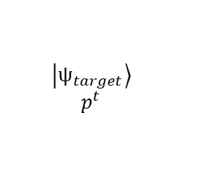
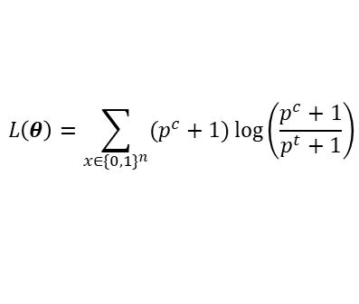
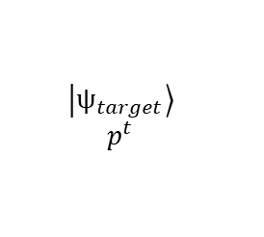
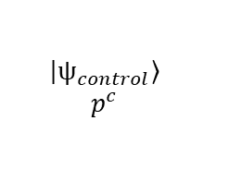
Optimization – Quantum circuit
Target distribution (pt)
3 qubits, 5000 steps, 6 parameters
$$L\left(θ\right)=\sum_{x∈{\{0,1\}}^{n}}{(p^{c}+1)\log\left(\frac{p^{c}+1}{p^{t}+1}\right)}$$
Loss function
Initial Control distribution (pc)
$$\left|\left.ψ_{control}\right\rangle \right.$$
$$p^{c}$$
$$\left|\left.ψ_{target}\right\rangle \right.$$
$$p^{t}$$
Final Control distribution (pc)
$$\left|\left.ψ_{control}\right\rangle \right.$$
$$p^{c}$$
$$\left|\left.ψ_{target}\right\rangle \right.$$
$$p^{t}$$

Slide 3
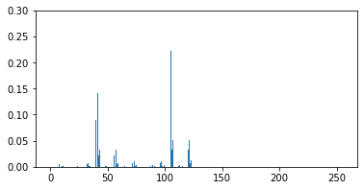
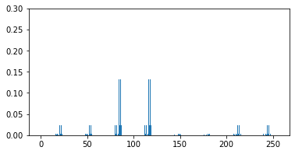
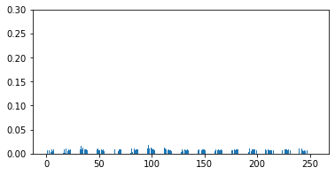
Optimization – Quantum circuit
Target distribution (pt)
8 qubits, 100 steps, 56 parameters
$$L\left(θ\right)=\sum_{x∈{\{0,1\}}^{n}}{(p^{c}+1)\log\left(\frac{p^{c}+1}{p^{t}+1}\right)}$$
Loss function
Initial Control distribution (pc)
$$\left|\left.ψ_{control}\right\rangle \right.$$
$$p^{c}$$
$$\left|\left.ψ_{target}\right\rangle \right.$$
$$p^{t}$$
Final Control distribution (pc)

Slide 4
Quantum state preparation
A divide-and-conquer algorithm for quantum state preparation
https://www.nature.com/articles/s41598-021-85474-1
https://github.com/adjs/dcsp/blob/master/random_vector.ipynb
Quantum State Preparation with Optimal Circuit Depth: Implementations and Applications
https://arxiv.org/abs/2201.11495

Slide 5
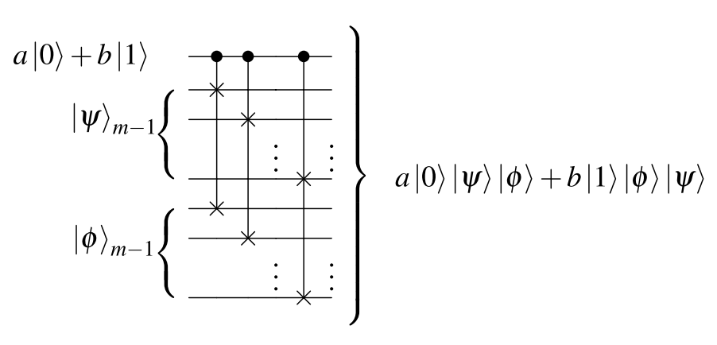

Divide-and-conquer algorithm
Divide a problem into subproblem of the same class
Takes a quantum state vector$\left|\left.ψ\right\rangle \right.$as input (2^{n} dimension)
It uses 2^{n}-1 qubits to encode the input vector, but only n qubits for measurement
Relies on controlled-swap operations

Slide 6
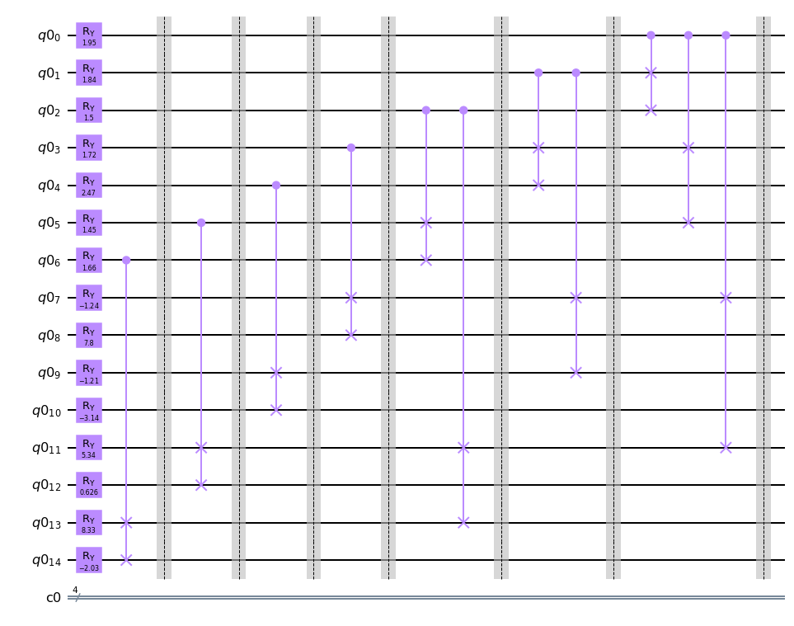
Divide-and-conquer algorithm (cont.)
Uses a tree approach to compute rotation angles, and smaller quantum state (sub-problem)
Navigates through the tree to setup c-swap gates
Example: 4-qubit vector (length = 16)
 |  |  |  | state | proba.
α₀ | α₁ | α₃ | α₇ | 0.181 | 0.0327
 |  |  |  | -0.129 | 0.0167
 |  |  | α₈ | -0.187 | 0.0349
 |  |  |  | -0.177 | 0.0312
 |  | α₄ | α₉ | 0.121 | 0.0147
 |  |  |  | -0.083 | 0.0070
 |  |  | α₁₀ | 0.001 | 0.0000
 |  |  |  | -0.420 | 0.1763
 | α₂ | α₅ | α₁₁ | -0.405 | 0.1639
 |  |  |  | 0.207 | 0.0428
 |  |  | α₁₂ | 0.383 | 0.1467
 |  |  |  | 0.124 | 0.0154
 |  | α₆ | α₁₃ | -0.198 | 0.0390
 |  |  |  | -0.325 | 0.1055
 |  |  | α₁₄ | 0.220 | 0.0482
 |  |  |  | -0.354 | 0.1251

Slide 7
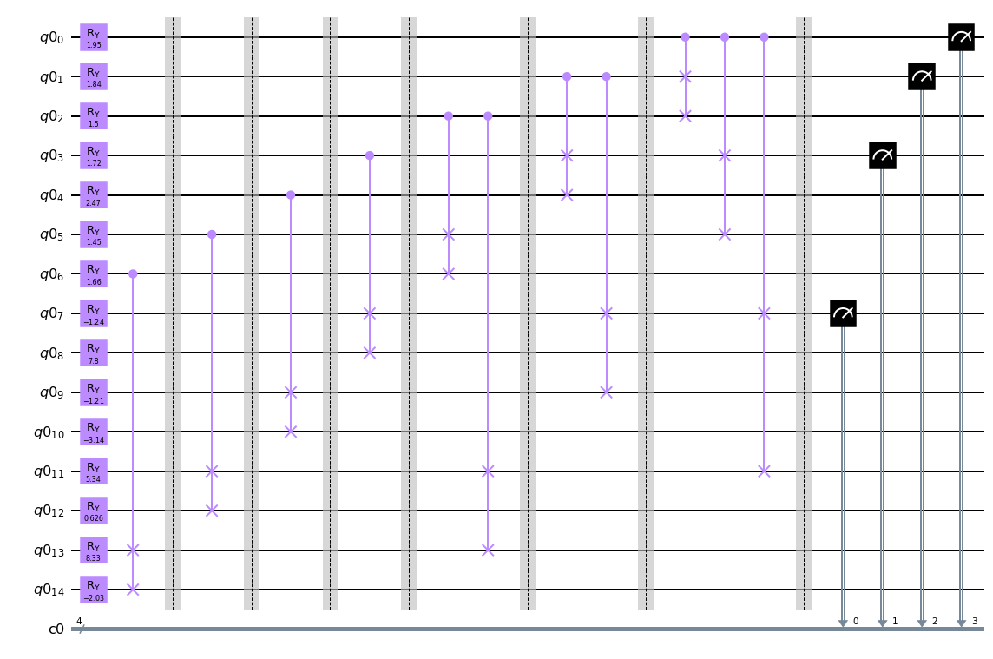
Divide-and-conquer algorithm (cont.)
Measurement qubits are chosen accordingly (4 qubits)

Slide 8

Divide-and-conquer algorithm (cont.)
Potential uses
It might help to encode the $ψ_{control}$ and $ψ_{target}$ states when the initial state is 0_{n}
It may reveal a new architecture for the Quantum Circ. when the initial state is $ψ_{control}$ and the encoded state is $ψ_{target}$
Disadvantages
The # of qubits increases exponentially
$$T(θ)$$
$$\left|\left.ψ_{control}\right\rangle \right.$$
$$p^{c}$$
$$\left|\left.ψ_{target}\right\rangle \right.$$
$$p^{t}$$

Slide 9
Thanks!

