Slide 1
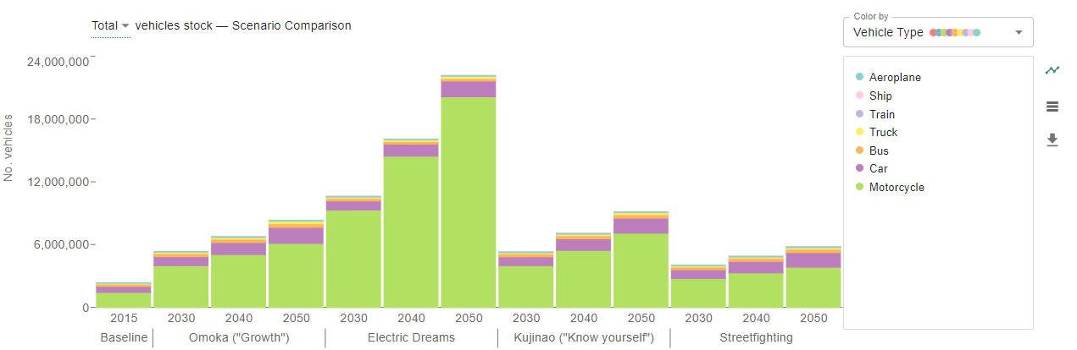
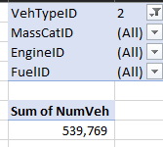
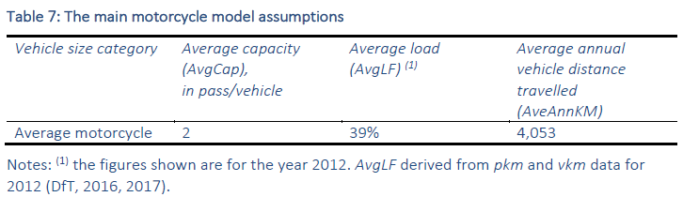
There are the right number of motos in the base year (but this is 2012). They grow very quickly.
39% of 2 ppl is 0.78 ppl. Wit

Slide 2
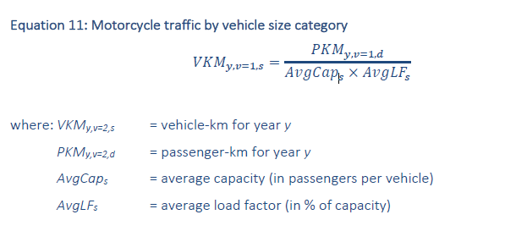
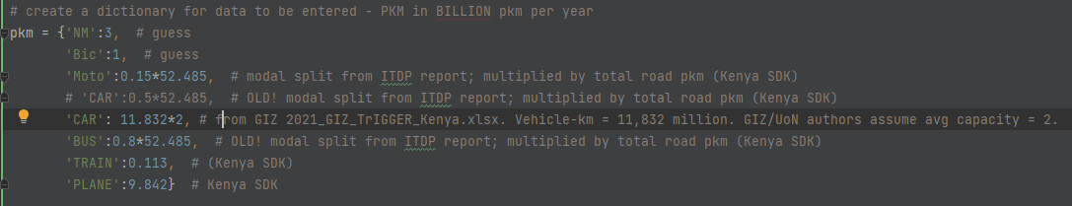
They are calculated in a fairly simple manner. We’re setting the pkm in parameters, and it’s from the ITDP paper
That’s not 15%!

Slide 3
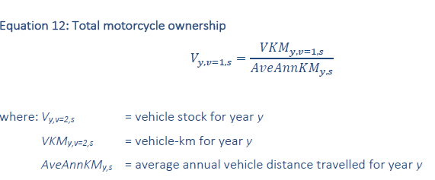
Total motorcycle stock is then calculated thus:

Slide 4
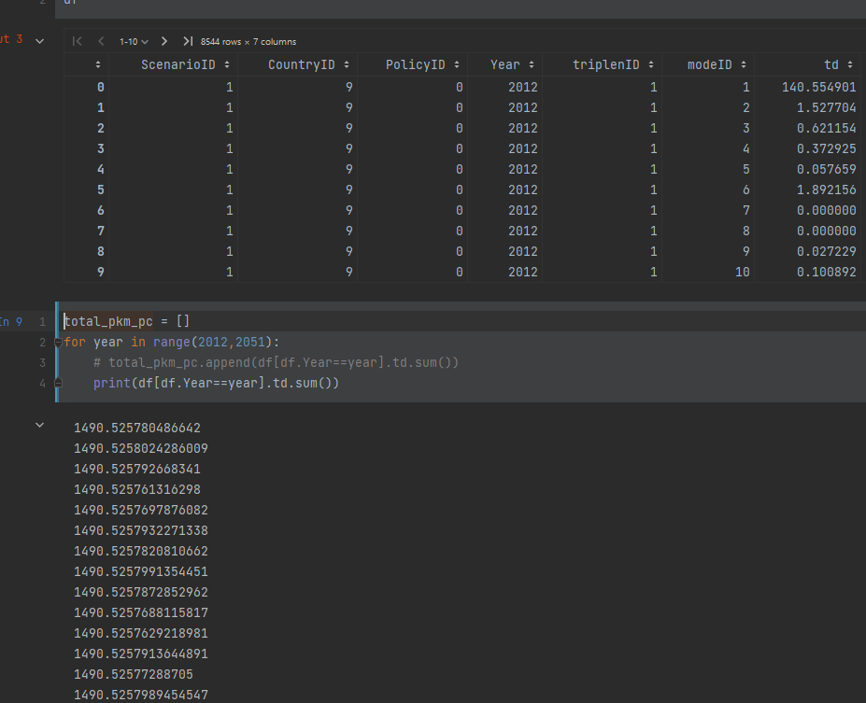
The pkm per capita total from the mode shares by triplen is the same for all years.
So the Q is how do the pkm change and why are they not reflected in this table
Presumably they must change on the basis of the motorbike calculation

