Slide 1
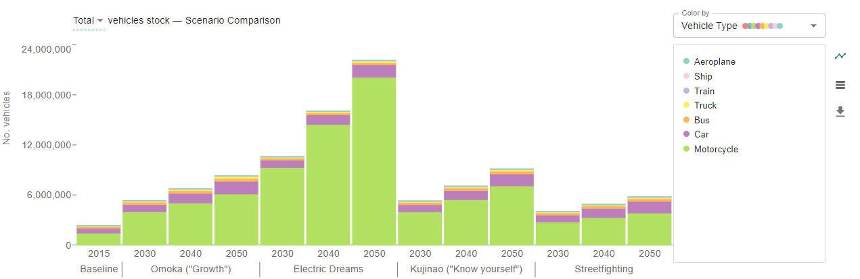
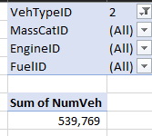
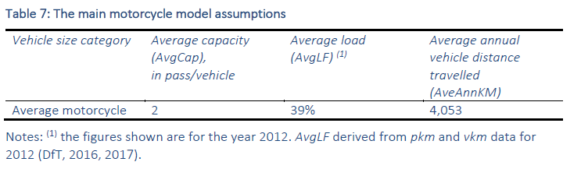
There are the right number of motos in the base year (but this is 2012). They grow very quickly.
39% of 2 ppl is 0.78 ppl. Wit

Slide 2
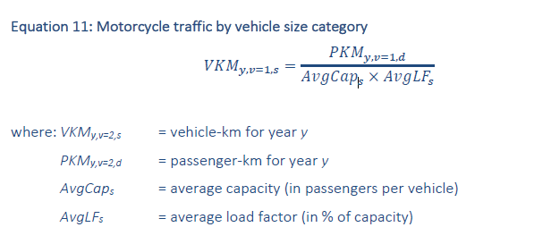
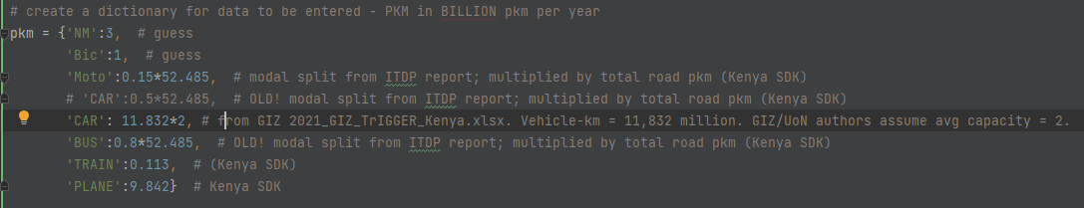
They are calculated in a fairly simple manner. We’re setting the pkm in parameters, and it’s from the ITDP paper
That’s not 15%!

Slide 3
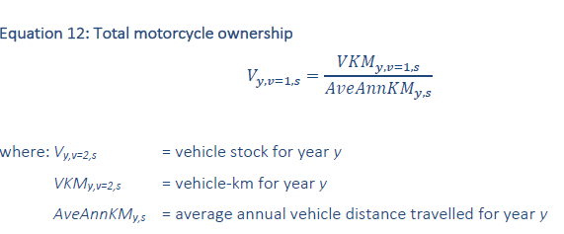
Total motorcycle stock is then calculated thus:

Slide 4
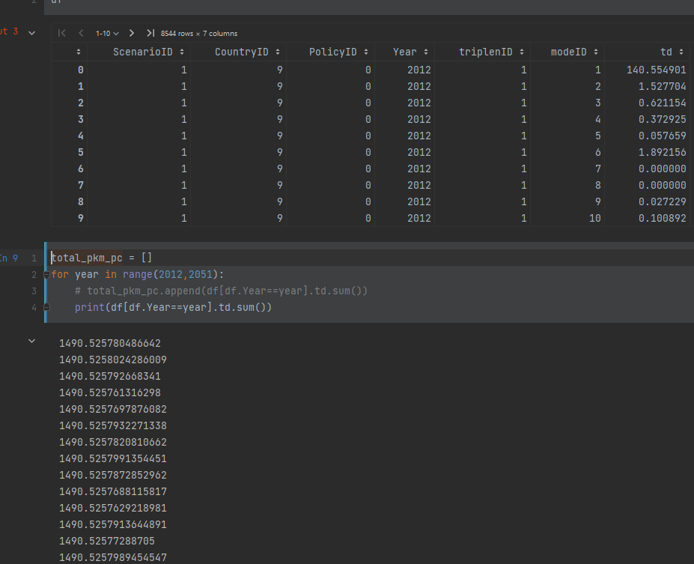
The pkm per capita total from the mode shares by triplen is the same for all years.
So the Q is how do the pkm change and why are they not reflected in this table
Presumably they must change on the basis of the motorbike calculation

Slide 5
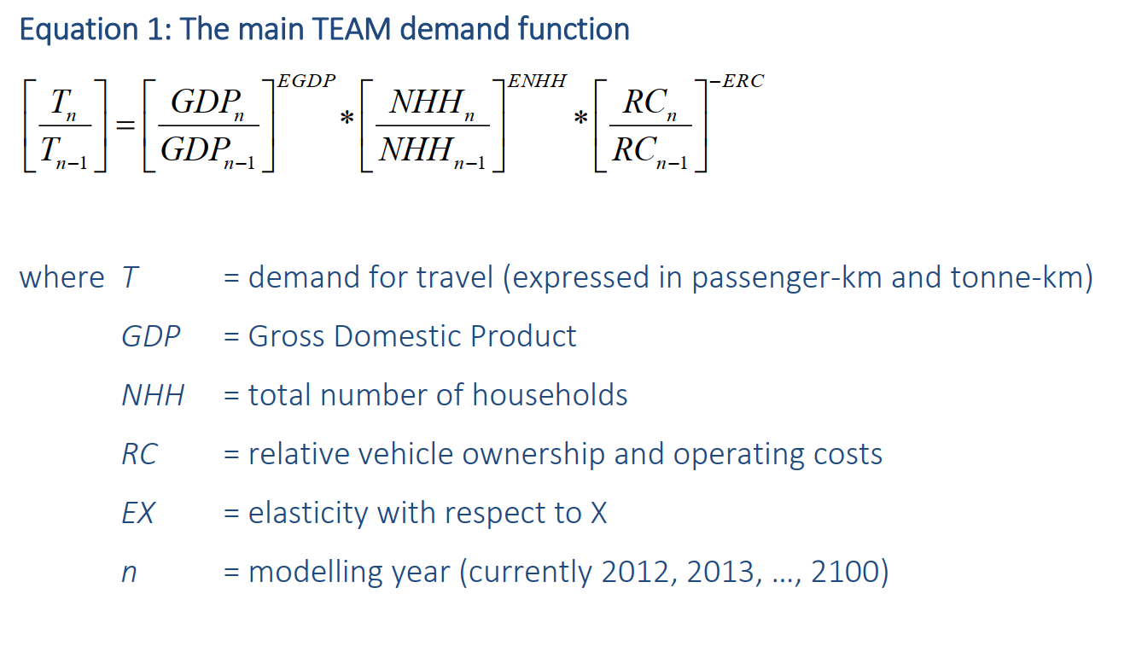
Re-visited
Pkm stays the same for all years (except a dip due to covid) for all scenarios, in both mode_shares_triplength and travel_demand
But this could be an artefact of the demand input sheets?
Go through how pkm is entered/calculated?
← What TEAM ref says

Slide 6
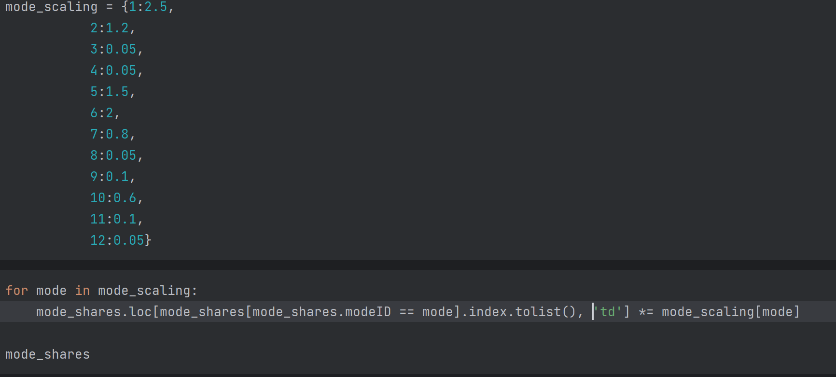
1. Enter mode shares by trip length from a set of semi-arbitrary (‘based on’ ITDP/GIZ) scaling factors UK → Kenya
This will set the td column for a given mode for all trip distances and every year

Slide 7
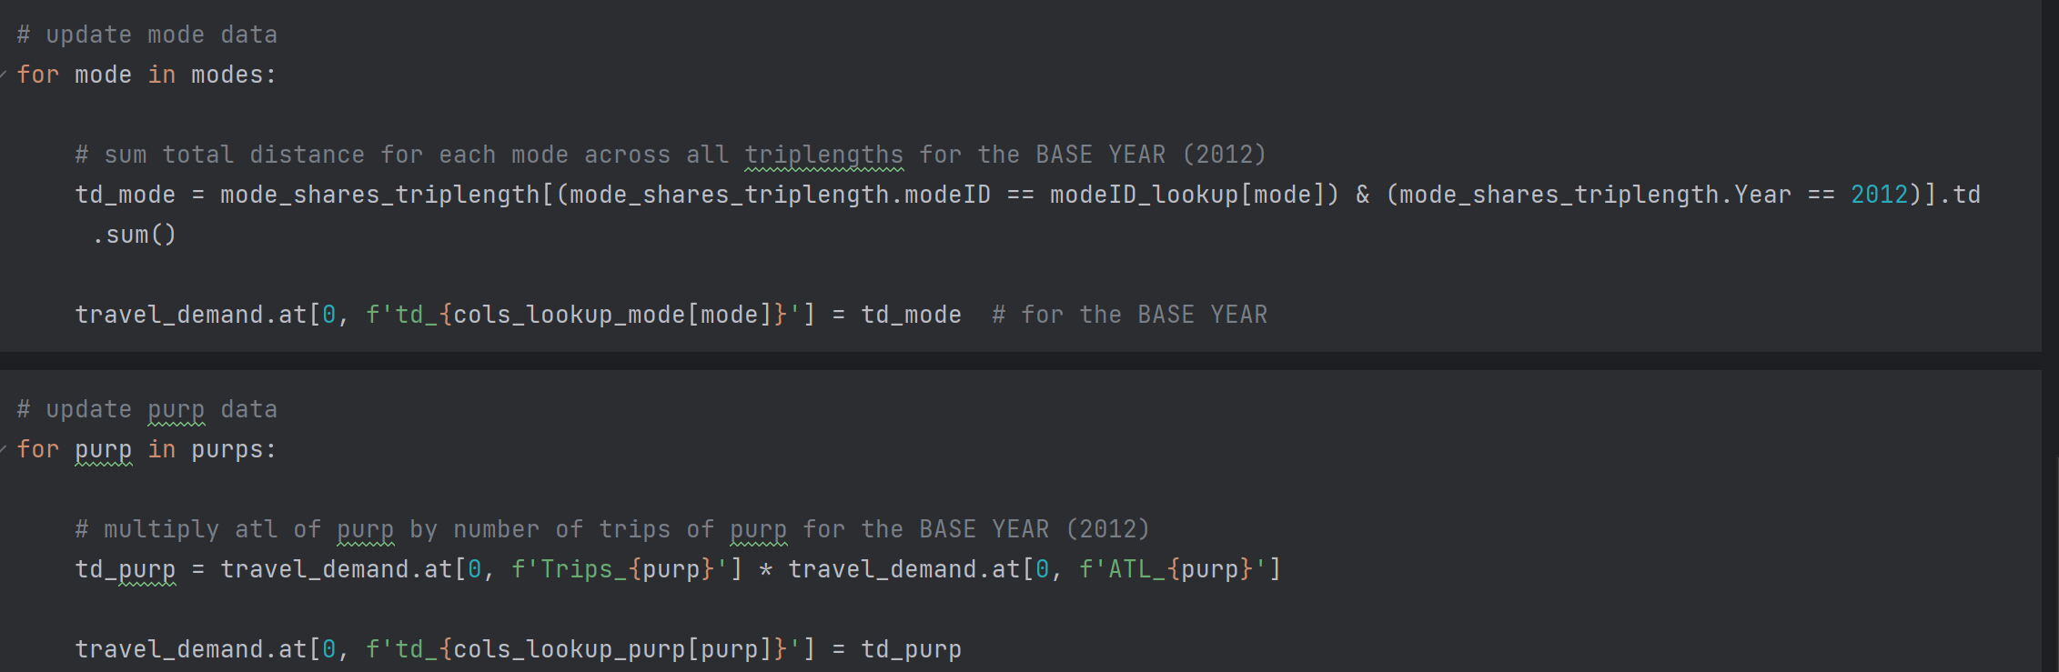
2. Enter travel demand data in travel_demand sheet based on processed WB travel survey results for the *base year* only

Slide 8
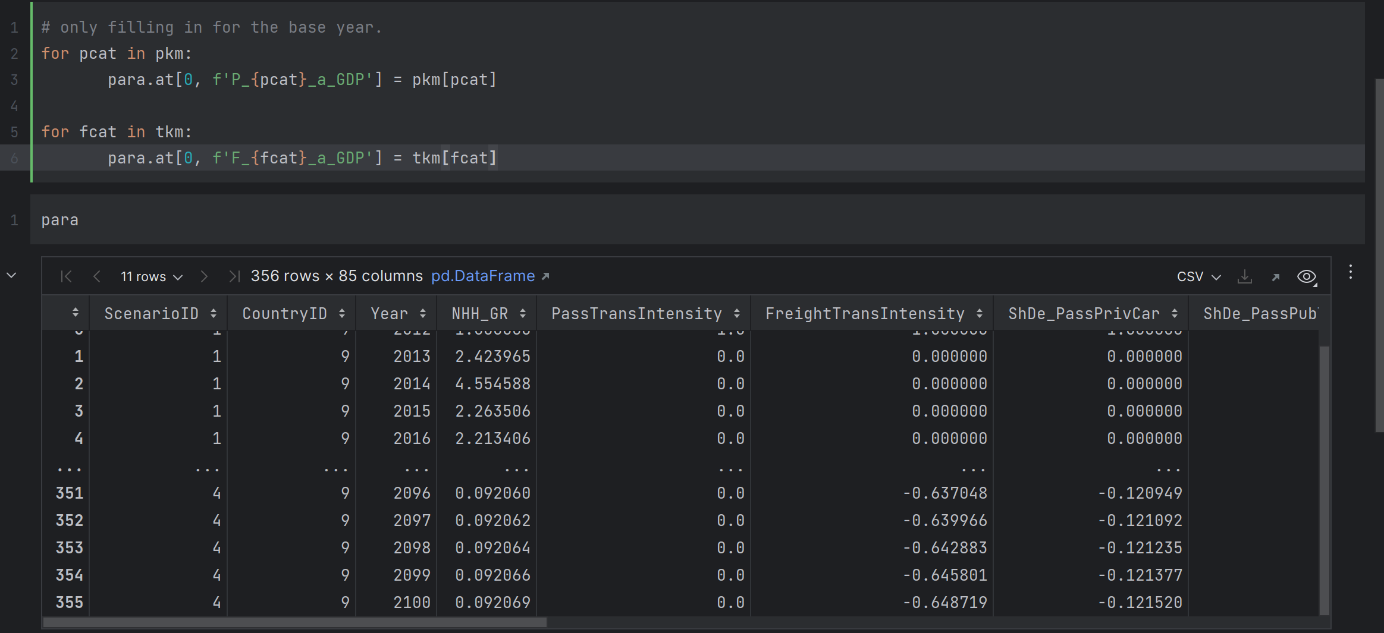
3. Enter pkm and tkm in the parameters sheet for the base year, base d on the OVERALL splits in ITDP report/GIZ data/SDK

Slide 9
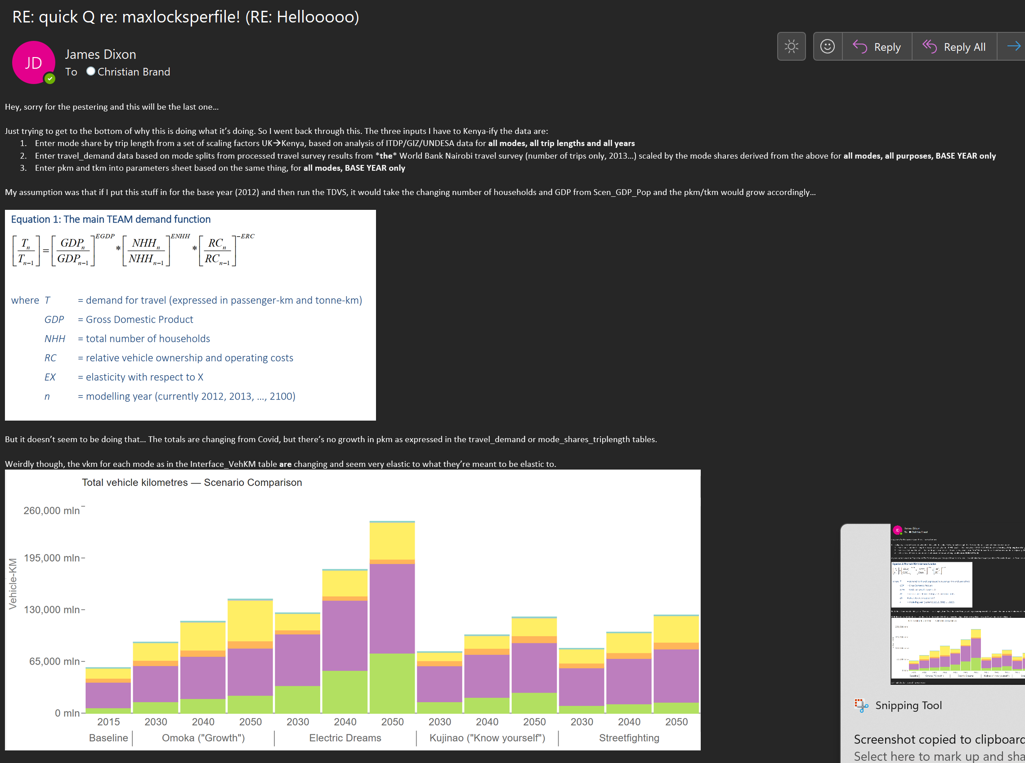
The pkms and tkms are NOT well aligned across the different data inputs – we can fix this relatively easily
The pkm is still, however, not being driven by the drivers. Wait for CB’s response on this.

Slide 10
Quick update – what else needs doing
Go through each one in turn – what’s wrong?

Slide 11
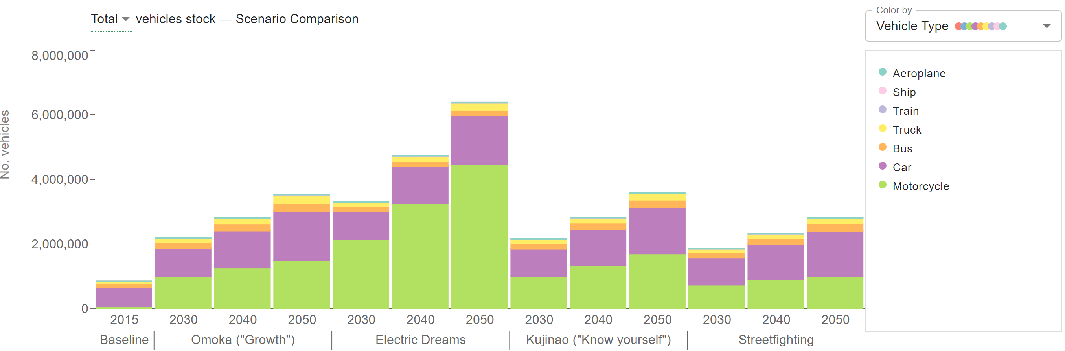
Vehicle stock

Slide 12
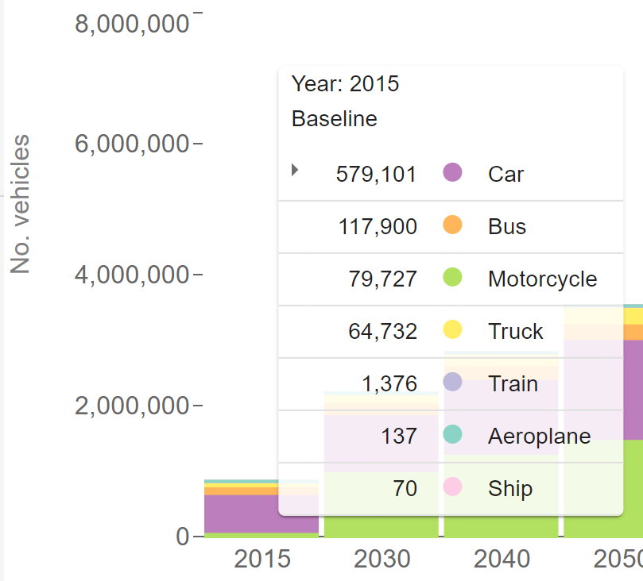
Base year vehicle stocks
This could still be because broken vehicle stock data (old).
Verified that newer version is ok and replaced.
Have now put in all the tables in the Kujinao version.
Will run tomorrow morning.
Seems fixed.

Slide 13
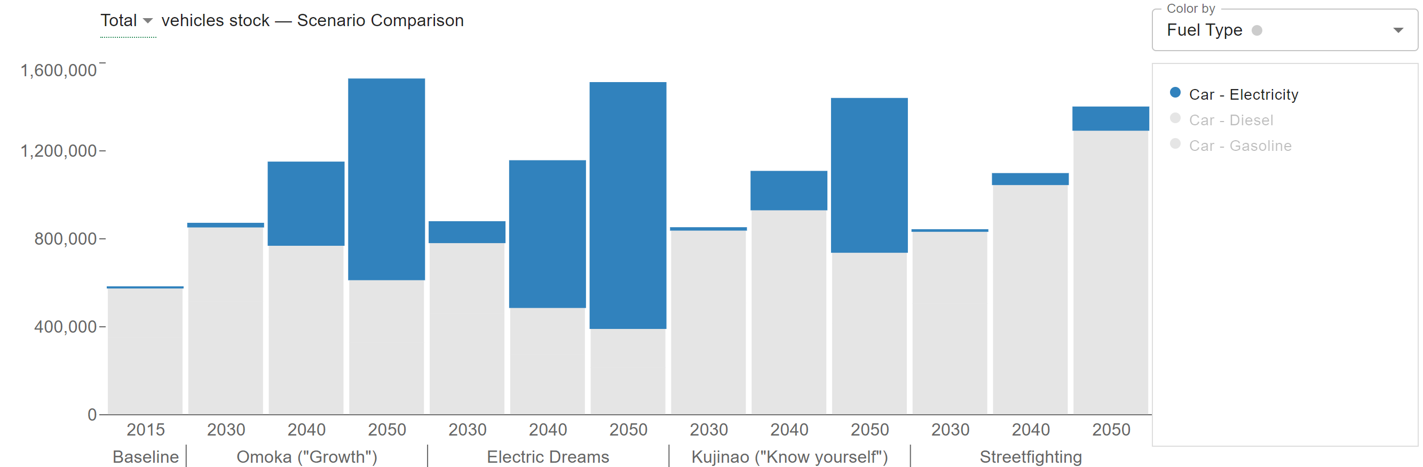
Uptake results cars
Less uptake for Kujinao – change tech subsidies and awareness
-done

Slide 14
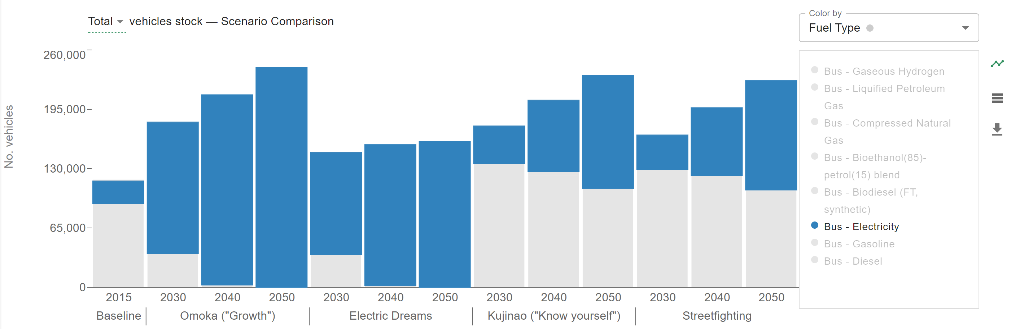
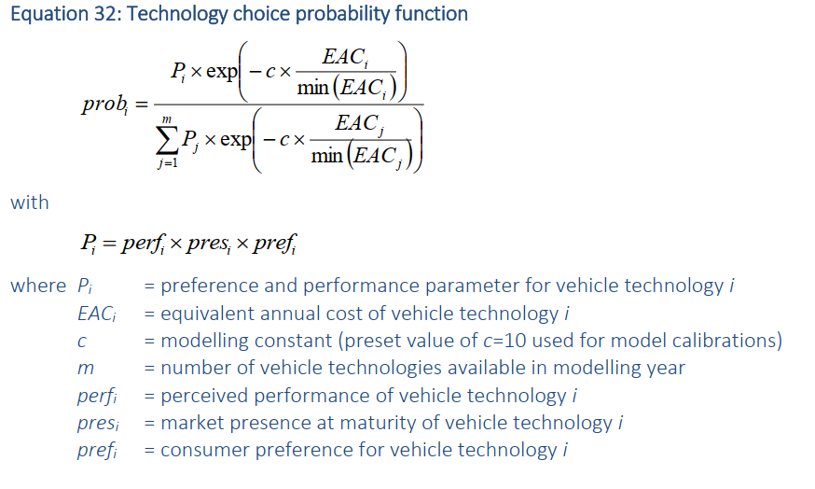
Uptake results buses
I think that’s ok. Maybe less uptake in Streetfighting?
This is driven by annual costs so we can affect it by playing with subisidies

Slide 15
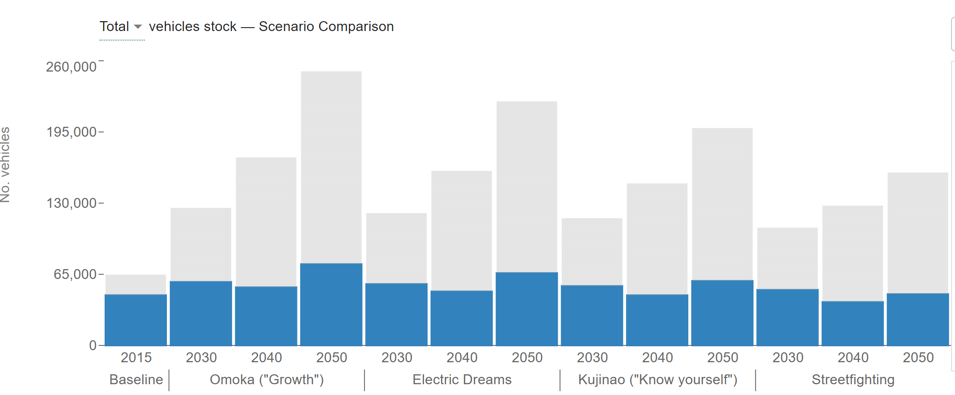
Uptake - trucks
The proportions of different tech are exactly the same across scenarios. change this.
This is because there is a sheet Scen_VanTypes, analogous to Scen_CarSegments, that sets things like supply penalties
But, actually, we are changing supply penalties in Cost_Data. Why?

Slide 16
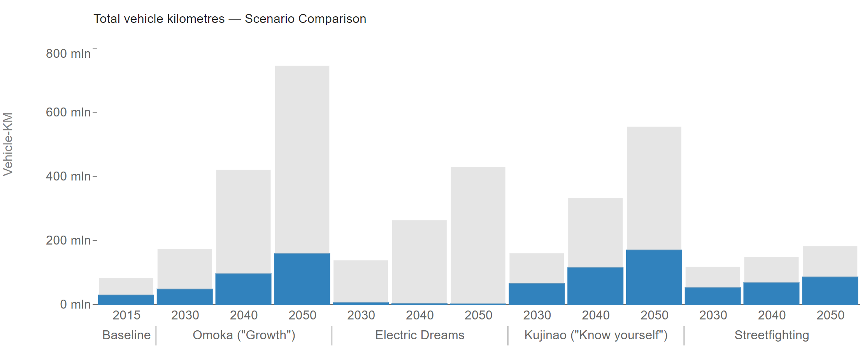
Uptake – DIESEL trains
Here electric train uptake is too low for the omoka scenario

Slide 17
Plan of action – transport demand data
Current method:
Enter mode share by trip length from a set of scaling factors UKàKenya, based on analysis of ITDP/GIZ/UNDESA data for all modes, all trip lengths and all years
Enter travel_demand data based on mode splits from processed travel survey results from *the* World Bank Nairobi travel survey (number of trips only, 2013…) scaled by the mode shares derived from the above for all modes, all purposes, BASE YEAR only
Enter pkm and tkm into parameters sheet based on the same thing, for all modes, BASE YEAR only
They are not linked up.
Now they are – to the best of all possibilities!

Slide 18
Next
Go through different uptake issues, and change parameters. Run model again, upload data to dashboard.

Slide 19
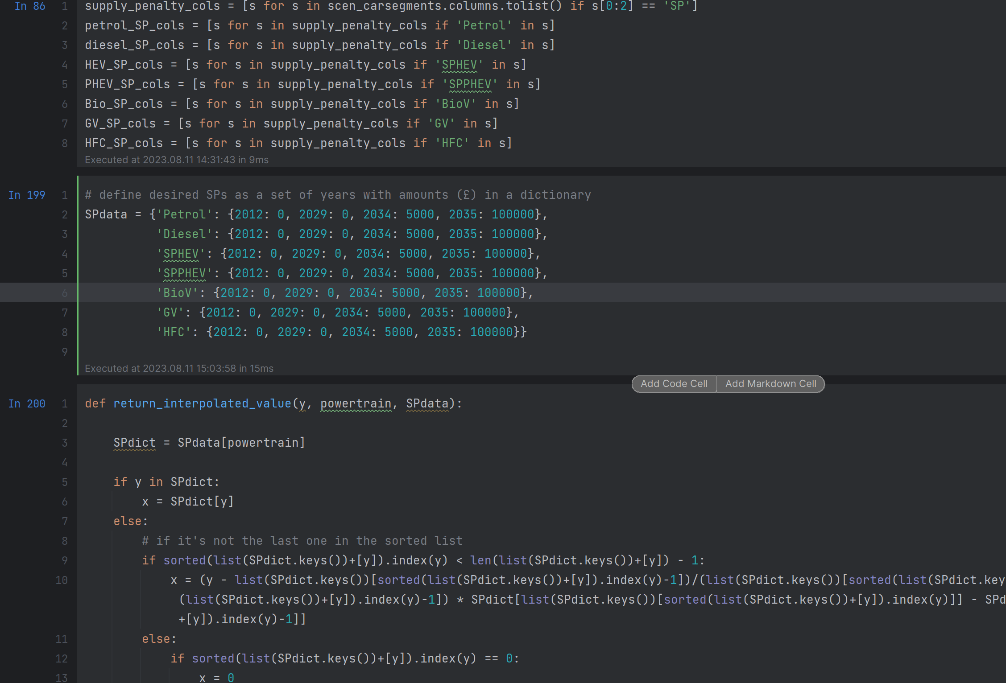
Next: re-oprn Scen_carSegments_change_supply… to change the supply penalties properly.

Slide 20
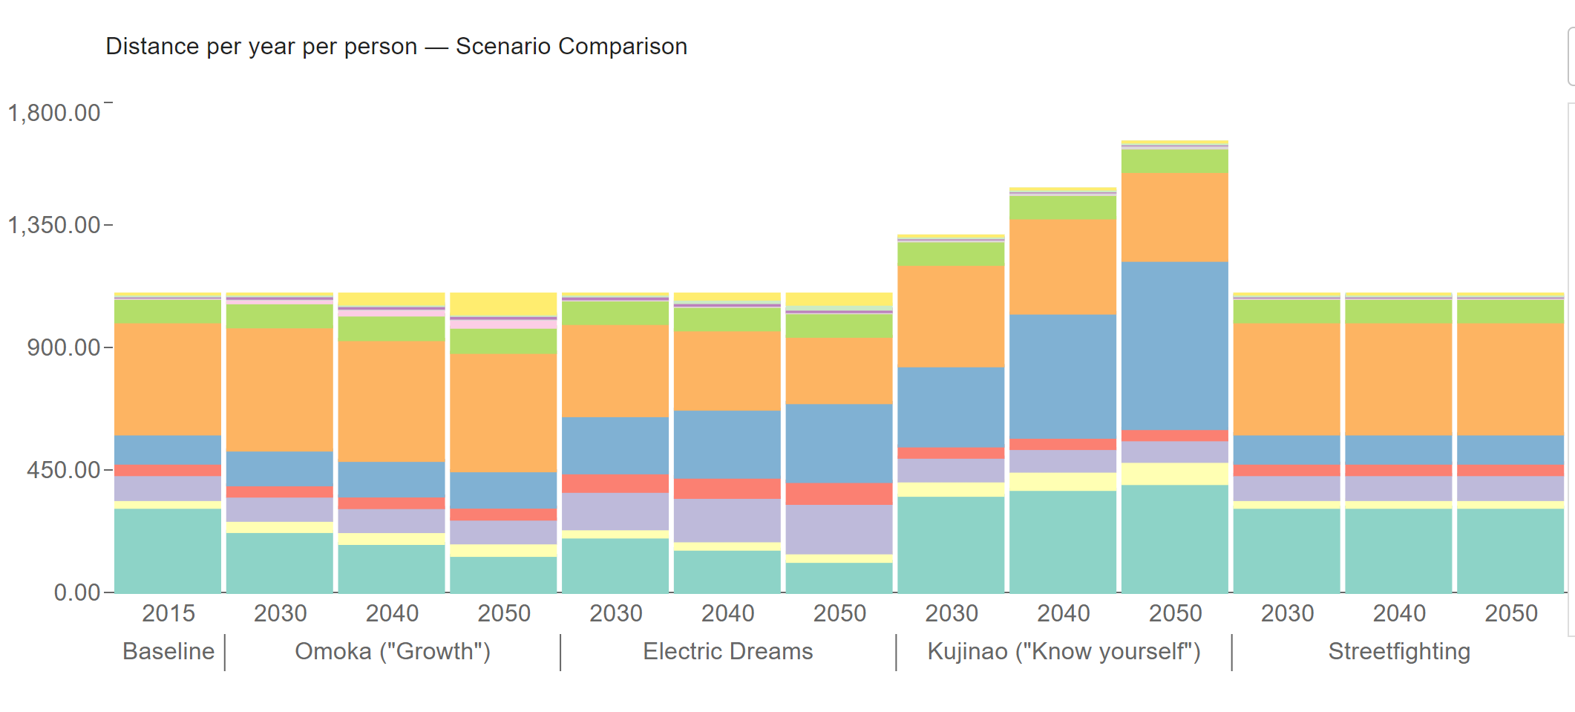
Done, and ran them again
What’s going on with that?

Slide 21
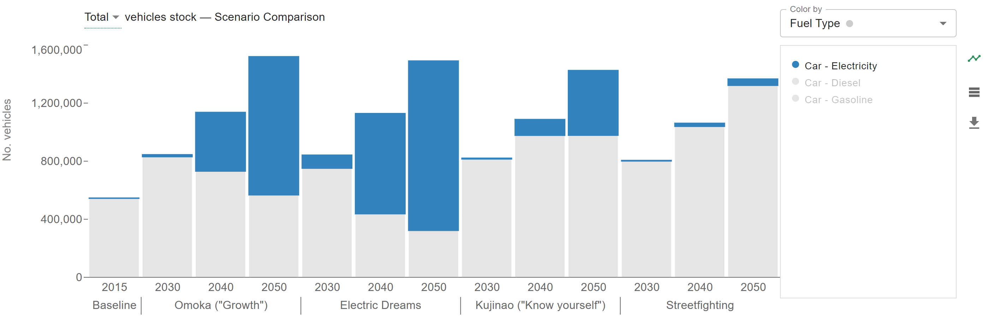
Uptake - car
good

Slide 22
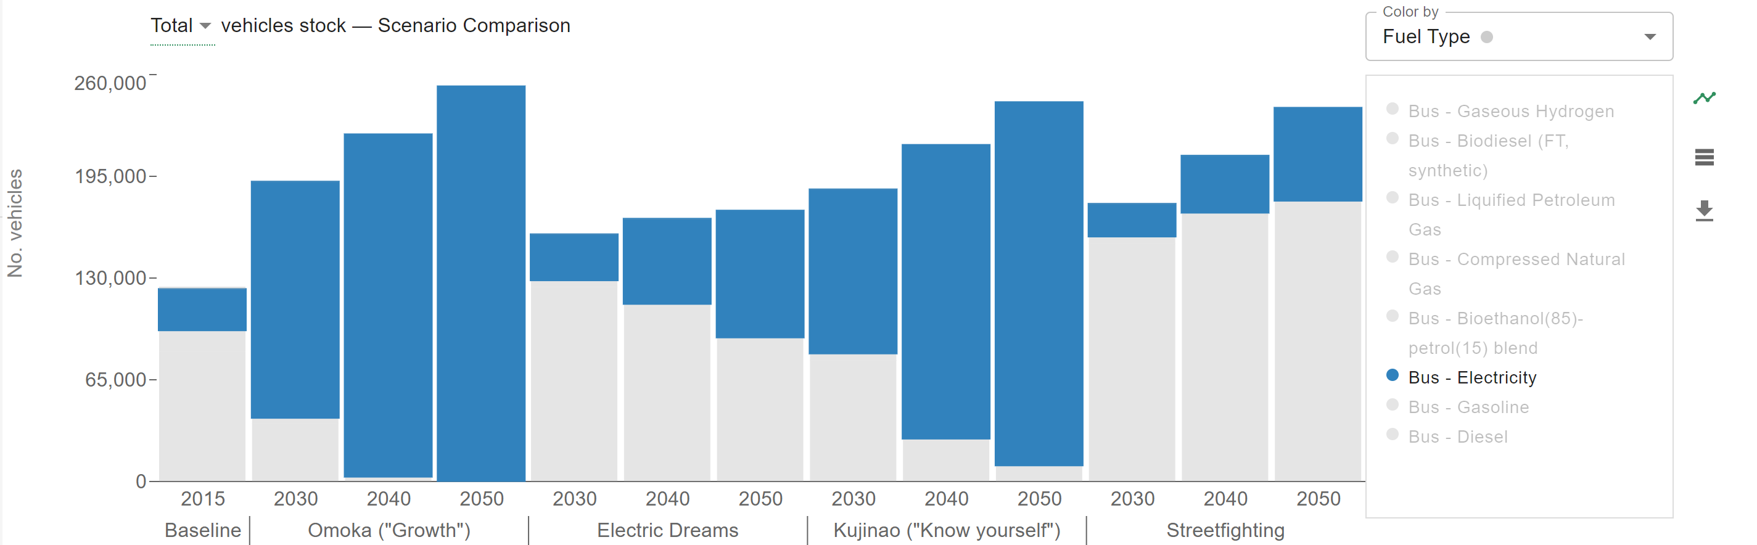
bus
Incentives too big for kujinao electric buses

Slide 23
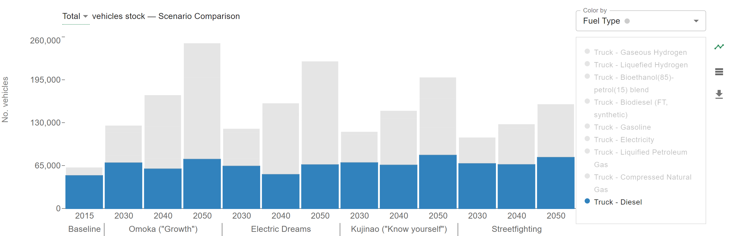
trcuks
Probs about right – highest proportion of disel in streetfighting, lowest in omoka

Slide 24
Tech subsidy
Add a year dimension to this! Makes no sense otherwise…

Slide 25
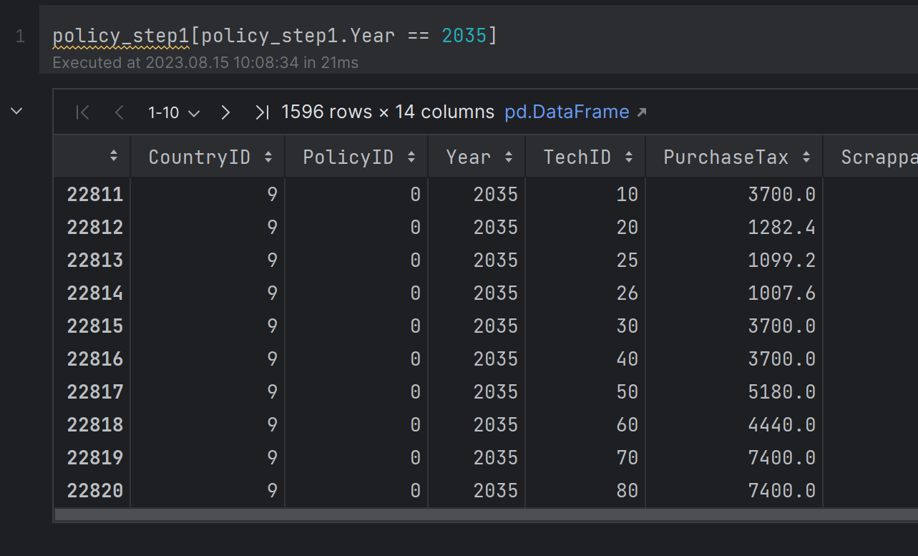
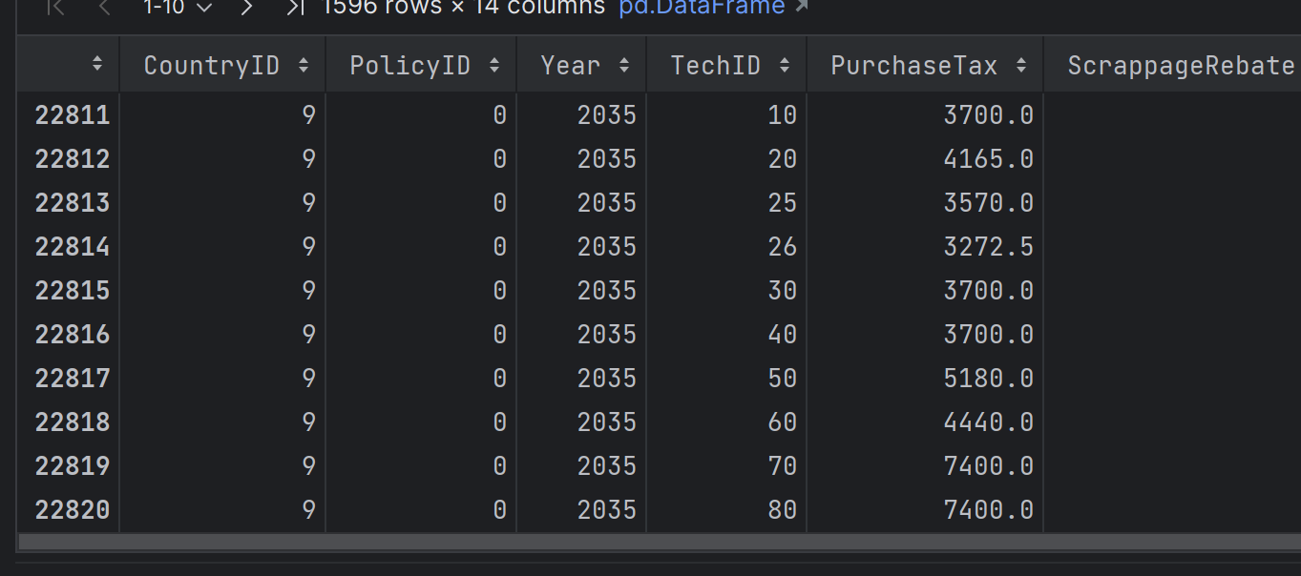
OMOKA
STREETFIGHTING

Slide 26
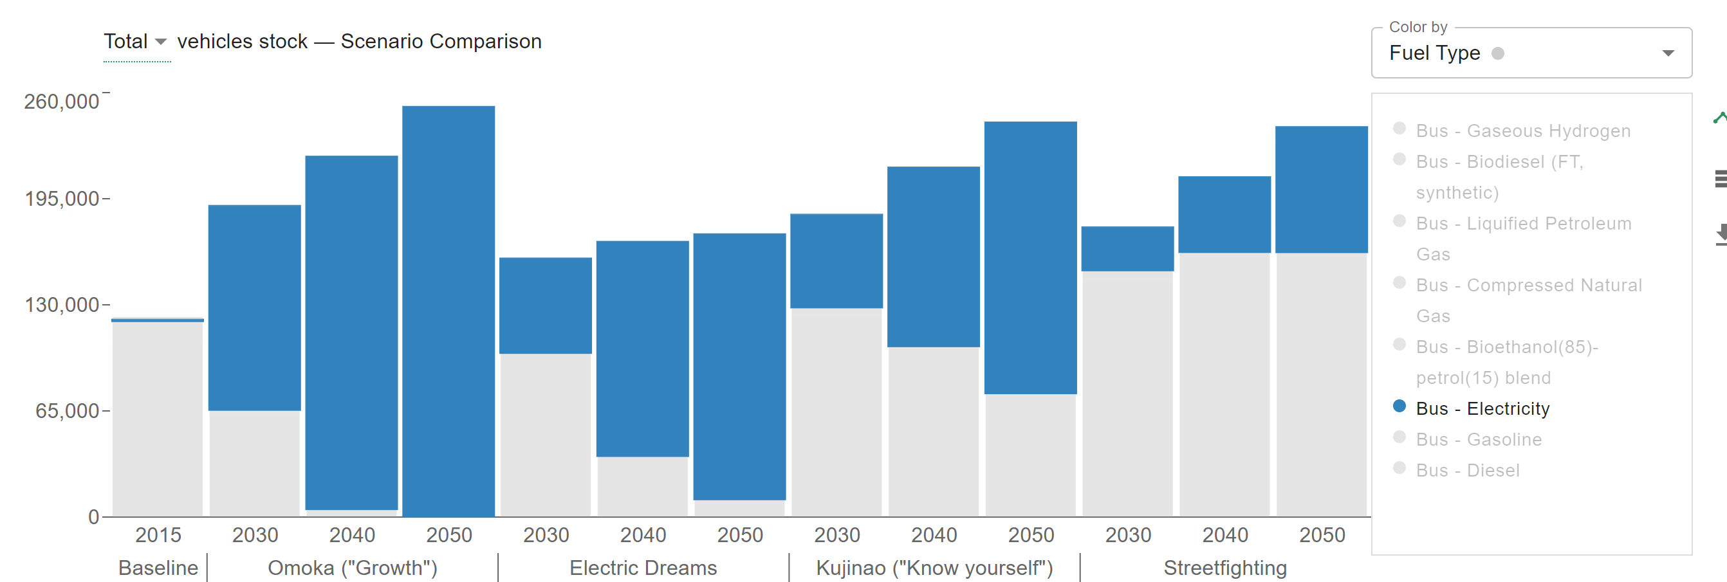

Slide 27
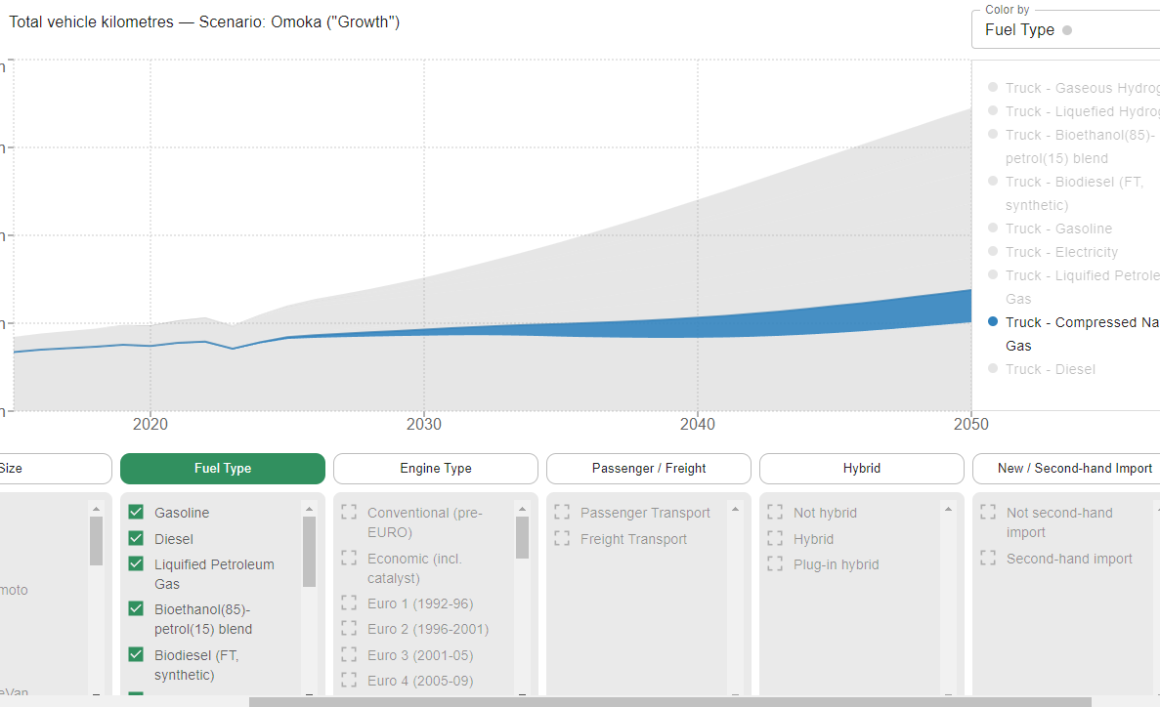
New runs with new SP for vans&trucks

Slide 28
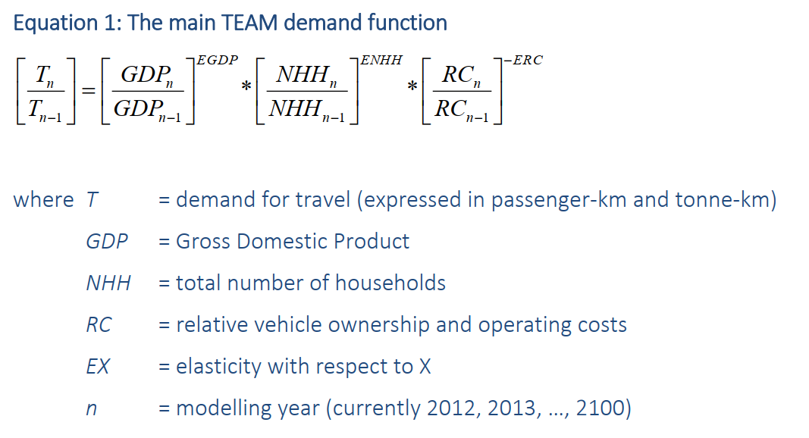
Moto calibration

Slide 29
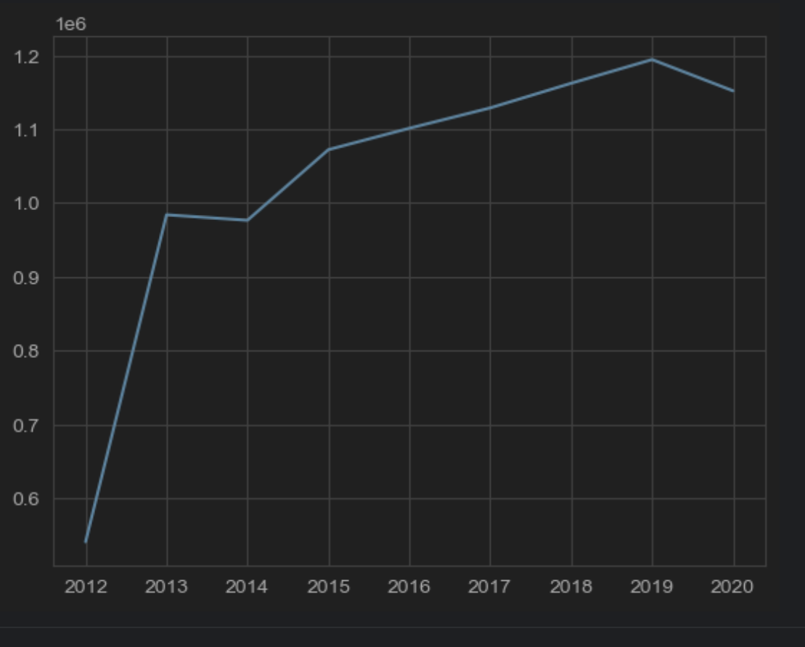

Slide 30
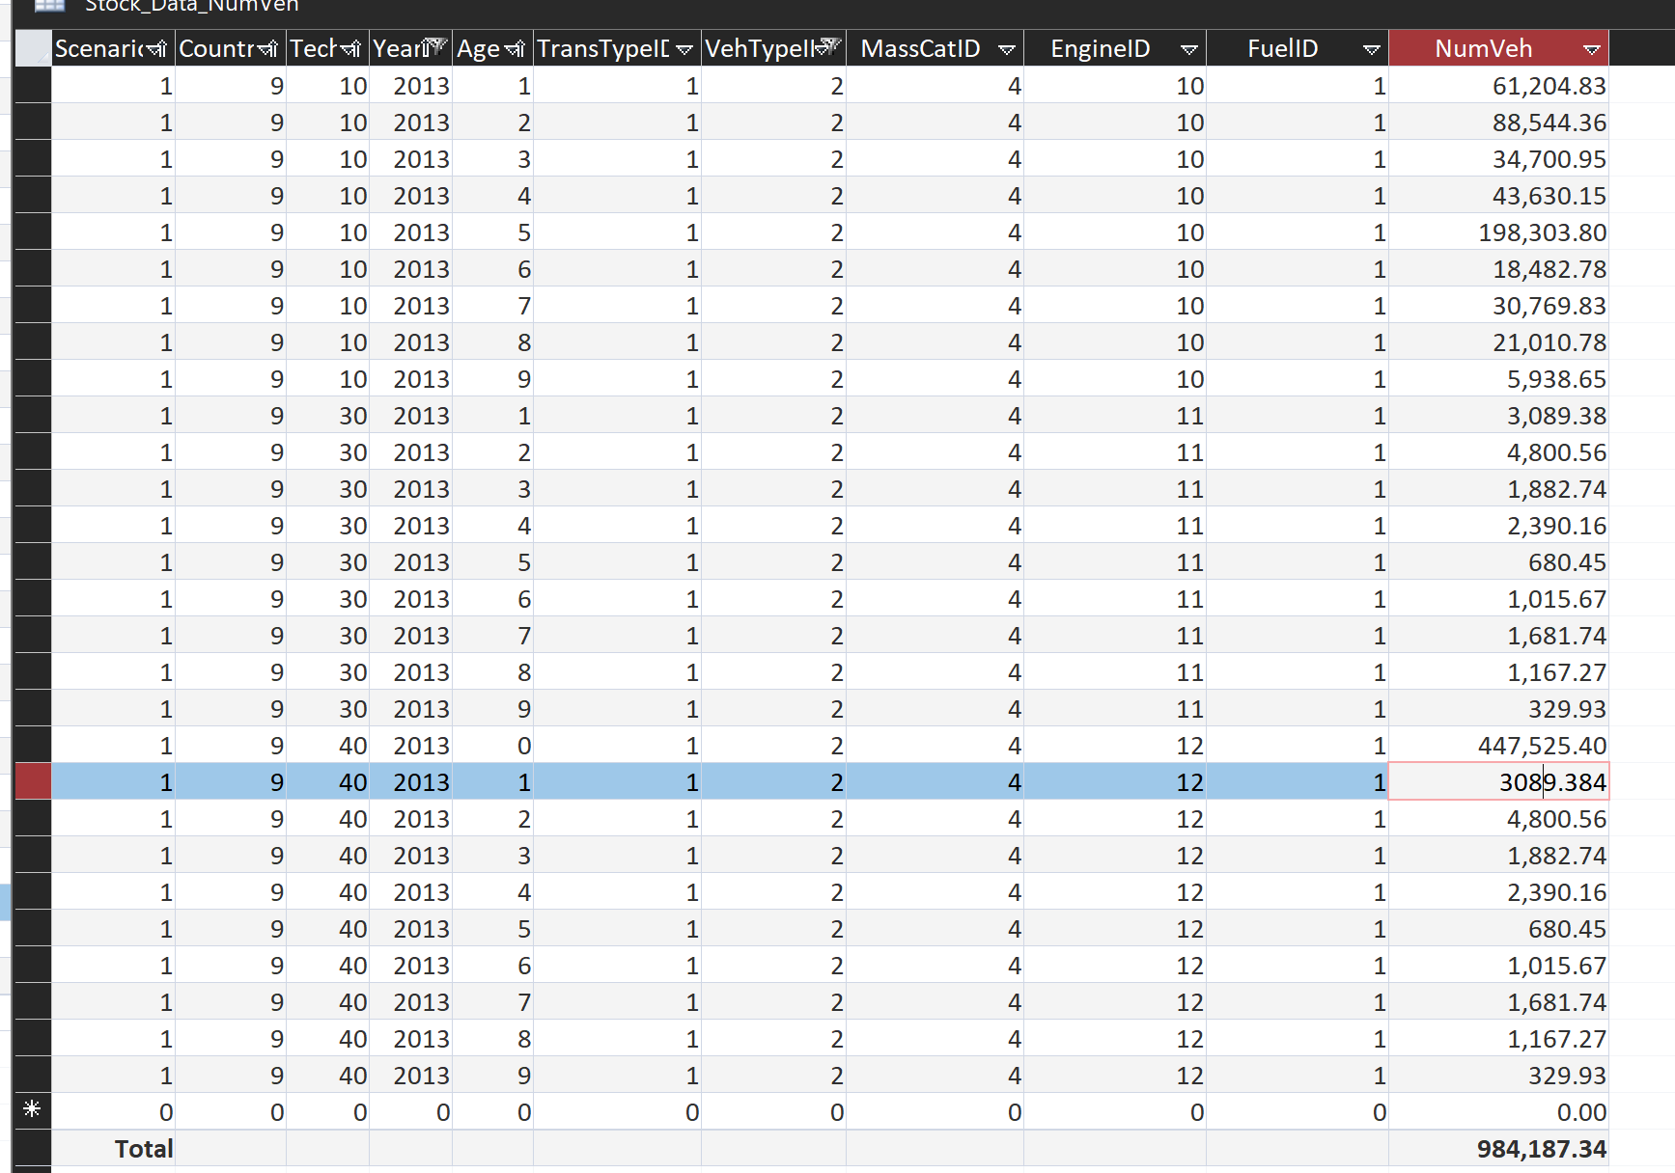
This is the problem

