Slide 1



Fire Up the Locants
ORGANIC CHEMISTRY · ASYNCHRONOUS ACTIVITY 03
NAME IT, DRAW IT
Charizard says hi
James Joseph A. Pulvinar
BSChE-2A

Slide 2
PART A -
STRUCTURE → NAME

Slide 3

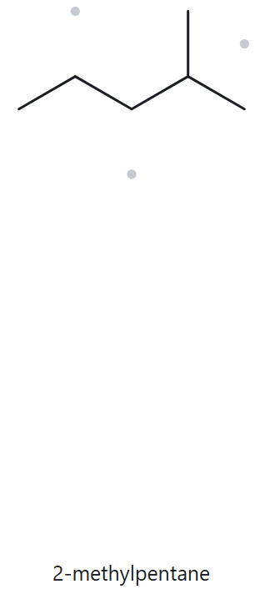
CARD A01-Foundation
MOLECULAR FORMULA: C6H14
PART A - STRUCTURE → NAME
1
NUMBERED PARENT
2
NAMING TRAIL
  Parent: longest chain = 5 C → pentane.
  Numbering: left → right gives 4; right → left gives 2. 2 < 4, so number from the right.
  Substituents: methyl on C2 → 2-methyl.
3
MY NAME
4
THE ALKANE CHECK
  Returned Name:
2-methylpentane
2-methylpentane
✅ Match
The rebuilt structure is a 5-C chain with one CH3 on the second carbon. The tool applies the same rules as the naming trail: longest chain first, then lowest locant (2 beats 4). Both therefore give the same name.
✓ longest chain confirmed
✓ lowest locants
✓ alphabetical order
✓ punctuation
✓ formula counted

Slide 4
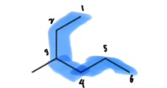
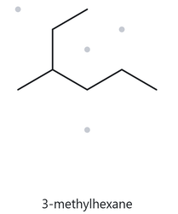
CARD A02-Foundation
MOLECULAR FORMULA: C7H16
PART A - STRUCTURE → NAME
  Parent: longest chain = 6 C → hexane. The horizontal path is only 5 C.
  Numbering: top → bottom gives 3; the other direction gives 4. 3 < 4, so number from the top.
  Substituents: the short left stub is a methyl on C3 → 3-methyl
1
NUMBERED PARENT
2
NAMING TRAIL
3
MY NAME
4
THE ALKANE CHECK
  Returned Name:
3-methylhexane
3-methylhexane
✅ Match
  The structure has a 6-C path through the branch point, with one methyl on the third carbon. The tool traces the longest chain through branch points, so hexane is chosen over the 5-C horizontal path, and 3 is the lowest locant
✓ longest chain confirmed
✓ lowest locants
✓ alphabetical order
✓ punctuation
✓ formula counted

Slide 5
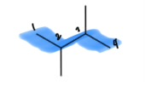
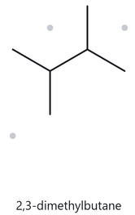
CARD A03-Foundation
MOLECULAR FORMULA: C6H14
PART A - STRUCTURE → NAME
1
NUMBERED PARENT
2
NAMING TRAIL
  Parent: longest chain = 4 C → butane.
  Numbering: both directions give 2,3, so the sets tie and either direction is fine.
  Substituents: methyl on C2 and methyl on C3 → 2,3-dimethyl
3
MY NAME
4
THE ALKANE CHECK
  Returned Name:
2,3-dimethylbutane
✅ Match
2,3-dimethylbutane
  The structure is a 4-C chain with one methyl on each middle carbon. The locant set is {2,3} from both ends, and the tool writes identical groups with the prefix di- and a comma between locants.
✓ longest chain confirmed
✓ lowest locants
✓ alphabetical order
✓ punctuation
✓ formula counted

Slide 6

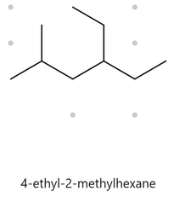
CARD A04-Developing
MOLECULAR FORMULA: C9H20
PART A - STRUCTURE → NAME
1
NUMBERED PARENT
2
NAMING TRAIL
  Parent: 6 C → hexane. Another 6-C path runs through the ethyl, but it carries the same two substituents (a methyl and an ethyl), so it leads to the same name.
  Numbering: left → right gives 2,4; right → left gives 3,5. First point of difference: 2 < 3, so number from the left.
  Substituents: ethyl on C4, then methyl on C2 → 4-ethyl-2-methyl. Alphabetical order sets the citation order, not the locants.
3
MY NAME
4
THE ALKANE CHECK
  Returned Name:
4-ethyl-2-methylhexane
✅ Match
4-ethyl-2-methylhexane
  The tool numbers from the end that gives {2,4}, not {3,5}. It cites ethyl before methyl because e comes before m alphabetically, even though ethyl has the higher locant.
✓ longest chain confirmed
✓ lowest locants
✓ alphabetical order
✓ punctuation
✓ formula counted

Slide 7
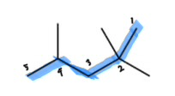
CARD A05-Developing
MOLECULAR FORMULA: C8H18
PART A - STRUCTURE → NAME
1
NUMBERED PARENT
2
NAMING TRAIL
  Parent: longest chain = 5 C → pentane.
  Numbering: left → right gives 2,4,4; right → left gives 2,2,4. The first terms tie at 2. At the second term 2 < 4, so number from the right.
  Substituents: methyl on C2, C2 and C4 → 2,2,4-trimethyl.
3
MY NAME
4
THE ALKANE CHECK
  Returned Name:
2,3-dimethylbutane
✅ Match
2,2,4-trimethylpentane
  The tool numbers from the end that gives {2,4}, not {3,5}. It cites ethyl before methyl because e comes before m alphabetically, even though ethyl has the higher locant.
✓ longest chain confirmed
✓ lowest locants
✓ alphabetical order
✓ punctuation
✓ formula counted

Slide 8
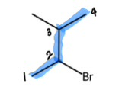
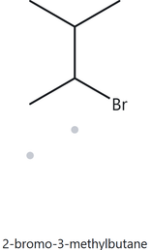
CARD A06-Developing
MOLECULAR FORMULA: C5H11Br
PART A - STRUCTURE → NAME
1
NUMBERED PARENT
2
NAMING TRAIL
  Parent: longest chain = 4 C → butane.
  Numbering: both directions give {2,3}, so the locant sets tie.
  Tie-break: bromo (b) precedes methyl (m) alphabetically, so bromo gets C2.
  Substituents: bromo on C2, methyl on C3 → 2-bromo-3-methyl.
3
MY NAME
4
THE ALKANE CHECK
  Returned Name:
2-bromo-3-methylhexane
✅ Match
2-bromo-3-methylbutane
  The locants tie at {2,3}, so the tool applies the alphabetical tie-break and gives the lower number to bromo. The halogen is written as a prefix (bromo) and is not part of the parent name.
✓ longest chain confirmed
✓ lowest locants
✓ alphabetical order
✓ punctuation
✓ formula counted

Slide 9
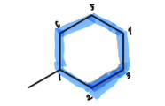
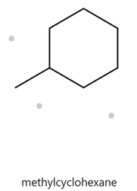
CARD A07-Developing
MOLECULAR FORMULA: C7H14
PART A - STRUCTURE → NAME
1
NUMBERED PARENT
2
NAMING TRAIL
  Parent: the ring is the parent, 6 C → cyclohexane.
  Numbering: there is only one substituent, so there are no locants to compare. The substituent carbon is C1, and no locant is written.
  Substituents: methyl.
3
MY NAME
4
THE ALKANE CHECK
  Returned Name:
methylcyclohexane
✅ Match
methylcyclohexane
  The structure is a 6-C ring with one CH3. The tool takes the ring as the parent and, because there is only one substituent, writes no locant (the name is not 1-methylcyclohexane).
✓ longest chain confirmed
✓ lowest locants
✓ alphabetical order
✓ punctuation
✓ formula counted

Slide 10
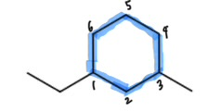
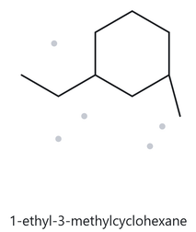
CARD A08-Challenge
MOLECULAR FORMULA: C8
PART A - STRUCTURE → NAME
1
NUMBERED PARENT
2
NAMING TRAIL
  Parent: the ring is the parent → cyclohexane.
  Numbering: going the short way round gives {1,3} whichever substituent is C1. The long way round gives {1,5}. {1,3} wins, and the two short-way sets tie.
  Tie-break: ethyl (e) precedes methyl (m), so ethyl gets C1.
  Substituents: ethyl on C1, methyl on C3 → 1-ethyl-3-methyl.
3
MY NAME
4
THE ALKANE CHECK
  Returned Name:
1-ethyl-3-methylcyclohexane
✅ Match
1-ethyl-3-methylcyclohexane
  The two substituents are separated by one ring carbon, so the lowest locant set is {1,3}. The sets tie in both directions, so the alphabetical rule places ethyl on C1.
✓ longest chain confirmed
✓ lowest locants
✓ alphabetical order
✓ punctuation
✓ formula counted

Slide 11
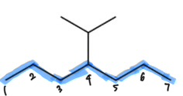
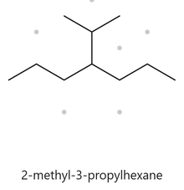
CARD A09-Challenge
MOLECULAR FORMULA: C10H22
PART A - STRUCTURE → NAME
1
NUMBERED PARENT
2
NAMING TRAIL
  Parent: Parent (7 C) highlighted; the 3-C branch is a substituent.
  Numbering: both directions give 4, so the sets tie.
  Substituents: a 3-carbon branch attached through its middle carbon is isopropyl, also written (1-methylethyl) or propan-2-yl, on C4.
3
MY NAME
4
THE ALKANE CHECK
  Returned Name:
4-isopropylhexane
❌ Did Not Match
4-isopropylheptane
  The tool numbers from the end that gives {2,4}, not {3,5}. It cites ethyl before methyl because e comes before m alphabetically, even though ethyl has the higher locant.
✓ longest chain confirmed
✓ lowest locants
✓ alphabetical order
✓ punctuation
✓ formula counted

Slide 12
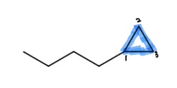
CARD A10-Challenge
MOLECULAR FORMULA: C7H14
PART A - STRUCTURE → NAME
1
NUMBERED PARENT
2
NAMING TRAIL
  Parent: the ring is the parent under this activity’s rule, even though the chain (4 C) is longer than the ring (3 C) → cyclopropane.
  Numbering: one substituent, so no locant is needed.
  Substituents: unbranched 4-carbon chain → butyl.
3
MY NAME
4
THE ALKANE CHECK
  Returned Name:
butylcyclopropane
✅ Match
butylcyclopropane
  The tool follows the same ring-as-parent rule as this activity. It names the 3-C ring as the parent and the chain as butyl, with no locant for a single substituent.
✓ longest chain confirmed
✓ lowest locants
✓ alphabetical order
✓ punctuation
✓ formula counted

Slide 13
PART B -
NAME → STRUCTURE

Slide 14
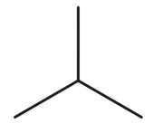
CARD B01-Foundation
Given Name: 2-methylpropane
PART B - NAME → STRUCTURE
1
NAME DECODED
2
BOND LINE STRUCTURE
Parent: propane → a 3-carbon chain.
Substituents: methyl on C2.
Expected formula: 3 + 1 = 4 C;
open chain → CₙH₂ₙ₊₂ = C₄H₁₀
3
FORMULA
4
BACK-CHECK
  Counted from the drawing: C₄H₁₀
  Open chain: CₙH₂ₙ₊₂ = C₄H₁₀ ✓
  Returned by The Alkane: 2-methylpropane
  ✓ Same as the given name
  The longest chain is 3 C (propane) with one methyl on the middle carbon, so the locant is 2 from either end.
✓ parent length matches
✓ substituent positions match
✓ formula agrees
✓ back-check recorded

Slide 15
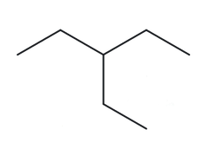
CARD B02-Foundation
Given Name: 3-ethylpentane
PART B - NAME → STRUCTURE
1
NAME DECODED
2
BOND LINE STRUCTURE
Parent: pentane (5-carbon chain)
Substituents: ethyl on C3.
Expected formula: 5 + 2 = 7 C; open chain → C₇H₁₆.
3
FORMULA
4
BACK-CHECK
  Counted from the drawing: C₇H₁₆
  Open chain: CₙH₂ₙ₊₂ = C₇H₁₆ ✓
  Returned by The Alkane: 2-methylpropane
  ✓ Same as the given name
  The longest chain is 3 C (propane) with one methyl on the middle carbon, so the locant is 2 from either end.
✓ parent length matches
✓ substituent positions match
✓ formula agrees
✓ back-check recorded

Slide 16
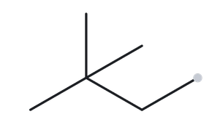
CARD B03-Foundation
Given Name: 2,2-dimethylbutane
PART B - NAME → STRUCTURE
1
NAME DECODED
2
BOND LINE STRUCTURE
Parent: butane (4-carbon chain)
Substituents: two methyls, both on C2.
Expected formula: 4 + 2 = 6 C; open chain → C₆H₁₄.
3
FORMULA
4
BACK-CHECK
  Counted from the drawing: C₆H₁₄.
  Open chain: CₙH₂ₙ₊₂ = C₆H₁₄ ✓
  Returned by The Alkane: 2,2-dimethylbutane
  ✓ Same as the given name
  The longest chain is 4 C (butane). Numbering gives 2,2 from one end and 3,3 from the other, so 2,2 wins.
✓ parent length matches
✓ substituent positions match
✓ formula agrees
✓ back-check recorded

Slide 17
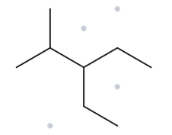
CARD B04-Developing
Given Name: 3-ethyl-2-methylpentane
PART B - NAME → STRUCTURE
1
NAME DECODED
2
BOND LINE STRUCTURE
Parent: pentane (5-carbon chain)
Substituents: methyl on C2; ethyl on C3. Ethyl is cited first because e comes before m, even though its locant is higher.
Expected formula: 5 + 1 + 2 = 8 C; open chain → C₈H₁₈.
3
FORMULA
4
BACK-CHECK
  Counted from the drawing: C₈H₁₈.
  Open chain: CₙH₂ₙ₊₂ = C₈H₁₈ ✓
  Returned by The Alkane: 3-ethyl-2-methylpentane
  ✓ Same as the given name
  Numbering gives {2,3} from one end and {3,4} from the other, so {2,3} wins. Ethyl is cited before methyl alphabetically.
✓ parent length matches
✓ substituent positions match
✓ formula agrees
✓ back-check recorded

Slide 18
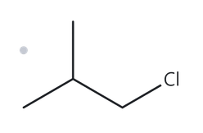
CARD B05-Developing
Given Name: 1-chloro-2-methylpropane
PART B - NAME → STRUCTURE
1
NAME DECODED
2
BOND LINE STRUCTURE
Parent: propane (3-carbon chain)
Substituents: chloro on C1; methyl on C2.
Expected formula: 3 + 1 = 4 C; open chain → C₄H₁₀; Cl replaces one H → C₄H₉Cl.
3
FORMULA
4
BACK-CHECK
  Returned by The Alkane: 1-chloro-2-methylpropane
  ✓ Same as the given name
  Numbering gives {1,2} from the Cl end and {2,3} from the other, so {1,2} wins. Chloro is cited before methyl alphabetically.
  Counted from the drawing: C₄H₉Cl.
  Open chain: CₙH₂ₙ₊₂ = C₄H₁₀; minus one H for Cl = C₄H₉Cl ✓
✓ parent length matches
✓ substituent positions match
✓ formula agrees
✓ back-check recorded

Slide 19
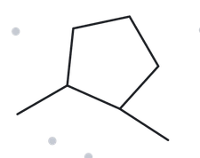
CARD B06-Developing
Given Name: 1,2-dimethylcyclopentane
PART B - NAME → STRUCTURE
1
NAME DECODED
2
BOND LINE STRUCTURE
Parent: cyclopentane (5-carbon ring)
Substituents: methyl on C1; methyl on C2.
Expected formula: 5 + 2 = 7 C; one ring → C₇H₁₄.
3
FORMULA
4
BACK-CHECK
  Returned by The Alkane: 1,2-dimethylcyclopentane
  ✓ Same as the given name
  The ring is the parent. Numbering the short way round gives {1,2}, and the long way gives {1,5}, so {1,2} wins.
  Counted from the drawing: C₇H₁₄.
  One ring: CₙH₂ₙ = C₇H₁₄ ✓
✓ parent length matches
✓ substituent positions match
✓ formula agrees
✓ back-check recorded

Slide 20
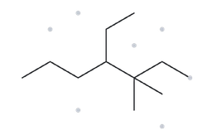
CARD B07-Developing
Given Name: 4-ethyl-3,3-dimethylheptane
PART B - NAME → STRUCTURE
1
NAME DECODED
2
BOND LINE STRUCTURE
Parent: heptane (7-carbon chain)
Substituents: two methyls on C3 (3,3-dimethyl); ethyl on C4. Ethyl is cited first because e comes before m.
Expected formula: 7 + 2 + 2 = 11 C; open chain → C₁₁H₂₄
3
FORMULA
4
BACK-CHECK
  Returned by The Alkane: 4-ethyl-3,3-dimethylheptane
  ✓ Same as the given name
  The longest chain is 7 C. Numbering gives {3,3,4} from one end and {4,5,5} from the other, so {3,3,4} wins. Ethyl is cited before dimethyl.
  Counted from the drawing: C₁₁H₂₄.
  Open chain: CₙH₂ₙ₊₂ = C₁₁H₂₄ ✓
✓ parent length matches
✓ substituent positions match
✓ formula agrees
✓ back-check recorded

Slide 21
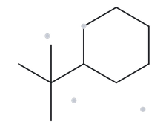
CARD B08-Challenge
Given Name: tert-butylcyclohexane
PART B - NAME → STRUCTURE
1
NAME DECODED
2
BOND LINE STRUCTURE
Parent: cyclohexane (6-carbon ring)
Substituents: tert-butyl, (CH₃)₃C–, a 4-carbon group, on C1. A single substituent on a ring needs no locant.
Expected formula: 6 + 4 = 10 C; one ring → C₁₀H₂₀.
3
FORMULA
4
BACK-CHECK
  Returned by The Alkane: (1,1-dimethylethyl)cyclohexane
  ✓ Same as the given name
  tert-Butyl and (1,1-dimethylethyl) are equivalent names for the same group (Appendix B.3).
  Counted from the drawing: C₁₀H₂₀.
  One ring: CₙH₂ₙ = C₁₀H₂₀ ✓
✓ parent length matches
✓ substituent positions match
✓ formula agrees
✓ back-check recorded

Slide 22
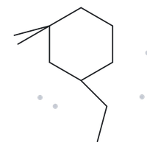
CARD B09-Challenge
Given Name: 3-ethyl-1,1-dimethylcyclohexane
PART B - NAME → STRUCTURE
1
NAME DECODED
2
BOND LINE STRUCTURE
Parent: cyclohexane (6-carbon ring)
Substituents: two methyls on C1 (1,1-dimethyl); ethyl on C3.
Expected formula: 6 + 2 + 2 = 10 C; one ring → C₁₀H₂₀.
3
FORMULA
4
BACK-CHECK
  Returned by The Alkane: 3-ethyl-1,1-dimethylcyclohexane
  ✓ Same as the given name
  Numbering gives {1,1,3} one way round the ring and {1,1,5} the other, so {1,1,3} wins. Ethyl is cited before dimethyl.
  Counted from the drawing: C₁₀H₂₀.
  One ring: CₙH₂ₙ = C₁₀H₂₀ ✓
✓ parent length matches
✓ substituent positions match
✓ formula agrees
✓ back-check recorded

Slide 23
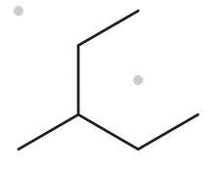
CARD B10-Challenge
Given Name: 2-ethylbutane
PART B - NAME → STRUCTURE
1
NAME DECODED
2
BOND LINE STRUCTURE
Parent: butane (4-carbon chain)
Substituents: ethyl on C2.
Expected formula: 4 + 2 = 6 C; open chain → C₆H₁₄.
3
FORMULA
4
BACK-CHECK
  Returned by The Alkane: 3-methylpentane
  ✘ Different from the given name
  Rule broken: the longest-chain rule (Appendix B.1, step 1). The path ethyl → C2 → C3 → C4 has 5 carbons, which is longer than the 4-carbon “butane” chain. The parent is therefore pentane, and the leftover CH₃ is a methyl on C3 (position 3 from either end).
  Counted from the drawing: C₆H₁₄.
  Open chain: CₙH₂ₙ₊₂ = C₆H₁₄ ✓
✓ parent length matches
✓ substituent positions match
✓ formula agrees
✓ back-check recorded

