Slide 1
One Ninja, Four Views
ORGANIC CHEMISTRY · ASYNCHRONOUS ACTIVITY 02
One Molecule, Four Representations:
From Molecular Formula to Bond-Line Structure
Froakie says hi
James Joseph A. Pulvinar
BSChE-2A

Slide 2

CARD 01 — PROPANE
Molecular Formula: C₃H₈
1
MOLECULAR FORMULA
2
LEWIS STRUCTURE
C₃H₈
H
H
H
H
C
C
C
H
H
H
H
3
CONDENSED STRUCTURAL FORMULA
4
BOND-LINE FORMULA
CH₃CH₂CH₃
✓ Atom Count Verified
✓ Valence Checked
✓ Bond order checked
✓ Same connectivity confirmed

Slide 3
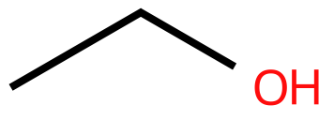
CARD 02 — ETHANOL
Molecular Formula: C₂H₆O
1
MOLECULAR FORMULA
2
LEWIS STRUCTURE
C₂H₆O
H
H
H
C
C
O
H
H
H
3
CONDENSED STRUCTURAL FORMULA
4
BOND-LINE FORMULA
CH₃CH₂OH
✓ Atom Count Verified
✓ Valence Checked
✓ Bond order checked
✓ Same connectivity confirmed

Slide 4
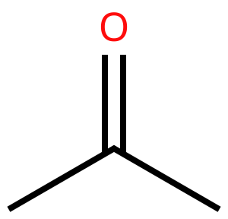
CARD 03 — ACETONE (PROPAN-2-ONE)
Molecular Formula: C₃H₆O
1
MOLECULAR FORMULA
2
LEWIS STRUCTURE
C₃H₆O
O
H
H
H
C
C
C
H
H
H
3
CONDENSED STRUCTURAL FORMULA
4
BOND-LINE FORMULA
CH₃COCH₃
✓ Atom Count Verified
✓ Valence Checked
✓ Bond order checked
✓ Same connectivity confirmed

Slide 5
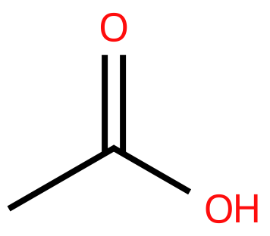
CARD 04 — ACETIC ACID (ETHANOIC ACID)
Molecular Formula: C₂H₄O₂
1
MOLECULAR FORMULA
2
LEWIS STRUCTURE
C₂H₄O₂
O
H
H
C
C
O
H
H
3
CONDENSED STRUCTURAL FORMULA
4
BOND-LINE FORMULA
CH₃COOH
✓ Atom Count Verified
✓ Valence Checked
✓ Bond order checked
✓ Same connectivity confirmed

Slide 6
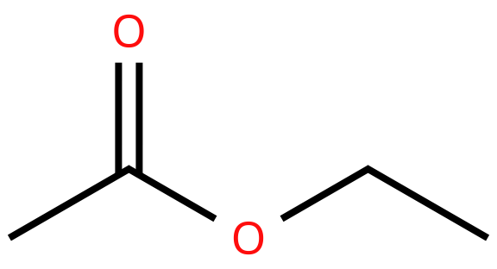
CARD 05 — ETHYL ACETATE (ETHYL ETHANOATE)
Molecular Formula: C₄H₈O₂
1
MOLECULAR FORMULA
2
LEWIS STRUCTURE
C₄H₈O₂
O
H
H
H
H
C
C
O
C
C
H
H
H
H
3
CONDENSED STRUCTURAL FORMULA
4
BOND-LINE FORMULA
CH₃COOCH₂CH₃
✓ Atom Count Verified
✓ Valence Checked
✓ Bond order checked
✓ Same connectivity confirmed

Slide 7
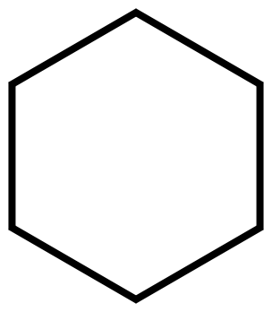
CARD 06 — CYCLOHEXANE
Molecular Formula: C₆H₁₂
1
MOLECULAR FORMULA
2
LEWIS STRUCTURE
C₆H₁₂
H
H
H
C
C
H
H
H
C
C
H
H
H
C
C
H
H
H
3
CONDENSED STRUCTURAL FORMULA
4
BOND-LINE FORMULA
(CH₂)₆
✓ Atom Count Verified
✓ Valence Checked
✓ Bond order checked
✓ Same connectivity confirmed

Slide 8
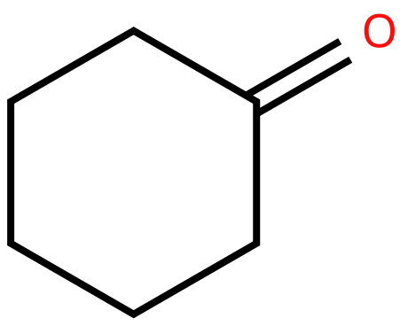
CARD 07 — CYCLOHEXANONE
Molecular Formula: C₆H₁₀O
1
MOLECULAR FORMULA
2
LEWIS STRUCTURE
C₆H₁₀O
O
H
C
C
H
H
H
C
C
H
C
C
H
H
H
H
H
3
CONDENSED STRUCTURAL FORMULA
4
BOND-LINE FORMULA
(CH₂)₅CO
✓ Atom Count Verified
✓ Valence Checked
✓ Bond order checked
✓ Same connectivity confirmed

Slide 9
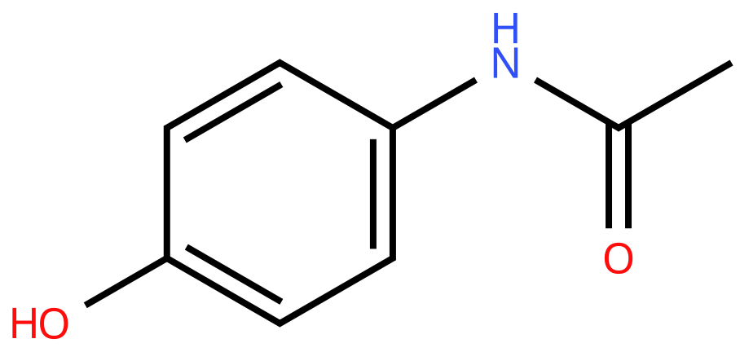
CARD 08 — ACETAMINOPHEN (PARACETAMOL)
Molecular Formula: C₈H₉NO₂
1
MOLECULAR FORMULA
2
LEWIS STRUCTURE
C₈H₉NO₂
H
H
C
C
H
H
O
C
C
N
H
H
C
C
C
C
H
H
H
O
3
CONDENSED STRUCTURAL FORMULA
4
BOND-LINE FORMULA
HOC₆H₄NHCOCH₃
✓ Atom Count Verified
✓ Valence Checked
✓ Bond order checked
✓ Same connectivity confirmed

Slide 10
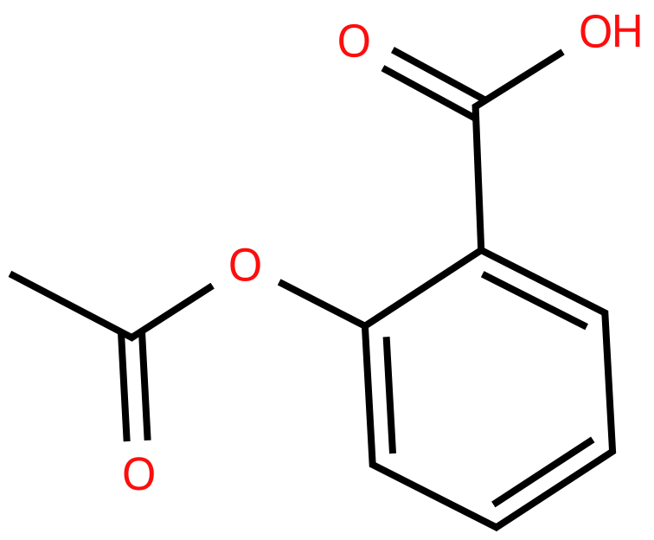
CARD 09 — ASPIRIN (ACETYLSALICYLIC ACID)
Molecular Formula: C₉H₈O₄
1
MOLECULAR FORMULA
2
LEWIS STRUCTURE
C₉H₈O₄
O
H
O
C
H
C
C
H
H
O
C
C
C
H
H
C
C
C
O
H
H
3
CONDENSED STRUCTURAL FORMULA
4
BOND-LINE FORMULA
CH₃COOC₆H₄COOH
✓ Atom Count Verified
✓ Valence Checked
✓ Bond order checked
✓ Same connectivity confirmed

Slide 11
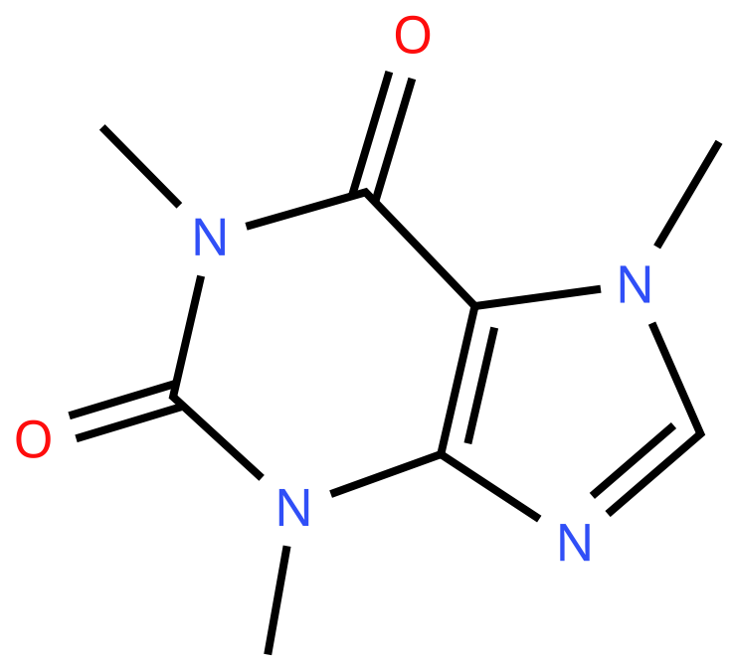
CARD 10 — CAFFEINE
Molecular Formula: C₈H₁₀N₄O₂
1
MOLECULAR FORMULA
2
LEWIS STRUCTURE
C₈H₁₀N₄O₂
O
H
H
H
C
H
H
C
C
N
H
N
C
C
C
C
H
O
N
N
H
C
H
H
3
CONDENSED STRUCTURAL FORMULA
4
BOND-LINE FORMULA
C₈H₁₀N₄O₂ or
C₅HN₄O₂(CH₃)₃
✓ Atom Count Verified
✓ Valence Checked
✓ Bond order checked
✓ Same connectivity confirmed

