Slide 1
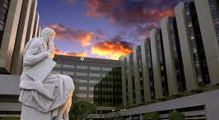
Cedars-Sinai Medical Center

Slide 2
MSDS 7330 DB Project
Why study where patients coming from?
Understand areas to better serve or expand medical services to. Increase competitiveness to areas which are underserved.
Why study patient age?
Position hospital and medical services to anticipate shifts in demographics in the patient base.
Why use HL7?
Very high accuracy as all patients that are admitted to the hospital have one HL7 message generated and propagated to disparate systems.

Slide 3




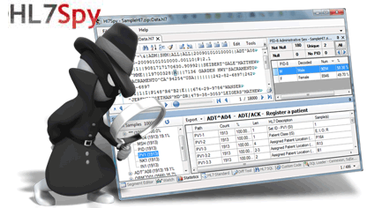

Software Packages
import math
Import hl7
Import mysql.connector

Slide 4
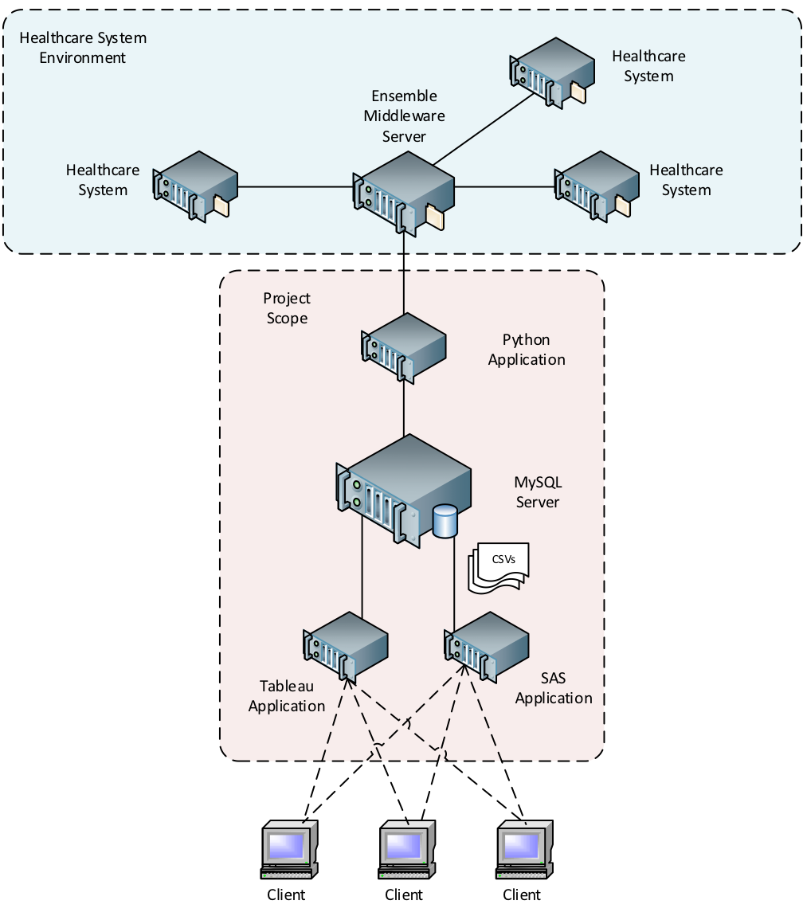
Conceptual Design
Use Python to read in the HL7 messages, parse out the patient information, such as gender, age, zip code, country code and insert into MySQL database.
Use Python to compute all the distances from the Medical Center zip code. Use GeoCode lat/long data which contain all lat/longs of zip codes in the US. Load the distances into MySQL database.
Use Tableau to visualize the information, connecting to MySQL as the data source.
Use SAS to analyze statistics.

Slide 5
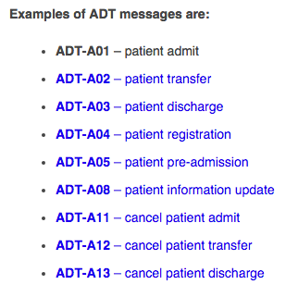
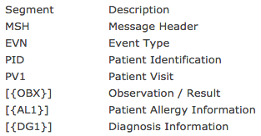
HL7 Messages
A01 Message Structure
A01 Sample Message
MSH|^~\&|TEST|TEST|IEPRD|TEST|20151002104146|7196|ADT^A01|185992044|T|2.3|||AL||||||
EVN|A01|20151002104146||ADT_EVENT|7196^CSHS^ED^REGISTRARAAA^^^^^CSMC^^^^^MAH|20151002104141|
PID|1||E2528374^^^^ EPI ~200710904^^^GSMRN^GSMRN||CUPCAKE^REDVELVET^^^^^D~CUPCAKE^REDVELVET^^^^^L|SMITH^^^|19550909|F||White|25 WESTST^^PASADENA^CA^91108^USA^ P^^LOS ANGELES
|LOS ANGELES|(333)4445555^P^PH^^^ 333^4445555||EN^ENGLISH|MARRIED|NR|7734563|000-00 -0001|||NON-HISPANIC|^^NYC^^^|||||||N||
PV1|1|ED|ER^ IE3 7^01^CAAC^D^^MAH^^^^|ER||||||EMD|||||||||49103634192|SELF|||||||||||||||||||||AD|^^^CAAC^^^^^^^||20151002104000||||||||||PV2||||||||||||||||||||||N||||||||||||||||
Car|||||||||||

Slide 6
Data Sources
HL7 Messages
Inpatient Only (ADT-A01)
Date Range: 12/2014 to 11/2015
Geo Coding Data
Lat/Long database downloaded from OpenGeoCode.org

Slide 7
Data Issues
Processing Issues
807 records failed to parse in Python HL7 module from non-compliant characters in HL7 message. Resulted in loading of 154,363 out of 155,170 (99.5%) records to MySQL.
Missing Values
12,967 records missing Zip Codes (8.4% of the data)
66 records missing Country Codes (3-digit ISO code)
1191 records with invalid DOB

Slide 8
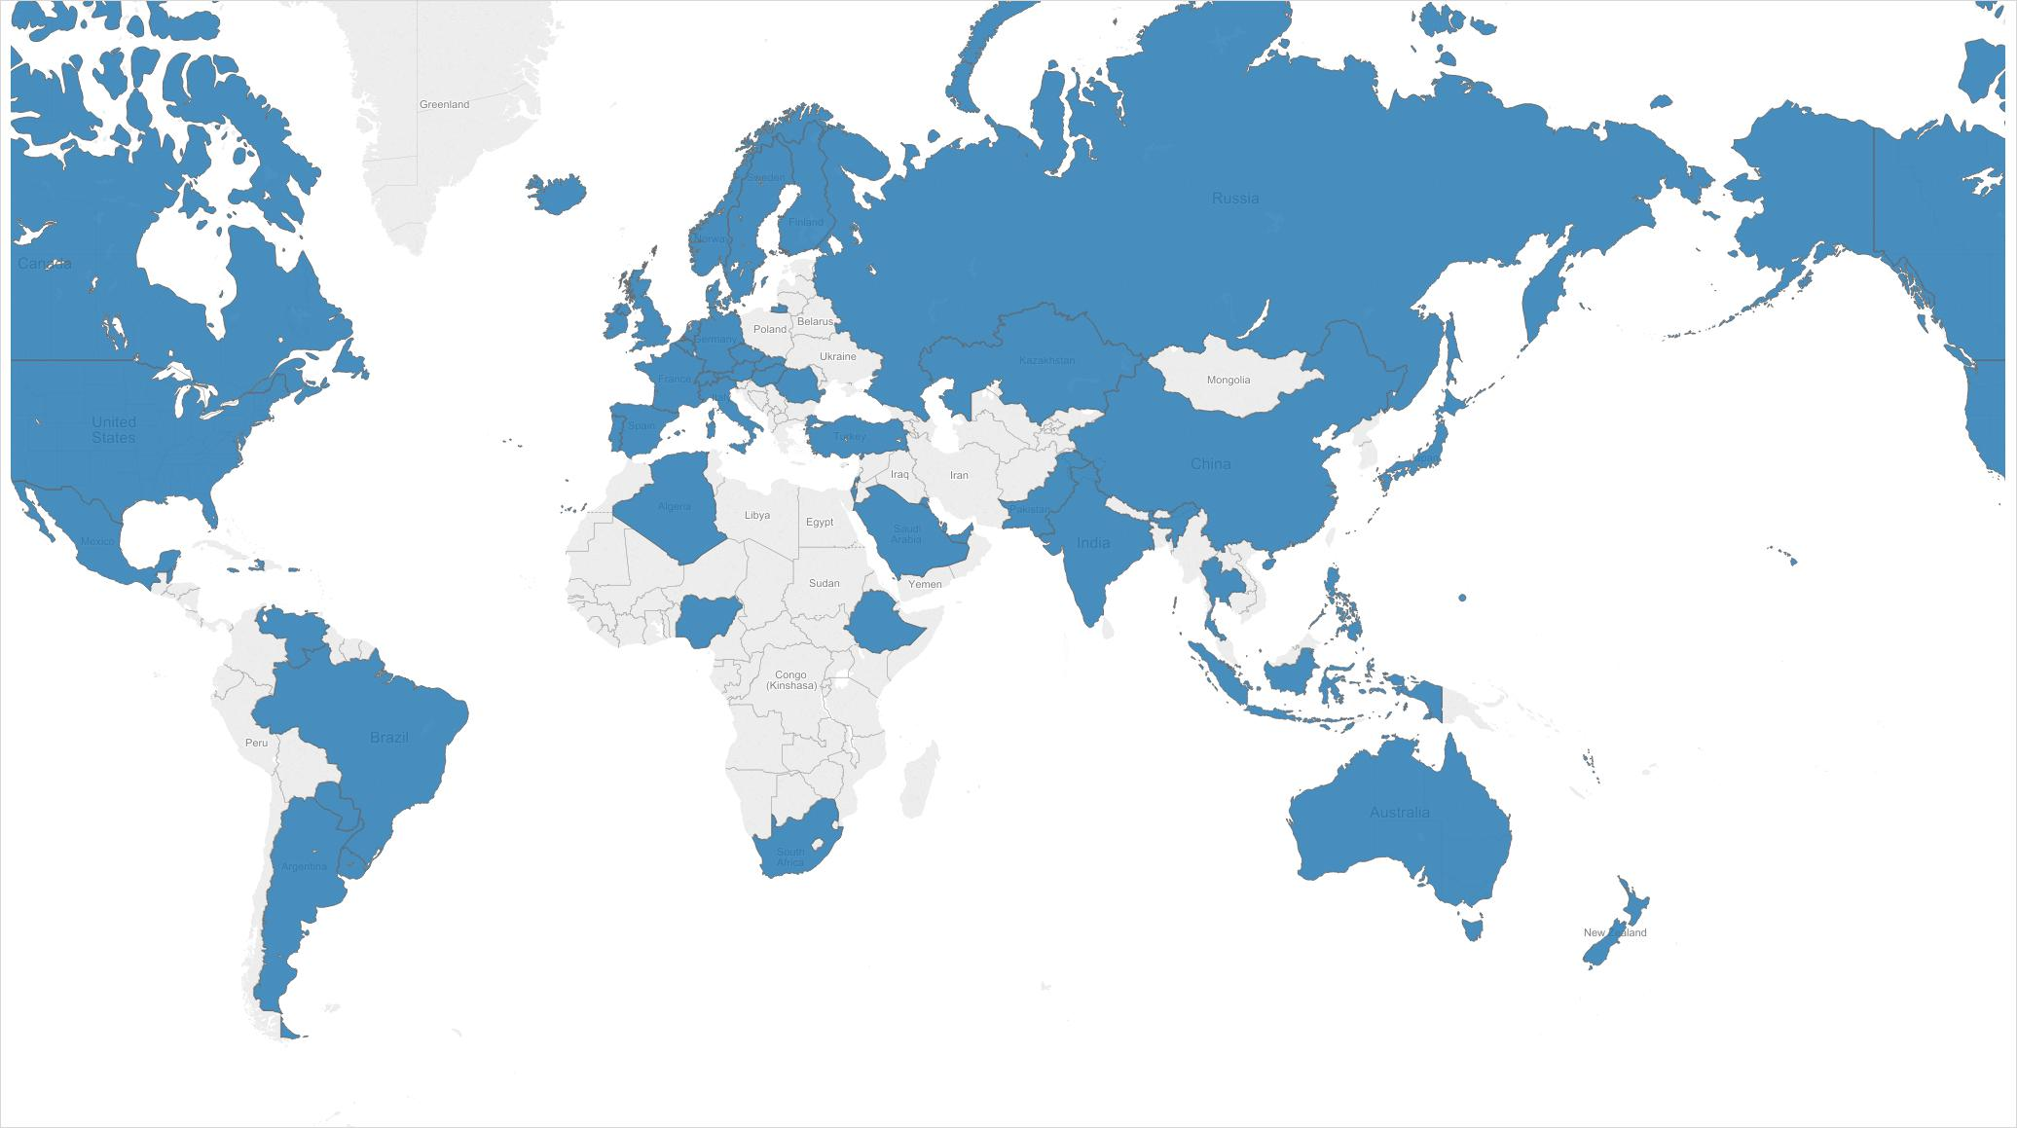
Patient Admits Worldwide

Slide 9
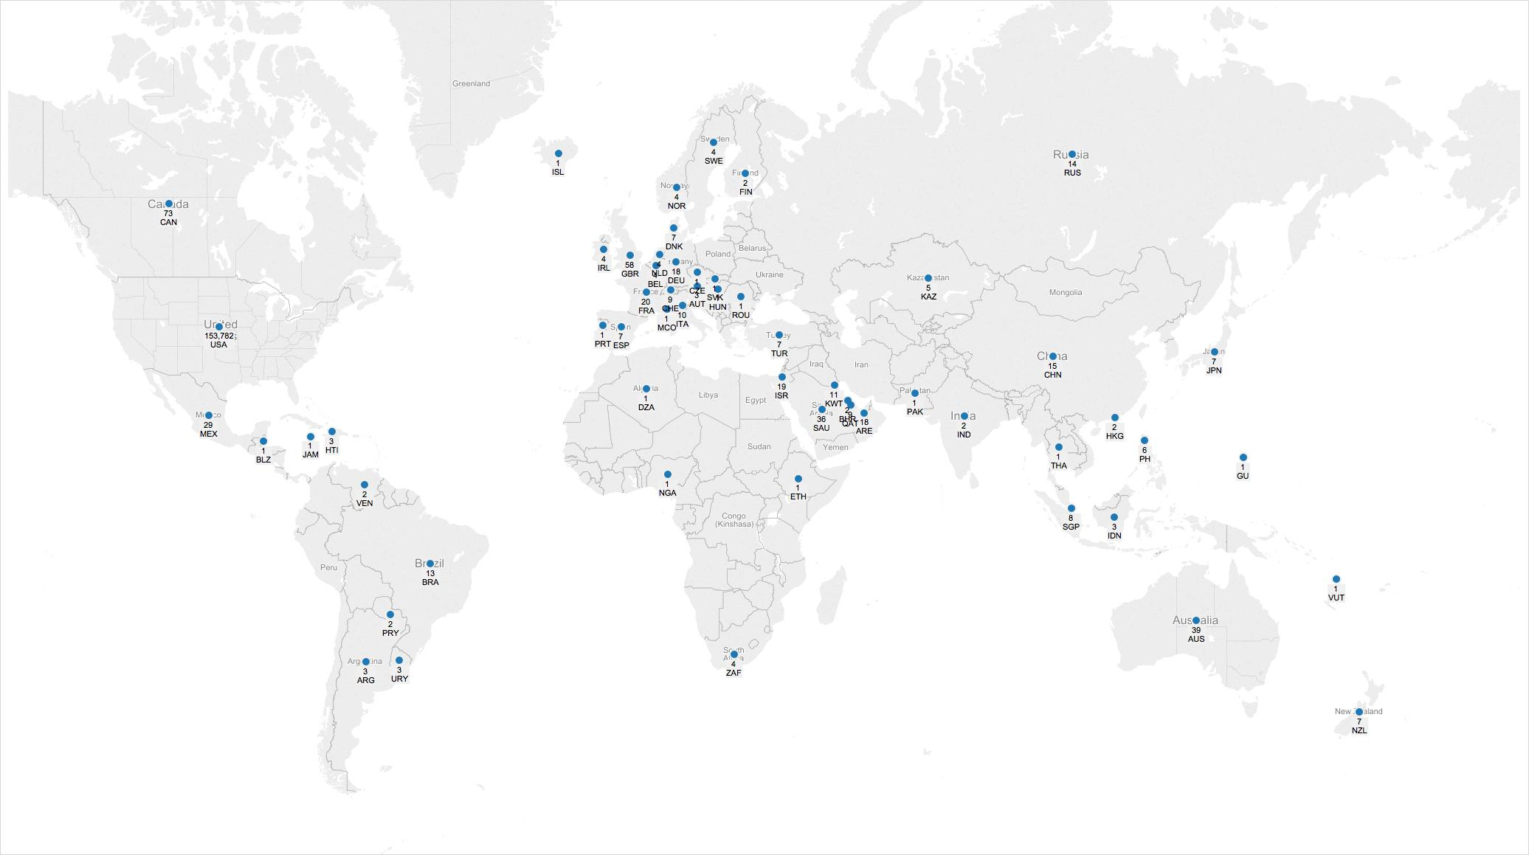
Patient Admits Worldwide

Slide 10
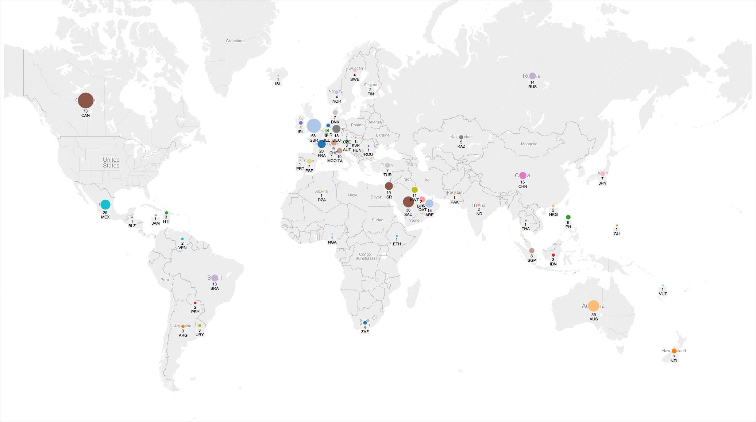
Patient Admits Worldwide

Slide 11
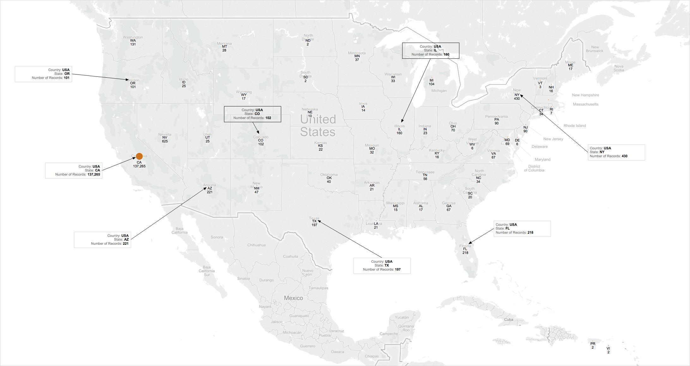
Patient Admits in Lower 48 States

Slide 12
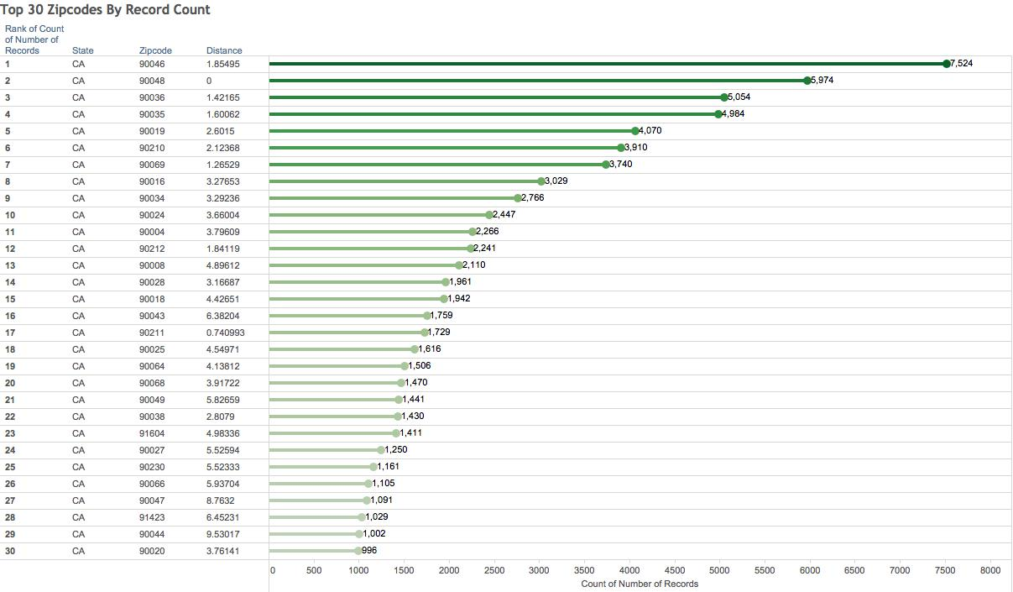
30 Top Ranked Zips By Patient Admits

Slide 13
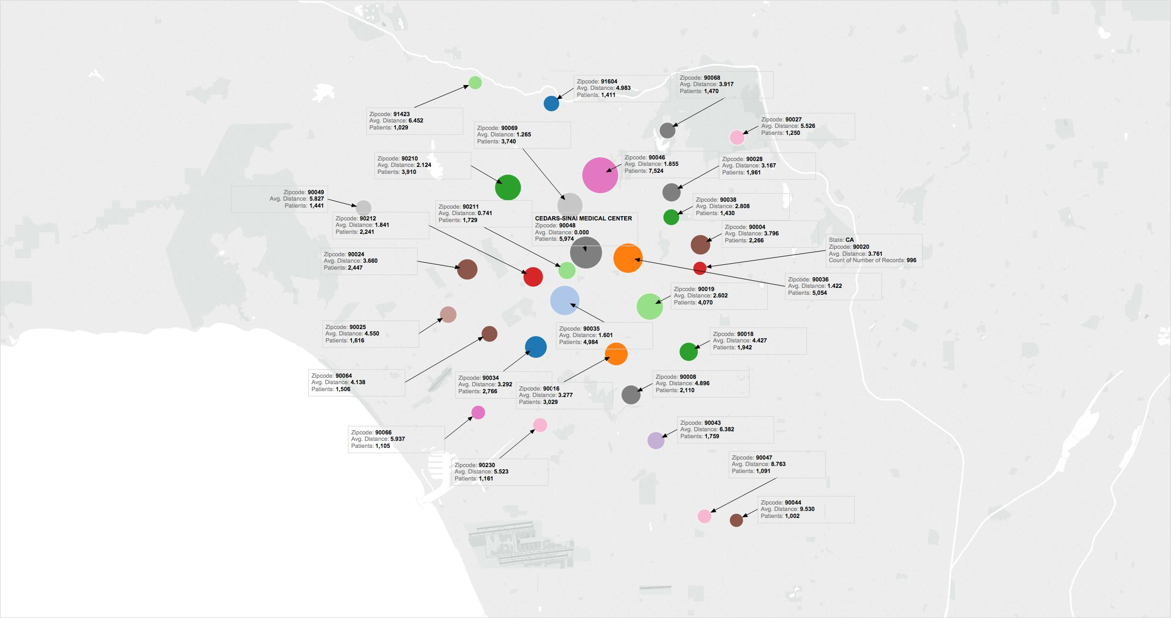
30 Top Ranked Zips By Patient Admits

Slide 14
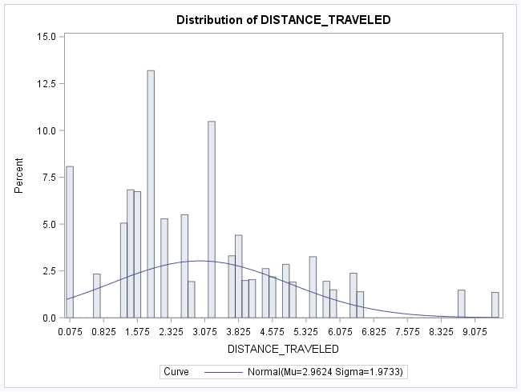
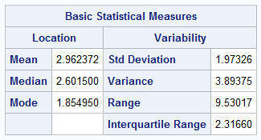
Top 30 Zip Codes / SAS Analysis
The Top 30 Zip Codes by Patient Admits fall within a 10-mile radius of the Medical Center.
The Top 30 Zip Codes by Patient Admits accounts for 52.3% of all Patient Admits from 11/2014 to 12/2015.
A typical patient travels an average of 2.96 miles to the Medical Center, with a standard deviation of 1.97 miles.

Slide 15
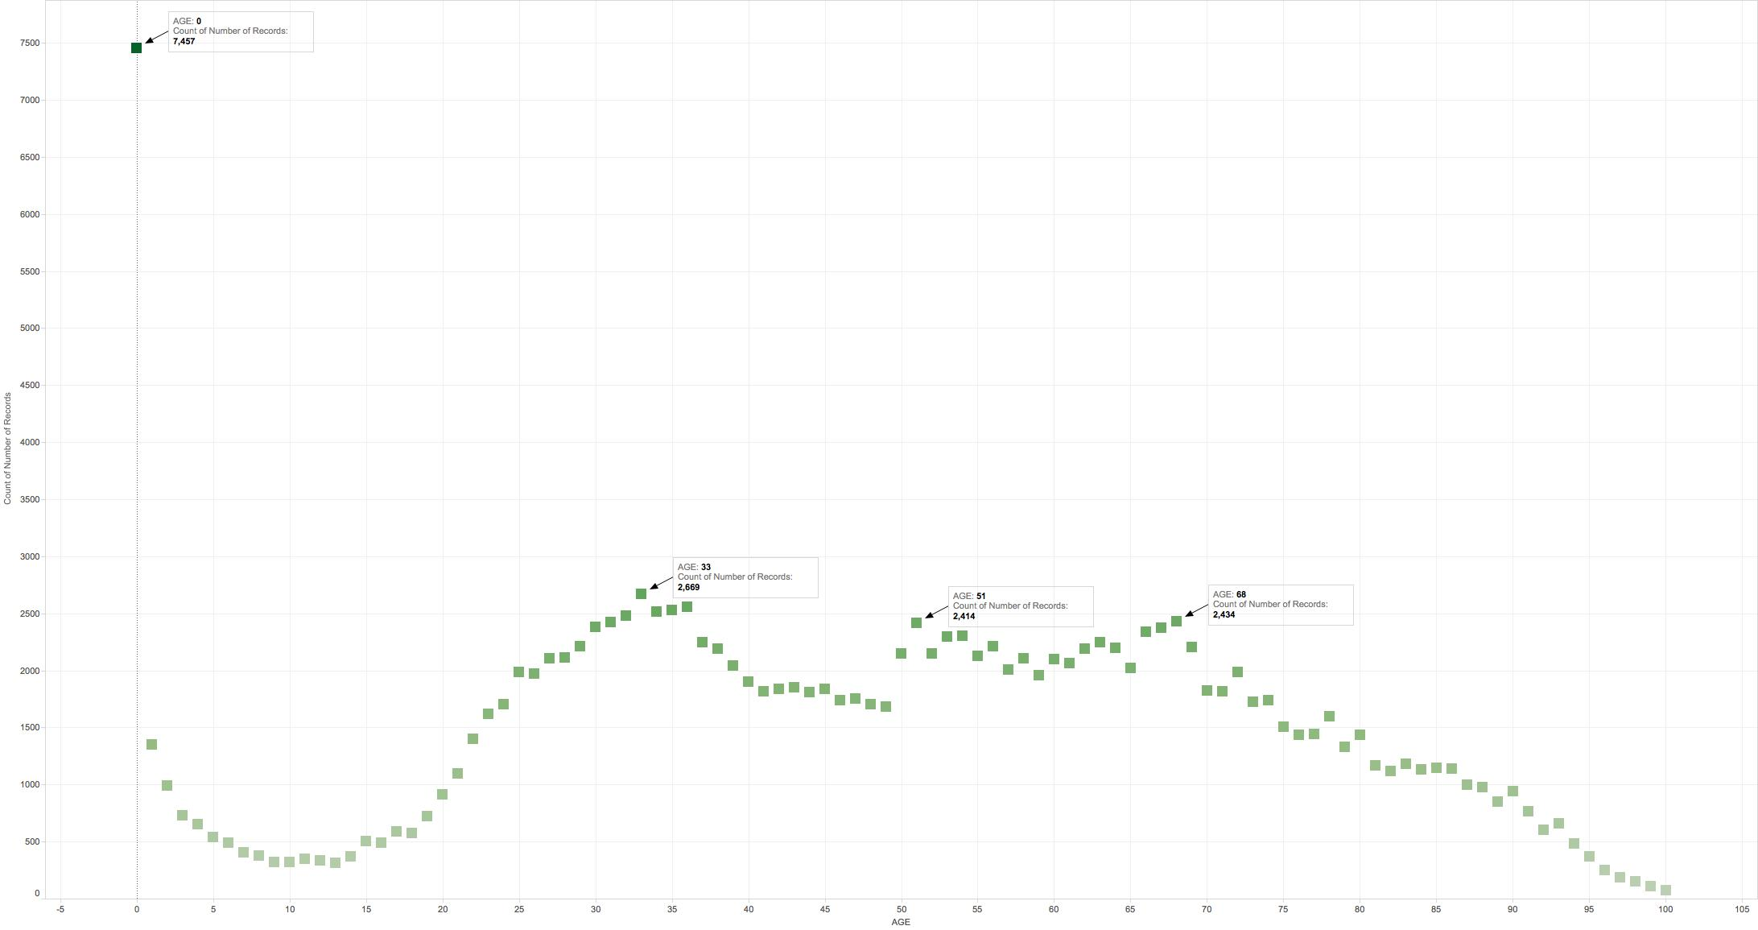
Patient Age By Count

Slide 16
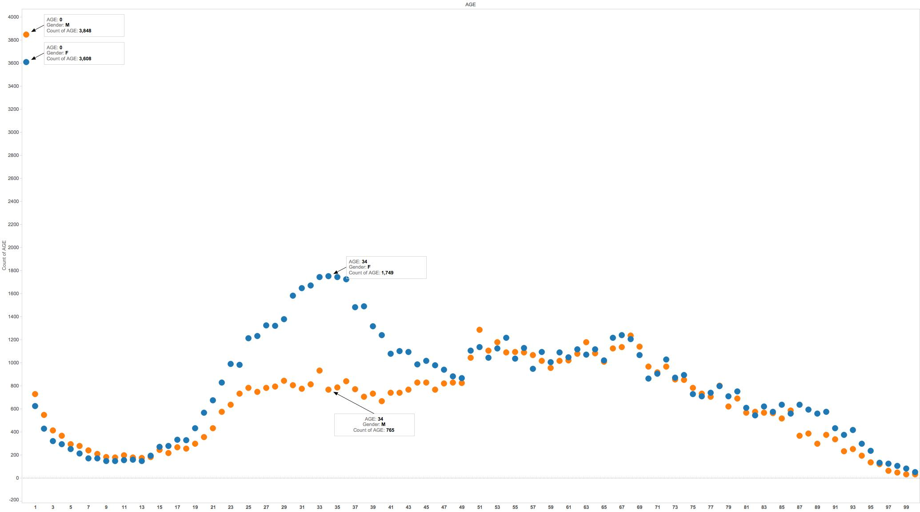
Patient Age/Gender By Count

Slide 17
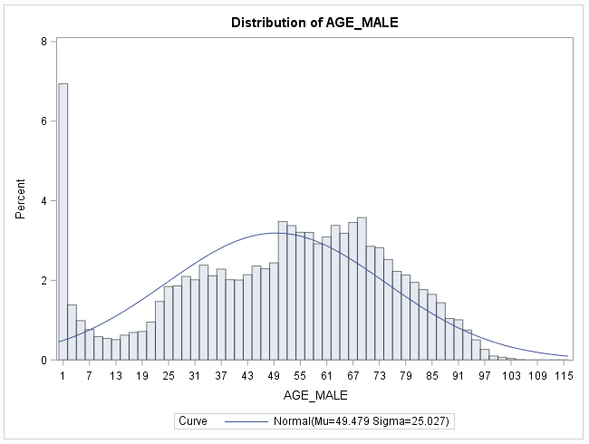
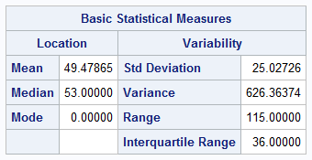
Patient Age/Male
The population of male ages follows the normal curve closely.
There is a large spike of male patients between 0 and 1 years old.
The average male patient is 49.48 years old with a standard deviation of 25.027 years.

Slide 18
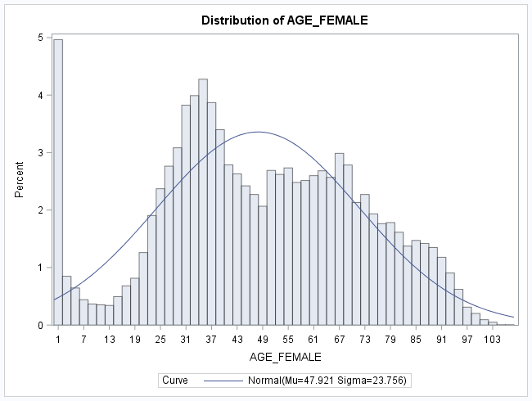
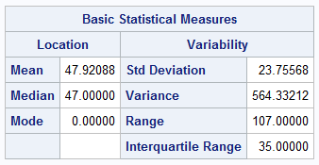
Patient Age/Female
The population of female ages does not follow a normal curve exactly.
There is a large spike of female patients between 0 and 1 years old.
There is a disproportionate number of female patients between ages 25 to 40.
The average female patient is 47.9 years old with a standard deviation of 23.76 years.

