Slide 1

Why Do Customers Churn?

Slide 2
Executive Summary
OBJECTIVE
The goal of this analysis is to determine whether a relationship can be established between the content airing on Univision NOW the day a customer signs up, and the likelihood for that customer to have churned within 90 days
METHODOLOGY
Univision NOW order data was extracted from the months of March, April, and May (2016)
The analysis employs two predictive models: (1) K-Nearest-Neighbors, and (2) Logistic Regression
RESULT
Neither model could form a prediction better (i.e. more accurate) than the mean of the raw data
Therefore, the analysis implies that, based on KNN and logistic models, no categorical relationship exists between the content on Univision NOW the day a customer signed up, and the likelihood that customer churned within 90 days

Slide 3
Background
ABOUT UNIVISION NOW
This analysis will support our Univision NOW subscription video business
Content: Univision NOW includes the live 24-hour feeds of our two broadcast networks, Univision and UniMas, as well as on demand content (primetime shows)
Key content genres are live sports (primarily soccer), drama (primarily telenovelas), and reality shows (primarily competition)
Univision NOW is sold directly to consumers for $6/month and launched November 2015
A key cost (and performance metric) for businesses like Univision NOW is the Cost per Acquisition – the cost is takes to acquire a new customer. A complement of acquisition cost is the average days before customers churn – with lower churn, the business needs to acquire fewer subscribers to reach overall subscriber goals and bottom-line growth

Slide 4
Defining the Problem and Understanding the Data
PROBLEM STATEMENT
Is there a relationship between the content airing on Univision NOW the day a customer signs up, and the likelihood for that customer to have churned within 90 days?
DATA
Part of the data originates from the vendor Univision hired to run the back-end streaming technology for Univision NOW
The data includes information about the data a customer placed an order, and if and when that customer churned
The integrity of this data is likely very good; it is generated automatically and must be auditable, since it is the same system that determines the amount of revenue to remit to clients (like Univision) every month
The other part of the data originated from the “content calendar”, a free-form entry spreadsheet maintained by our marketing team
The data includes information about special events, like soccer matches or telenovela premieres or finales
The integrity of this data is probably not as good as the vendor-provided order data; it is manually calculated and therefore prone to human error and judgment
Univision NOW order data was extracted from the months of March, April, and May (2016)

Slide 5
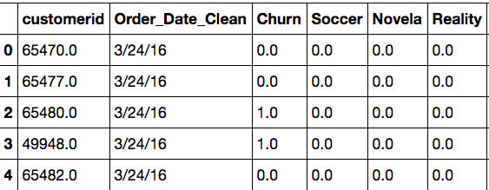
Setting up the Analysis
STEP 1: DETERMINE WHAT FORMAT THE OUTPUT WILL TAKE, AND WHAT INPUTS ARE REQUIRED
I determined I wanted to predict a categorical variable – whether or not a customer churned within 90s days
90 days is a semi-arbitrary number; it does loosely consider customer acquisition costs; can be altered in future analyses
I next determined I would need categorical variables (0’s or 1’s) for whether there was a soccer match, novela premiere/finale, or a reality show premiere/finale
STEP 2: CLEAN UP THE DATA AND FORMAT IT SO IT CAN PUT THROUGH PREDICTIVE MODELS
First I cleaned up the data
The original order data set contained about two-dozen other fields
I considered keeping Purchase_Device (e.g. iPhone, Android) but chose to exclude for the time being
The content calendar needed to be standardized and put into 1’s and 0’s.
Then I created the “Churned within 90 days” field
Calculated field based on whether the customer’s churn date (if one existed) was within 90 days of the order data
5 Header Rows of the Data After Clean-Up

Slide 6
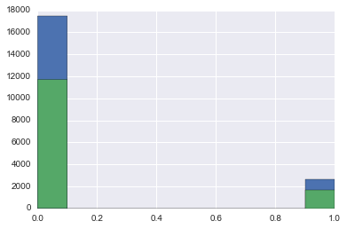
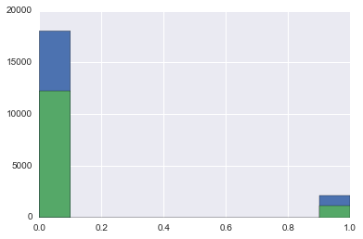
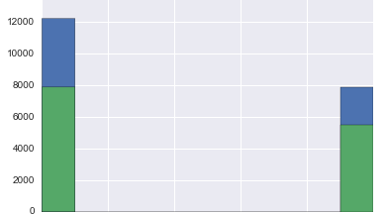
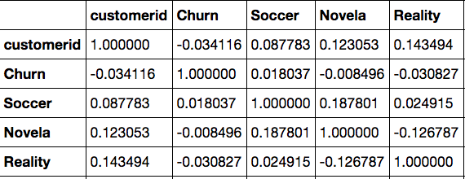
Visualizing the Data
Histogram Plots
Soccer (X) vs Churn (Y)
Novela (X) vs Churn (Y)
Reality (X) vs Churn (Y)
Correlation Matrix
At first glance, no variable appears to have a strong correlation to Churn
However there is a very slight positive correlation with soccer, and a very slight negative correlation with Novela and Reality

Slide 7
Modeling Approach & Outcomes
MODELING CATEGORICAL VARIABLES
I used two models to predict the categorical variable outcome (Churn): K-Nearest-Neighbors and Logistic Regression (both with GridsearchCV)
In both cases, I am optimizing for overall accuracy. This is not a scenario where, say, False Negatives create a terrible real-world outcome (as with, say, medical diagnoses)
MODEL OUTCOMES
K-Nearest-Neighbors (“KNN”):
The best model was found at K = 16 neighbors, with a score of 58.53%
Logistic Regression:
The score is 60.06%
Coefficients: Soccer 0.09, Novela -0.10, Reality -0.24
However, the mean of the data itself is 60%!
This implies the 3 independent variables contain no (or almost no) predictive power for the dependent variables.
Is this true?

Slide 8
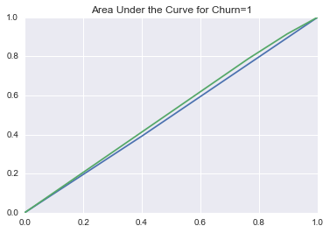
Modeling Outcomes (cont.)
ROC Curve is just barely above 0.5
This supports the theory that the independent variables contain nearly no predictive power for the dependent variable
ROC Curve
AM I SURE THIS IS CORRECT?
It’s worth checking! Maybe I built the predictive models incorrectly.
NEXT STEP: CREATE A “RIGGED” INDEPENDENT VARIABLE THAT PERFECTLY CORRELATES TO ‘CHURN’
If the models generate a perfectly predictive outcome, then we have (at least a little) reassurance that the models are correctly built

Slide 9
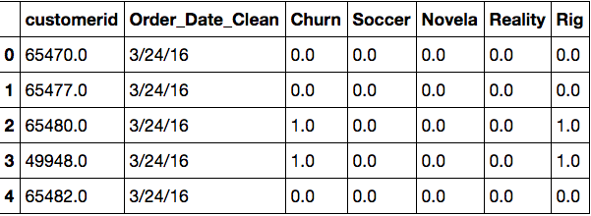
Modeling Approach & Outcomes
RIGGED MODEL OUTCOMES
K-Nearest-Neighbors (“KNN”):
The score is always 100% with zero standard deviation
Not surprisingly, the most important variable (by far) is “Rig”
Logistic Regression:
The score is always 100% with zero standard deviation
Not surprisingly, the most important variable (by far) is “Rig”
Therefore, it appears the models are doing their job, but our independent variables may simply not be very effective predictors of Churn!

Slide 10
Conclusions and Next Steps
CONCLUSIONS
Based on the models in this analysis, I was unable to demonstrate a meaningful relationship between any key content on Univision NOW the day a customer signed up, and the probability that customer had churned within 90 days.
NEXT STEPS
Broaden the content “window” from the day a customer signed up to also include the 1-2 days prior
Rationale: customers may sign up on a Friday in expectation of a big soccer match on Saturday
Add viewership (aka “usage”) data to the analysis
Once the data is available, it will be even more important to know whether soccer fans or novela fans have higher/lower retention rates
If subsequent analysis demonstrates links between content and retention rates, then the Univision NOW management team can enact strategies to reduce churn
E.g. if soccer fans churn because the Mexican soccer season is over, we may consider acquiring additional soccer rights to “plug the gap” until the Mexican league begins again

Slide 11




Much Love

