Slide 1
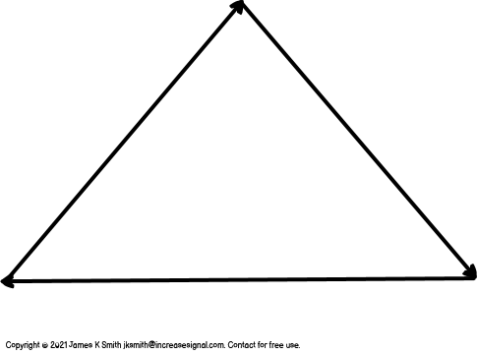
High performing teams who execute with certainty and stability display and practice these characteristics
Tactics, techniques, procedures
Mastery, autonomy, purpose
Competence and Excellence of Execution

