Slide 1
Composites Program – Module 1

Slide 2
4 Blocker
Program
Issues

Slide 3
Factory Preparation / Readiness Requirements
Requirement / Scope:
Factory to be prepared to receive module 1 buy the end of year with commissioning due to be complete before end of Q1 ’17
The work to complete the factory preparation for the full composite line (up to 4 more modules) will follow on from this but the timescale has not yet been confirmed by the business (this is likely to be mid to late 2018)
Driving Factors:
Produce samples for NPI & Qualification Program Early Q2 ‘17
Alberto wants the ability to produce shorter lengths of CPA from Q2 ’17 to enable WSI to offer an unqualified commercial product for trial
Full production capability for Libra project by end of 2018 (NPI project linked opportunity)
Market forecast for CPA take up from 2019
NPI Project Constraints:
Module 1 to be installed where the pipe can be spooled directly from reel and delivered to a take-up reel due to requirement to reverse line (re-spool) for additional layers. The pipe will (if at all possible) not significantly change direction between the reel and the module 1 machine.
Module 1 will have a high utilisation between commissioning date (Q1 ’17) and Q1 ’18, therefore re-location needs to be outside of this timeframe to avoid project delays.
Existing prototype line will be utilised until end of Q3 ‘16, any relocation (NIC) will need to be Q4 16 at the earliest.
Module 1 PM (Kevin) will provide a breakdown of these key milestones / dates.
CAPEX PM will be responsible for the following:
Options for line placement
Down select of options & CAPEX application for full line cost
Full schedule & cost for Module 1 installation work
  Including milestones for information / equipment provided by NPI – Module 1 sub-contractor / Mgmt team
Outline schedule & cost for Full line installation work
Execution plan for new line installation

Slide 4
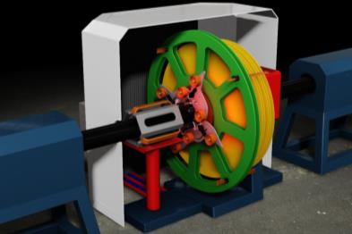
Project Name: Composite Taping Line
AFE and IFS asset ref :
Kevin Wright
Project status & roadblocks
Financials
AFPT quotation for for $2.7mm USD to cover the entire project.
includes $335k USD to cover initial Engineering and Design Costs PO Raised.
Expenditure in current year 2016 expected to be $3.9mm USD
Expenditure in 2017 (1st Qtr) $800K USD
Composite Taping program is advancing with a need to qualify pipe on Production Machine.
FEED PO placed with AFPT
Action plan
Second stage PO for Manufacturing to be progressed
Seek quotations from GE Inspect Tech and Surface Generation for NDT and Post Process heating Module.
Requested project value: $4,700,000
Expected cost at completion: $4.700,000
Financial status:
Timeframe
Feed PO placed April 2016 to suit requirements of Composite Program.
Target design completion by end of June 16
Complete Installation in Newcastle by end of March 17
Expected completion date: March 2017
Original Completion Date March 2017
Timeframe status:

Slide 5
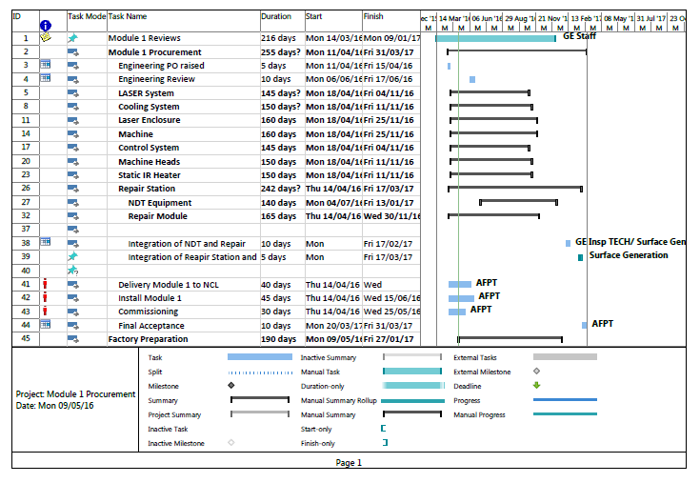
Program

Slide 6
Regular contact ongoing with AFPT
Focus over next period to be Factory preparation and assist production in identifications of restrictions / requirements. Resources and continuity are factors for consideration.
P6 Program will highlight that installation is likely to be part of critical path for overall qualification
Specification issued to GE Inspection Technologies to prepare quotation for NDT equipment. Need to progress due to manufacturing timescales.
Contact with Surface Generation to prepare quotation for Post Process Heating Module. Previous discussion with Composite Team have taken place.
GE Bentley Nevada – awaiting quotation prior to decision on Condition Monitoring
GE Quality – Review requirements for data capture and storage.

