Slide 1
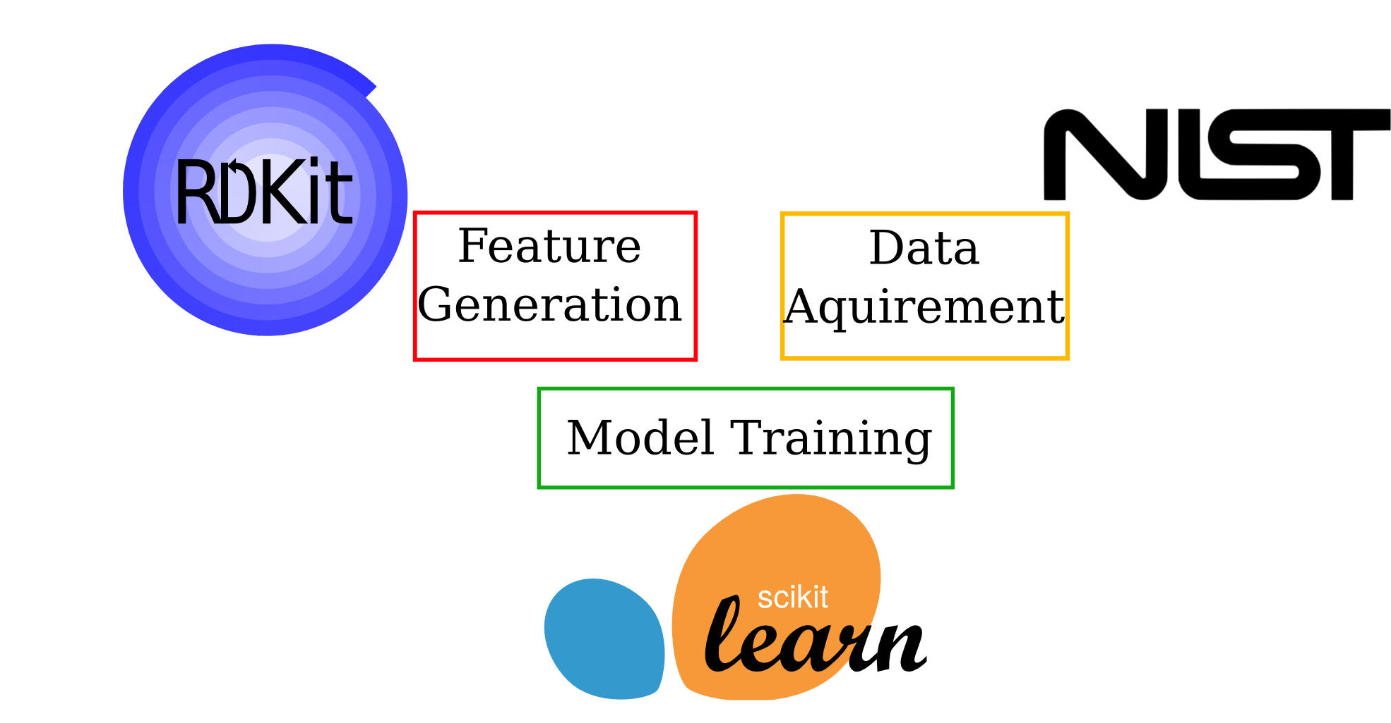
Salty Application of High Performance Computing and Machine Learning to Guide Intelligent Solvent Design Wesley Beckner, Yatong Ge, and Miwako Ito

