Slide 1


Slide 2

So Long and Thanks for All the Phishing Emails!

Slide 3

Looking back on my internship
FitNesse migration
ED squad
Overall impressions

Slide 4

Getting rid of FitNesse
Migrated test suites for 13 core services to TestNG
Added test utility to copy AR data from dev/prod
Removes dependency on Java 6
Tests can run alongside the code, no longer need to dig through FitNesse fixtures to debug

Slide 5

Getting rid of FitNesse
Experience with tooling
Bamboo plan
Maven
Debugging and reading logs
Best practices in Java
Issues with data-driven tests

Slide 6
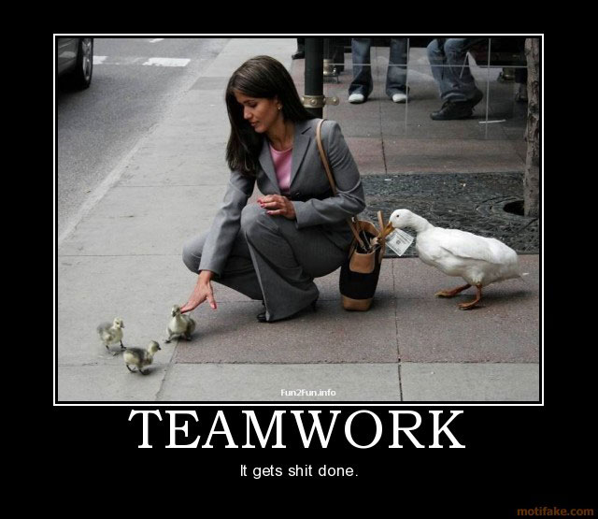
ED Squad
Agile pilot
Pride/communication in the team
Balance between completing work/free capacity
Otpp-ng-scripts
Incremental benefits save lots of time/frustration
Frontend experience?
Mentorship opportunity

Slide 7

UI Test Boulder
Convert sections of Client Desktop to web components
Add stable automated test coverage
Components are readable, easily reusable
Less work to upgrade to new version of Angular or even React

Slide 8

The Big Picture
Culture
Great people
Learning opportunities
Why?
Knowledgeable mentors
Same responsibility as any other full time dev
Concerns?
Knowledge sharing/SBPUG losing steam
Testing as a bottleneck in Agile

Slide 9

Winning culture
Great people
Culture of learning
Make sure something about SBPUG/
Anyone’s opinion is respected
Why?

Slide 10

Internship takeaways
Treated just like a full-time dev
Great mentors
Enjoyed frontend more than I thought I would
Enjoyed people management experience
Something about looking to keep current or stuff

Slide 11
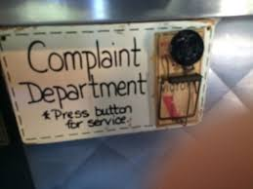
Concerns?
SBPBUG/Knowledge sharing
Testing as a bottleneck for Agile
Something about looking to keep current or stuff

