Slide 1
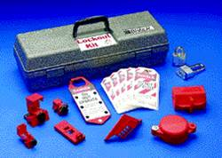
CONTROL OF HAZARDOUS ENERGY (LOCKOUT/TAGOUT) OSHA 29 C FR 1910-147

Slide 2
“This material was produced under grant numbers SH-22300-11-60-F-17 from the Occupational Safety and Health Administration, U.S. Department of Labor. It does not necessarily reflect the views or policies of the U.S. Department of Labor, nor does mention of trade names, commercial products, or organizations imply endorsement by the U.S. Government.”

Slide 3
What is LOCKOUT/TAGOUT?
“Lockout/Tagout” refers to specific practices and procedures to safeguard employees from the unexpected energization or startup of machinery and equipment, or the release of hazardous energy during service or maintenance activities.
“Lockout” is the placement of a lockout device on an energy-isolating device, in accordance with an established procedure, ensuring that the energy-isolating device and the equipment being controlled cannot be operated until the lockout device is removed.
“Tagout” is the placement of a tagout device on an energy-isolating device, in accordance with an established procedure, to indicate that the energy-isolating device and the equipment being controlled may not be operated until the tagout device is removed.
References: “OSHA Standard for the Control of Hazardous Energy (Lockout / Tagout)” 29 CFR 1910.147 and OSHA Publication 3120 “Control of Hazardous Energy – Lockout/Tagout”

Slide 4
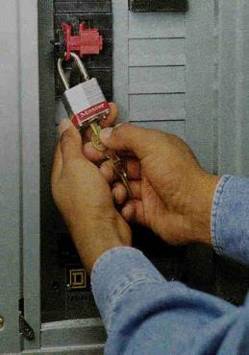
Lockout/Tagout
Training Objectives:
What is lockout/tagout.
What is hazardous energy.
Causes of fatalities/injuries.
When lockout/tagout applies.
Employer responsibility.
Employee training.
Lockout/tagout procedures required.
Types of lockout devices.
Requirement for tags.

Slide 5

LOCKOUT/TAGOUT
The OSHA Standard for the Control of Hazardous Energy (Lockout/Tagout) 29 CFR 1910.147 covers the servicing and maintenance of machines and equipment in which the unexpected start-up or the release of stored energy could cause injury to employees.

Slide 6
What Does LOTO Require?
Lockout/Tagout requires, in part, that a designated individual turns off and disconnects the machinery or equipment from its energy sources(s) before performing service or maintenance and that the authorized employee(s) either lock or tag the energy-isolating device(s) to prevent the release of hazardous energy and take steps to verify that the energy has been isolated effectively.
If the potential exists for the release of hazardous stored energy or for the reaccumulation of stored energy to a hazardous level, the employer must ensure that the employee(s) take steps to prevent injury that may result from the release of the stored energy.

Slide 7
COMMONLY USED LOTO TERMS
Affected Employee – An employee whose job requires him/her to operate or use a machine or equipment on which servicing or maintenance is being performed under lockout tagout.
Authorized Employee – A person who locks out or tags out machines or equipment in order to perform servicing or maintenance on that machine or equipment.
Energy Source – Any source of electrical, mechanical, hydraulic, pneumatic, chemical, thermal, or other energy.
Lockout Device – Uses a positive means such as a lock to hold an energy isolating device in the safe position and prevent the energizing of a machine or equipment.
Tagout Device – A prominent warning device which can be securely fastened to an energy-isolating device.
Energy-Isolating Device – A mechanical device that physically prevents the transmission or release of energy.

Slide 8
Lockout in General Industry Service and Maintenance Operations
The standard applies to the control of hazardous energy when employees are involved in service or maintenance activities such as constructing, installing, setting up, adjusting, inspecting, modifying, and maintaining or servicing machines or equipment.
These activities include lubricating, cleaning or unjamming machines, and making adjustments or tool changes, where the employees may be exposed to hazardous energy.

Slide 9
Lockout in General Industry Service and Maintenance Operations (Cont.)
If a service or maintenance activity is part of the normal production operation, the employee performing the servicing may be subjected to hazards not normally associated with the production operation itself.
Workers performing service or maintenance activities during normal production operations must follow LOTO procedures if they:
Remove or bypass machine guards or other safety devices,
Place any part of their bodies in or near a machine’s point of operation, or
Place any part of their bodies in a danger zone associated with machine operations.

Slide 10
EXCEPTIONS
The employee is performing work involving minor tool changes and adjustments or other minor servicing activities that are routine, repetitive, and integral to the use of the production equipment, that occur during normal production operations, and provided that the work is performed using alternative measures which provide effective protection.
Exposure to hazardous energy is controlled completely by unplugging the equipment from an electrical outlet and where the employee doing the service or maintenance has exclusive control of the plug.
An employee is performing hot-tap operations on pressurized pipelines that distribute gas, steam, water, or petroleum products, for which the employer shows the following: Continuity of service is essential; shutdown of the system is impractical; and the employee follows documented procedures and uses special equipment that provides proven, effective employee protection.

Slide 11
Employers must establish a written energy-control program including:
Energy-control procedures for removing the energy supply from machines and for placing appropriate LOTO devices on the energy-isolating devices to prevent unexpected reenergization.
The training of employees on the energy-control program, including the safe application, use, and removal of energy controls.
A review of these procedures periodically (at least annually) to ensure that they are effective and being followed.

Slide 12
What Employees Need to Know about LOTO
“Authorized employees”
Hazardous energy source recognition
The type & magnitude of the hazardous energy sources in the workplace
Energy-control procedures, including the methods and means to isolate & control those energy sources
“Affected employees”
Recognize when the energy-control procedure is being used
Understand the purpose of the procedure
Understand the importance of not tampering with lockout or tagout devices and not starting or using equipment that has been locked or tagged out
“Other employees”
Must receive instruction regarding the energy-control procedure and the prohibition against removing a LOTO device and attempting to restart, reenergize, or operate the machinery
If tagout devices are used, all employees must receive training regarding the limitations of tags

Slide 13

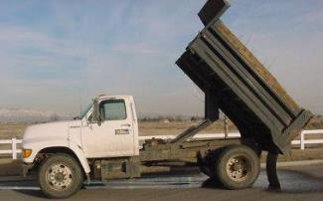
What is Hazardous Energy?
Electricity – live or stored
Mechanical - moving machine parts
Hydraulic, pneumatic, or mechanical movement in machinery
3
Notes:
“Stored mechanical movement means some part of a machine can be moved by electricity, hydraulic fluid, air pressure, water pressure or gravity. This energy can sometimes still exist or be stored when the machinery is turned off. For example, hydraulic fluids can move machinery parts even when the motor or electricity is off, if a certain valve is opened.
In the truck photo, the upraised truck bed has hazardous stored mechanical energy because gravity could move it down on top of a mechanic working under it, if the bed is not physically blocked in the up position.”

Slide 14


What is Hazardous Energy? The Standard applies to all sources of energy, including but not limited to: Mechanical, electrical, hydraulic, pneumatic, chemical and thermal energy
Thermal Energy: Stored heat (steam lines or hot liquids)
Hydraulic Energy: Stored energy (steam or hydraulic fluid)
Chemicals in pipelines under pressure or force of gravity
Any other active or stored energy sources that could harm a worker
4
Notes:
“Chemicals may not seem like stored energy in the normal meaning of the word, but some chemicals like acids, would cause injury if suddenly sprayed or splashed on a worker, thinking a pipeline is empty or has been bled out, disconnects a pipe or opens a valve.”

Slide 15

Hazardous Energy Source Examples
Live electrical lines
Electrical capacitors
Lasers
Hydraulic lifts
Pneumatic (air pressure) lines
Springs
Notes:
“Other examples include forklifts with the forks in the up position, steam and hot liquid pipes, fuel lines such as natural gas to heaters.
These examples are considered hazardous, because just “turning them off” does not guarantee they won’t accidentally be turned on again during maintenance or repair, or they continue to have stored energy after being “turned off”. Think of a compressed spring, or a pressured line that has not been bled off.” Fatalitities have occurred when the mast slides down on the repairman. Mast should have been blocked to prevent movement.

Slide 16
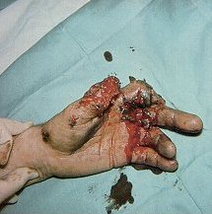
What kind of injuries can happen?
Shock or electrocution from live parts
Scalding from steam or hot liquids
Chemical burns or poisoning
From machinery:
- Deep cuts and gashes
- Crushing injuries
- Amputations
Notes:
[Note: The photo may be too graphic or distracting for some people. You can make it disappear by clicking on the picture.] Pipes or other equipment not properly bled out may have or contain steam, air, chemicals, which may be inadvertently disbursed and cause injury.

Slide 17
Fatalities & Injuries
Causes for injuries:
Failure to stop equipment
Failure to disconnect the power source
Failure to dissipate residual (stored) energy
Accidental restarting of equipment
Failure to clean work area before reactivation

Slide 18
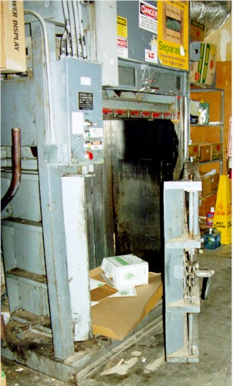
Fatality Example
A man working inside a supermarket cardboard compactor was crushed when the unblocked compactor suddenly came down on top of him
Discussion Point: Are you aware of any fatalities?
Notes:
“This fatality happened recently in the state of Washington.”

Slide 19
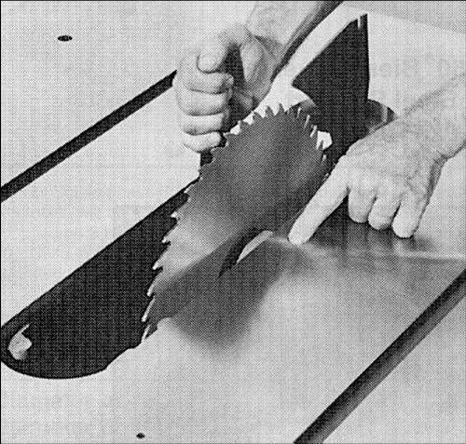
When is Lockout / Tag-out required?
When someone will be servicing or repairing machinery or equipment and the unexpected machinery start-up or release of stored energy could cause injury
Notes:
“In many fatalities or injuries, another employee will start up a machine or open a valve, not aware that someone else is repairing the machine. The person working on this saw obviously would not want someone inadvertently starting up the saw.”

Slide 20
LOTO vs. Machine Guarding
Machine guarding protects the operator from the hazards of the machine while under NORMAL operating conditions.
Lockout / Tagout refers to a practice to safeguard employees from the unexpected energization or startup of machinery and equipment, or the release of hazardous energy during service or maintenance activities. Lockout devices hold energy-isolation devices in a safe or “off” position. They provide protection by preventing machines or equipment from becoming energized because they are locked out and no one can remove the lock without a key or other unlocking mechanism such as bolt cutters.

Slide 21
Service and Maintenance Examples
Installing, constructing,
Adjusting, modifying,
Unjamming, cleaning,
Lubrication, inspecting,
Setup - preparing for normal function, Including die changes
These activities often require a worker to place all or part of their body into the machine’s hazard zone.
Notes:
“Service & Maintenance -- when the machine isn’t being used for actual production and service, repair or maintenance work is being done.
Setup - a particular type of service to a machine when it is being prepared for production use.
In the photo, the setup person is installing and adjusting the dies for production stamping of a composite material.
Problems:
There is no block under the upper die to positively prevent it from coming down.
A key in the computer control on the other side of the machine is all that prevents machine activation.”

Slide 22
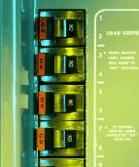
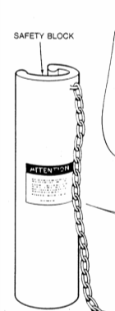
What is an energy-isolating device?
A device that physically prevents transmission or the release of energy.
Circuit Breaker
Pipeline Valve
Machine Block
Anything else that positively blocks or isolates energy.
Notes:
“These are also called “energy control devices”. Regular on-off switches (push buttons, selector switches, etc.) are not energy-isolating devices since they can fail – they are not designed for energy isolation.

Slide 23
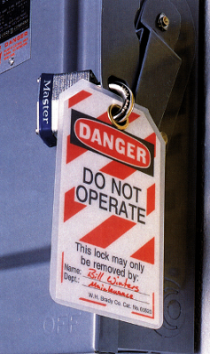
What is a Lockout Device?
A device that positively prevents a machine from being:
started up
turned on
machinery parts from moving
becoming electrically energized
blocks a pipeline, steam line or air line.
Notes:
“A lockout device is a usually a lock, key, valve or switch cover that holds an energy isolating or control device in the off or safe position until the lockout device is removed. Lockout must be done according to an established procedure.”

Slide 24
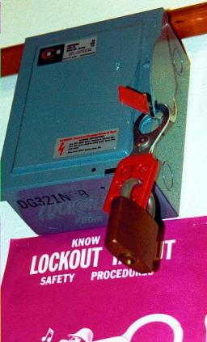
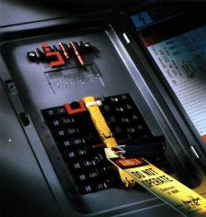
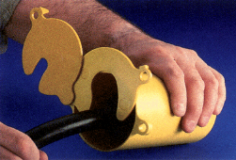
Electrical Lockout Devices
Locked out circuit breaker
Locked out electrical panel
Locked out electrical plug
Notes:
“If you don’t have an electrical disconnect next to a machine, then you can attach a lock to the electrical panel. There are also individual circuit breaker locks, which may be better than locking the electrical panel cover since in an emergency, it may be necessary to get to the panel to shut off breakers other than the one that is locked out.
You don’t have to have a lockout procedure for a machine with all its energy controlled by pulling the plug if the worker maintains exclusive control of the plug. If that is not the case, the photo on the right shows how to lockout a plug at the end of an electrical cord.”

Slide 25
Fluid & Gas Lockout Devices
Notes:
“These lockout devices prevent the valves in air, water, gas or steam lines from being opened.”

Slide 26
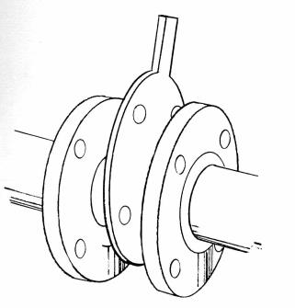
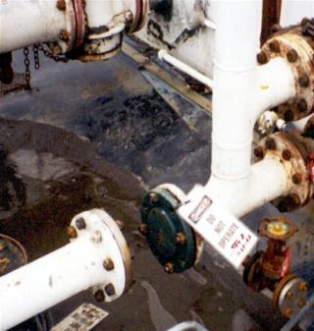
Pipe Lockout Examples
Notes:
“A physical block or break in a pipeline prevents steam, gas or liquids from flowing through the pipe to the area where maintenance work is being done. For example, the pipe to a chemical tank must be blocked or disconnected before someone goes in to do repair or maintenance.”

Slide 27
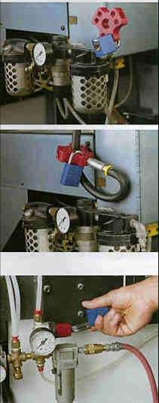
Pneumatic Lockout Examples
17
Notes:
“These devices prevent compressed air from flowing through lines and moving some part of the machinery. The locks prevent anyone from hooking up the lines while maintenance is being done.”

Slide 28
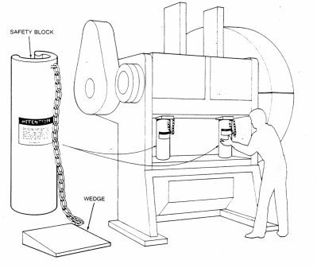
Physical Blocks
Punch Press Block

Slide 29
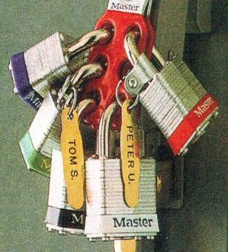
Group Lockout Devices
Used when more than one person doing maintenance or repair on same machine or equipment.
Machinery or equipment can’t be started up until all locks are removed.
Each person places and removes their own lock.
Notes:
“Group or “gang” locks are typically used when several people are doing maintenance and repair at the same time on a machine or piece of equipment. Each lock should have a clear identification (usually a name) showing who it belongs to. No one can remove another person’s lock.”

Slide 30
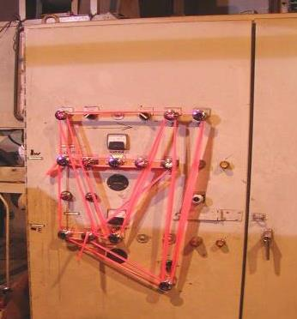
Example of a bad lockout/tagout
Notes:
“This obviously not a real lockout device since it could be easily removed.”

Slide 31
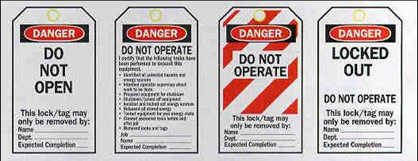
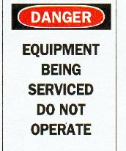
What is Tag-out?
Tags are warning devices only
They don’t provide the same physical restraint or level of protection as lockout devices.
Tags may evoke a false sense of security
They can only be removed by an authorized person.
They must be legible, securely attached and resistant to degradation.
Notes:
“Tags cannot be used as a substitute for lockout devices. They can only be used alone if there is no other way to positively control hazardous energy. However, they are often used along with lockout devices as an additional warning. The separate sign can be used as further warning or information.”

Slide 32
Requirements for LOTO Devices
The employer must provide these devices and they must be singularly identified and not used for other purposes.
They must be durable enough to withstand workplace conditions;
Standardized enough to minimize the likelihood of premature or accidently removal; and
Labeled to identify the specific employees authorized to apply and remove them.
Notes:
“Tags cannot be used as a substitute for lockout devices. They can only be used alone if there is no other way to positively control hazardous energy. However, they are often used along with lockout devices as an additional warning. The separate sign can be used as further warning or information.”

Slide 33
ENERGY-CONTROL PROCEDURES MUST:
Outline the scope, purpose, authorization, rules and techniques that employees will use to control hazardous energy sources, as well as the means that will be used to enforce compliance. These procedures must provide employees at least the following information:
A statement on how to use the procedures
Specific procedural steps to shut down, isolate, block, and secure machines
Specific steps designating the safe placement, removal and transfer of LOTO devices and identifying who has responsibility for the LOTO devices
Specific requirements for testing machines to determine & verify the effectiveness of LOTO devices and other energy-control measures

Slide 34
TYPICAL MINIMAL LOCKOUT SHUTDOWN PROCEDURES REQUIRE WORKERS TO:
Prepare for shutdown
Shut down the machine
Disconnect or isolate the machine from the energy source(s)
Apply the lockout or tagout device(s) to the energy-isolating device(s)
Release, restrain or otherwise render safe all potential hazardous stored or residual energy
Verify the isolation & deenergization of the machine

Slide 35
Lockout Procedures
Six Steps to Follow:
Notify affected employees that machine or equipment will be shut down and locked out
2. Shut down the machinery or equipment
Isolate energy sources with energy-isolating devices
Lock out energy-isolating devices with assigned locks.
5. Release or restrain stored or residual energy
6. Test machinery to make sure it can’t start up
Notes:
“These steps must be followed in the order shown.”

Slide 36
Lockout Steps
Notify
employees
Shutdown
Equipment
Isolate
Energy
Attach Lockout
Device
Release
Stored Energy
Verify Lockout
Service &
Maintenance
Notes:
[A visual view of the two preceding slides.]

Slide 37
Example: Release of Stored Energy
Pressurized Vessel - “Slowly open the receiver tank port and bleed off any internal pressure.”
Pressurized Piping - “Loosen both line valves to relieve all pressure in the cooling circuit.”
Electrical Capacitor - “Ground out capacitor…”

Slide 38
VERIFY EQUIPMENT IS DE-ENERGIZED Example: Attempt to Operate
“…adjust the temperature cycle thermostat to check that all electrical energies have been shut off.”
“Push the start function button to verify that electric power has been removed.”
“Crack the steam inlet and discharge line outlet valves…”

Slide 39
WHAT DO I DO IF I CANNOT LOCK OUT THE EQUIPMENT?
If the energy-isolating device associated with the machinery cannot be locked out, you must securely fasten a tagout device as close as safely possible to the energy-isolating device in a position where it will be immediately obvious to anyone attempting to operate the device.
You also must meet all of the tagout provisions of the standard.
The tag alerts employees to the hazard of reenergization and states that employees may not operate the machinery to which it is attached until the tag is removed in accordance with an established procedure.

Slide 40
TYPICAL MINIMAL LOCKOUT STARTUP PROCEDURES REQUIRE WORKERS TO:
Before removing LOTO devices, the employees must take the following steps in accordance with the specific provisions of the employer’s energy-control program:
Inspect machines or their components to assure that they are operational intact and that nonessential items are removed from the area; and
Check to assure that everyone is positioned safely and away from machines.
After removing the lockout or tagout devices but before reenergizing the machine, the employer must assure that all employees who operate or work with the machine, as well as those in the area where service or maintenance is performed, know that the devices have been removed and that the machine is capable of being reenergized.

Slide 41
Start-up Procedures
Only authorized employee can do startup
All warned to stay clear
Remove all tools, locks and tags
Remove, reverse, open or reactivate isolating devices
Visual check that all is clear
Start up machine, process or line flow
Notes:
“These steps must also be followed in the order shown.”

