Slide 1
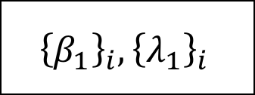
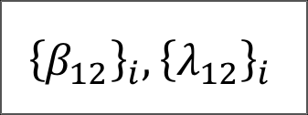



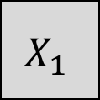
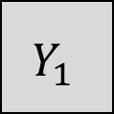
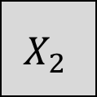
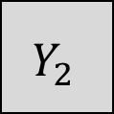
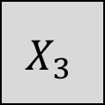
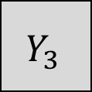
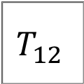
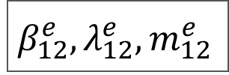
$$X_{1}$$
$$Y_{1}$$
$${\left\{β_{1}\right\}}_{i},{\left\{λ_{1}\right\}}_{i}$$
$$T_{12}$$
$$β_{12}^{e},λ_{12}^{e}, m_{12}^{e}$$
$${\left\{β_{12}\right\}}_{i},{\left\{λ_{12}\right\}}_{i}$$
$$X_{2}$$
$$Y_{2}$$
$$\hat{\operatorname{Pr}\left(Y_{3} | X_{3}\right)}=f\left(X_{3},T_{12},{\left\{β_{12}\right\}}_{i},{\left\{λ_{12}\right\}}_{i} ,β_{12}^{e},λ_{12}^{e}, m_{12}^{e} \right)$$
$$X_{3}$$
$$Y_{3}$$
$$=f_{12}(X_{3})$$
$$\hat{\operatorname{Pr}\left(Y_{3} | X_{3}\right)}\text{⫫} Y_{3}|X_{3}$$
$$f_{12}\left(∙\right)\text{⫫} X_{3},Y_{3}$$

