Slide 1
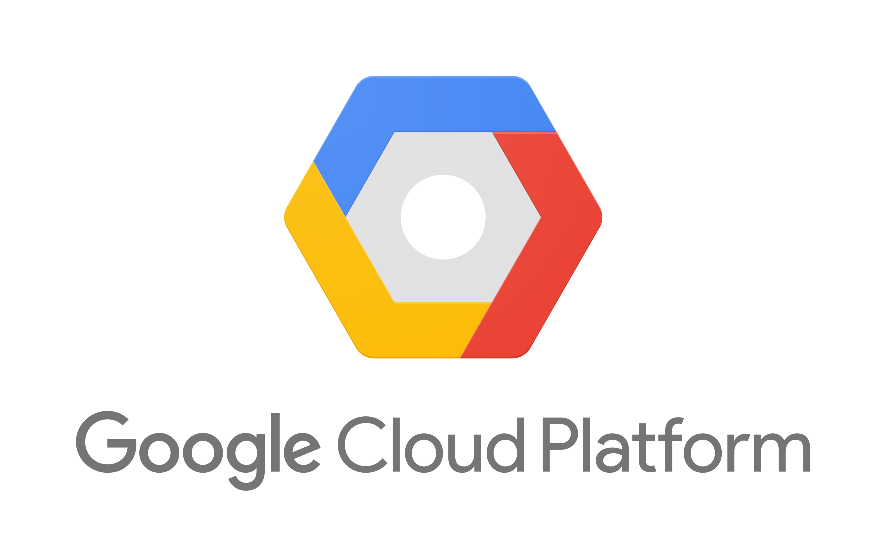

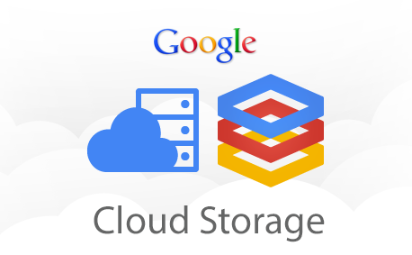
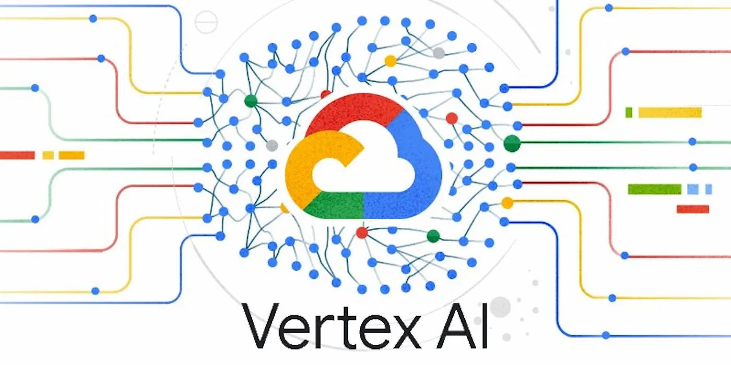
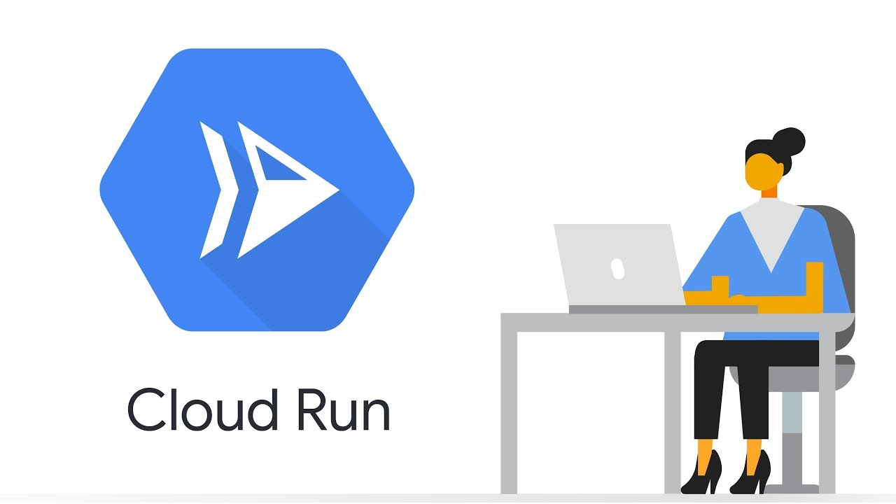
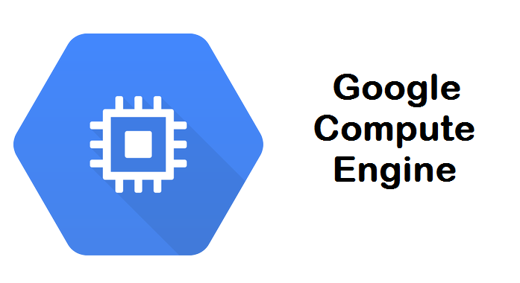
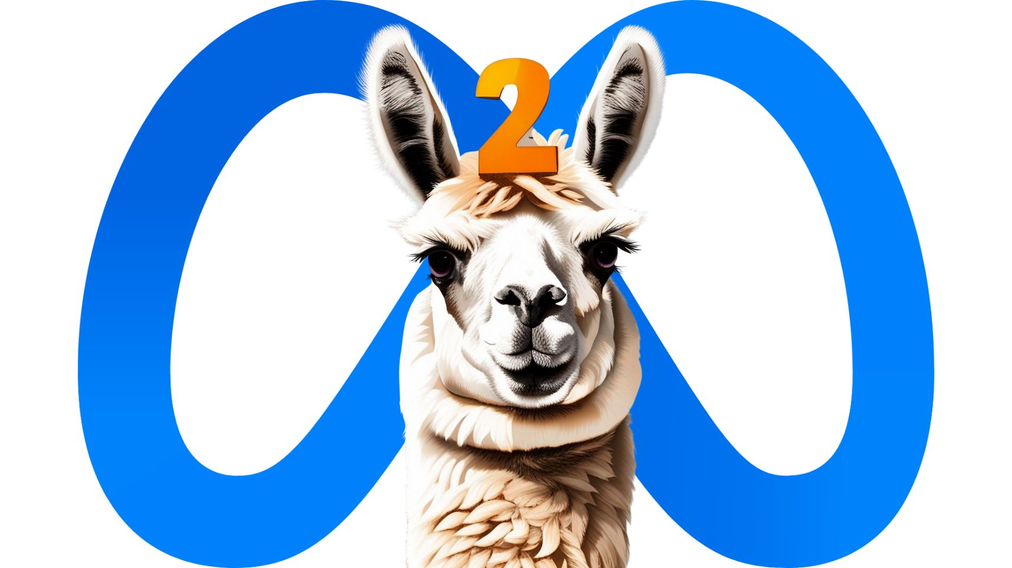
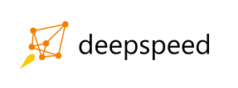

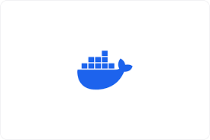

Model Repository Hub
Buckets for model artifacts
Serverless inference endpoints
Serverless container deployments
High-speed large-model inference
Interactive Web Applications
Prune Quantize
Deploy Model
Build App
Deploy App
Containers: - Images built with individual Dockerfiles - Deployment orchestrated with docker-compose
GitHub for Script and Version control

